Slide 1
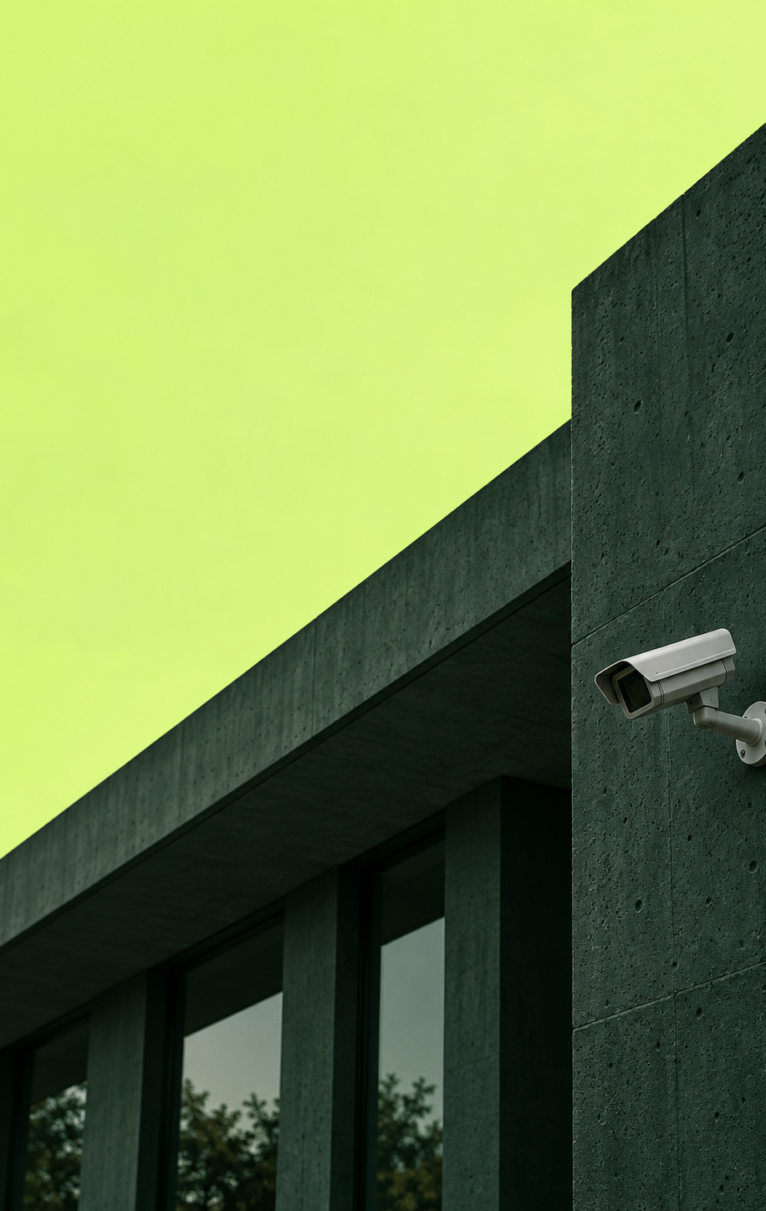

NIVRA
Before impact.
Bal Bharati Hackathon 3.0 / Idea Submission
PROBLEM STATEMENT
Developing incidents can go unnoticed;
camera footage alone cannot bring help.
Theme: T3 — AI for Good
Team: Damage Control
School: Bal Bharati Public School, Pitampura
Team leader: __________________________
Team size (excluding mentor): 5 Category: ____
NIVRA / BAL BHARATI HACKATHON 3.0
01
Notes:
NIVRA is an idea, not a validated prototype. Structure follows Idea Submission Template BBH3.0, content slides 1–7. All generated imagery is conceptual. Personal details, team size and category left blank at user request. PP prefix is based on school usage, not a verified hackathon code list. T3 chosen for AI for Good.

Slide 2
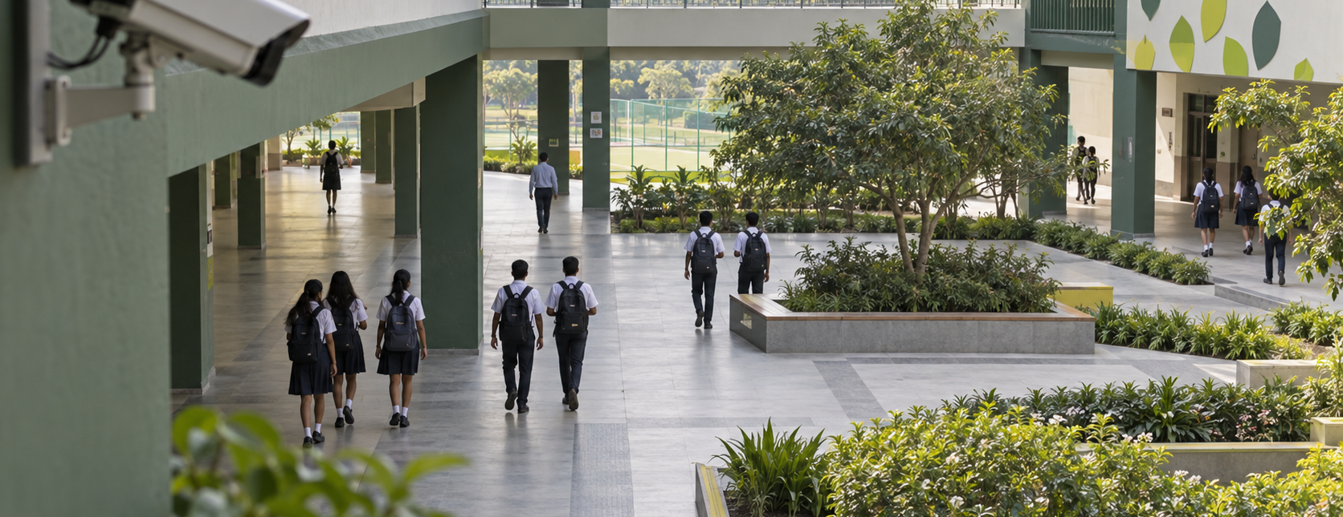
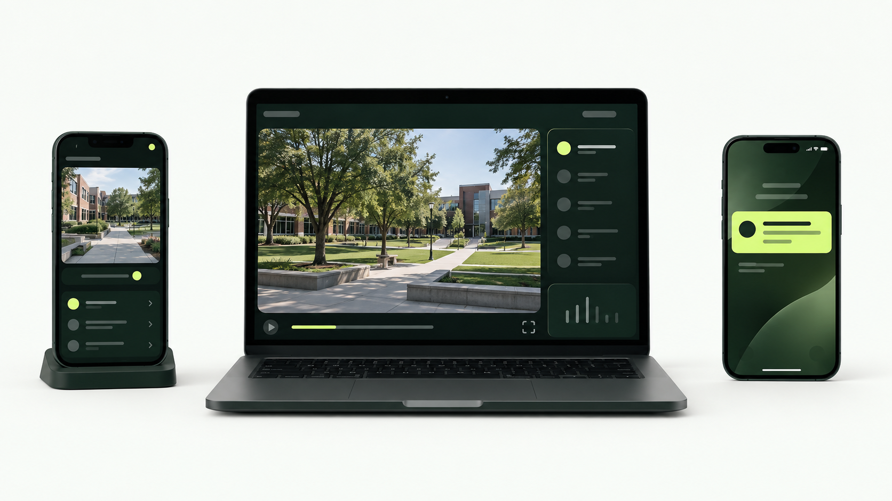
Your Idea
AI-assisted early intervention, with a human in charge.
Idea / Solution
Problem Resolution
Use a phone or camera feed to flag visible movement patterns that may need attention.
Give staff a short replay and location, then connect a confirmed alert to a responder.
Observe → flag → human review
Decide → dispatch → acknowledge
NIVRA / BAL BHARATI HACKATHON 3.0
02
Notes:
NIVRA is an idea, not a validated prototype. Structure follows Idea Submission Template BBH3.0, content slides 1–7. All generated imagery is conceptual. Proposed users: campus safety staff, teachers and event marshals. Problem is a hypothesis to validate; no user interviews or impact measurements are claimed.

Slide 3
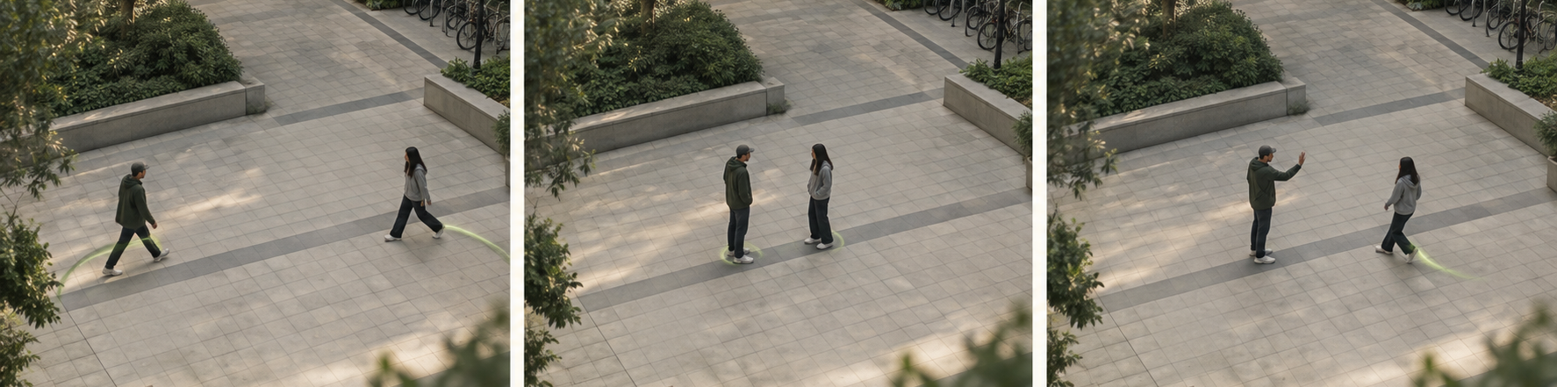
Warning patterns, seen over time
YOUR IDEA / WHAT NIVRA WOULD LOOK FOR
Closing distance
Aggressive gestures
Crowd convergence
People rapidly move closer.
Sudden, repeated body movements.
Several people gather around an event.
Multiple cues would request a review. A movement pattern alone does not establish intent.
NIVRA / BAL BHARATI HACKATHON 3.0
03
Notes:
NIVRA is an idea, not a validated prototype. Structure follows Idea Submission Template BBH3.0, content slides 1–7. All generated imagery is conceptual. Repository rule: repeated fast arm extensions and retractions directed toward another person’s upper body, normalized to body scale and checked across time. Standard mode requires three distinct pulses within five seconds; Early review uses two clear episodes with wider approach tolerance. This remains experimental, not a trained fight classifier.

Slide 4
Eight seconds of context. A human decision.
YOUR IDEA / PROPOSED OPERATOR WORKFLOW
Review the previous 8 seconds
See the location and warning signals, then choose the next action.
Dismiss
Monitor
Dispatch
Close a false or harmless alert.
Keep watching when context is unclear.
Send an available responder and record acknowledgement.
NIVRA / BAL BHARATI HACKATHON 3.0
04
Notes:
NIVRA is an idea, not a validated prototype. Structure follows Idea Submission Template BBH3.0, content slides 1–7. All generated imagery is conceptual. Repository implementation: review events use an eight-second global alert cooldown. The browser keeps frames local; video is not uploaded, recorded or persisted. Human confirmation precedes dispatch. No facial recognition, identification or automatic policing.

Slide 5
Technical Approach
Proposed architecture / one supervised demo
01 / CAPTURE
02 / ANALYSE
03 / REVIEW
04 / RESPOND
Camera or video
→
Worker pipeline
→
Scene + rail
→
Local session
Browser camera or local video
a permitted scene.
MediaPipe Pose Landmarker and EfficientDet-Lite0
Canvas skeletons, object boxes and
reasoned review event.
Tone, acknowledge and replay;
session log and close.
Frontend / runtime
Workers / models
React 19 + TypeScript + Vite. Canvas draws aligned skeletons and object boxes.
Two MediaPipe workers isolate pose runtimes; an EfficientDet-Lite0 CPU worker runs object analysis. No backend or cloud service is required.
Local browser inference. Frames, tracks and review events stay in the session.
NIVRA / BAL BHARATI HACKATHON 3.0
05
Notes:
NIVRA is an idea, not a validated prototype. Structure follows Idea Submission Template BBH3.0, content slides 1–7. All generated imagery is conceptual. Repository stack: React 19.2.8, TypeScript 6, Vite 8.2.1, @mediapipe/tasks-vision 1.0.1, local WASM assets, Pose Landmarker Full/Lite float16 bundles and EfficientDet-Lite0. GPU is attempted for real-time pose; CPU is the reference fallback and review-scan runtime.

Slide 6
Feasibility and Viability
Technical
Operational
MediaPipe and EfficientDet assets are bundled locally. Pose and object rules are implemented; real-world accuracy remains unvalidated.
Camera, local video or scripted test scenario. Operator reviews one event at a time and acknowledges it.
Resources needed
Data & build plan
Node 24, Chrome, browser camera/video, local model assets and a capable CPU/GPU. No cloud backend.
Frames are not uploaded, recorded or persisted. Use permitted staged footage and the repository’s scripted scenarios.
Challenge / risk | Proposed mitigation
Ordinary play creates false alerts | Use temporal rules; require human review before dispatch.
Occlusion, poor light or network loss | Show confidence / offline state; test varied scenes.
Video privacy and child data | Minimise retention and access; obtain school approval and review applicable rules.
NIVRA / BAL BHARATI HACKATHON 3.0
06
Notes:
NIVRA is an idea, not a validated prototype. Structure follows Idea Submission Template BBH3.0, content slides 1–7. All generated imagery is conceptual. Repository evidence: local camera/video/test scenario paths, local model assets, CPU fallback and recovery notices. npm run verify passed in the cloned repository: lint, 211 tests and production build. These checks do not establish real-world detection accuracy.

Slide 7
Build small. Test the complete response.
FEASIBILITY / PROPOSED VALIDATION PLAN
01
Connect
02
Stage
Open camera or local video in Chrome; no cloud connection.
Use permitted footage or the repository’s scripted test scenes.
03
Review
04
Respond
Test alerts, the 8-second replay and operator choices.
Deliver a confirmed alert; record acknowledgement and closure.
Measure
211 automated tests • build output • false alerts • missed staged events • review time
NIVRA / BAL BHARATI HACKATHON 3.0
07
Notes:
NIVRA is an idea, not a validated prototype. Structure follows Idea Submission Template BBH3.0, content slides 1–7. All generated imagery is conceptual. Current stage remains idea. No data, working end-to-end prototype or performance results are asserted. Include poor lighting, occlusion and lost-network cases. Obtain school permission and privacy review before any trial.

Slide 8
Impact and Benefits
Why earlier attention matters.
The supplied public violence metrics report frames a large human and economic burden.
1 in 6
12,000 / day
$20.3T–$30T
high-school students report a physical fight within 12 months.
people reportedly lose their lives worldwide to trauma and violence.
estimated global annual cost of interpersonal violence.
NIVRA’s intended contribution
Guardrails
Move from passive recording to observable signals, human review and coordinated response.
Local processing • no identity inference • human decision before action
Source: supplied public_violence_metrics_report.pdf. Figures are reproduced as reported and were not independently verified.
NIVRA / BAL BHARATI HACKATHON 3.0
08
Notes:
NIVRA is an idea, not a validated prototype. Structure follows Idea Submission Template BBH3.0, content slides 1–7. All generated imagery is conceptual. The three headline figures come from the user-supplied public_violence_metrics_report.pdf. They establish problem scale, not NIVRA performance or causal impact. Verify the report independently before formal publication.

Slide 9
Research and References
Evidence informs the idea; it does not validate NIVRA.
01 / SCHOOL SAFETY
Proposed stack
MoE, School Safety & Security Guidelines (2021).
Establishes institutional safety responsibilities.
React + TypeScript + Vite
02 / TECHNICAL BASIS
React 19 UI, TypeScript 6 and Vite 8 build.
Google Research, BlazePose (2020), and MediaPipe docs.
Support pose estimation—not prediction of violence.
MediaPipe Pose Landmarker
Full/Lite float16 bundles via @mediapipe/tasks-vision.
03 / EXISTING SOLUTION
Axis Object Analytics: object tracking and event triggers.
NIVRA proposes human review plus response acknowledgement.
EfficientDet-Lite0
Lower-frequency CPU worker for local object analysis.
04 / DATA & PRIVACY
Web Workers + WASM
Planned data: permissioned staged volunteer videos; none yet.
DPDP Act (2023): assess applicable privacy rules before a pilot.
Separate pose workers, GPU attempt and CPU fallback; no backend.
NIVRA / BAL BHARATI HACKATHON 3.0
09
Notes:
NIVRA is an idea, not a validated prototype. Structure follows Idea Submission Template BBH3.0, content slides 1–7. All generated imagery is conceptual. Sources: https://dsel.education.gov.in/sites/default/files/guidelines/guidelines_sss.pdf
https://research.google/blog/on-device-real-time-body-pose-tracking-with-mediapipe-blazepose/
https://developers.google.com/edge/mediapipe/solutions/vision/pose_landmarker/web_js
https://www.axis.com/products/axis-object-analytics
https://www.meity.gov.in/static/uploads/2024/06/2bf1f0e9f04e6fb4f8fef35e82c42aa5.pdf
Sources accessed September 2026. Dataset is planned self-collected material, not an existing dataset.

Slide 10
Team Member Details
Bal Bharati Public School, Pitampura
Students
SL | Student ID | Name | Class | DOB | Email | Phone Number | Gender
1 | 223564 | Harsh Jain | 12C | 23/04/09 | 223564@pp.balbharati.org | 9810141505 | Male
2 | 218461 | Tanishq Aggarwal | 12C | 09/05/09 | 218461@pp.balbharati.org | 9810398813 | Male
3 | 201362 | Keshav Garg | 12D | 11/06/09 | 201362@pp.balbharati.org | 7011900075 | Male
4 | 213266 | Reyansh Garg | 12D | 02/07/09 | 213266@pp.balbharati.org | 8595774056 | Male
5 | 213283 | Asmi Sharma | 12D | 28/03/10 | 213283@pp.balbharati.org | 8595612803 | Female
Mentor
SL | Name | UID | Address | DOB | Email | Phone Number | Gender
1
NIVRA / BAL BHARATI HACKATHON 3.0
10
Notes:
NIVRA is an idea, not a validated prototype. Structure follows Idea Submission Template BBH3.0, content slides 1–7. All generated imagery is conceptual. Student details copied from user registration data. Mentor fields remain blank; student dates of birth were supplied by the team. Tables are native and editable.

