Slide 1
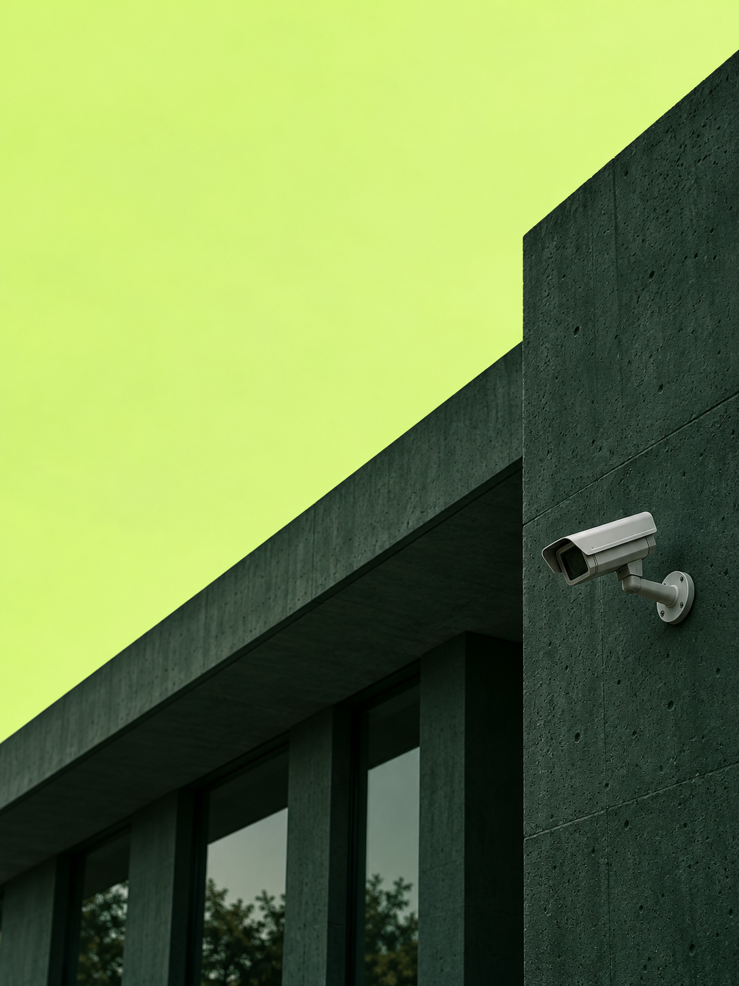

NIVRA
Before
impact.
AI-assisted early intervention
for safer public spaces
Team Damage Control
T3 · AI for Good / Idea proposal
Notes:
Source: NIVRA_COMPLETE_CONTEXT_FOR_HARSH_JAIN.md, project definition only. User clarified on 21 September 2026 that NIVRA is currently an idea; this supersedes older prototype claims. Pitch structure informed by supplied HACKATON 3.0.pptx. Generated scenes are conceptual illustrations, not product screenshots or evidence of real incidents. Theme T3 selected for AI for Good. School code and submission category are unverified and intentionally omitted. Team name comes from the project brief.

Slide 2
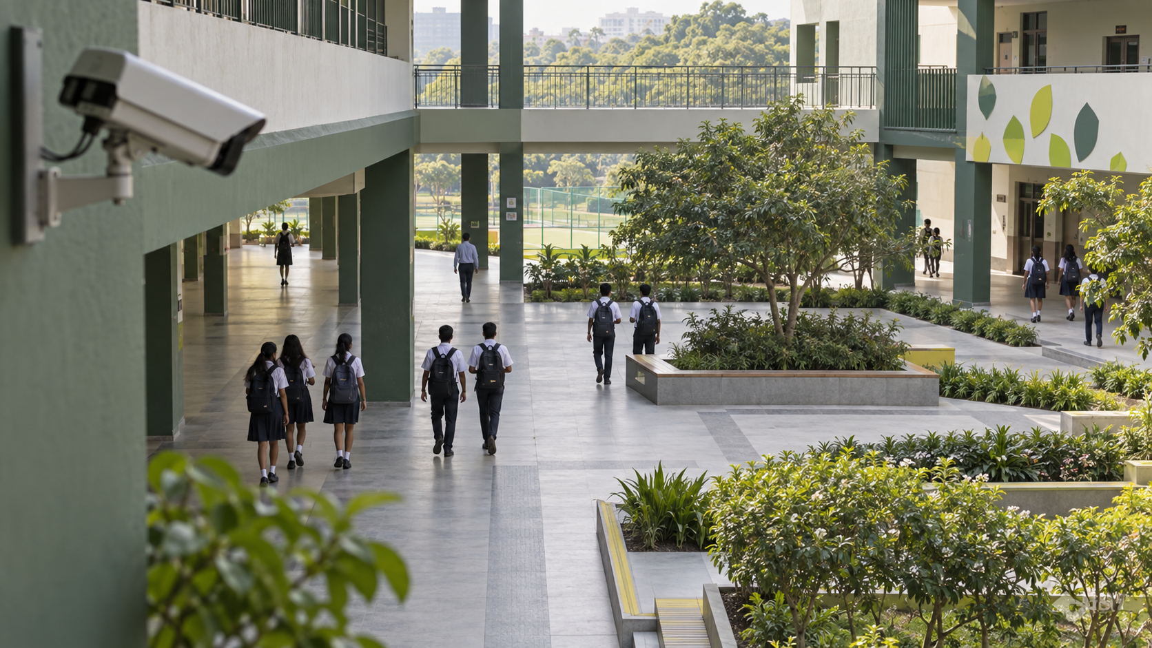
A camera can record.
Someone still has to notice.
The gap
When a developing incident goes unnoticed, footage alone cannot bring help.
Our first users
Campus safety staff, teachers and event marshals who need a clear place and reason to respond.
NIVRA
02
Notes:
Source: NIVRA_COMPLETE_CONTEXT_FOR_HARSH_JAIN.md, project definition only. User clarified on 21 September 2026 that NIVRA is currently an idea; this supersedes older prototype claims. Pitch structure informed by supplied HACKATON 3.0.pptx. Generated scenes are conceptual illustrations, not product screenshots or evidence of real incidents. Problem framing is a design hypothesis to validate with campus staff. No interviews, incident rates or response-time measurements are claimed.

Slide 3
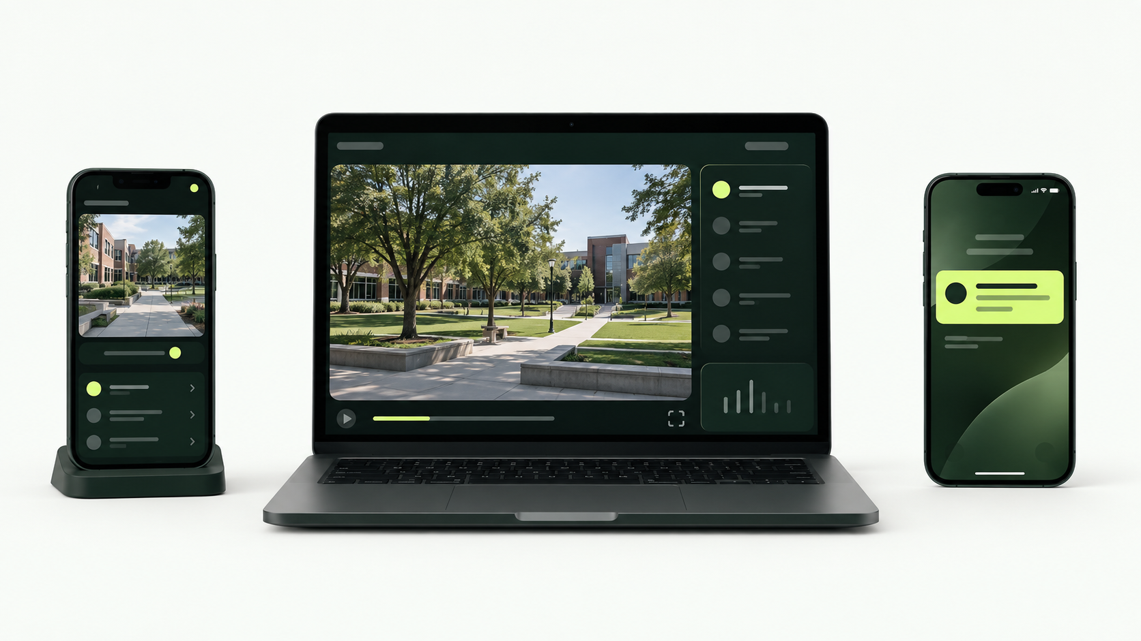
One connected response
A proposed workflow using a camera, a laptop and responder phones
01 Observe
02 Review
03 Respond
An approved phone or CCTV feed captures the scene.
NIVRA flags a movement pattern. A person reviews the replay.
The operator sends a location. Staff acknowledge and act.
NIVRA
03
Notes:
Source: NIVRA_COMPLETE_CONTEXT_FOR_HARSH_JAIN.md, project definition only. User clarified on 21 September 2026 that NIVRA is currently an idea; this supersedes older prototype claims. Pitch structure informed by supplied HACKATON 3.0.pptx. Generated scenes are conceptual illustrations, not product screenshots or evidence of real incidents. All three connected surfaces are proposed. Generated device screens are illustrative concepts, not a working product.

Slide 4
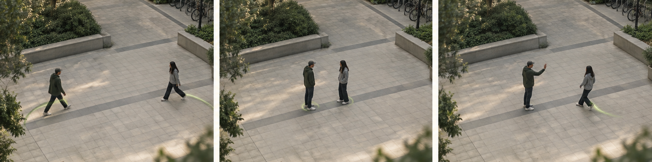
AI looks at movement over time
Computer vision estimates body positions. Rules combine repeated visible changes.
Distance closes
Movement changes
A review is requested
People repeatedly move closer.
Gestures or speed increase.
A human checks the context.
NIVRA
04
Notes:
Source: NIVRA_COMPLETE_CONTEXT_FOR_HARSH_JAIN.md, project definition only. User clarified on 21 September 2026 that NIVRA is currently an idea; this supersedes older prototype claims. Pitch structure informed by supplied HACKATON 3.0.pptx. Generated scenes are conceptual illustrations, not product screenshots or evidence of real incidents. Illustrative staged sequence. Signals indicate review priority, not intent or a probability of violence. Proposed approach uses pose estimation plus transparent temporal rules. Model selection and accuracy remain untested.

Slide 5
People make
the call.
Human review
Dismiss, keep watching or send help.
No identity inference
No facial recognition or guilt scores.
NIVRA would support attention.
A trained person would decide
what happens next.
Limited video use
Short context buffers and restricted access.
Visible limitations
Poor light and blocked views must be flagged.
NIVRA
05
Notes:
Source: NIVRA_COMPLETE_CONTEXT_FOR_HARSH_JAIN.md, project definition only. User clarified on 21 September 2026 that NIVRA is currently an idea; this supersedes older prototype claims. Pitch structure informed by supplied HACKATON 3.0.pptx. Generated scenes are conceptual illustrations, not product screenshots or evidence of real incidents. Safeguards are design commitments to implement and test, not claims of deployed controls or legal compliance. Human decisions precede operational dispatch.

Slide 6
The smallest demo worth building
Two phones. One laptop. One staged interaction.
01
Connect
02
Flag
Stream an approved phone camera to the laptop.
Use pose estimates and movement rules to raise a review.
03
Decide
04
Close the loop
Show a short replay. Let the operator dismiss or dispatch.
Send an alert to phone two and record acknowledgement.
Current stage: idea. The prototype and its performance still need to be validated.
NIVRA
06
Notes:
Source: NIVRA_COMPLETE_CONTEXT_FOR_HARSH_JAIN.md, project definition only. User clarified on 21 September 2026 that NIVRA is currently an idea; this supersedes older prototype claims. Pitch structure informed by supplied HACKATON 3.0.pptx. Generated scenes are conceptual illustrations, not product screenshots or evidence of real incidents. Proposed demonstration only. A candidate stack could use a browser camera, existing pose model, temporal rules and event notifications. There is no working end-to-end prototype claimed.

Slide 7
More time
to respond.
What we would measure
Time to human review
Time to staff acknowledgement
The goal is earlier human attention
and a clearer path from alert to help.
False alerts during ordinary activity
Missed events in staged tests
Start with one supervised campus trial
Test staged interactions and everyday movement.
Review false alerts with staff before expanding.
NIVRA
07
Notes:
Source: NIVRA_COMPLETE_CONTEXT_FOR_HARSH_JAIN.md, project definition only. User clarified on 21 September 2026 that NIVRA is currently an idea; this supersedes older prototype claims. Pitch structure informed by supplied HACKATON 3.0.pptx. Generated scenes are conceptual illustrations, not product screenshots or evidence of real incidents. Expected impact is an untested goal. No percentage improvement, prevention guarantee or real pilot is claimed. Any future trial requires school permission, participant notice and privacy review.

