Slide 1


NIVRA
Before impact.
Bal Bharati Hackathon 3.0 / Idea Submission
PROBLEM STATEMENT
Developing incidents can go unnoticed;
camera footage alone cannot bring help.
Theme: T3 — AI for Good
Team: Damage Control
School: Bal Bharati Public School, Pitampura
Team leader: __________________________
Team size (excluding mentor): ____ Category: ____
NIVRA / BAL BHARATI HACKATHON 3.0
01
Notes:
NIVRA is an idea, not a validated prototype. Structure follows Idea Submission Template BBH3.0, content slides 1–7. All generated imagery is conceptual. Personal details, team size and category left blank at user request. PP prefix is based on school usage, not a verified hackathon code list. T3 chosen for AI for Good.

Slide 2
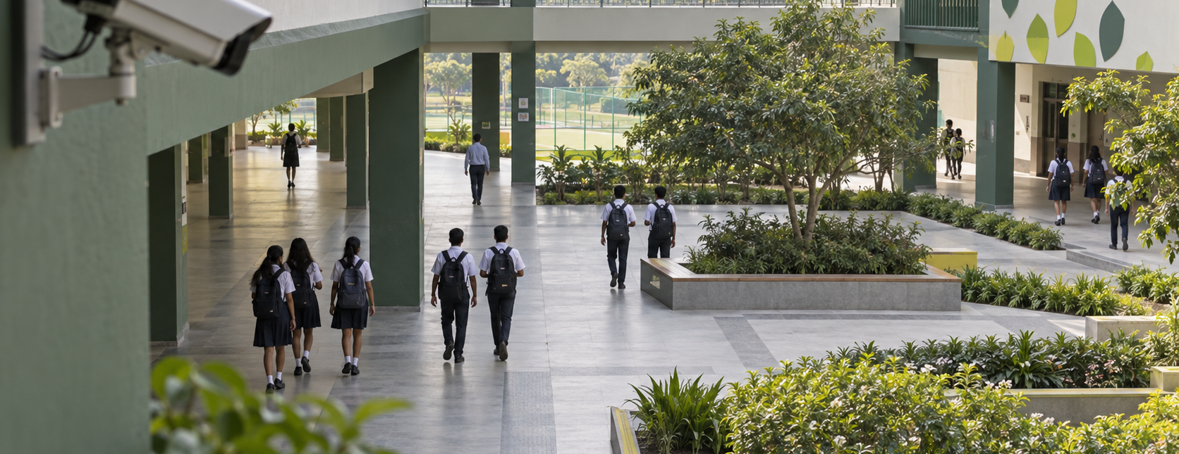
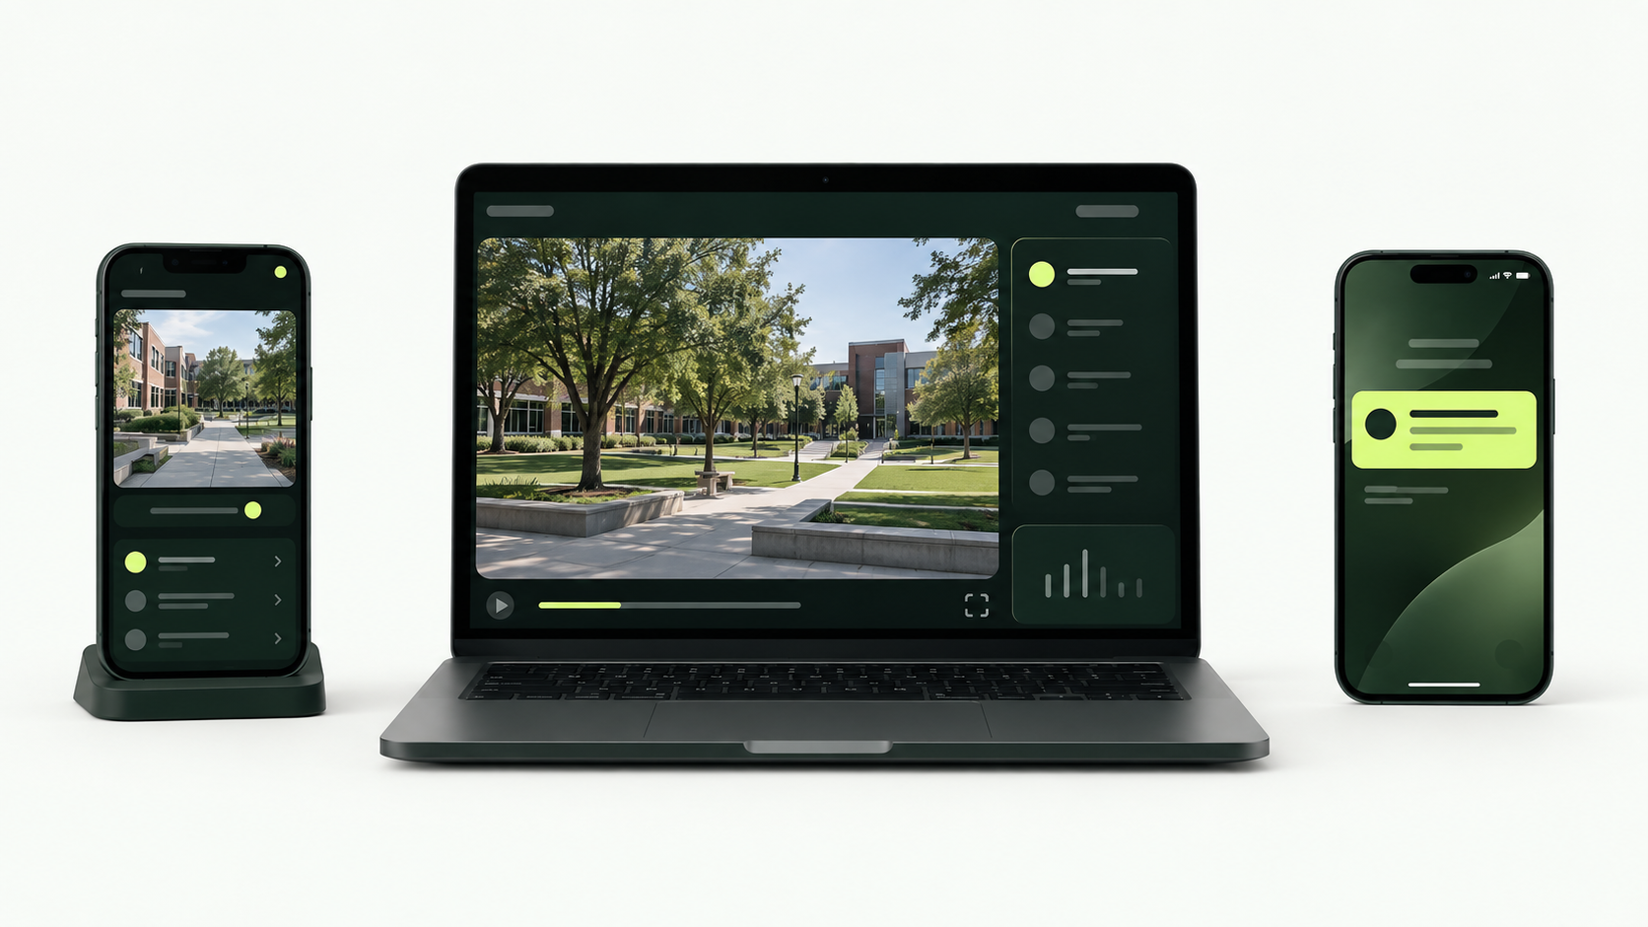
Your Idea
AI-assisted early intervention, with a human in charge.
Idea / Solution
Problem Resolution
Use a phone or camera feed to flag visible movement patterns that may need attention.
Give staff a short replay and location, then connect a confirmed alert to a responder.
Observe → flag → human review
Decide → dispatch → acknowledge
NIVRA / BAL BHARATI HACKATHON 3.0
02
Notes:
NIVRA is an idea, not a validated prototype. Structure follows Idea Submission Template BBH3.0, content slides 1–7. All generated imagery is conceptual. Proposed users: campus safety staff, teachers and event marshals. Problem is a hypothesis to validate; no user interviews or impact measurements are claimed.

Slide 3
Technical Approach
Proposed architecture / one supervised demo
01 / CAPTURE
02 / ANALYSE
03 / REVIEW
04 / RESPOND
Approved camera
→
Pose + time rules
→
Operator screen
→
Responder phone
Phone browser captures
a permitted scene.
Local landmarks and
repeated motion cues.
Replay, location and
dismiss / send options.
Human-approved alert;
acknowledge and close.
Frontend / browser
Backend / event workflow
React views for camera, operator and responder. Run pose inference in a worker.
FastAPI + WebSockets for alerts and acknowledgements; local demo, no cloud required.
AI prioritises review. It does not infer identity, intent or guilt.
NIVRA / BAL BHARATI HACKATHON 3.0
03
Notes:
NIVRA is an idea, not a validated prototype. Structure follows Idea Submission Template BBH3.0, content slides 1–7. All generated imagery is conceptual. Candidate design, not implemented. Camera/browser compatibility, multi-person tracking and temporal thresholds need validation. Short video buffer proposed; event metadata is the default stored record.

Slide 4
Feasibility and Viability
Technical
Operational
Existing pose models are available. Reliable escalation cues remain unproven.
One camera, one operator, one responder. Trial the workflow with school staff.
Resources needed
Data & build plan
Two phones, a laptop, network, web/ML skills and mentor support. Build in small stages.
Permissioned staged clips; none collected yet. Connect → flag → review → acknowledge.
Challenge / risk | Proposed mitigation
Ordinary play creates false alerts | Use temporal rules; require human review before dispatch.
Occlusion, poor light or network loss | Show confidence / offline state; test varied scenes.
Video privacy and child data | Minimise retention and access; obtain school approval and review applicable rules.
NIVRA / BAL BHARATI HACKATHON 3.0
04
Notes:
NIVRA is an idea, not a validated prototype. Structure follows Idea Submission Template BBH3.0, content slides 1–7. All generated imagery is conceptual. Resource needs are a plan, not an inventory of confirmed team skills or equipment. Test false alerts, missed staged events, and delivery/acknowledgement failures. No guaranteed detection accuracy.

Slide 5
Impact and Benefits
More time to respond.
Social
Economic
Aim: earlier human attention to developing incidents.
Explore reuse of existing devices; costs and savings are unvalidated.
Environmental
End users
Possible device reuse; no measured environmental benefit claimed.
Staff receive context, location and a clear response action.
Institutions / industry
Scalability
A proposed alert-to-acknowledgement record for safety teams.
Start with one campus; expand only after controlled testing.
NIVRA / BAL BHARATI HACKATHON 3.0
05
Notes:
NIVRA is an idea, not a validated prototype. Structure follows Idea Submission Template BBH3.0, content slides 1–7. All generated imagery is conceptual. All benefits are intended outcomes. Evaluate time to review, time to acknowledgement, false alerts and missed staged events before any expansion.

Slide 6
Research and References
Evidence informs the idea; it does not validate NIVRA.
01 / SCHOOL SAFETY
Proposed stack
MoE, School Safety & Security Guidelines (2021).
Establishes institutional safety responsibilities.
React + browser camera
02 / TECHNICAL BASIS
Three device roles and scene capture.
Google Research, BlazePose (2020), and MediaPipe docs.
Support pose estimation—not prediction of violence.
MediaPipe Pose
Body landmarks in a browser worker.
03 / EXISTING SOLUTION
Axis Object Analytics: object tracking and event triggers.
NIVRA proposes human review plus response acknowledgement.
Temporal rules
Repeated visible changes trigger review.
04 / DATA & PRIVACY
FastAPI + WebSockets
Planned data: permissioned staged volunteer videos; none yet.
DPDP Act (2023): assess applicable privacy rules before a pilot.
Alert delivery and acknowledgement.
NIVRA / BAL BHARATI HACKATHON 3.0
06
Notes:
NIVRA is an idea, not a validated prototype. Structure follows Idea Submission Template BBH3.0, content slides 1–7. All generated imagery is conceptual. Sources: https://dsel.education.gov.in/sites/default/files/guidelines/guidelines_sss.pdf
https://research.google/blog/on-device-real-time-body-pose-tracking-with-mediapipe-blazepose/
https://developers.google.com/edge/mediapipe/solutions/vision/pose_landmarker/web_js
https://www.axis.com/products/axis-object-analytics
https://www.meity.gov.in/static/uploads/2024/06/2bf1f0e9f04e6fb4f8fef35e82c42aa5.pdf
Sources accessed September 2026. Dataset is planned self-collected material, not an existing dataset.

Slide 7
Team Member Details
Bal Bharati Public School, Pitampura
Students
SL | Student ID | Name | Class | DOB | Email | Phone Number | Gender
1
2
3
4
5
Mentor
SL | Name | UID | Address | DOB | Email | Phone Number | Gender
1
NIVRA / BAL BHARATI HACKATHON 3.0
07
Notes:
NIVRA is an idea, not a validated prototype. Structure follows Idea Submission Template BBH3.0, content slides 1–7. All generated imagery is conceptual. All student and mentor details deliberately left blank at user request. Tables remain native and editable. Fill only the applicable student rows before submission.

