Slide 1


Bal Bharati Hackathon 3.0
Idea Submission
NIVRA: Before Impact
Spot warning signs. Help staff respond sooner.
Category: Cat2
Problem Statement Title
CCTV can miss warning signs before an incident escalates
Theme
T3 | AI for Good
Team Name
Team Damage Control
Team Leader
Harsh Jain
Unit Name
Bal Bharati Public School, Pitampura
Team Size
5 students (excluding mentor)
1
01 / 10
Notes:
Team leader is taken as Harsh Jain, the first listed student and requester. Category 2 is inferred from the supplied Class 10 example and the Class 12 team. School prefix PP follows the Pitampura unit naming used in student email addresses; verify portal conventions before submission.

Slide 2
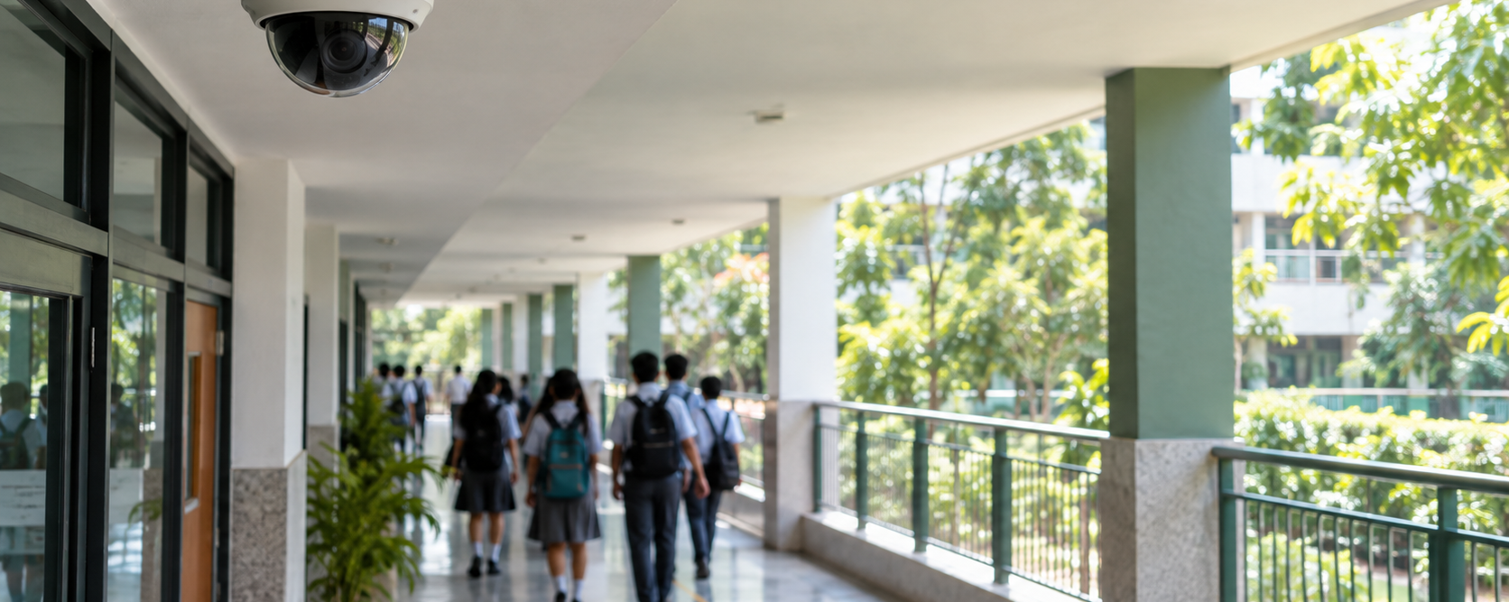
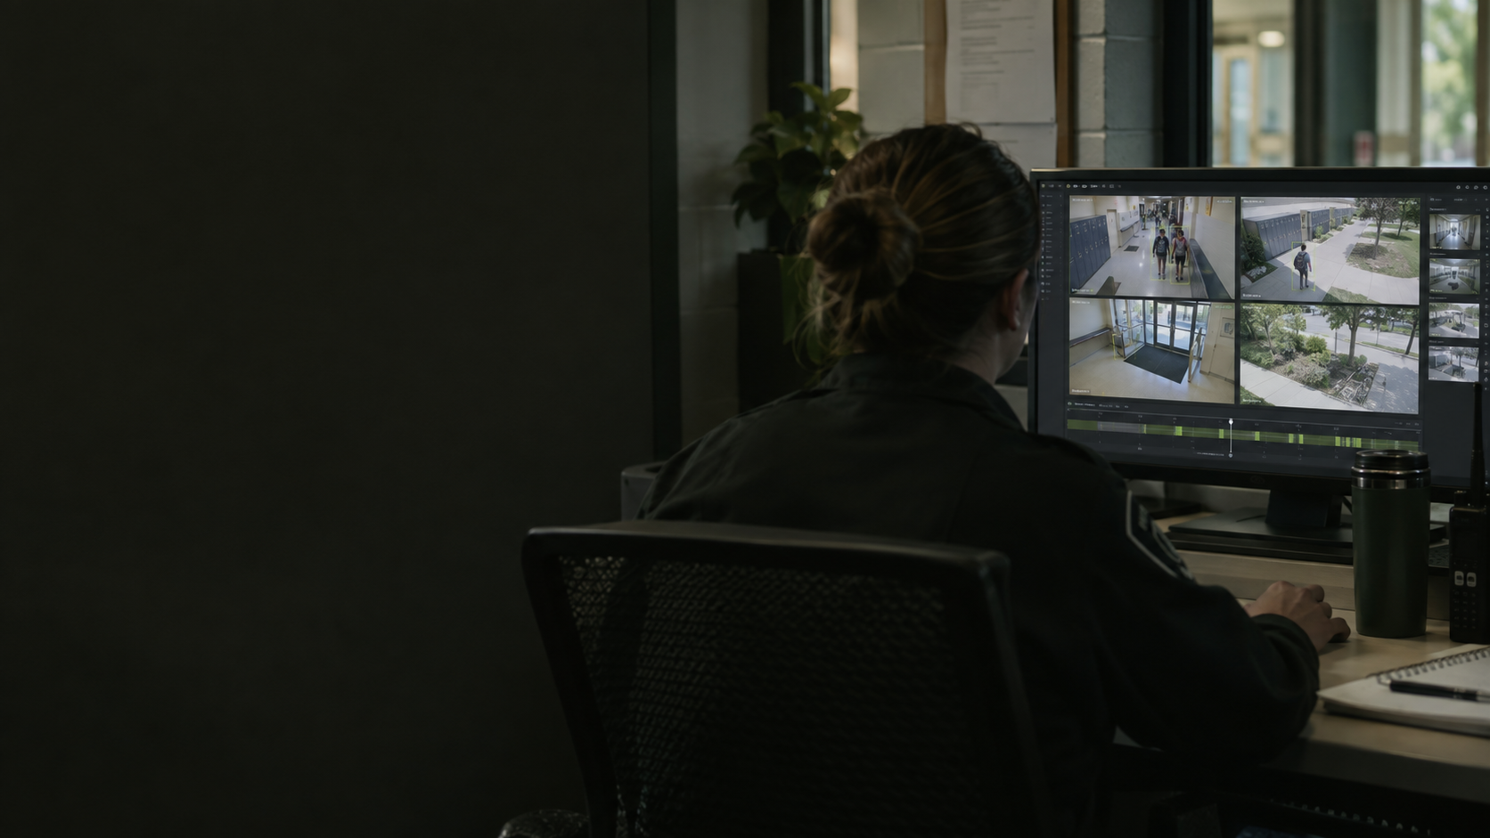
Your Idea
IDEA / SOLUTION :
Problem Resolution :
A camera can record a fight.
Who notices it starting?
NIVRA draws attention
to moments worth checking.
• Staff cannot watch every feed at once.
• A developing incident can go unnoticed.
• It flags concerning movement.
• A member of staff reviews the alert.
Illustrative AI-generated scenes. The proposed CCTV response system is still under development.
02 / 10

Slide 3
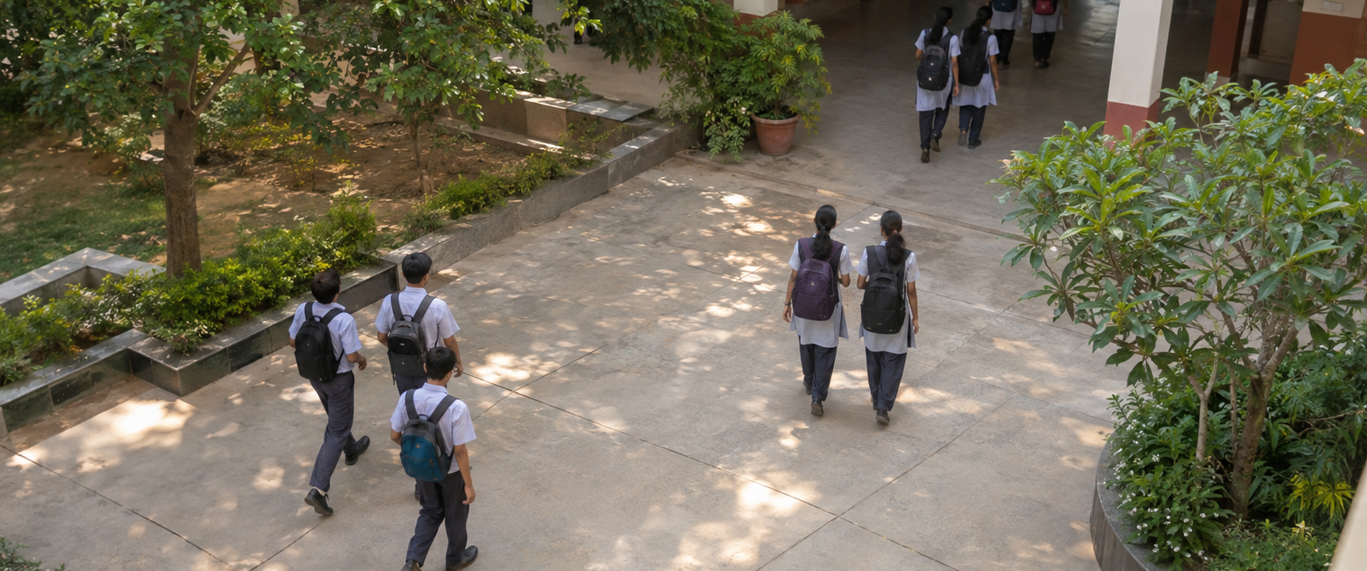
Your Idea | Visible signals
WHAT TRIGGERS A REVIEW?
A PERSON MAKES THE CALL
01 / Notice the alert
NIVRA highlights a pattern worth checking.
02 / Look at the scene
Staff assess what is actually happening.
Movement needs context.
03 / Decide what to do
• Repeated, directed arm movements
• The distance between people
• Several signals over time
Dismiss it, keep watching, or arrange help.
Experimental motion rules; sports, play, occlusion and camera angle can produce errors.
03 / 10

Slide 4
TECHNICAL APPROACH
BROWSER ARCHITECTURE
Inputs
Camera, local video or scripted scenario.
Input
Vision
Rules
Review
Two Web Workers
→
→
→
Camera / video
Pose + objects
Motion history
Banner + tone
One for pose, one for objects. Local MediaPipe + WASM.
Frames remain in the browser
Runtime
GPU for real-time pose when supported. CPU for review scans and fallback.
• Video is processed on the device.
• No footage is uploaded or recorded by the app.
• Temporary tracks clear when the session ends.
04 / 10
Notes:
Verified from VisionWorkerClient.ts: exactly two workers, pose and object, not three. Object analysis lower-frequency CPU. Browser app is statically hosted with Sites. No FastAPI or WebSocket responder backend exists in this repository.

Slide 5
TECHNICAL APPROACH | Demo
CURRENT LAB AND NEXT STEPS
Try the current lab
1. Choose camera, video or test scenario.
2. Inspect skeletons and review reasons.
3. Acknowledge alerts; pause, replay or stop.
Proposed next: connected response
211 tests passed
• Connect cameras across a site
• Replay the previous 8 seconds
• Help staff contact an available responder
Lint and production build also passed during local verification.
Planned features, not current capabilities. Generated illustration; current app uses an 8-second alert cooldown.
05 / 10

Slide 6
NIVRA / BROWSER PROTOTYPE
Feasibility and Viability
FEASIBILITY OF THE IDEA
Runs in a browser on a laptop or phone.
Uses camera input or a local video file.
Start with one supervised school trial before connecting more cameras.
POTENTIAL CHALLENGES & RISKS
STRATEGIES TO OVERCOME THEM
01 Sports and play can trigger reviews.
02 Occlusion or weak devices reduce coverage.
03 School video needs permission and privacy controls.
01 Require human review; test positive and quiet clips.
02 Use Lite / CPU fallback; show visibility and runtime state.
03 Keep frames local; obtain school approval before trials.
06 / 10
Notes:
Privacy boundary follows repo. Future trials require suitable permissions and review of applicable child-data rules. No compliance certification or proven safety outcome is claimed.

Slide 7
Impact and Benefits
Social Impact
Economic Impact
Environmental Impact
Help staff notice a developing incident and decide when to step in.
Build on existing cameras where possible, reducing the need for new equipment.
Reuse suitable devices and extend their working life.
BENEFITS OF THE SOLUTION
For staff: fewer feeds to search when an alert appears.
For schools: a practical way to trial earlier incident review.
Next step: measure missed events, false alerts and review time.
Expected benefits. Safety outcomes, costs and environmental savings have not yet been measured.
07 / 10
Notes:
Benefits are intended outcomes. Measure missed events, false alerts, review latency and usability. Earlier attention and reduced harm have not been measured in a deployment.

Slide 8
Impact and Benefits | Why it matters
4.4 million
1.25 million
~12,000 / day
Global injury-related deaths in 2019, including unintentional injuries.
Violence-related injury deaths in 2019, including self-harm and conflict.
Approximate daily equivalent of 4.4 million. Not a count of public fights.
WHAT THESE FIGURES MEAN FOR NIVRA
Our focus is narrower: help staff notice a developing incident sooner.
Test whether alerts are useful, timely and easy to review.
These global figures describe the problem; they do not prove NIVRA works.
Source: WHO, Preventing injuries and violence (2022), 2019 estimates.
08 / 10

Slide 9
Research and References
Technology Stack
EVIDENCE AND SOURCES
IMPLEMENTED IN THE REPOSITORY
NIVRA repository
React 19 + TypeScript + Vite
Implementation, test fixtures and limitations.
Browser UI and production build.
WHO | Injuries and violence
MediaPipe Tasks Vision 1.0.1
Broad global burden; not product impact.
Pose Landmarker Full / Lite, float16.
MediaPipe Pose Landmarker
EfficientDet-Lite0
Landmark API and model documentation.
Optional object analysis on CPU.
MoE school safety / DPDP Act
Web Workers + WASM + Canvas
Policy context and privacy review before trials.
Two workers; GPU attempt / CPU fallback.
Axis Object Analytics
Vitest + Playwright + Oxlint
Existing event-analytics category for comparison.
Unit tests, browser tests and lint tools.
Data: bundled exercise fixture + scripted observations; representative safety evaluation remains to be done.
09 / 10
Notes:
Additional reference: https://www.meity.gov.in/static/uploads/2024/06/2bf1f0e9f04e6fb4f8fef35e82c42aa5.pdf . Model card cautions against surveillance/life-critical use. Public demo: https://nivra-vision-lab.topperly.chatgpt.site . Supplied metrics PDF used as secondary context, not an authoritative source for unverified costs.

Slide 10
Team Member Details
Student’s Details
SL | Student ID | Name | Class | DOB | Email | Phone Number | Gender
1 | 223564 | Harsh Jain | 12C | 23/04/2009 | 223564@pp.balbharati.org | 9810141505 | Male
2 | 218461 | Tanishq Aggarwal | 12C | 09/05/2009 | 218461@pp.balbharati.org | 9810398813 | Male
3 | 201362 | Keshav Garg | 12D | 11/06/2009 | 201362@pp.balbharati.org | 7011900075 | Male
4 | 213266 | Reyansh Garg | 12D | 02/07/2009 | 213266@pp.balbharati.org | 8595774056 | Male
5 | 213283 | Asmi Sharma | 12D | 28/03/2010 | 213283@pp.balbharati.org | 8595612803 | Female
Mentor Details
SL | Name | UID | Address | DOB | Email | Phone Number | Gender
1
10 / 10
Notes:
All five students and DOBs supplied by user. Mentor fields intentionally blank. No student information is published to the public demo.

