Slide 1


Bal Bharati Hackathon 3.0
Idea Submission
NIVRA: Before Impact
AI-assisted observation. Human-led decisions.
Category: Cat2
Problem Statement Title
CCTV can miss warning signs before an incident escalates
Theme
T3 | AI for Good
Team Name
Team Damage Control
Team Leader
Harsh Jain
Unit Name
Bal Bharati Public School, Pitampura
Team Size
5 students (excluding mentor)
1
01 / 10
Notes:
Team leader is taken as Harsh Jain, the first listed student and requester. Category 2 is inferred from the supplied Class 10 example and the Class 12 team. School prefix PP follows the Pitampura unit naming used in student email addresses; verify portal conventions before submission.

Slide 2
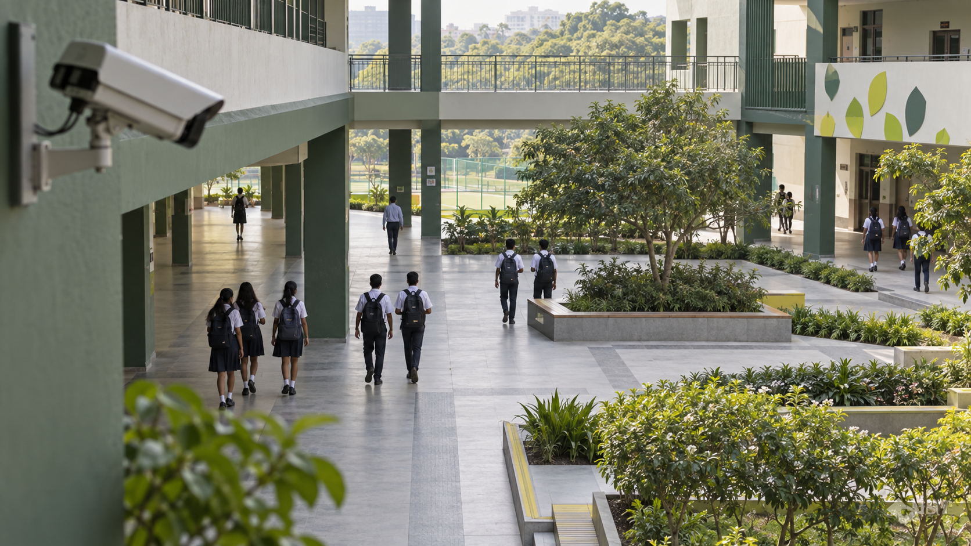
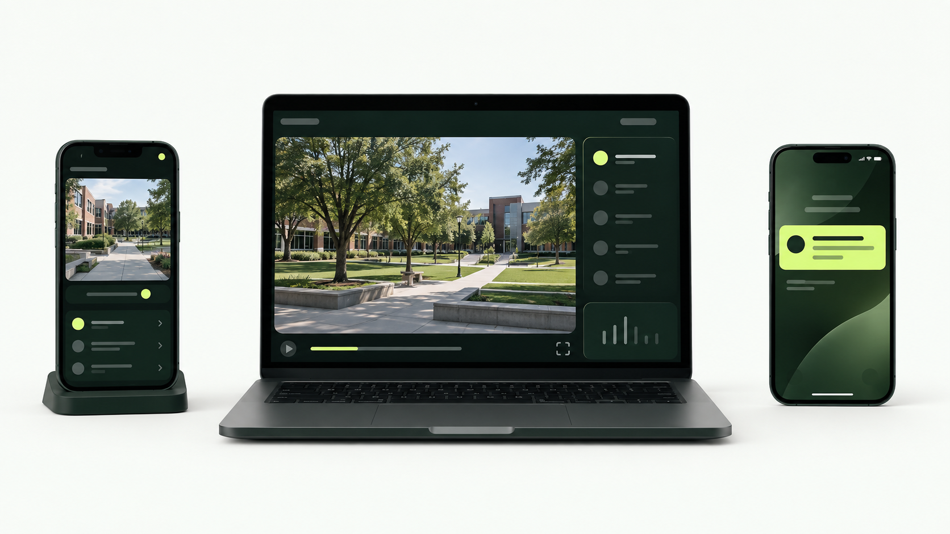
Your Idea
IDEA / SOLUTION :
Problem Resolution :
THE PROBLEM
OUR ANSWER: NIVRA
• CCTV records incidents after they happen.
• Warning signs are easy to miss in live feeds.
• Operators need useful context, not a noisy alarm.
• Watches movement over time.
• Flags explainable warning patterns.
• Keeps a human in control of every response.
Images are generated concepts. The multi-device response network is proposed, not implemented.
02 / 10

Slide 3
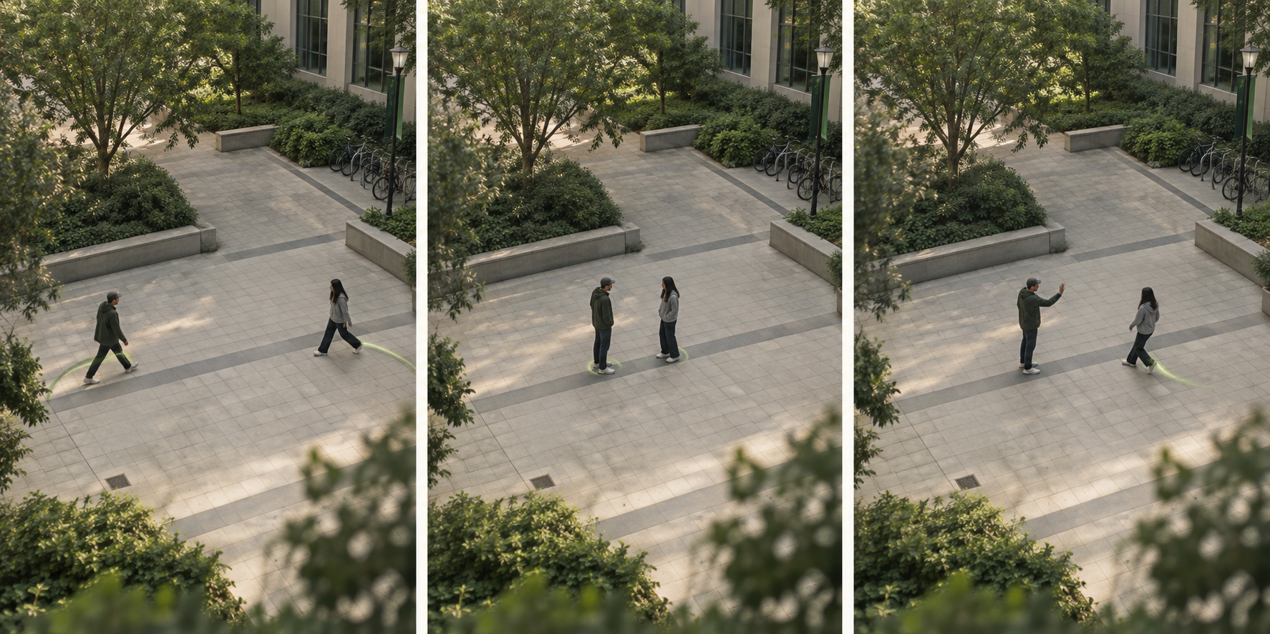
Your Idea | Visible signals
WHAT NIVRA LOOKS FOR
WHAT THE OPERATOR DOES
01 / SEE
Tracks people and objects temporarily.
02 / CHECK
Compares movement with simple rules.
Visible warning signals
03 / REVIEW
• Rapidly closing distance
• Repeated directed arm movements
• Crowd convergence or sudden changes
Shows the alert reason; a person decides what happens next.
Experimental motion rules; sports, play, occlusion and camera angle can produce errors.
03 / 10

Slide 4
TECHNICAL APPROACH
BROWSER ARCHITECTURE
Inputs
Camera, local video or scripted scenario.
Input
Vision
Rules
Review
Two Web Workers
→
→
→
Camera / video
Pose + objects
Motion history
Banner + tone
One for pose, one for objects. Local MediaPipe + WASM.
Frames remain in the browser
Runtime
GPU for real-time pose when supported. CPU for review scans and fallback.
No frame uploads or recordings. Tracks and review logs are session-only. No application backend is required.
04 / 10
Notes:
Verified from VisionWorkerClient.ts: exactly two workers, pose and object, not three. Object analysis lower-frequency CPU. Browser app is statically hosted with Sites. No FastAPI or WebSocket responder backend exists in this repository.

Slide 5
TECHNICAL APPROACH | Demo
CURRENT LAB AND NEXT STEPS
Try the current lab
1. Choose camera, video or test scenario.
2. Inspect skeletons and review reasons.
3. Acknowledge alerts; pause, replay or stop.
Proposed next: connected response
211 tests passed
Lint and production build also passed during local verification.
Multi-camera coordination, an 8-second context replay and responder dispatch remain future work.
Current app: 8-second alert cooldown, not an 8-second footage buffer. Mockup is conceptual.
05 / 10

Slide 6
NIVRA / BROWSER PROTOTYPE
Feasibility and Viability
FEASIBILITY OF THE IDEA
Technical: local model bundles, configurable Full/Lite pose and CPU recovery.
Operational: familiar camera/video controls; a person reviews each alert.
Resources: current Chrome, laptop or phone; Node 24 for local development.
POTENTIAL CHALLENGES & RISKS
STRATEGIES TO OVERCOME THEM
01 Sports and play can trigger reviews.
02 Occlusion or weak devices reduce coverage.
03 School video needs permission and privacy controls.
01 Require human review; test positive and quiet clips.
02 Use Lite / CPU fallback; show visibility and runtime state.
03 Keep frames local; obtain school approval before trials.
06 / 10
Notes:
Privacy boundary follows repo. Future trials require suitable permissions and review of applicable child-data rules. No compliance certification or proven safety outcome is claimed.

Slide 7
Impact and Benefits
Social Impact
Economic Impact
Environmental Impact
Earlier attention to visible changes, with the final decision left to staff.
Reuse existing devices where practical. No measured savings or pricing claim.
Potential hardware reuse. No measured environmental benefit.
BENEFITS OF THE SOLUTION
End users: clear visual alerts, reasons and local acknowledgement.
Institutions: a basis for testing a supervised safety workflow.
Scalability: validate one location before multi-camera or responder integration.
07 / 10
Notes:
Benefits are intended outcomes. Measure missed events, false alerts, review latency and usability. Earlier attention and reduced harm have not been measured in a deployment.

Slide 8
Impact and Benefits | Why it matters
4.4 million
1.25 million
~12,000 / day
Global injury-related deaths in 2019, including unintentional injuries.
Violence-related injury deaths in 2019, including self-harm and conflict.
Approximate daily equivalent of 4.4 million. Not a count of public fights.
WHAT THESE FIGURES MEAN FOR NIVRA
The scale of harm supports investigating better observation and response.
These broad global totals are not NIVRA’s addressable market or preventable cases.
Product value must be demonstrated through supervised, representative tests.
Source: WHO, Preventing injuries and violence (2022), 2019 estimates.
08 / 10

Slide 9
Research and References
Technology Stack
EVIDENCE AND SOURCES
IMPLEMENTED IN THE REPOSITORY
NIVRA repository
React 19 + TypeScript + Vite
Implementation, test fixtures and limitations.
Browser UI and production build.
WHO | Injuries and violence
MediaPipe Tasks Vision 1.0.1
Broad global burden; not product impact.
Pose Landmarker Full / Lite, float16.
MediaPipe Pose Landmarker
EfficientDet-Lite0
Landmark API and model documentation.
Optional object analysis on CPU.
MoE school safety / DPDP Act
Web Workers + WASM + Canvas
Policy context and privacy review before trials.
Two workers; GPU attempt / CPU fallback.
Axis Object Analytics
Vitest + Playwright + Oxlint
Existing event-analytics category for comparison.
Unit tests, browser tests and lint tools.
Data: bundled exercise fixture + scripted observations; representative safety evaluation remains to be done.
09 / 10
Notes:
Additional reference: https://www.meity.gov.in/static/uploads/2024/06/2bf1f0e9f04e6fb4f8fef35e82c42aa5.pdf . Model card cautions against surveillance/life-critical use. Public demo: https://nivra-vision-lab.topperly.chatgpt.site . Supplied metrics PDF used as secondary context, not an authoritative source for unverified costs.

Slide 10
Team Member Details
Student’s Details
SL | Student ID | Name | Class | DOB | Email | Phone Number | Gender
1 | 223564 | Harsh Jain | 12C | 23/04/2009 | 223564@pp.balbharati.org | 9810141505 | Male
2 | 218461 | Tanishq Aggarwal | 12C | 09/05/2009 | 218461@pp.balbharati.org | 9810398813 | Male
3 | 201362 | Keshav Garg | 12D | 11/06/2009 | 201362@pp.balbharati.org | 7011900075 | Male
4 | 213266 | Reyansh Garg | 12D | 02/07/2009 | 213266@pp.balbharati.org | 8595774056 | Male
5 | 213283 | Asmi Sharma | 12D | 28/03/2010 | 213283@pp.balbharati.org | 8595612803 | Female
Mentor Details
SL | Name | UID | Address | DOB | Email | Phone Number | Gender
1
10 / 10
Notes:
All five students and DOBs supplied by user. Mentor fields intentionally blank. No student information is published to the public demo.

