Slide 1
REAL ESTATE PRICE PREDICTION
BY HARSH NAVIN SETA AND KARTIK SHUKLA
(2019BCS-024 & 2019BCS-077)

Slide 2
ABSTRACT
The real estate market is exposed to many fluctuations in prices because of existing correlations with many variables, some of which cannot be controlled or might even be unknown. Housing prices can increase rapidly, yet the numerous listings available on-line where houses are sold or rented are not likely to be updated that often. In some cases, individuals interested in selling a house (or apartment) might include it in some online listing, and forget about updating the price .

Slide 3
Aim
To develop a machine learning model that will help us predict the prices of the houses so that a person can buy the house at a suitable price.

Slide 4
Object Oriented Programming
Object-oriented programming (OOP) is a computer programming model that organizes software design around data, or objects, rather than functions and logic. An object can be defined as a data field that has unique attributes and behavior.
This approach to programming is well-suited for programs that are large,complex and actively updated or maintained. The organization of an object-oriented program also makes the method beneficial to collaborative development, where projects are divided into groups.

Slide 5
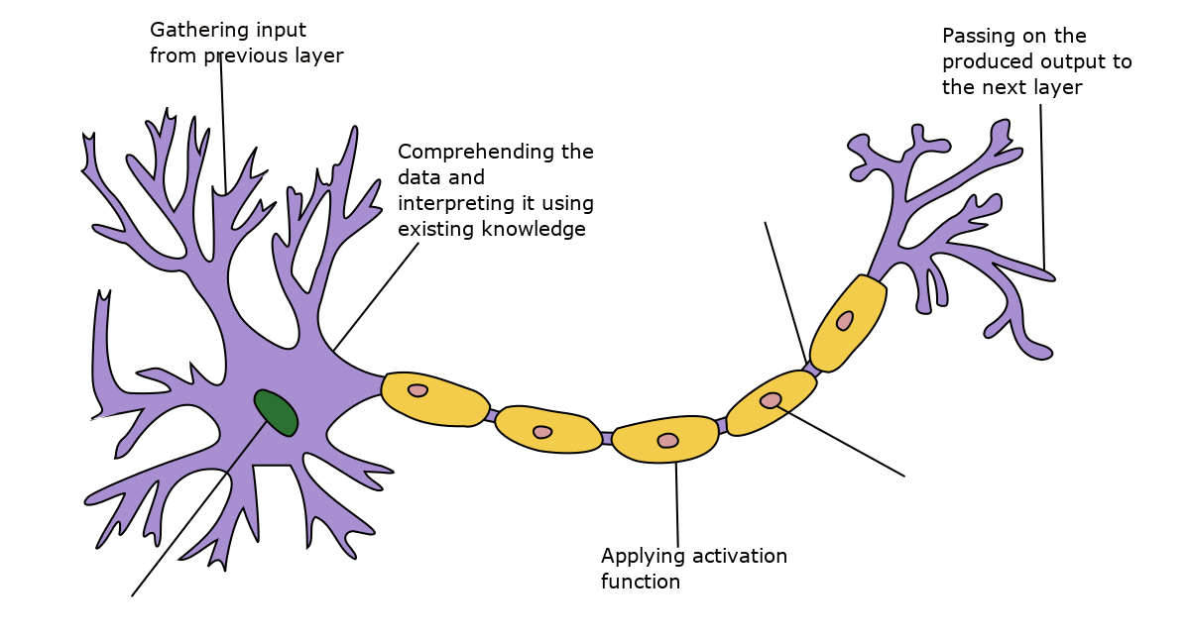
Neural Networks
Neural networks are artificial systems that were inspired by biological neural networks.

Slide 6
Neural Networks and Deep learning
These systems learn to perform tasks by being exposed to various datasets and examples without any task-specific rules. The idea is that the system generates identifying characteristics from the data they have been passed without being programmed with a pre-programmed understanding of these datasets.
Neural networks are based on computational models for threshold logic. Threshold logic is a combination of algorithms and mathematics. Neural networks are based either on the study of the brain or on the application of neural networks to artificial intelligence.
Hence, the intelligence brought in by Neural Network to a model has played a major role in the modern day era of Deep learning.

Slide 7
Normalization
Normalization becomes an essential first step when the features in a data set vary in their range. This is because variables that are measured at different scales do not contribute equally to the analysis and might end up creating a bias.
Max-min normalization is one of the most common ways to normalize data.
Formula:
X_col[ i ] = (X_col[ i ] - X_col.min() ) / ( X_col.max() - X_col.min() )
For every feature, the minimum value of that feature gets transformed into a 0, the maximum value gets transformed into a 1, and every other value gets transformed into a decimal between 0 and 1.

Slide 8
Randomization of input data
Before one uses a dataset imported from a source, it is very important to first randomize the data.
This is a healthy, essential practice to avoid having any pre-existing pattern in our data-set. Because these unnecessary patterns can be learnt by our model.
Our parameters will be wrongly misled, which is not favourable.

Slide 9
Algorithms
Stochastic Gradient Descent
Xavier’s Initialisation
Forwardpropogation Algorithm
Backpropogation Algorithm

Slide 10
Stochastic Gradient Descent
In Gradient Descent, there is a term called “batch” which denotes the total number of samples from a dataset that is used for calculating the gradient for each iteration. In typical Gradient Descent optimization,like Batch Gradient Descent, the batch is taken to be the whole dataset.
The word ‘stochastic‘ means a system or a process that is linked with a random probability. Hence, in Stochastic Gradient Descent, one example is selected randomly instead of the whole data set for each iteration.
Suppose, you have a huge dataset, so if you use a typical Batch Gradient Descent optimization technique, you will have to use all of the one million samples for completing one iteration while performing the Gradient Descent, and it has to be done for every iteration until the minima is reached. Hence, it becomes computationally very expensive to perform.Whereas stochastic updates the parameters learning from each example
Due to our computational constraint, we’ve preferred Stochastic Gradient descent algorithm.

Slide 11
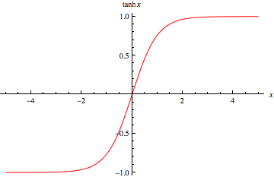
Xavier’s Initialisation
Here we can see that tanh activation function saturates to 1 or -1 very quickly as x gets greater than 1 or -1.
Hence we need to prevent the gradients from exploding and reaching very high values.
This makes gradient descent very slow as parameters get stuck in these saturated regions.

Slide 12
Xavier’s initialisation
Xavier initalisation helps us overcome this problem.
To avoid the parameters from exploding, we initialise the parameters as
parameters[ i ] := parameters [ i ] * sqrt (2/layer_dims [ i-1])
Hence if number of parameters in a layer is more then the parameters are
less in magnitude.
Therefore , z[i]= dot(A[i-1],W[i-1]) which is sum of multiplication of corresponding Ai’s and Wi’s elements.
Hence z[i] remains just around 1 or -1 preventing the saturation in gradient descent.

Slide 13
Forwardpropogation Algorithm
The input data is fed in the forward direction through the network. Each hidden layer accepts the input data, processes it as per the activation function and passes to the successive layer.
Let Input-> X,Output ->Y, Learning Rate -> alpha ,
CacheLayers ->Z, Neuron Layer->A,Parameter -> w,
Activation Function ->g(),No of Layers -> L+1,
A[0]:=X
for i from 1 to L:
Z[i]:= dot(A[i-1],w[i-1])
A[i]:=g(Z(i))
Compute Cost:
Total Cost := ½*(Y-A[L])^2

Slide 14
At each neuron in a hidden or output layer, the processing happens in two steps:
1.Preactivation: it is a weighted sum of inputs i.e. the linear transformation of weights w.r.t to inputs available. Based on this aggregated sum and activation function the neuron makes a decision whether to pass this information further or not.
2.Activation: the calculated weighted sum of inputs is passed to the activation function. An activation function is a mathematical function which adds non-linearity to the network. There are four commonly used and popular activation functions — sigmoid, hyperbolic tangent(tanh), ReLU and Softmax.

Slide 15
Backpropogation Algorithm
Back-propagation is the essence of neural net training. It is the method of fine-tuning the weights of a neural net based on the error rate obtained in the previous epoch (i.e.,iteration). Proper tuning of the weights allows you to reduce error rates and to makethe model reliable by increasing its generalization.
dA[L] := A[L] - Y
for i from L-1 to 1:
dA[i] := dot( dA[i+1]) , w[ i ].transpose)
for i from 0 to L-1:
dW[i]:=dot( dA[i+1]*g’(z[i+1]), A[ i ].transpose)
w[i]:= w[i]- alpha * dw[i]

Slide 16
Hyper-parameters of our model
It is a known fact that training a deep learning model is a highly empirical process.
But why ? The answer is Hyper-parameters.
These are the parameters that govern the ebb and flow of a
training model.
They need to be tuned in such a way, in order to achieve high-end optimal performance of our model.
Let us look at the hyper-parameters in our training model.

Slide 17
Hyper-parameters
1 . Learning Rate :
Probably the most influencial hyper-parameter in a Gradient descent practice.
The amount that the weights are updated during training is referred to as the step size or the “learning rate”.It has to be set to a small positive value.
Smaller learning rates require more time and epochs to converge the weights, whereaslarger learning rates result in rapid changes and require fewer training epochs.
2. Number of epochs :
The number of epochs is the number of complete passes through the training dataset.
The size of a batch must be more than or equal to one and less than or equal to the number of samples in the training dataset.
The number of epochs can be set to an integer value between one and infinity.

Slide 18
Hyper-parameters
3. Activation Function :
Activation functions are mathematical functions that determine the output of the layers of a neural network.
The function is attached to each neuron in the network, and determines whether it should be activated (“fired”) or not, based on whether each neuron’s input is relevant for the model’s prediction.
ReLU and tanh activation functions are one of the most used and prescribed Regression functions in modern day deep learning era which are both accounted for in our model.
4. Topology of our network:
The topology of a network defines the ‘structure’ of a neural network.
In simple words, it means the dimensions of layers of our network.

Slide 19
Classes Defined
Neural Network
Data Members:
•vector<RowVector*> neuronLayers;Stores the different layers of out network.
•vector<RowVector*> cacheLayers;Stores the unactivated (activation fn not yetapplied) values of layers.
•vector<RowVector*> deltas;Stores the error contribution of each neurons
•vector<Matrix*> parameters;The parameters of network

Slide 20
•vector<float >train_pred, test_pred ; stores our prediction
•vector<float >train_total_cost, train_avg_cost ; stores our total and avg train cost
•vector<float >test_total_cost, test_avg_cost ; stores our total and avg test cost
•vector<int> layer_dims ; dimensions of Neural Network
•float learningRate;
•int num_epochs; set the number of epochs
•string activation_func ; set the activation function to tanh or relu

Slide 21
Member Function:
•NeuralNetwork(public; constructor)
•propagateForward(public; void):Function for forward propagation of data.
•propagateBackward(public; void):Function for backward propagation of errors madeby neurons.
•calcErrors(public; void):Function to calculate errors made by neurons in eachlayer
•updateWeights(public; void):Function to update the weights of connections.
•train(public;void):Function to train the neural network give an array of data points
•predict(public; void):Function to make prediction on our test set.

Slide 22
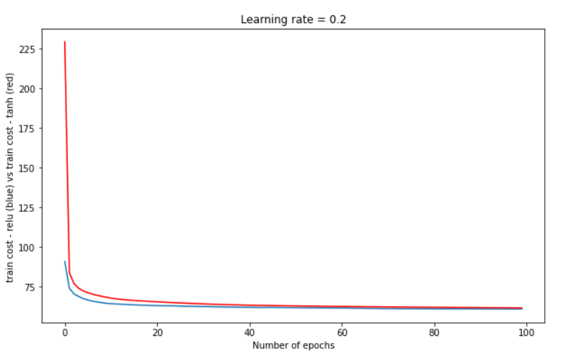
Observation
Testing the activation functions relu and tanh we can see that relu is giving us the better performance that tanh activation fucntion as it gives us lowercost.That is why we have included relu as the activation functions n our model.

Slide 23
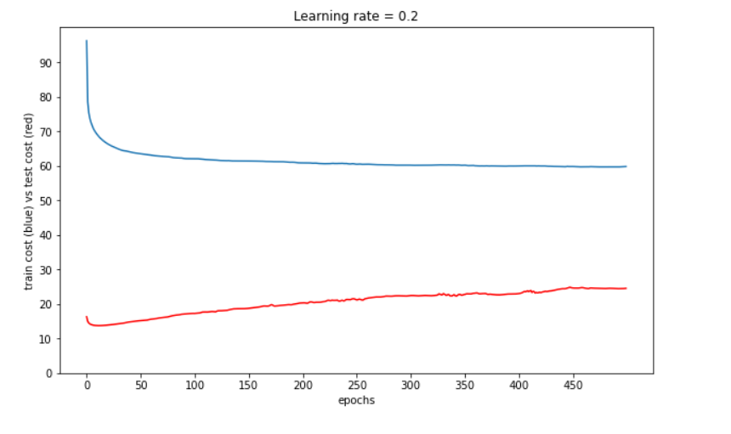
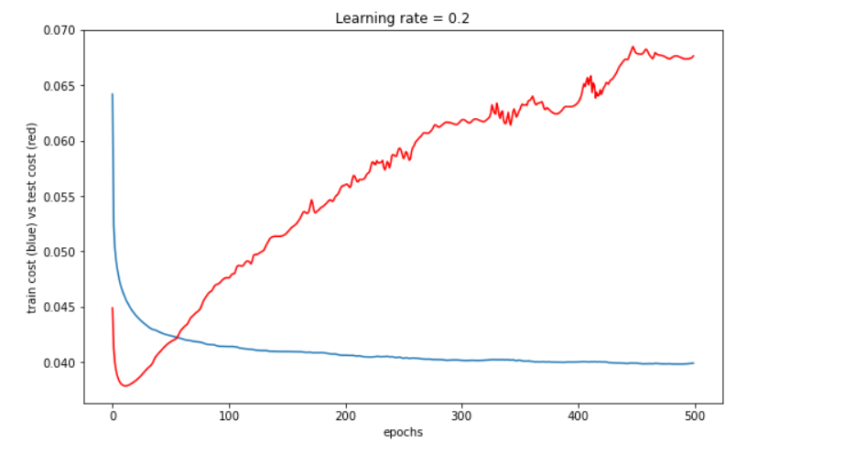
As we can see that after around ten epochs the avrage and the totaltest cost increases abruptly,which is not favorable.so we stop at 10 epochs.

Slide 24
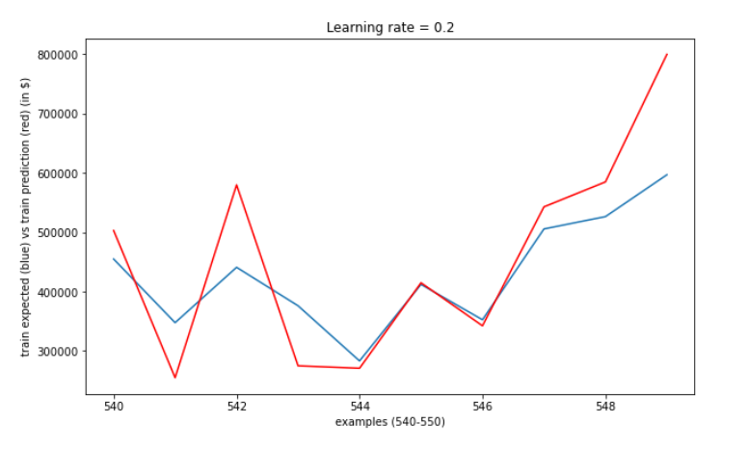
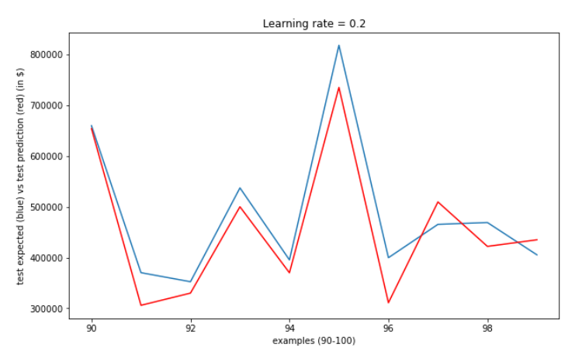
Result
These are a few random snaps of the graphs that represent the our prediction vsthe expected output for traning and test data.

Slide 25
Conclusion
Using our Neural Network regression model, we were able to produce a decently accurate predictions on our training and test set.
This shows how useful Deep learning models is even in real life applications like predicting real estate prices.
In reality, Modern day deep learning has reached heights like never before.
Deep learning is a technology that powers Facebook’s news feed, Netflix’s recommendation engine and Google’s search is radically transforming industries like health care and education.
Hence we can say that Deep learning has revolutionized the artificial intelligence technologies.

Slide 26
References
1.https://prateekvjoshi.com/2016/03/29/understanding-xavier-initialization-in-deep-neural-networks/
2.https://missinglink.ai/guides/neural-network-concepts/7-types-neural-network-activation-functions-right/#:~:text=Activation%20functions%20are%20mathematical%20.equations,relevant%20for%20the%20model's%20prediction
3.https://towardsdatascience.com/forward-propagation-in-neural-networks-simplified-math-and-code-version-bbcfef6f9250
4.http://neuralnetworksanddeeplearning.com/chap2.html

