Slide 1
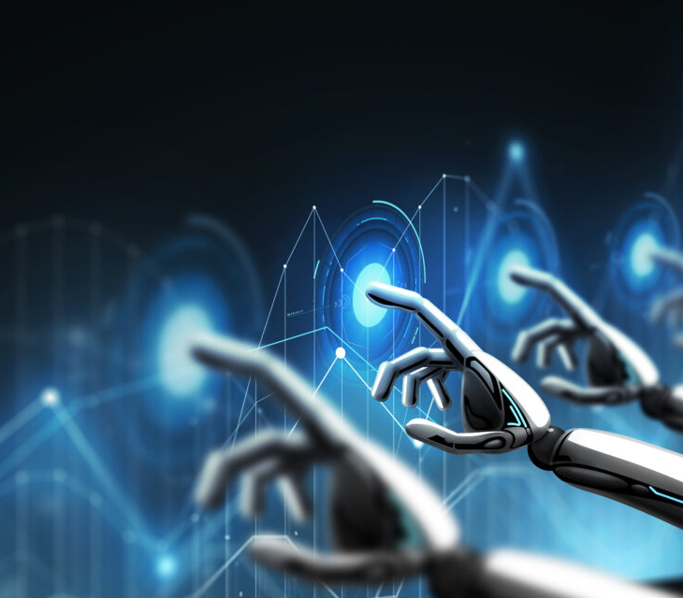
CYBERSECURITY
AWARENESS-stay safe in the digital world
Presented by- Manveer Kaur & Harshpreet Singh

Slide 2
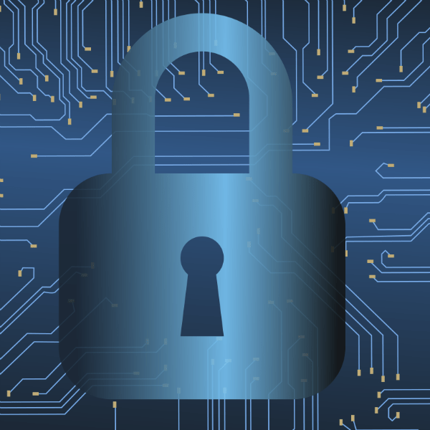
Introduction to cybersecurity
Cybersecurity is the practice of protecting systems, networks, and data from digital attacks that aim to steal, alter, or destroy sensitive information or disrupt normal business operations.
As technology advances, so do cyber threats-making awareness essential for everyone.

Slide 3
Importance of cybersecurity
Protects personal and financial data
Prevents identify theft
Secures organizational information
Builds trust in online services
Ensures safe digital communication

Slide 4
Common cyber threats
Malware: Malicious software such as viruses, worms, and spyware designed to damage or gain unauthorized access to a computer system.
Ransomware: A type of malware that encrypts a victim's files, demanding a ransom for the decryption key.
Phishing: Deceptive attempts to trick individuals into revealing sensitive information, often through fake emails or websites.
Social Engineering: Manipulating people to perform actions or divulge confidential information.
DDoS Attacks: Overwhelming a system with a flood of internet traffic to make it unavailable to its intended users.

Slide 5
Insider Threats: Malicious actions or negligence by current or former employees, contractors, or partners.
Credential Theft: Stealing usernames and passwords to gain unauthorized access to accounts.
Zero-Day Exploits: Attacks that take advantage of a vulnerability in software before the developers are aware of it.
Man-in-the-Middle (MitM) Attacks: An attacker secretly relays and possibly alters the communication between two parties who believe they are communicating directly with each other.
AI Attacks: Leveraging artificial intelligence to carry out more sophisticated and targeted attacks

Slide 6
A graph of Indian cyber attacks over the last five years would show a significant increase, with the number of incidents rising from 2020 to 2024

Slide 7
Signs of a cyber attack
Performance Issues: Your device is suddenly slow, frequently crashing, or unexpectedly restarting.
Unknown Software/Files: New programs, applications, toolbars, or files appear that you didn't install or download.
Pop-ups & Redirects: An increase in pop-up ads or your browser redirecting you to unfamiliar or suspicious websites.
Disabled Security: Your antivirus or firewall software is inexplicably turned off or not working correctly.
Hardware Anomalies: Your camera or microphone indicator light is on when not in use, or your battery is draining much faster than usual.

Slide 8
Cybersecurity best practices
FOR USERS
Use strong, unique passwords: Create long, complex passwords with a mix of letters, numbers, and symbols for each account. Use a password manager to help generate and store them securely.
Enable multi-factor authentication (MFA): This adds an extra layer of security by requiring more than just a password to log in.

Slide 9
FOR BUSINESS AND ORGANIZATIONS
Implement strong password and MFA policies: Enforce strong password requirements and mandate multi-factor authentication for all users.
Secure your network: Use firewalls and Virtual Private Networks (VPNs) to protect your network and secure data in transit.
Secure endpoints: Implement security measures for all devices that connect to the network, including laptops, tablets, and IoT devices.

Slide 10
CYBER HYGIENE TIPS
Lock your device when not in use
Use secure websites(https://)
Regularly change passwords
Install firewalls and trusted security apps
Educate yourself ans others about cyber safety

Slide 11
Cyber laws in india
Information technology Act, 2000 – main law governing cybercrimes
Covers offenses like:
  Identity theft
  Cyber fraud
  Data theft
  Online defamation
Enforced by CERT-In(Indian Computer Emergency Response Team)

Slide 12
Real-life cybercrime examples
-2017: WannaCry Ransomware Attack - affected 200,000 computers worldwide
-2021: Facebook Data Leak – 500 million user records exposed
-2023: Indian AI Scam Calls – impersonating officials for money theft

Slide 13
Role of individuals
1st
Cybersecurity isn’t just an IT issue – it’s everyone’s responsibility.
2nd
By staying informed and alert, individuals can stop cyber threats before they spread.

Slide 14
Conclusion
Cybersecurity awareness is the first step toward a safer digital world.
~
Think before you click. Protect before you connect.

Slide 15

“Awareness is the first step to prevention. Be smart. Be cyber safe.”

