Slide 1
SQL DATA PROJECT
Hospital Management System
A SQL Server (T-SQL) Data Analysis Case Study — Patients, Doctors, Appointments,
Billing & Hospital Operations
Harsh Pandey
Data Analyst | BI Analyst | AI Analyst
github.com/harshpandey97
14 Tables • 15 Business Questions Solved • 3 Reusable KPI Views

Slide 2
PROJECT OVERVIEW
Turning Raw Hospital Records Into Decisions
🏥
🎯
📊
The Scenario
The Goal
The Deliverable
A mid-size hospital tracks patients, doctors, nurses, appointments, admissions, treatments, billing and lab work across 14 relational tables — but has no reporting layer to act on it.
Write production-style T-SQL against realistic sample data to answer 15 real operational and financial questions hospital management would actually ask.
Ranked queries, aggregations, and window functions — packaged into 3 reusable KPI views for revenue, doctor performance, and room occupancy.
40
25
60
₹305K
Patients
Doctors
Appointments
Billed Revenue
Hospital Management System — SQL Data Analysis
2

Slide 3
DATABASE DESIGN
A 14-Table Relational Schema
Core operational entities linked through clean foreign keys — sized at ~40 rows/table for a realistic but query-friendly demo dataset.
People & Care Teams
Clinical Activity
Resources
Finance
Departments
Appointments
Rooms
Billing
Doctors
Admissions
Medicines
Payments
Nurses
Treatments
Prescriptions
Patients
LabTests
TestResults
Hospital Management System — SQL Data Analysis
3

Slide 4
APPROACH
Tools, Techniques & SQL Skills Applied
T-SQL Techniques
Platform & Deliverables
Aggregations — SUM, AVG, COUNT across joins
✅
Microsoft SQL Server (T-SQL)
Schema + sample data + solution scripts
Window functions — RANK(), DENSE_RANK()
✅
40 rows / table sample dataset
Multi-table JOINs (up to 3 tables deep)
Realistic scale — enough variety, fast to query
Date functions — YEAR, MONTH, DATEDIFF, FORMAT
✅
15 business questions answered
Doctors, revenue, occupancy, meds, labs & more
Conditional aggregation with CASE WHEN
✅
3 production-style KPI views
Reusable views (CREATE OR ALTER VIEW)
Revenue, doctor performance, room occupancy
Hospital Management System — SQL Data Analysis
4

Slide 5
PART A
Care Team & Operations Analytics
Questions 1–2, 12 — staffing mix, workload and reach

Slide 6
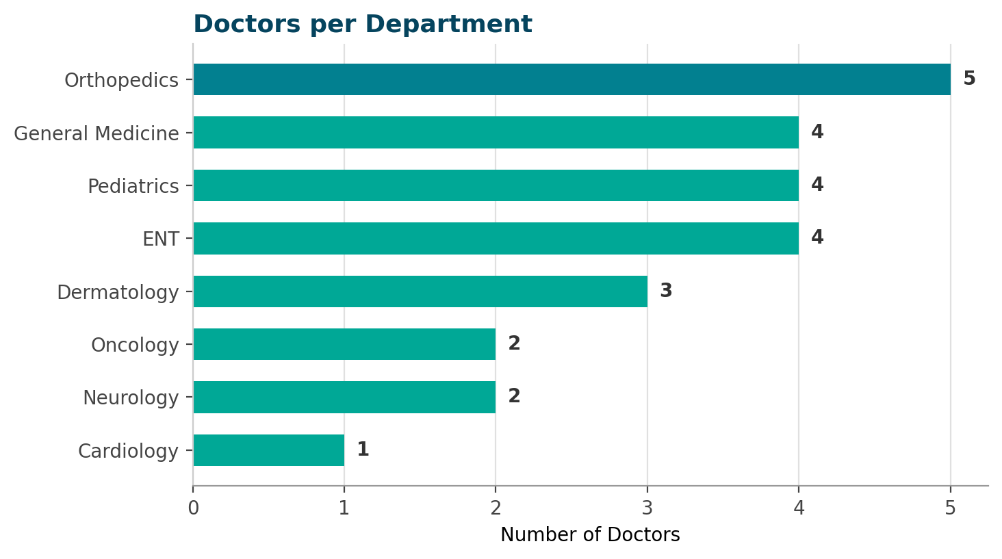
STAFFING
Q1
Which Department Has the Most Doctors?
KEY INSIGHT
Orthopedics leads staffing
Orthopedics fields 5 doctors — the largest specialist bench of any department.
General Medicine, Pediatrics and ENT are tied at 4 doctors each.
Cardiology has just 1 doctor despite carrying the highest consultation fee (₹1,000) — a potential capacity gap.
Hospital Management System — SQL Data Analysis
6

Slide 7
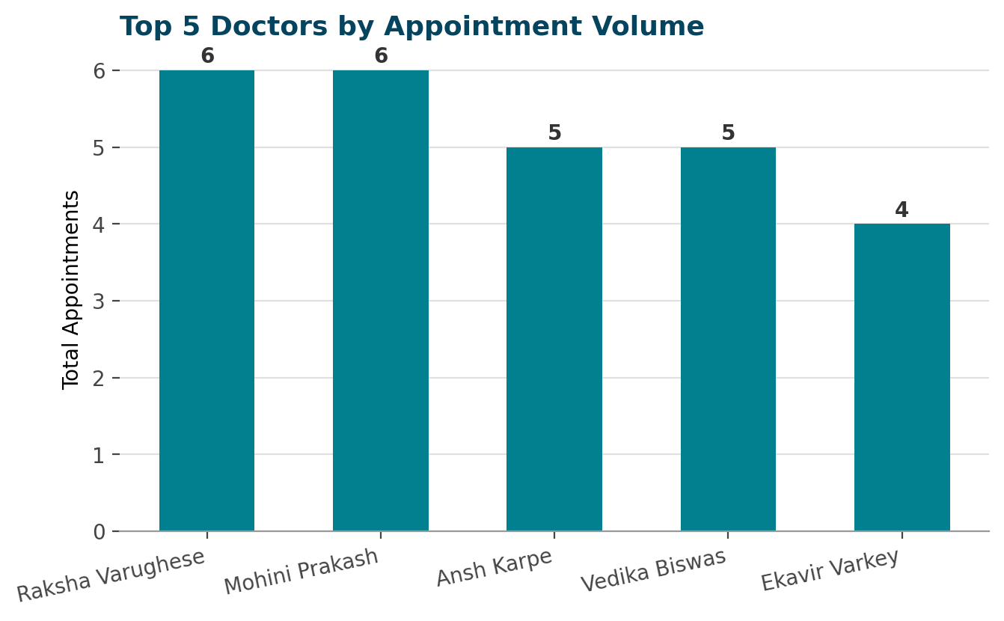
WORKLOAD
Q2
Which Doctors See the Most Patients?
KEY INSIGHT
Two doctors tie for busiest
Dr. Raksha Varughese and Dr. Mohini Prakash each logged 6 appointments — the highest of any doctor.
General Physicians and Orthopedic Surgeons dominate the top 5 by volume.
Ranked with SQL's RANK() window function so ties share a position.
Hospital Management System — SQL Data Analysis
7

Slide 8
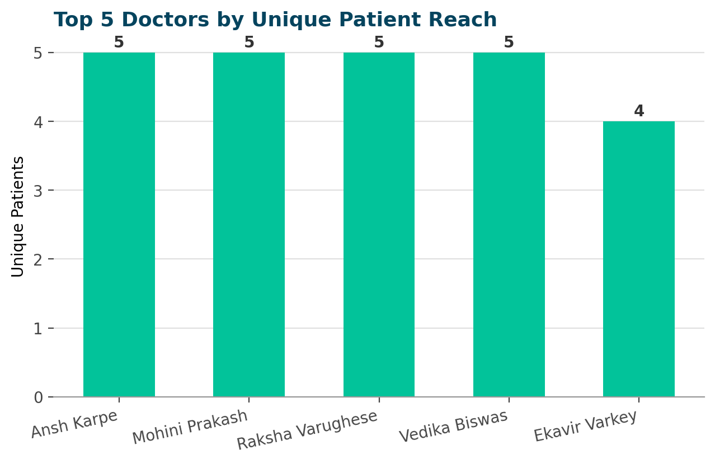
REACH
Q12
Top Doctors by Unique Patient Count
KEY INSIGHT
Volume vs. reach diverge
4 different doctors each treated 5 distinct patients — a broader reach than raw appointment counts alone suggest.
COUNT(DISTINCT patient_id) reveals doctors who serve more unique people rather than repeat visits from the same few.
Useful for measuring patient-facing coverage, not just busyness.
Hospital Management System — SQL Data Analysis
8

Slide 9
PART B
Financial & Revenue Analytics
Questions 3, 4, 7, 10, 15 — where the money comes from

Slide 10
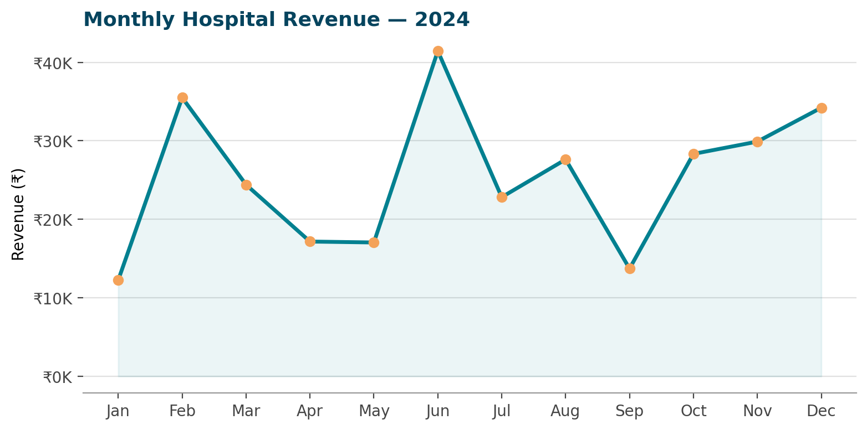
REVENUE
Q3
Monthly Revenue Trend
KEY INSIGHT
June is the peak month
June generated ₹41.4K — the hospital's highest month — followed by a February spike of ₹35.5K.
September dipped to the year's lowest at ₹13.7K.
Revenue recovers steadily from September through December, closing the year strong.
Hospital Management System — SQL Data Analysis
10

Slide 11
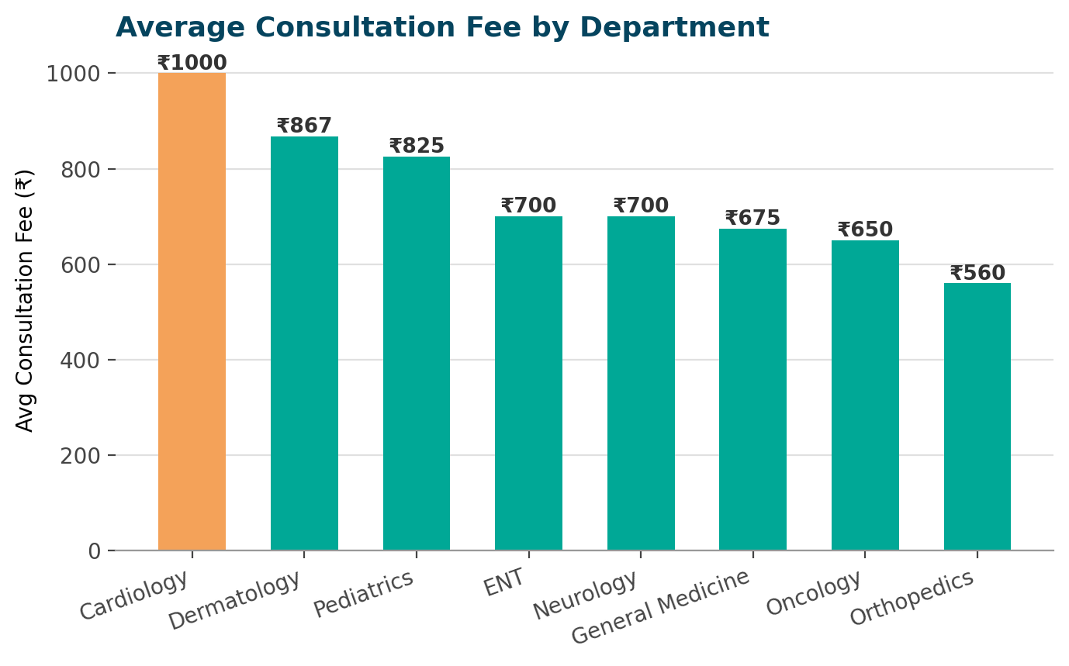
PRICING
Q4
Average Consultation Fee by Department
KEY INSIGHT
Cardiology commands the premium
Cardiology charges an average ₹1,000 per consult — the highest of all 8 departments.
Dermatology (₹867) and Pediatrics (₹825) follow.
Orthopedics is the most affordable at ₹560 despite having the most doctors.
Hospital Management System — SQL Data Analysis
11

Slide 12
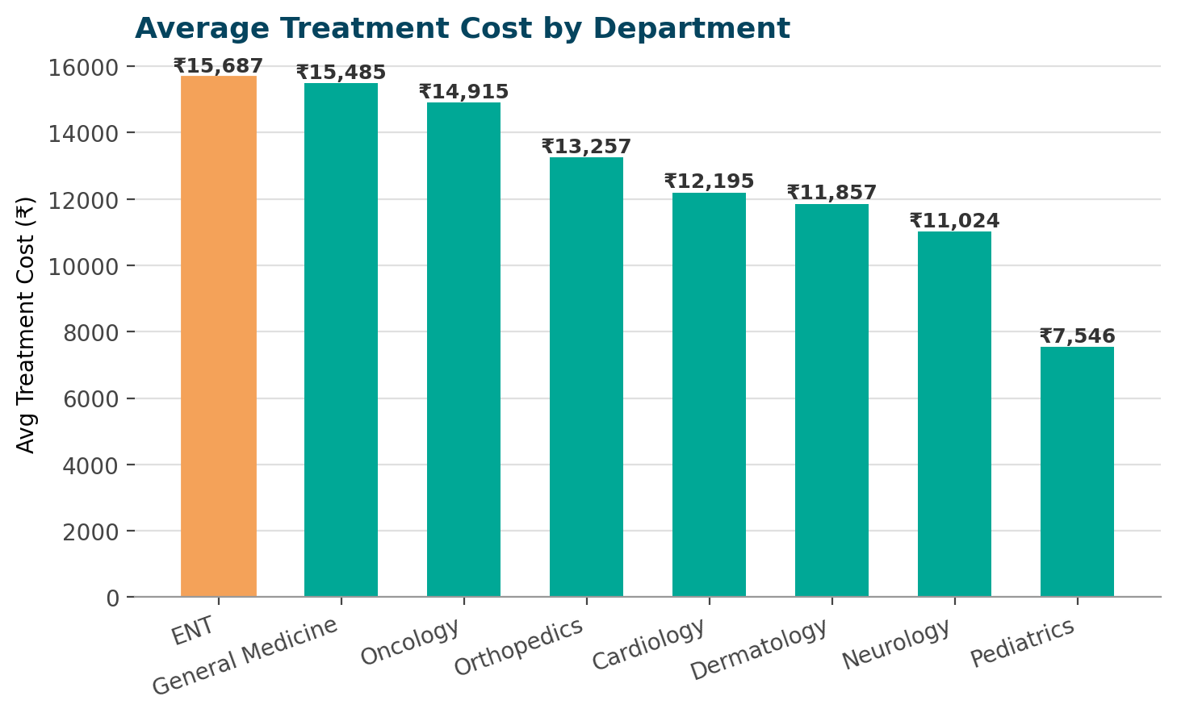
COST
Q7
Average Treatment Cost by Department
KEY INSIGHT
ENT treatments cost the most
ENT treatments average ₹15,687 per procedure — the highest of any department, across 9 treatments.
Pediatrics is the least costly on average, at ₹7,546.
Cost and consultation fee don't move together — Cardiology has the priciest consults but not the priciest treatments.
Hospital Management System — SQL Data Analysis
12

Slide 13
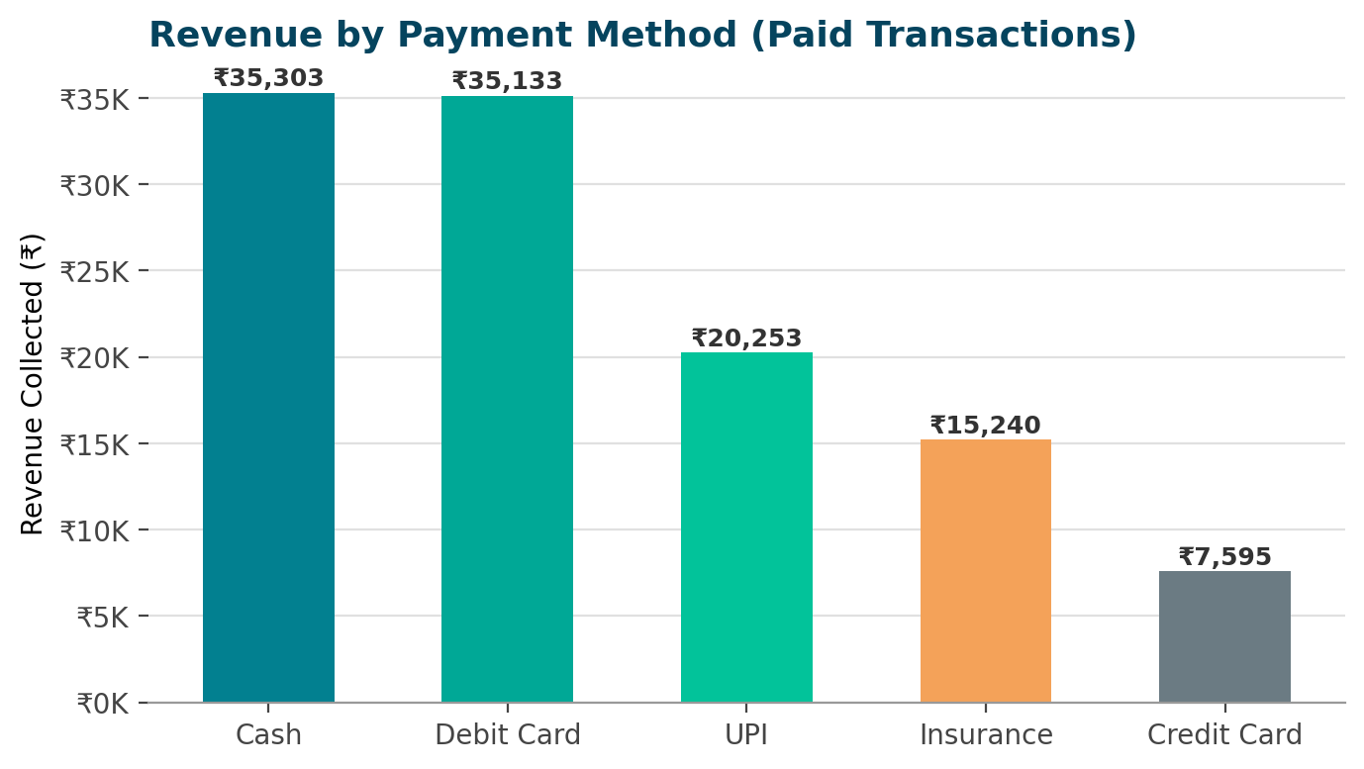
COLLECTIONS
Q10
Revenue by Payment Method
KEY INSIGHT
Cash & card lead collections
Cash (₹35.3K) and Debit Card (₹35.1K) are the top two channels among successfully paid bills.
Insurance settlements lag despite being used often — pointing to slower claim cycles.
Only 'Paid' status transactions are counted here, isolating actual cash collected.
Hospital Management System — SQL Data Analysis
13

Slide 14
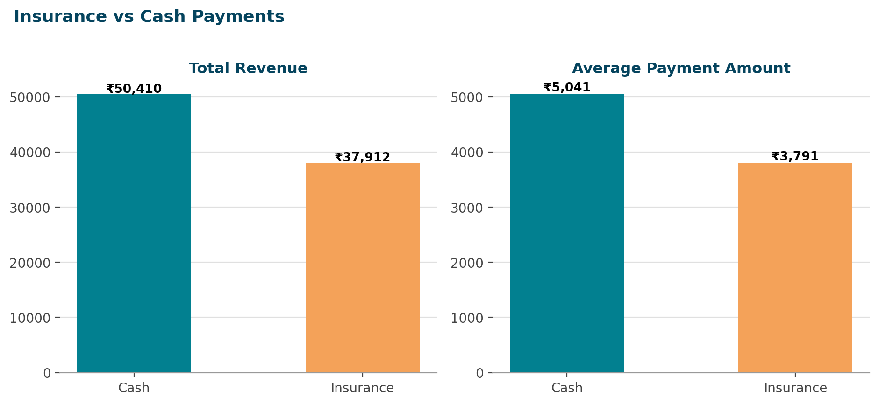
COMPARISON
Q15
Insurance vs. Cash Payments
KEY INSIGHT
Cash outperforms insurance
Cash generated ₹50.4K in total revenue vs. ₹37.9K for insurance, from the same 10 transactions each.
Average cash payment (₹5,041) is ~33% higher than average insurance payout (₹3,791).
Insurance claims may be settling at a discount versus the billed amount.
Hospital Management System — SQL Data Analysis
14

Slide 15
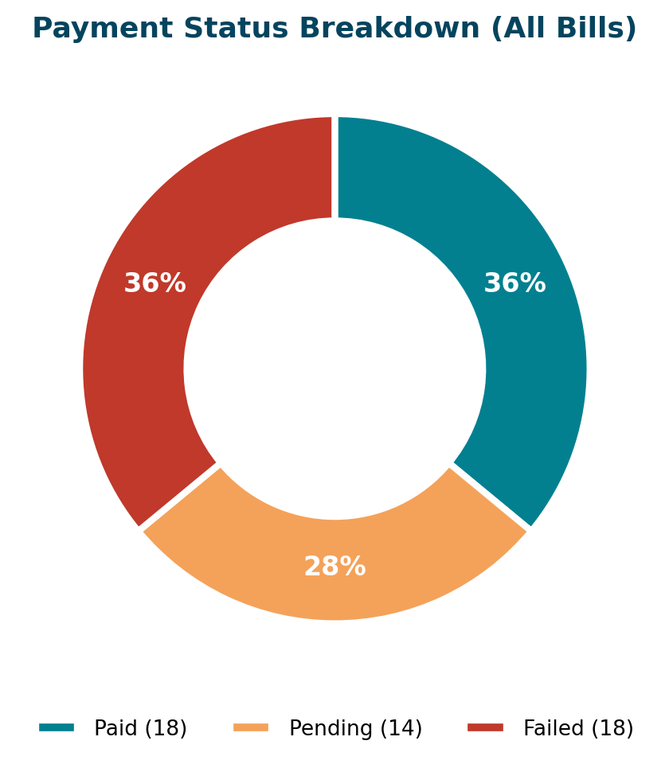
RISK
Q0
Where Is Billing Revenue Getting Stuck?
KEY INSIGHT
1 in 3 payments fails
Of all 50 recorded payments, only 36% are marked 'Paid' — an equal 36% are 'Failed'.
The remaining 28% sit in 'Pending' status awaiting settlement.
This signals a real collections bottleneck worth investigating — a natural next KPI to track over time.
Hospital Management System — SQL Data Analysis
15

Slide 16
PART C
Clinical Operations Analytics
Questions 5, 6, 13, 14 — medicines, labs, stays and rooms

Slide 17
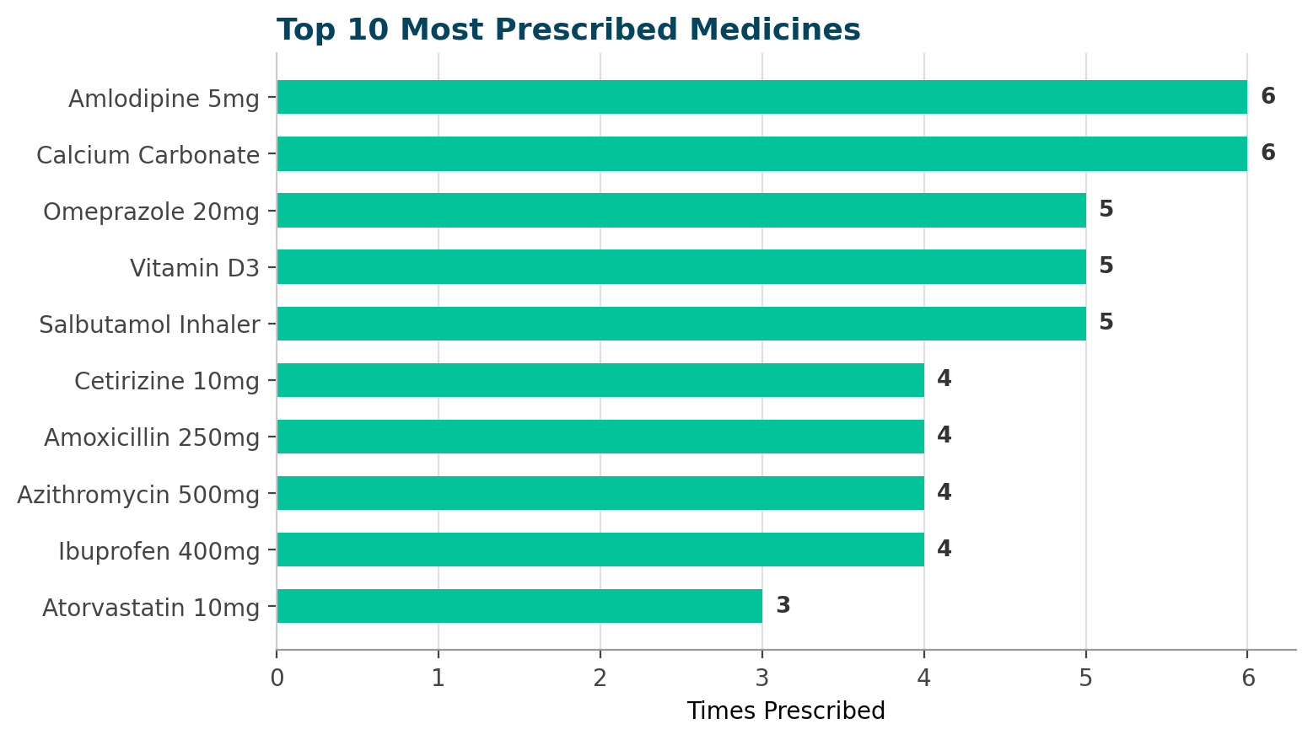
PHARMACY
Q5
Most Prescribed Medicines
KEY INSIGHT
Chronic-care drugs top the list
Amlodipine 5mg and Calcium Carbonate are each prescribed 6 times — the most of any medicine.
Omeprazole, Vitamin D3 and Salbutamol Inhaler follow closely at 5 each.
Batch variants of the same drug were grouped to reveal true demand by active medicine.
Hospital Management System — SQL Data Analysis
17

Slide 18
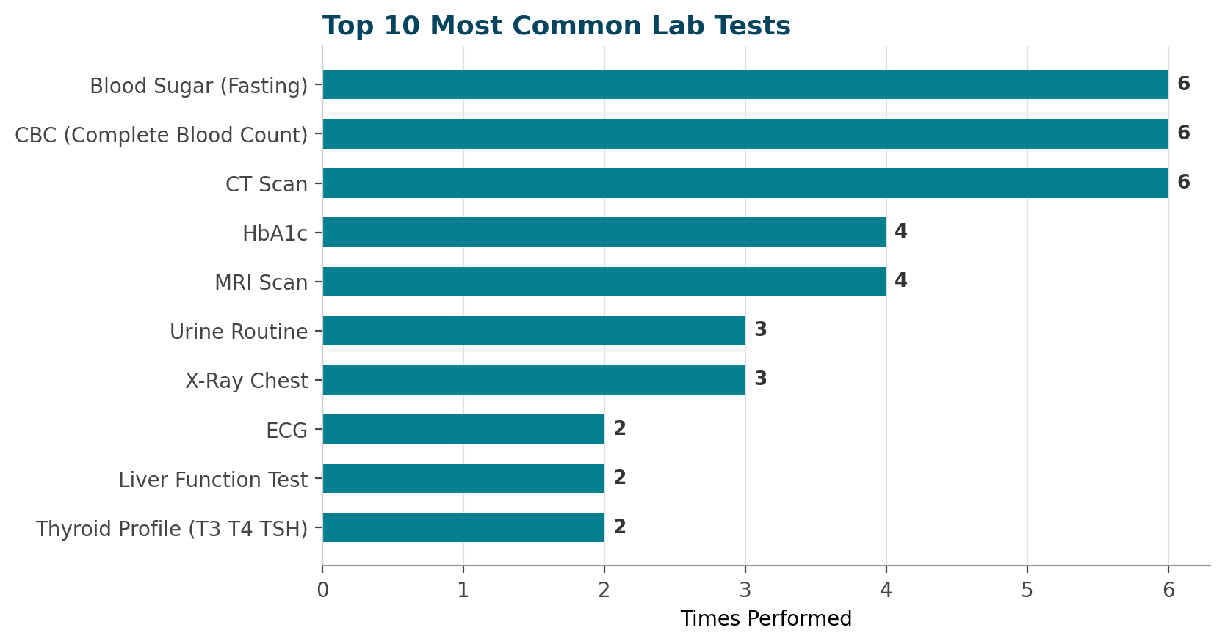
DIAGNOSTICS
Q6
Most Common Lab Tests
KEY INSIGHT
Routine screens dominate volume
Blood Sugar (Fasting), CBC and CT Scan are tied as the most-ordered tests, each performed 6 times.
MRI Scan and HbA1c follow at 4 each — reflecting steady diabetes and neuro workups.
CT/MRI scans are high-frequency AND high-cost — a good place to check turnaround time.
Hospital Management System — SQL Data Analysis
18

Slide 19
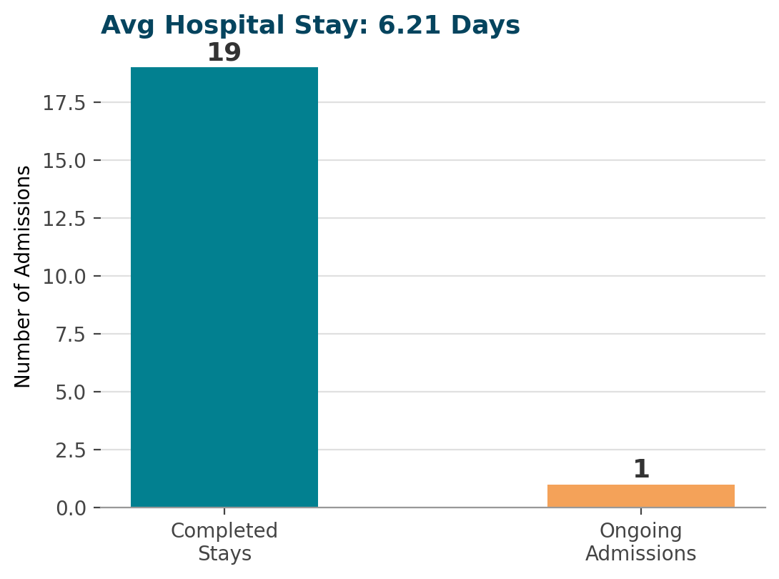
STAYS
Q13
Average Hospital Stay Duration
KEY INSIGHT
Stays average just over 6 days
Completed admissions last an average of 6.21 days from admission to discharge.
19 of 20 admissions have a recorded discharge date; 1 patient remains admitted (cardiac observation).
DATEDIFF(DAY, admission_date, discharge_date) is filtered to exclude the still-admitted case.
Hospital Management System — SQL Data Analysis
19

Slide 20
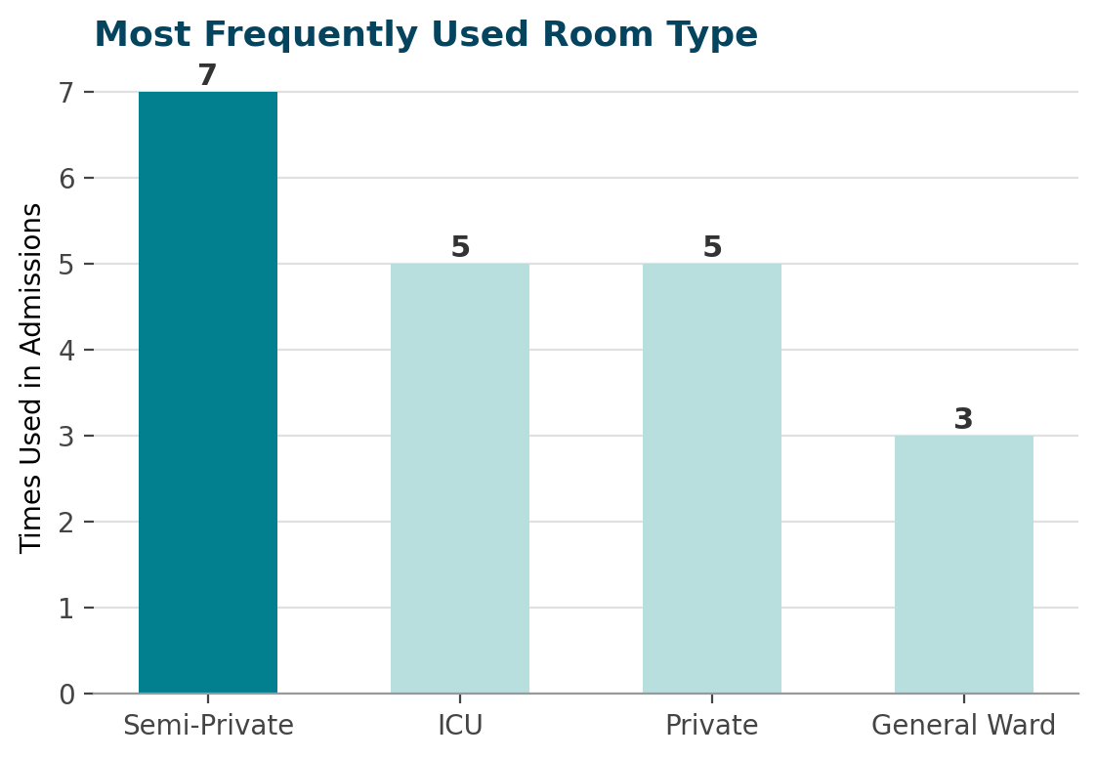
ROOMS
Q14
Most Frequently Used Room Type
KEY INSIGHT
Semi-Private rooms see the most turnover
Semi-Private rooms were used in 7 admissions — more than any other type.
ICU and Private rooms tie at 5 admissions each, reflecting a steady stream of critical cases.
General Ward sees the least admission activity at 3, despite being the cheapest option.
Hospital Management System — SQL Data Analysis
20

Slide 21
PART D
Patient & Facility Analytics
Questions 8, 9, 11 — where patients come from and how full the hospital runs

Slide 22
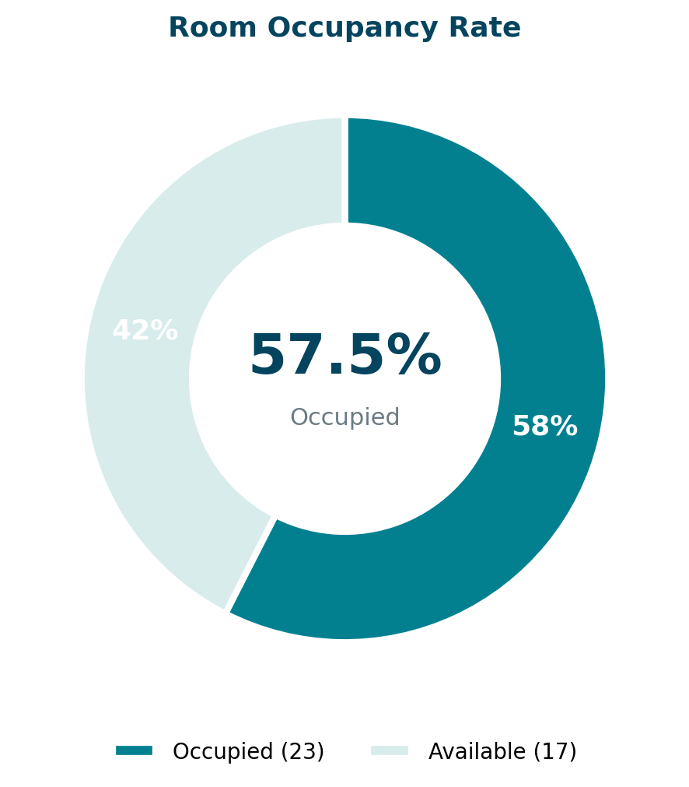
CAPACITY
Q8
Room Occupancy Rate
KEY INSIGHT
Over half the hospital is full
57.5% of all 40 rooms are currently Occupied — 23 rooms in use against 17 available.
That leaves meaningful headroom, but ICU and Deluxe rooms trend toward being the tightest categories.
A live version of this view would flag when occupancy nears a safety threshold.
Hospital Management System — SQL Data Analysis
22

Slide 23
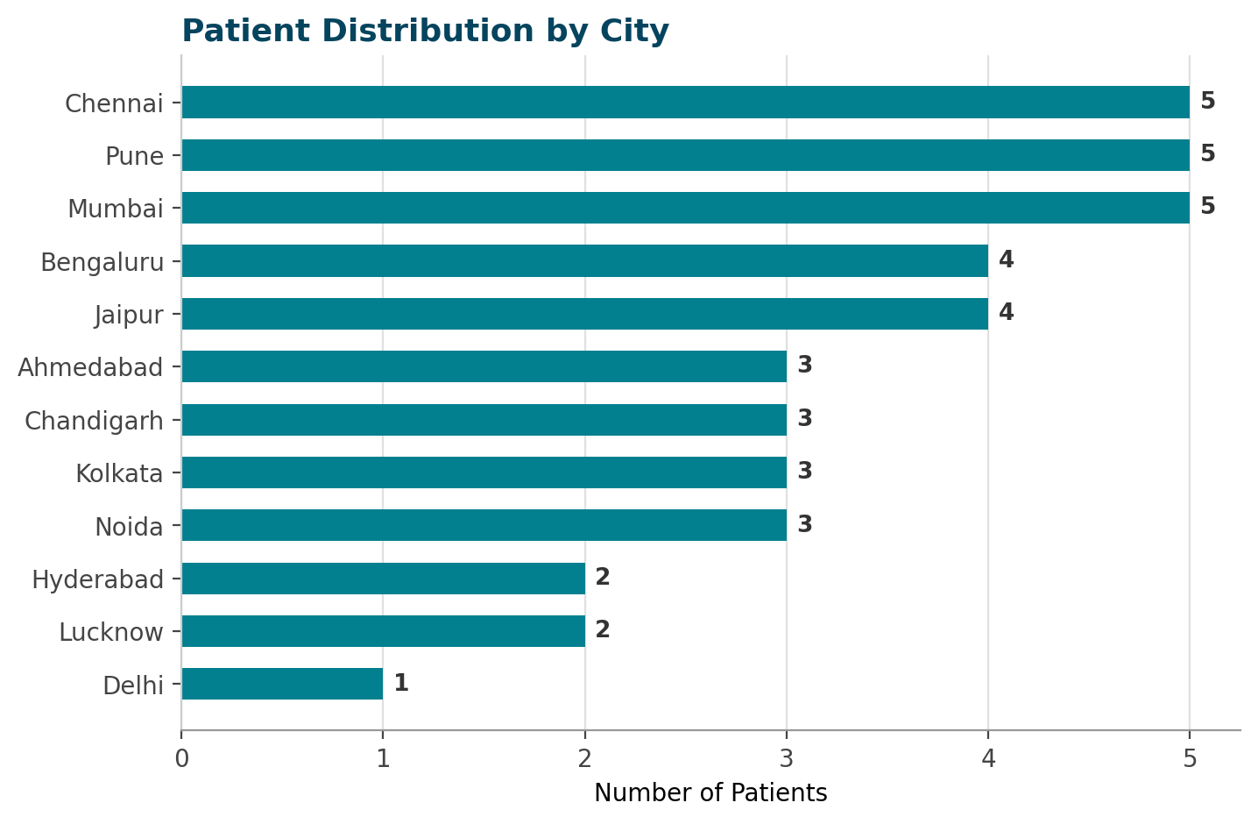
GEOGRAPHY
Q9
Patient Distribution by City
KEY INSIGHT
Metro hubs lead patient volume
Chennai, Pune and Mumbai each contribute 5 patients — the top three source cities.
Bengaluru and Jaipur follow with 4 patients apiece.
Patients span 12 cities across India, suggesting a referral base beyond the immediate metro.
Hospital Management System — SQL Data Analysis
23

Slide 24
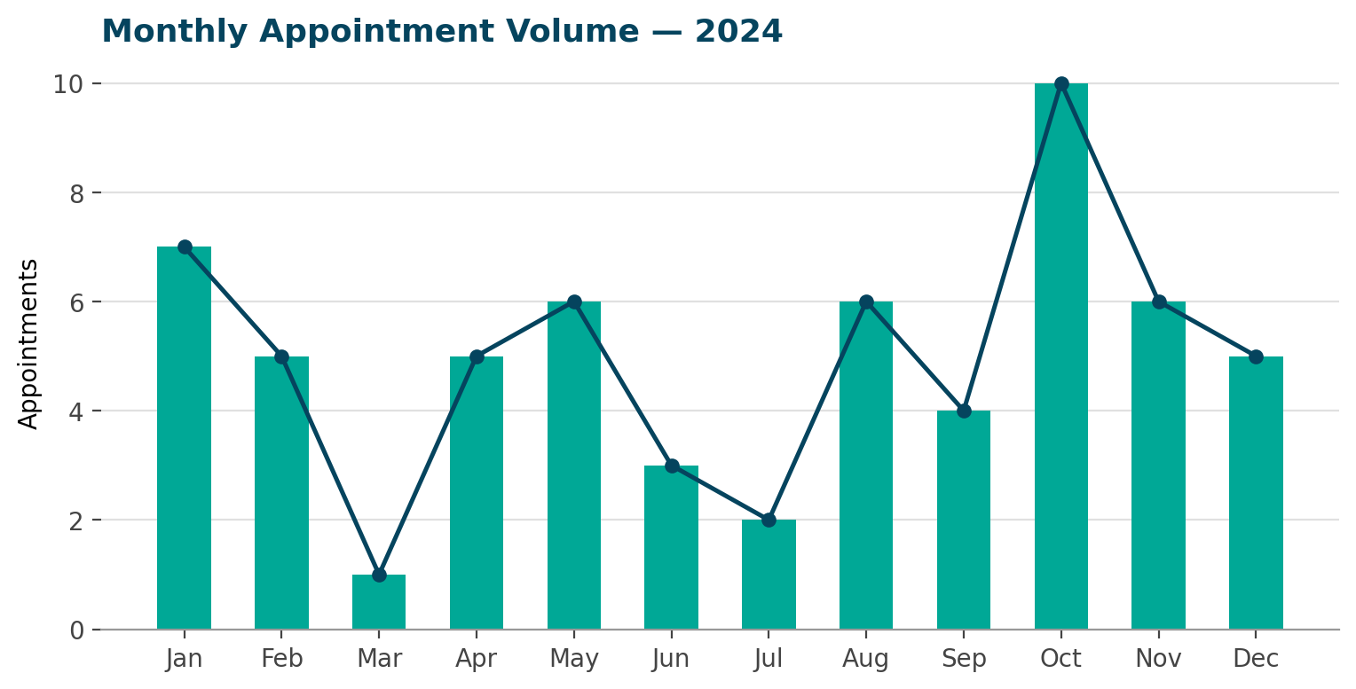
DEMAND
Q11
Monthly Appointment Volume
KEY INSIGHT
October is the busiest month for visits
October recorded 10 appointments — the year's peak — while March saw just 1.
Demand is uneven month to month, with no clear seasonal pattern across the year.
Pairing this with the Q3 revenue trend shows visit volume and revenue don't always move together.
Hospital Management System — SQL Data Analysis
24

Slide 25
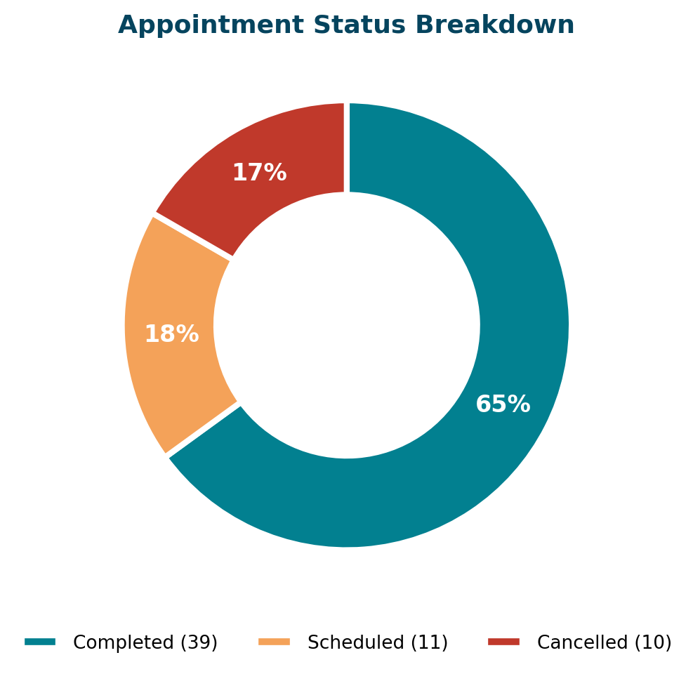
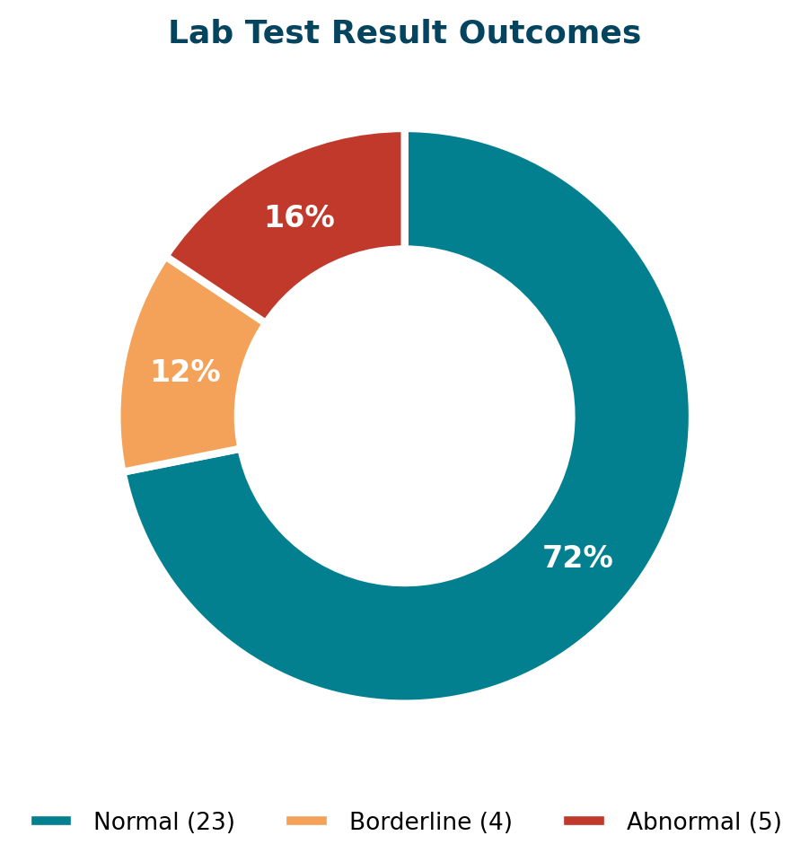
QUALITY
Appointment Reliability & Lab Result Quality
Hospital Management System — SQL Data Analysis
25

Slide 26
ENGINEERING
From One-Off Queries to Reusable KPI Views
Every recurring question was wrapped in a SQL View — so stakeholders query a stable name instead of re-writing logic each time.
💰
🩺
🛏️
vw_MonthlyRevenue
vw_DoctorPerformance
vw_RoomOccupancy
Aggregates Billing by year & month for trend reporting and dashboards.
Ranks every doctor by appointments and unique patients, joined to department.
Live occupancy % by room type — the same logic behind the Q8 donut chart.
SELECT * FROM vw_DoctorPerformance ORDER BY appointment_rank;
Hospital Management System — SQL Data Analysis
26

Slide 27
SUMMARY
What This Project Demonstrates
🔗
Relational thinking
Modeled 14 interlinked tables spanning clinical, resource and financial data.
🧮
Analytical SQL
Joins, aggregation, CASE logic, DATEDIFF and window functions (RANK/DENSE_RANK) used purposefully, not decoratively.
📈
Business framing
Every query maps to a real hospital-management decision — staffing, pricing, capacity, or collections.
♻️
Production habits
Reusable views turn ad-hoc analysis into stable, dashboard-ready building blocks.
Harsh Pandey | Data Analyst / BI Analyst / AI Analyst | github.com/harshpandey97

