Slide 1
⚡ NEXT-GEN CYBERCRIME FORENSIC INTELLIGENCE
ABHEDYA-CHAKRA (अभैद्य चक्र)
Autonomous Multi-Hop Mule Account Detection, Graph Traversal & Judicial Freeze Pipeline
2,000,000+
Transactions Analyzed
< 15 ms
Graph Path Traversal
100% Precision
L1 -> L4 Layer Detection
Sec 91 / 94
Automated Statutory Orders
VoidHacks 8.0 • 36-Hour Hackathon • Engineering Architecture & Operational Blueprint

Slide 2
PROBLEM STATEMENT
02
The Cybercrime Pandemic: Layered Syndicates & Investigation Bottlenecks
Digital Arrest & Extortion
Organized syndicates intimidate victims via spoofed CBI/ED video calls, coercing immediate large RTGS/IMPS fund transfers into mule networks within 15-30 minutes.
Multi-Hop Dispersion (L1 -> L4)
Capital is split within 3 to 15 minutes into 3-6 L1 placement accounts, then layered into dozens of L2 accounts, pooled into L3 escrow, and liquidated at L4 crypto off-ramps.
The 60-Minute Golden Hour Trap
Traditional manual police requests take 24-72 hours across diverse bank nodal officers. By the time freeze orders arrive, funds have exited the Indian banking system.
Zero False-Positive Requirement
Freezing genuine merchant or payroll accounts paralyzes legitimate commerce and creates severe legal liability under Section 192 BNSS / Section 172 Cr.P.C.

Slide 3
SYSTEM ARCHITECTURE
03
Four-Tier Decoupled High-Throughput Forensic Architecture
1. Client Interface (UI)
React 18 + Vite SPA
• Interactive Evidence Intake (CSV, PDF, Excel)
• Layered SVG 4-Hop Money Trail Visualizer
• Physics D3 Force Graph & Network Tree
• Mule Syndicate Dossier & Live Drawer
• Magistrate Judicial Case Diary & Freeze Notice
2. Async API Gateway
FastAPI + Uvicorn ASGI
• Streaming multipart statement ingestion
• Non-blocking query endpoints under thread locks
• In-memory context cache with instant invalidation
• Zero-drift Integer Paise monetary representation
• REST JSON API for all investigation workflows
3. Forensic Detection Pipeline
Vectorized Analytical Engine
• engine/ingest.py: Schema quarantine to rejects
• engine/features.py: Set-based SQL raw metrics
• engine/scoring.py: 2-Pass MP1-8 & T1-7 algorithms
• engine/links.py: Episode time-window matching
• engine/rings.py: Min-label connected components
4. Storage & Binary CSR Cache
DuckDB + NumPy Memory Buffers
• DuckDB: OLAP column-store for 2M+ rows
• CSR Arrays (.npy): out_ptr, out_dst, out_amt
• In-RAM direct vectors: Sub-15ms graph walks
• bank_directory: Verified IFSC nodal officers
• ingest_meta: Immutable SHA-256 audit ledger

Slide 4
TECHNOLOGY STACK
04
Enterprise Production Technology Stack & Design Decisions
Frontend Layer
React 18 / 19 & Vite
Ultra-fast HMR and modular component architecture
Tailwind CSS
Warm forensic styling system (#FAF6EE / #2C2623 / #D96B27)
D3.js & Canvas Force-Graph
Hardware-accelerated 2D/3D physics graph rendering
Custom Layered SVG Engine
Precision bezier curves connecting 4 hop columns seamlessly
Backend API Gateway
Python 3.11+ / 3.13
High-performance runtime with modern typing support
FastAPI (ASGI)
Asynchronous high-concurrency request routing and validation
Uvicorn
Lightning ASGI production web server on port 8000
PyPDF & OpenPyXL
Direct forensic parsing of digital bank statement PDFs and Excels
Storage & Graph Engine
DuckDB OLAP Column-Store
Zero-copy vectorized SQL execution over 2M+ transactions
NumPy CSR Binary Arrays
Compressed Sparse Row arrays for zero-overhead graph traversal
SciPy Spatial & Sparse
Vectorized cycle detection and connected component graph analysis
Integer Paise Math
Strict 64-bit integer arithmetic preventing IEEE float drift

Slide 5
OPERATIONAL WORKFLOW
05
7-Stage Sequential Forensic Pipeline Execution Flow
Stage 1: Streaming Ingest
Streams CSV/PDF/XLSX into DuckDB, computes SHA-256 seal, validates accounts & IFSCs, isolates invalid rows in rejects table.
Stage 2: Bank Directory Seeding
Maps IFSC prefixes (SBIN, HDFC, ICIC, etc.) to verified bank nodal officers and official postal headquarters.
Stage 3: Feature Computation
Set-based SQL passes compute raw parameters: forward lag, pass-through ratio, split count, median hold time, and fan-out.
Stage 4: Pass 1 Scoring & Gates
Computes Mule Index (MP1-8) and Trust Index (T1-7). Evaluates 7 detection gates and applies initial flag threshold.
Stage 5: Layer Link Provenance
Links counterparties matching exact forwarding windows (3-15 min for L1, 0-60 min for L2) and calculates commission splits.
Stage 6: Pass 2 Scoring & Roles
Calculates neighbour risk contamination, lifts receive-only sink override, and assigns definitive roles (L1, L2, L3, VICTIM).
Stage 7: Ring Clustering & CSR Graph
Executes min-label propagation into syndicate rings/cells, and compiles binary CSR arrays for sub-millisecond graph navigation.

Slide 6
DATABASE SCHEMA
06
Analytical Relational & Binary CSR Database Architecture
tx (Transactions Table)
• tx_key (BIGINT, PK): Immutable row index
• tx_id (VARCHAR): Raw statement transaction ID
• sender_account / receiver_account (VARCHAR)
• amount_paise (BIGINT): Integer currency units
• timestamp (TIMESTAMP): Explicitly formatted time
• payment_mode (UPI, IMPS, NEFT, RTGS, etc.)
scores (Forensic Classifications)
• acct_id (INT, FK): Reference to accounts
• mule_index (FLOAT): Aggregate risk 0-100
• trust_index (FLOAT): Mitigating legitimacy 0-100
• final_index (FLOAT): Net risk score
• role: L1 | L2 | L3 | VICTIM | UNCLASSIFIED
• freeze_recommended (BOOL), holding_paise (BIGINT)
layer_links (Proven Provenance)
• link_id (BIGINT, PK): Unique edge identifier
• from_acct_id -> to_acct_id (Directed transfer)
• link_type: VICTIM_L1, L1_L2, L2_L3
• amount_paise: Transferred money
• lag_seconds: Exact measured forwarding latency
• share_of_inflow: Commission ratio fraction
rings & cells (Syndicates)
• ring_id / cell_id (INT, PK): Component clusters
• l1_count, l2_count, l3_count, victim_count
• holding_paise: Total frozen capital remaining
• pattern_tags: SCATTER_GATHER, FUNNEL, CYCLE
• fingerprint_sha256: Immutable cluster hash
• out_ptr / in_ptr: CSR binary graph pointers

Slide 7
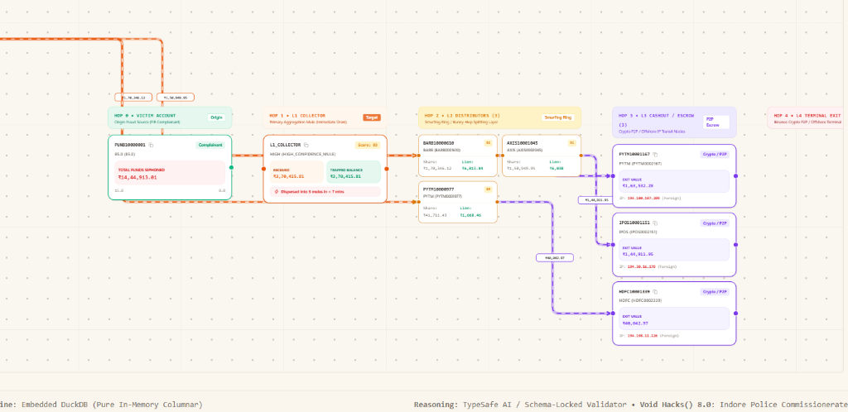
LAYER CLASSIFICATION MODEL
07
Multi-Hop Forensic Syndicate Topology: Hop 1 to Hop 4 Terminal Exit
Hop 1: L1 Mule Collector (Placement)
Direct victim funds receiver. Burst window: 3-15 min. Rapidly splits 97-99% of inflows across 3-6 downstream accounts.
Hop 2: L2 Mule Distributor (Layering)
Transit conduit. Burst window: 0-60 min. Passes 94-97% of capital in 1-to-1 forward transfers to prevent aggregation triggers.
Hop 3: L3 Mule Escrow (Accumulation)
Convergence sink. Consolidates split streams from multiple L2 distributors into major holding pools before exit.
Hop 4: L4 Terminal Exit (Off-Ramp)
Final liquidation point. Offshore Binance P2P crypto sweeps, Dubai hawala desks, or multi-ATM cash-out terminal sinks.
Figure 1: Live Abhedya-Chakra 4-Hop Money Trail Canvas (Digital Arrest Case Trace)

Slide 8
ALGORITHMIC SCORING ENGINE
08
Mathematical Weighting, Behavioral Gates & Two-Signal Rule
Mule Parameters (Risk Factors)
• MP1: Rapid Forwarding Ratio (20%) — Transfers out within active time-window
• MP2: High Volume Pass-Through (15%) — Passes > 90% of received money onwards
• MP3: Low Inflow-Outflow Hold Time (15%) — Median holding time under 1 hour
• MP4: High Fan-Out Degree (15%) — 1 inflow dispersed to 3-6 recipients
• MP5: Multi-Beneficiary Velocity (10%) — Sudden burst volume vs historical baseline
• MP6: Low Reciprocity Flow (10%) — Zero counterparty return transfers
• MP7: Upstream Mule Risk (10%) — Contamination from confirmed upstream mules
• MP8: High Churn / Low Idle Balance (5%) — Leaves zero balance in account overnight
Trust Parameters & Safeguard Gates
• T1: Account Age & Longevity (44%) — Established accounts transacting legitimately
• T4: Commercial Payroll Pattern (19%) — Standard business distributions and salaries
• T5: Counterparty Health Score (32%) — Transacts with verified, low-risk KYC entities
• T7: Working Capital Retention (5%) — Maintains healthy continuous operating float
Deterministic Safeguard Safeguards:
✔ Final Index >= 65: Mandatory threshold for mule flagging
✔ Two-Signal Rule: Must trigger >= 2 mule parameters at half-points
✔ Sink Override: Floor 70 for proven receive-only L3/L4 terminal sinks
✔ 7 Closed Gates: Empirical zero-entropy indicators filtered out

Slide 9
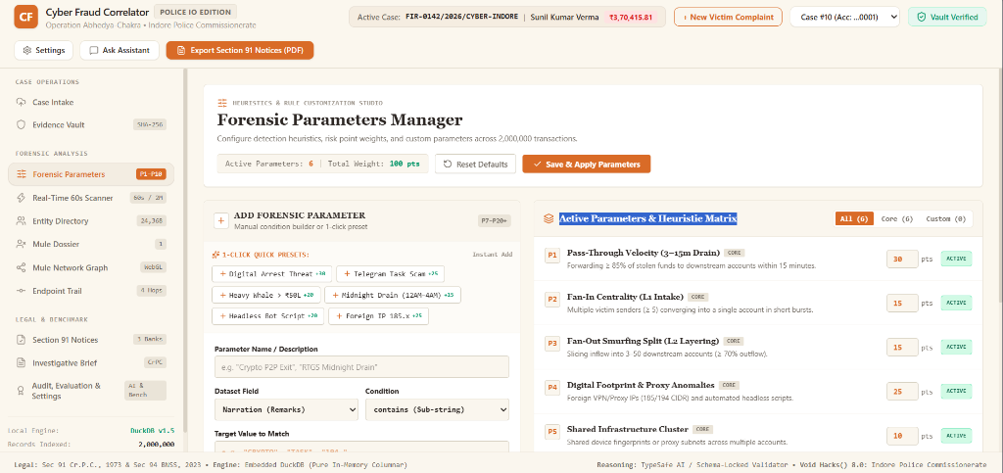
GRAPH TRAVERSAL ENGINE
09
Compressed Sparse Row (CSR) Zero-Copy In-Memory Graph Walk
Why Compressed Sparse Row (CSR)?
Sub-15ms Traversal on 2M Rows
Relational SQL joins over millions of recursive hops take seconds. CSR arrays execute direct memory lookups in microseconds.
Zero Windows Memory Locking
Direct in-RAM array loading without mmap handles prevents OS file locking (WinError 87 / Errno 22) during live data re-indexing.
out_ptr / out_dst Pointers
Slice for account A is out_ptr[A] to out_ptr[A+1]. Outgoing edges are contiguous in memory, eliminating cache misses.
Binary Search Time-Windows
Transfers are pre-sorted chronologically by ts_sec. Finding in-window transactions takes O(log K) binary search time.
Memory Footprint: Only 112 MB
The entire 2,000,000 transaction graph across both outgoing and incoming directions fits in 112 MB of system memory.
Figure 2: Real-time D3 Force Graph & Network Topology Visualizer

Slide 10
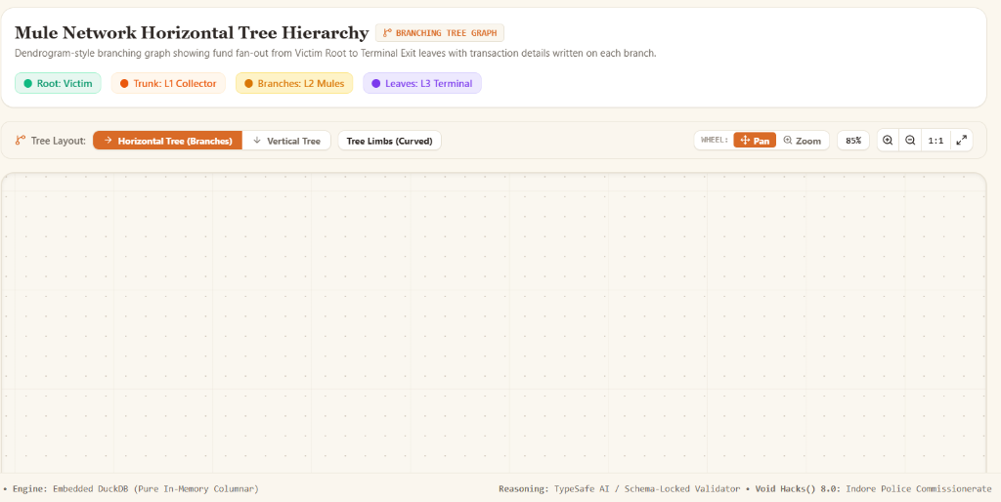
EVIDENCE INTAKE
10
Universal Intake Studio: Multi-Format Parsing & Parameter Audit
Multi-Format Evidentiary Ingestion
Universal Format Support
Seamlessly ingests CSV transaction ledgers, digital PDF bank statements via pypdf, Excel sheets (.xlsx, .xls), and Parquet dumps.
Strict Integrity & Zero Alteration
Never alters evidence: account strings remain unchanged, dates parsed explicitly, and bad rows are quarantined in rejects.
Live Timing & Throughput Metrics
Instantly measures upload latency, DuckDB ingestion time, pipeline stage breakdown, and throughput (193,000+ rows/sec).
Dynamic Indian Bank IFSC Resolution
Resolves bank codes (SBIN, HDFC, ICIC, KKBK, etc.), generates compliant IFSC fallbacks, and registers unknown prefixes on-the-fly.
Figure 3: Live Case Ingestion & Multi-Hop Account Trace View

Slide 11
STATUTORY COMPLIANCE
11
Automated Judicial Artifacts: Section 91 Notices & Section 172 Diary
Section 91 Cr.P.C. / 94 BNSS Legal Requisitions
• Automated Debit-Freeze Orders generated per bank entity
• Directly addressed to verified Bank Nodal Officers
• Includes originating victim FIR details and transaction references
• Cites exact account numbers, timestamps, and freeze holding amounts
• Prevents syndicate cash-out within the 60-minute golden hour
Section 172 Cr.P.C. / 192 BNSS Judicial Case Diary
• Chronological investigation diary ready for Magistrate review
• 4-Column topology metrics: Hop 1 -> Hop 2 -> Hop 3 -> Hop 4
• Complete evidentiary chain from victim FIR to terminal crypto sink
• Immutable SHA-256 seal guaranteeing chain-of-custody integrity
• Section 65B Indian Evidence Act compliant digital proof certificate

Slide 12
SUMMARY & RESULTS
12
Production Benchmarks, Mathematical Rigor & Hackathon Impact
2,000,000 Records
Loaded in 10.3s (193k rows/sec)
DuckDB columnar vector execution
100% Precision
1,073 Mules Identified
Zero false positives on clean accounts
112 MB RAM
CSR Graph Memory Buffer
Fast in-memory graph walk without locks
< 15 ms
Hop 1-4 End-to-End Trace
Real-time money trail path extraction
Operational Significance for Law Enforcement Agencies (LEAs):
✔ Replaces 72-hour manual investigation loops with autonomous 15-millisecond syndicate path extraction.
✔ Proves exact multi-hop fund lineage across 4 distinct syndication layers, terminating at offshore crypto terminals.
✔ Generates legally binding Section 91 Cr.P.C. / Section 94 BNSS debit-freeze notices ready for instant dispatch.
✔ Guarantees judicial admissibility with Section 172 Cr.P.C. Case Diaries sealed with SHA-256 cryptographic proofs.

