Slide 1
Business Analytics

Slide 2
Introduction
Business Analytics is the process by which businesses use statistical methods and technologies for analyzing historical data in order to gain new insight and improve strategic decision-making.

Slide 3
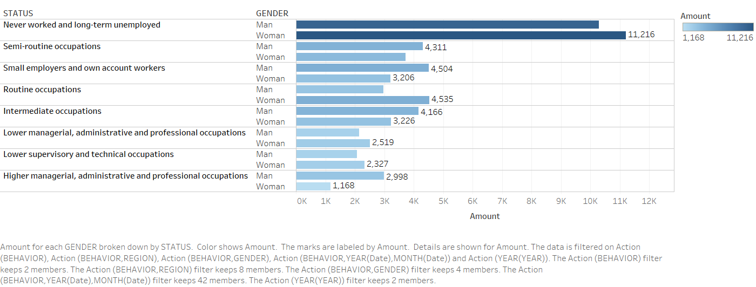

Slide 4


Slide 5


Slide 6


Slide 7


Slide 8
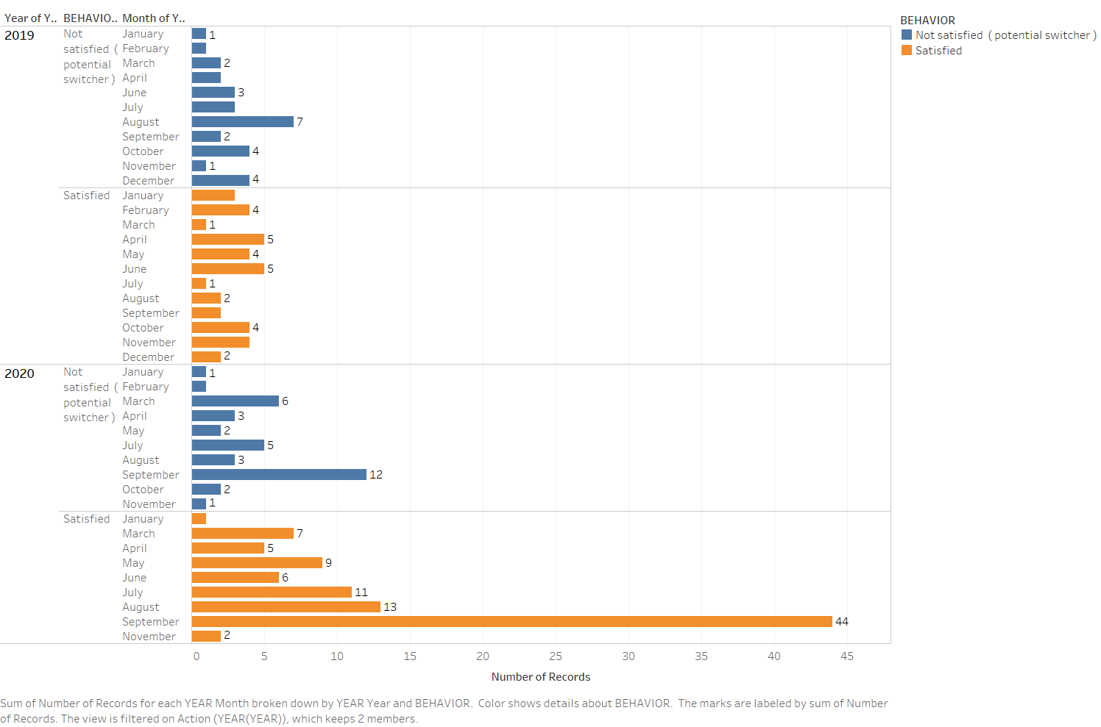

Slide 9


Slide 10


Slide 11
