Slide 1

Summer Upward Bound Program
Introduction to Web Development
Harsh Patel
24 June - Day 1
Upward Bound Program
Summer-2019

Slide 2
Who am I ?
Bachelor in Computer Engineering, GTU, India
Master’s in Science - Human Centred Computing, UMBC
Worked as Freelancer Graphic Designer- 2 years
Worked in Start-up as UX Designer- 1 year
Currently Product Designer at BooknTrain, Downtown, Baltimore
Graduate Senate for Graduate Student Association
GEARS President, UMBC
ACM SIGCHI Member
Upward Bound Program
Summer-2019

Slide 3
Web Development from my side
Previously, back in India I took classes of Web Development and taught 30 student over winter session.
Have strong command over Front-end and Back-end development.
Skillset: HTML5, CSS3, JS, React JS, JAVA, C, C++, Python
Design Tools : Adobe Photoshop, Adobe Illustrator, Adobe InDesign, Sketch, Adobe XD
Upward Bound Program
Summer-2019

Slide 4
Introduction
Name
From where
Previous School
Hobbies
Why web development
What you hope to learn from this course
Any prior experience ?
Upward Bound Program
Summer-2019

Slide 5
Class Activities
Practical Approach of the topics
Daily Assignments (depends)
Trending Topic Discussions
In-class Assessment
Upward Bound Program
Summer-2019

Slide 6
Grading
Daily homework / assignments – 40%
Exams 2 @ 15% each – 30%
Final Project – Portfolio / Website – 30%
Upward Bound Program
Summer-2019

Slide 7
Late work
All assignments and exams are to be completed by the due date.
In the case of significant events warranting late assignments, it is the student's responsibility to confer with me about the need well before it occurs.
I do not allow for makeups on weekly assignments – I will either allow you to turn in work late, excuse the assignment, or it will be counted against your grade.
Likewise, there is no make-up exams except through arrangement with me prior to the exam date: and then for reasons deemed valid enough to warrant the making of a new, and potentially harder, test.
There is no extra credit you can score unless specified.
Upward Bound Program
Summer-2019

Slide 8
Reference Materials
www.w3schools.com
www.tutorialspoint.com
www.udacity.com
https://youtu.be/ctMd2-ixxMw
Upward Bound Program
Summer-2019

Slide 9
What is Web Development?
Upward Bound Program
Summer-2019

Slide 10
Web development is a programming of web elements that enables website functionality as per the owner’s requirement.
Web development is a process includes web design, web content development, client-side/server-side scripting and network security configuration.
Web development is the work involved in developing a web site for the Internet (World Wide Web) [Wikipedia]
Web development is a broad term for the work involved in developing a website for the Internet.
Upward Bound Program
Summer-2019

Slide 11
About the Course !
Upward Bound Program
Summer-2019

Slide 12
This course is designed to start you on a path toward future studies in web development and design. Have you ever wondered how these websites actually work? How are they built? How do browsers, computers, and mobile devices interact with the web? What skills are necessary to build a website?
With almost 1 billion websites now on the internet, the answers to these questions could be your first step toward a better understanding of the internet and developing a new set of internet skills.
Upward Bound Program
Summer-2019

Slide 13
What to expect?
Upward Bound Program
Summer-2019

Slide 14
By the end of this course you’ll be able to describe the structure and functionality of the world wide web, create dynamic web pages using a combination of HTML, CSS, and JavaScript, WordPress apply essential programming language concepts when creating HTML forms, responsive Web design and release your webpages for the world to see.
Finally, you’ll be able to develop a working model for creating your own personal or portfolio websites in the future and be fully prepared to take the next step in a more advanced web development specialization.
Upward Bound Program
Summer-2019

Slide 15
Syllabus
Week 1- Introduction to web
Week 2- Introduction to HTML5
Week 3- Introduction to CSS3
Week 4- Introduction to JS & WordPress
Week 5- Advance Web & Portfolio Week
Upward Bound Program
Summer-2019

Slide 16
That’s too much information, isn’t it ?
Let’s start with the Internet.
Upward Bound Program
Summer-2019

Slide 17
Internet is a worldwide system of computer networks - a network of networks in which users at any one computer can get the information from any other computer in the world.
Websites, Softwares and Applications(Apps)
Upward Bound Program
Summer-2019

Slide 18
Exercise
Name a Website, App or a Software you liked and why ?
Upward Bound Program
Summer-2019

Slide 19
History of Web
In the year 1992, Tim Berners-Lee, a physicist in Geneva Switzerland came up with the term-World Wide Web - WWW - W3
HTTP-HyperText Transport Protocol- The protocol used to signify an Internet site is a World-Wide Web site.
A convention of codes used to access documents over the World-Wide Web. Without HTML codes, a document would be unreadable by a Web browser.
Upward Bound Program
Summer-2019

Slide 20
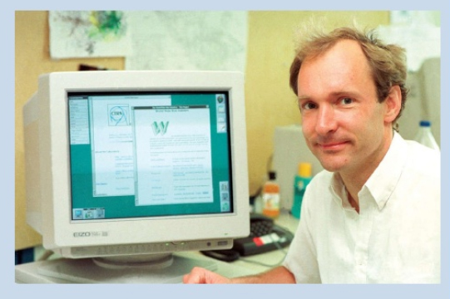
Upward Bound Program
Summer-2019

Slide 21
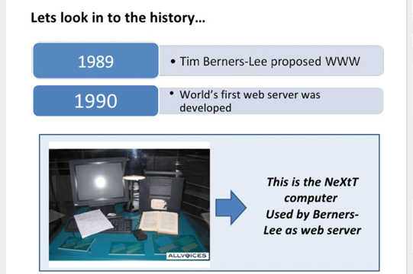
Upward Bound Program
Summer-2019

Slide 22
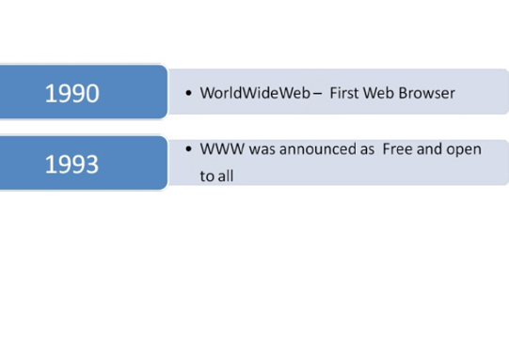
Upward Bound Program
Summer-2019

Slide 23
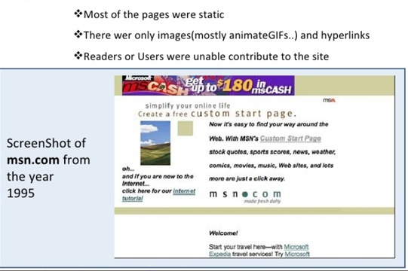
Upward Bound Program
Summer-2019

Slide 24
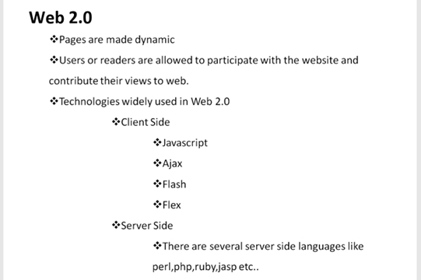
Upward Bound Program
Summer-2019

Slide 25
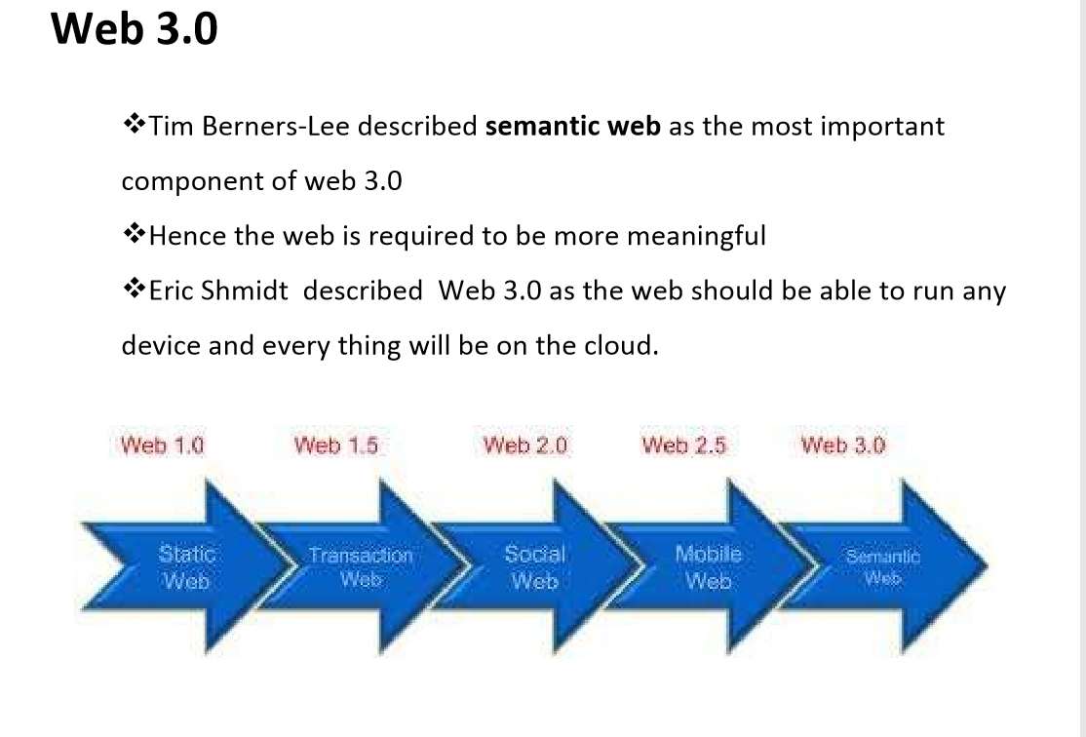
Upward Bound Program
Summer-2019

Slide 26
History of Web
June 1993 - Mosaic Prototyped
April 1994 - Clark & Andreesen form a company named Mosaic Communications
Oct 1994 - Netscape Beta released
Nov 1994 - Co is renamed Netscape
Aug 9th, 1995 - Netscape IPO
Upward Bound Program
Summer-2019

Slide 27
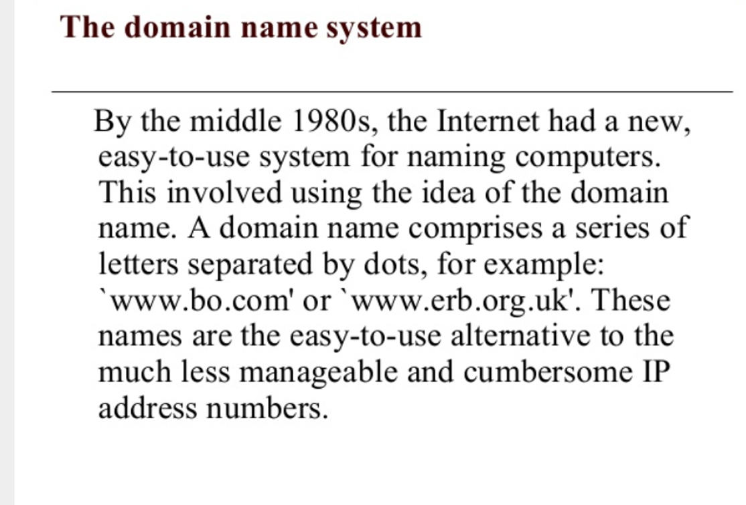
Domain name
Upward Bound Program
Summer-2019

Slide 28
How a Website Works ?
Upward Bound Program
Summer-2019

Slide 29
Hosting, Server & Domain name
Web Hosting is like a house. Most people rent house(s) or room(s) to stay. Same way, we put our website content/files on one of the hosting providers.
Website is everything in your house. Furniture, interior design. Visitors might leave your house if it's stinky and ugly. (Badly designed website)
Upward Bound Program
Summer-2019

Slide 30
Web development :
Front-end Development
2. Back-end Development
Upward Bound Program
Summer-2019

Slide 31
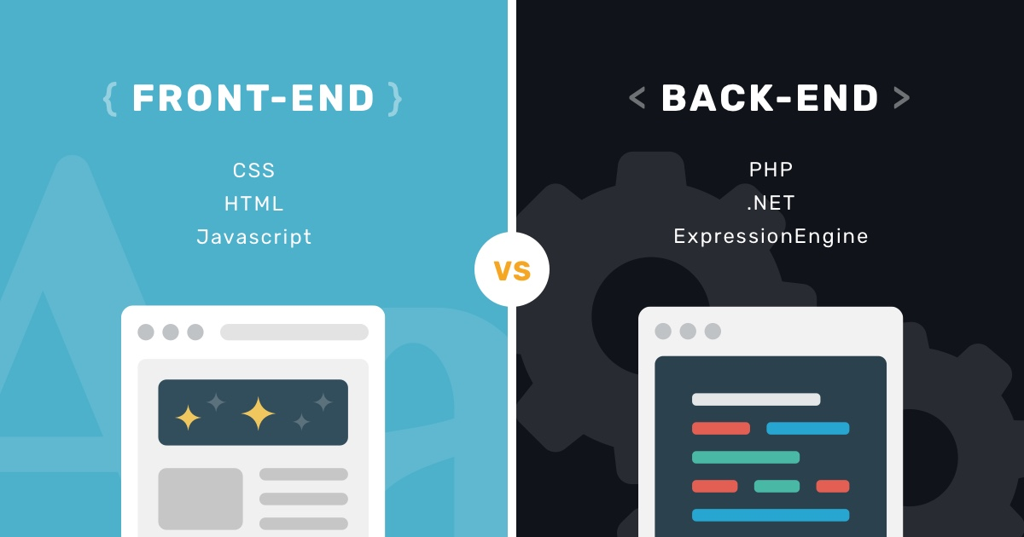
Upward Bound Program
Summer-2019

Slide 32
Front-end Development:
The frontend of a website is what you see and interact with on your browser. Also referred to as “client-side”, it includes everything from text and colors to buttons, images, and navigation menus
Upward Bound Program
Summer-2019

Slide 33
Front-end Development:
HTML : HTML is the fundamental coding language that creates and organizes web content so it can be displayed by a browser.
CSS: CSS is a language that accompanies HTML, and defines the style of a website’s content, such as layout, colors, fonts, etc
JavaScript: JavaScript is a programming language used for more interactive elements like drop down menus, modal windows, and contact forms
Upward Bound Program
Summer-2019

Slide 34
Back-end Development:
The backend development involve writing APIs, creating libraries, or working with components of systems that don’t have user interfaces or even systems of scientific programming.
In the web development world, most back-end developers concern themselves with building the actual logic behind the application they are working on.
Upward Bound Program
Summer-2019

Slide 35
Back-end Development:
Java, PHP, Ruby on Rails, Python, C, #C Sharp, C++ and .Net
Upward Bound Program
Summer-2019

Slide 36
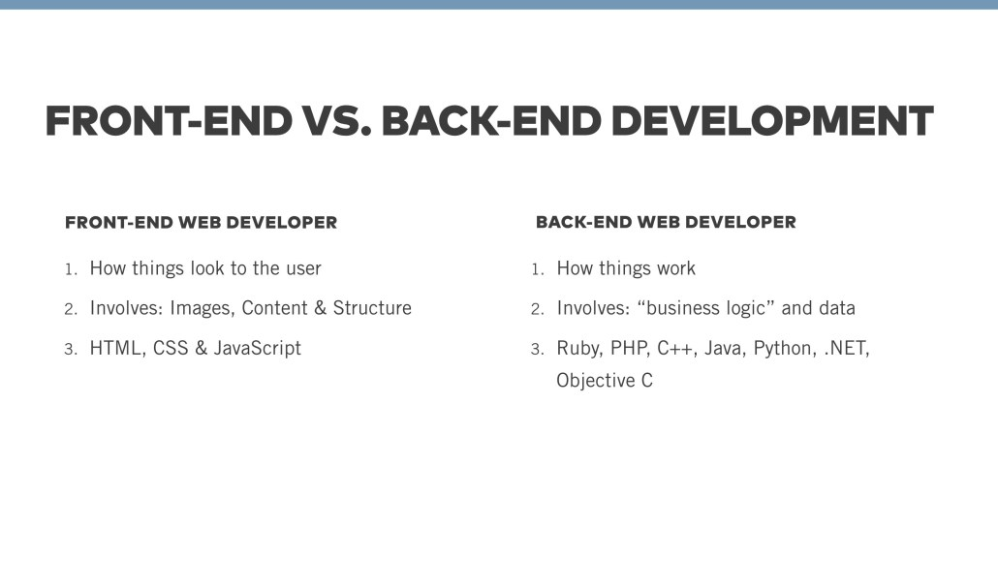
Upward Bound Program
Summer-2019

Slide 37
Environment setup
Sublime text editor.
Create a GitHub account.
Create a repository.
Clone the repository.
You are good to start coding from now.
Upward Bound Program
Summer-2019

Slide 38
What is HTML?
HTML, otherwise known as HyperText Markup Language, is the language used to create Web pages
Using HTML, you can create a Web page with text, graphics, sound, and video
Upward Bound Program
Summer-2019

Slide 39
What is HTML?
The essence of HTML programming is tags
A tag is a keyword enclosed by angle brackets ( Example: <I> )
There are opening and closing tags for many but not all tags; The affected text is between the two tags
Upward Bound Program
Summer-2019

Slide 40
What is HTML?
The opening and closing tags use the same command except the closing tag contains and additional forward slash /
For example, the expression <B> Warning </B> would cause the word ‘Warning’ to appear in bold face on a Web page
Upward Bound Program
Summer-2019

Slide 41
Nested Tags
Whenever you have HTML tags within other HTML tags, you must close the nearest tag first
Example:
<H1> <I> The Nation </I> </H1>
Upward Bound Program
Summer-2019

Slide 42
Structure of a Web Page
All Web pages share a common structure
All Web pages should contain a pair of <HTML>, <HEAD>, <TITLE>, and <BODY> tags
Upward Bound Program
Summer-2019

Slide 43
Structure of a Web Page
<HTML>
<HEAD>
<TITLE> Example </TITLE>
</HEAD>
<BODY>
This is where you would include the text and images on your Web page.
</BODY>
</HTML>
Upward Bound Program
Summer-2019

Slide 44
That’s it for today.
Upward Bound Program
Summer-2019

Slide 45
Contact
Harsh Patel
(302) 213 2158
la83051@umbc.edu
www.hegvi.com
Upward Bound Program
Summer-2019

