Slide 1

Campus Connect: Campus Chat and File Sharing System
Mini-project presentation
Computer Networks Laboratory (CSE20110)
Department of Computer Engineering and Technology
Harsh Patil – 1272250823
Group 1 Panel Batch
Faculty:
Academic Year: 2026–2027
Presentation date:
Computer Networks Laboratory CSE20110
15 seconds
Notes:
Suggested time: 15 seconds. Good morning. My project is Campus Connect, a chat and file-sharing website. I built it to study how HTTP, WebSocket and TCP work together in a real application. It is a single-member project, Group 1.

Slide 2
Problem and Objectives
Problem
Chat apps hide how messages and files travel, so students cannot see the protocols, delays and failures behind them.
Users: students of one campus using a web browser. Scope: one server for chat and files, tested on one computer.
Objectives
1. Deliver chat messages and files from a TCP server on port 3000: WebSocket for live messages, HTTP for sign-in and files.
2. Keep chat working when WebSocket is not used (HTTP long-polling) and refuse requests that are not allowed.
3. Measure connections, bytes and round-trip time, and compare WebSocket with long-polling.
Computer Networks Laboratory CSE20110
40 seconds
Notes:
Suggested time: 40 seconds. Chat apps hide the network from us. We see messages appear, but we do not see which protocol carries them, how long they take, or what happens when the connection drops. I wanted to see this myself. The users are students of one campus using a web browser, and the scope is one server, tested on one computer. I set three objectives. One: deliver messages and files from a TCP server on port 3000. Two: keep chat working when WebSocket is not used, and refuse requests that are not allowed. Three: measure the connections and compare WebSocket with long-polling.

Slide 3
Proposed Design and Tools
Browser 1
Student A
HTTP
Campus Connect server
WebSocket
HTTP routes (Express)
sign-in, history, files
SQLite database
and uploads folder
Live channel (Socket.IO)
messages, typing, status
Browser 2
Student B
HTTP
WebSocket
Listens on TCP port 3000
If WebSocket is blocked, Socket.IO falls back to HTTP long-polling
Tools: Node.js 22.22, Express 5.3, Socket.IO 4.8 [4], SQLite built into Node.js [5]; one Linux computer (2 cores, 8 GB RAM)
Protocols: HTTP/1.1 [1] for sign-in, history and files; WebSocket [3] for live chat, with HTTP long-polling as fallback; all over TCP [2]
Addressing: server listens on 0.0.0.0, TCP port 3000; test clients use 127.0.0.1 (loopback), client ports chosen by the operating system
Computer Networks Laboratory CSE20110
45 seconds
Notes:
Suggested time: 45 seconds. This is the design. The browsers are the clients. One Node.js server listens on TCP port 3000. For sign-in, history and files, the browser uses normal HTTP, the orange arrows. For live messages it uses a WebSocket, the navy arrows. A WebSocket starts as an HTTP request. The server answers 101 Switching Protocols, and the same TCP connection stays open, so the server can push a message straight away. If WebSocket is blocked, Socket.IO falls back to HTTP long-polling. Data is saved in a SQLite database and an uploads folder. I tested on one computer, so the address is 127.0.0.1, port 3000.

Slide 4
Implementation and Working
Student A
sends message:send over WebSocket
Server checks
signed in, chat member, 2,000 characters at most, flood limit
Server saves
message stored in the SQLite database
Server pushes
message:new to everyone in the chat room
Student B
message appears at once
acknowledgement returns to Student A
Implementation: server.js (routes and live channel) with auth, db, files and metrics modules; ping every 10 s, timeout 8 s [6]; 70 checks in tests/run.js
Working: messages go over WebSocket with an acknowledgement; files go by HTTP upload, then a live notice, then HTTP download
Troubleshooting: a hand-made WebSocket upgrade with a 17-byte key got HTTP 400; a 16-byte key got 101 Switching Protocols [3]
Computer Networks Laboratory CSE20110
55 seconds
Notes:
Suggested time: 55 seconds. Let me follow one message. Student A sends it over the WebSocket. The server first checks three things: the student is signed in, the student is a member of this chat, and the message is not longer than 2,000 characters or part of a flood. Then it saves the message in the database, sends an acknowledgement back to Student A, and pushes the message to everyone in the chat. Student B sees it at once. Files take a different path: an HTTP upload, a live notice over the WebSocket, and an HTTP download. One problem I solved: my hand-made WebSocket upgrade used a 17-byte key and got HTTP 400. With a 16-byte key, the server answered 101 Switching Protocols.

Slide 5
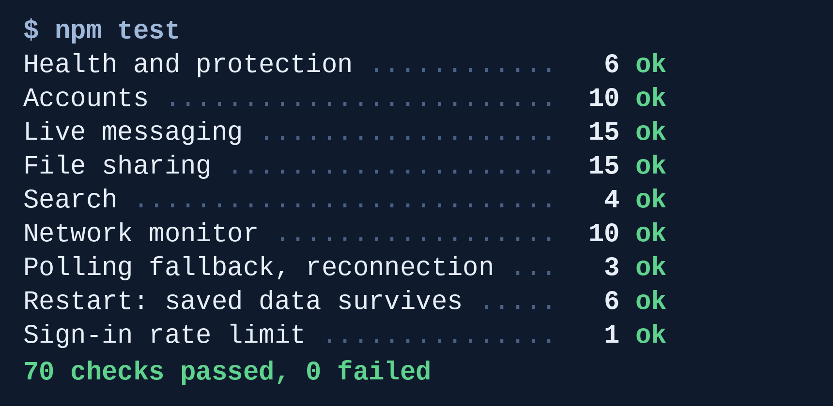
Testing and Results
npm test output by group, 21 Oct 2026
Test: npm test runs 70 checks (T1–T16) on the real server; a speed test sends 100 WebSocket and 40 polling messages
Expected: all checks pass; WebSocket delivers faster than long-polling
Observed: 70 passed, 0 failed; median delivery 1.65 ms (WebSocket) vs 4.90 ms (long-polling), loopback only
Objectives achieved: 6 of 7; public hosting failed because the hosting service paused deploys
Computer Networks Laboratory CSE20110
50 seconds
Notes:
Suggested time: 50 seconds. On the left is the test output: 70 checks in nine groups, all passed. On the right is the speed test. A WebSocket message reached the other student in a median of 1.65 milliseconds. With long-polling it took 4.90 milliseconds, about three times longer, because every polling message needs its own HTTP request. The 95th percentile shows the same gap: 2.63 against 8.06. These numbers come from one computer, so they show the cost of the protocol, not Wi-Fi speed. Six of the seven objectives were achieved. Public hosting was not, because the hosting service had paused deploys.

Slide 6
Working Demonstration
Function to demonstrate
Live chat and file sharing between two students, with the Network page showing the transport and round-trip time
1. Launch: npm start, then open localhost:3000 in two browser windows and sign in as two students
2. Send: type a message in window 1 and attach a PDF
3. Show: window 2 receives both at once; the Network page shows two WebSocket connections, bytes and round-trip time
Success criterion: message and file arrive in window 2 and the Network page shows live data; npm test ends with 70 checks passed
Computer Networks Laboratory CSE20110
65 seconds
Notes:
Suggested time: 65 seconds. Before the timer starts: server running, two browser windows open (one private), a small PDF ready. Keep a screenshot as backup, and say it is recorded evidence if you use it.
Now the demonstration. [Show window 1] I am signed in as student one here, and as student two in the private window. [Type a message in window 1 and send] I send a message from window one. [Switch to window 2] It appears in window two straight away, and the badge says Connected, WebSocket, with the round-trip time. [Attach the PDF in window 1] Now I attach a PDF. [Window 2] Window two gets a file notice with a Download button. [Open the Network page] Here I can see two WebSocket connections, the bytes sent, and the round-trip time measured by the server. This matches the 70 passed checks on the earlier slide.

Slide 7
Conclusion and Contributions
Outcome: working chat and file sharing over HTTP and WebSocket with a fallback; 70 of 70 checks passed; 6 of 7 objectives met
Application: class and lab group chats and file sharing on a campus
Limitation: tested on one computer only (loopback); not hosted publicly
Future scope: host with HTTPS and measure on a real Wi-Fi or LAN with many users
Team contributions: Harsh Patil (single member) – project definition, running the system, the Railway deployment attempt, demonstration and submission
AI use: Claude (Anthropic) helped write the code, tests, diagrams and slides. Results were checked by running npm test and the speed test; sources were opened and read on 21 Oct 2026.
Computer Networks Laboratory CSE20110
30 seconds
Notes:
Suggested time: 30 seconds. To conclude: Campus Connect works. Chat and files travel over HTTP and WebSocket with a fallback, 70 of 70 checks passed, and six of seven objectives were met. The limit is that it was tested on one computer only. Next, I would host it with HTTPS and measure on a real network. I used Claude, an AI assistant, for the code and slides, and I checked the results by running the tests. Thank you.

Slide 8
References
[1] R. Fielding, M. Nottingham, and J. Reschke, Eds., “HTTP Semantics,” RFC 9110, IETF, 2022. [Online]. Available: https://www.rfc-editor.org/rfc/rfc9110
[2] W. Eddy, Ed., “Transmission Control Protocol (TCP),” RFC 9293, IETF, 2022. [Online]. Available: https://www.rfc-editor.org/rfc/rfc9293
[3] I. Fette and A. Melnikov, “The WebSocket Protocol,” RFC 6455, IETF, Dec. 2011. [Online]. Available: https://www.rfc-editor.org/rfc/rfc6455
[4] Socket.IO, “How it works,” Socket.IO Documentation, v4. [Online]. Available: https://socket.io/docs/v4/how-it-works/
[5] Node.js, “SQLite,” Node.js API Documentation. [Online]. Available: https://nodejs.org/api/sqlite.html
[6] Socket.IO, “Server options,” Socket.IO Documentation, v4. [Online]. Available: https://socket.io/docs/v4/server-options/
All sources were accessed online on 21 October 2026.
Computer Networks Laboratory CSE20110
Backup slide
Notes:
Suggested time: Backup slide. Keep this slide for questions. All sources were opened and read on 21 October 2026.

