Slide 1

ES 22100 : Engineering Mechanics
4 Credits (3-1-0)
Dr. Sandeep Singh
Professor, Department of Mechanical Engineering
North Eastern Regional Institute of Scienec and Technology
Nirjuli, Arunachal Pradesh
ss/es2210024/315072024/01

Slide 2
What is Mechanics?
Mechanics : The branch of science which deals with the forces and their effects on the bodies on which they act is called mechanics.
Engineering Mechanics: Applied mechanics also known as Applied Mechanics is the branch of engineering which deals with the laws of mechanics as applied to the solution of engineering problems.
Application of Engineering Mechanics:
1. The motion of vehicles such as trains, buses etc. (Mechanical Engg.)
2. The design of building and forces on columns and walls.(Civil Engg.)
Design of Solenoids, Particle accelerators and study of Field Interactions in studies like Milikan’s Oil Drop Experiment (Electrical and Electronics Engg.)

Slide 3
Branch of Engineering Mechanics
1. Statics: The branch of Engineering Mechanics which deals with the forces and their effects while acting upon bodies which are at rest is called statics.
2. Dynamics: The branch of Engineering Mechanics which deals with the forces and their effects while acting upon bodies which are in motion is called dynamics.It is further divided into two types:
Kinetics: The branch of dynamics which deals with the relationship between motion of bodies and forces causing motion is called kinetics.
Kinematics: The branch of dynamics which deals with motion of bodies without considering the forces which cause motion is called kinematics.

Slide 4
What is a Physical Quantity?
Any quantity which can be measured is called physical quantity. There are two types of physical quantities:
1. Fundamental or basic quantities: The mutually independent quantities are called fundamental or basic quantities.
2. Derived Quantities: The quantities which can be expressed in terms of fundamental or basic quantities are called derived quantities e.g.
Velocity = Displacement/ Time = Length/Time
Linear momentum = Mass × velocity =Mass × Length/ Time

Slide 5
Some idealizations in Engg. Mechanics
Rigid Body : A rigid body may be defined as a body which does not changes in shape and size under the effect of forces acting on it. In fact , no body is perfectly rigid. Every body when acted upon by external forces will undergo certain changes.
Scalar and vector quantities
Scalar quantities have only magnitude but no direction. e.g. mass, length, density, work, pressure, heat, current etc.
Vector quantities have both magnitude as well as direction, for instance velocity, acceleration, moment, impulse, force etc.

Slide 6
Understanding Force
Force may be defined as a push or pull which either changes or tend to change the state of rest or of uniform motion of a body. Force is a vector quantity. Force is the agency that “alters Inertia” (Newton’s 1st Law).
Characteristics of force
1. Magnitude: The quantity of a force is called its magnitude such as 50 N, 80 N, 25 kg etc.
2. Direction: The direction of a force is the direction of the line along which it acts.
3. Nature of the force or sense: Nature of the force means whether the force is a push or a pull at the point of application.

Slide 7
More on Force
Effects of a force
1. It may change the state of rest or of uniform motion of a body.
2. It may change the direction of motion of a moving body.
3. It may change the shape internal stresses in the body.
4. It may produce internal stresses in the body.
Representation of a force
1. Explicit Vector representation: In this method, a force is graphically represented by a straight line drawn parallel to the line of action of force on any suitable scale. (2i+1j+3k kN)
2. Magnitude –Angle representation: In this method, a force is mentioned with its magnitude and the direction is specified in terms of angles it makes with respect to the coordinate axes. (25 N due North)

Slide 8
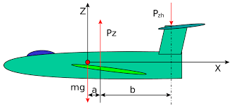
Force system
A force system is a collection of several forces acting simultaneously on a body in one or more planes. In figure below, the forces Pz, Pzh and mg constitute a force system.
Figure courtesy: Wikipedia

Slide 9
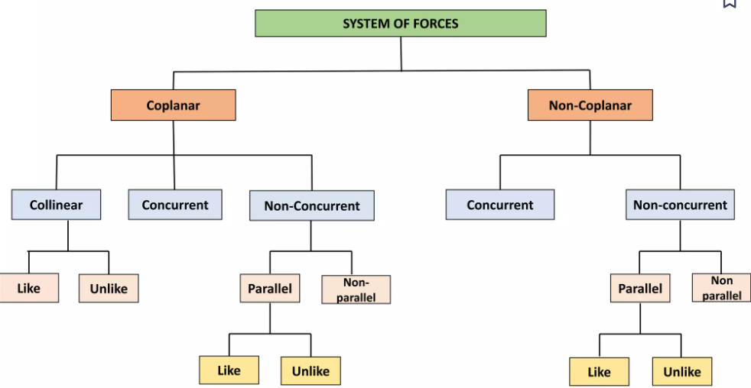
Co-planer and Non Co-planer force system
The force constituting the given system lie in the same plane. If the planes of action differ, the system is non Co-planer.

Slide 10
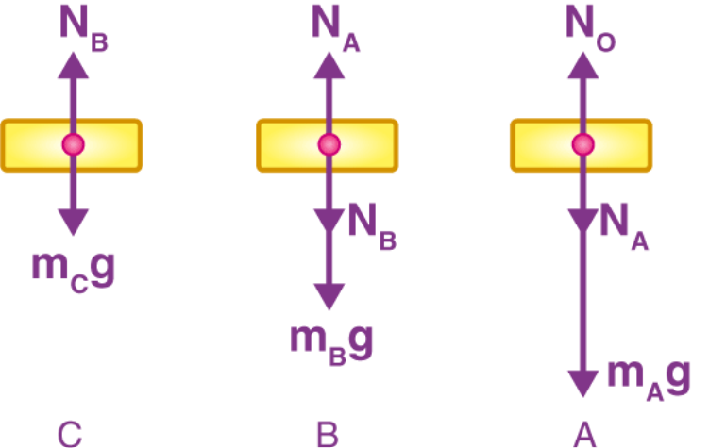
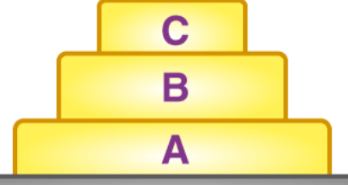
Free Body Diagram
To study the equilibrium of a body, it is imagined that the supports are replaced by the reaction exerted on body. A diagram of an isolated body which show only the reactions acting on the body is called a free body diagram (F.B.D). The following steps are followed for drawing a free body diagram:

Slide 11
Mathematical Treatment of Forces 1
Law of superposition of forces: It states that the action of a given system of forces on a rigid body will remain same even if we add or subtract from them another system of forces in equilibrium.
Principal of transmissibility of forces: It states that the point of application of a force may be changed to any other point along the line of action of the force without any change in the external effects produced by the force.
Parallelogram law of forces: Parallelogram law of forces states that if two forces acting simultaneously on a particle are represented in magnitude and direction by the two adjacent sides of a parallelogram, them their resultant is represented in magnitude and direction by the diagonal of the parallelogram passing through their point of intersection.
Triangle law of forces : Triangle law of forces states that if two forces acting simultaneously on a particle are represented in magnitude and direction by the two sides of a triangle taken in order, then their resultant is represented in magnitude and direction by the third side of the triangle taken in opposite order.

Slide 12
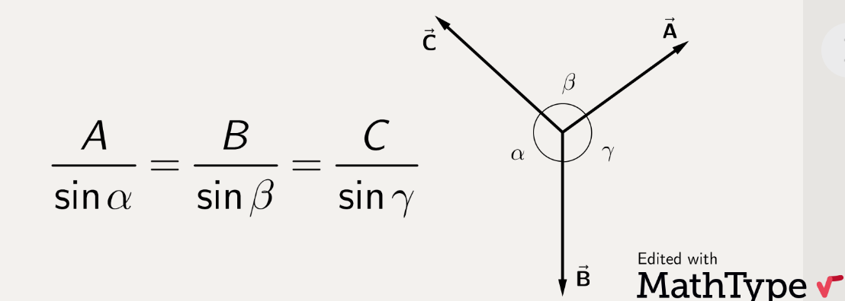
Mathematical Treatment of Forces 2
Polygon law of forces
If a number of forces acting simultaneously on a particle are represented in magnitude and direction by the side of a polygon taken in order, then their resultant in represented in magnitude and direction by the closing side of polygon taken in opposite order.
Lami’s Theorem
Lami’s Theorem states that if three coplaner forces acting at a point are in equilibrium, then each force is proportional to the sine of the angle between the other two forces.

