Slide 1
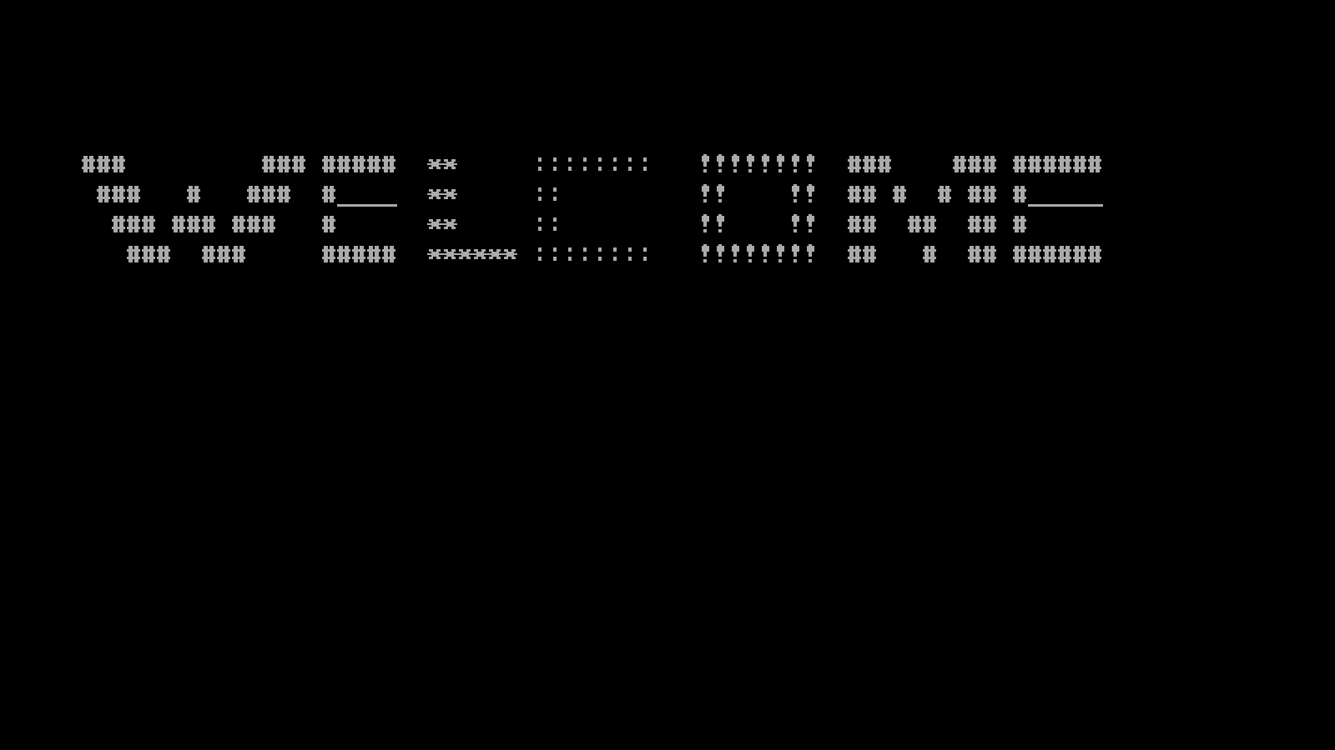
WELCOME SCREEN

Slide 2
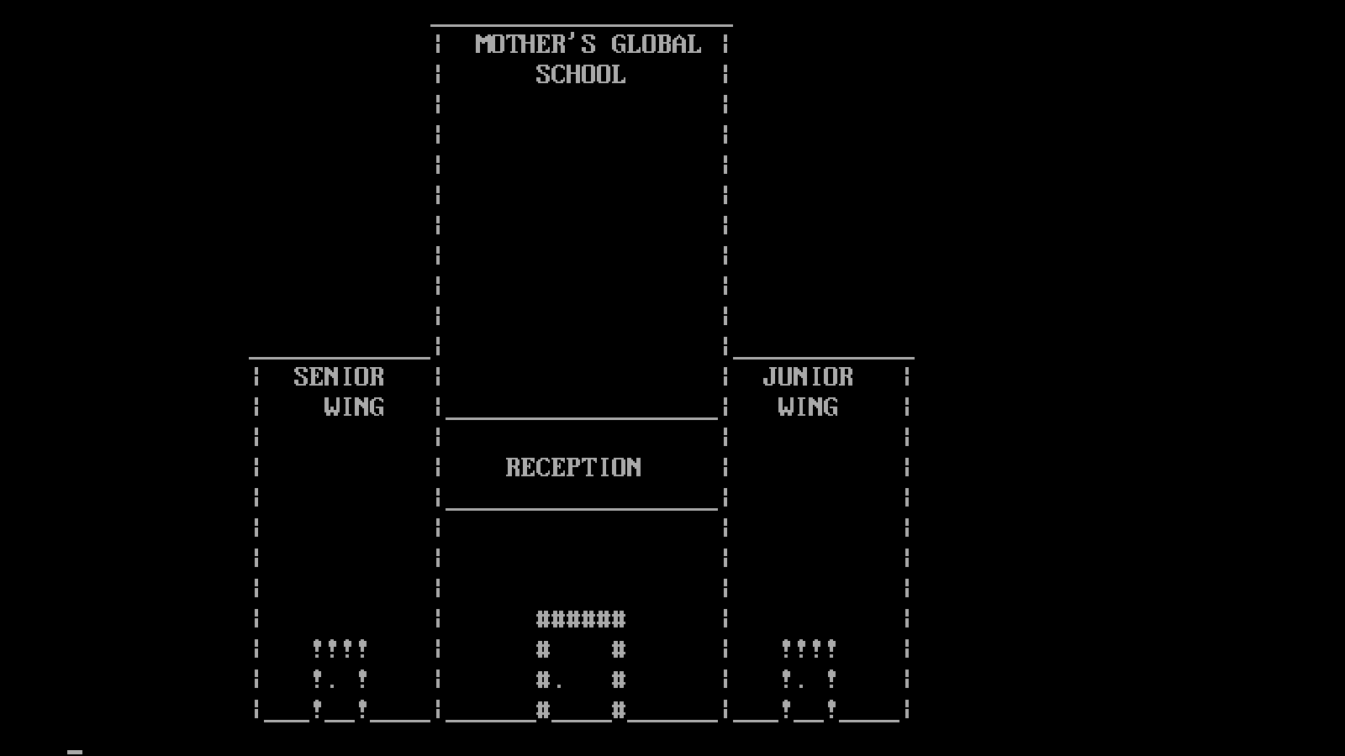

Slide 3
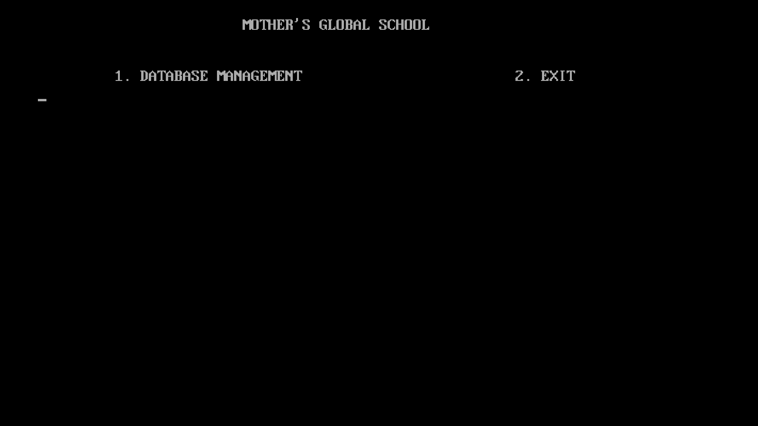

Slide 4
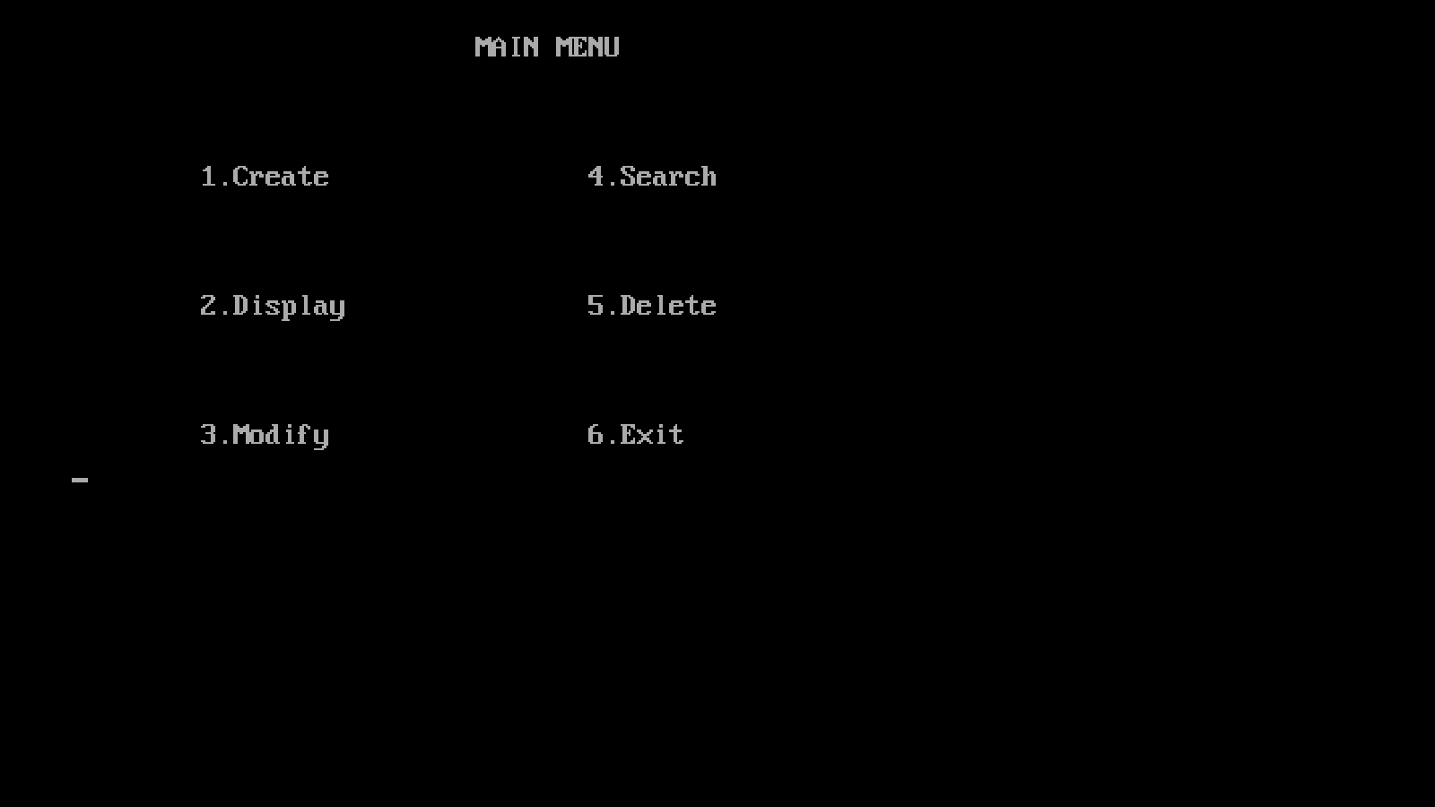
AFTER ENTERING DATABASE

Slide 5
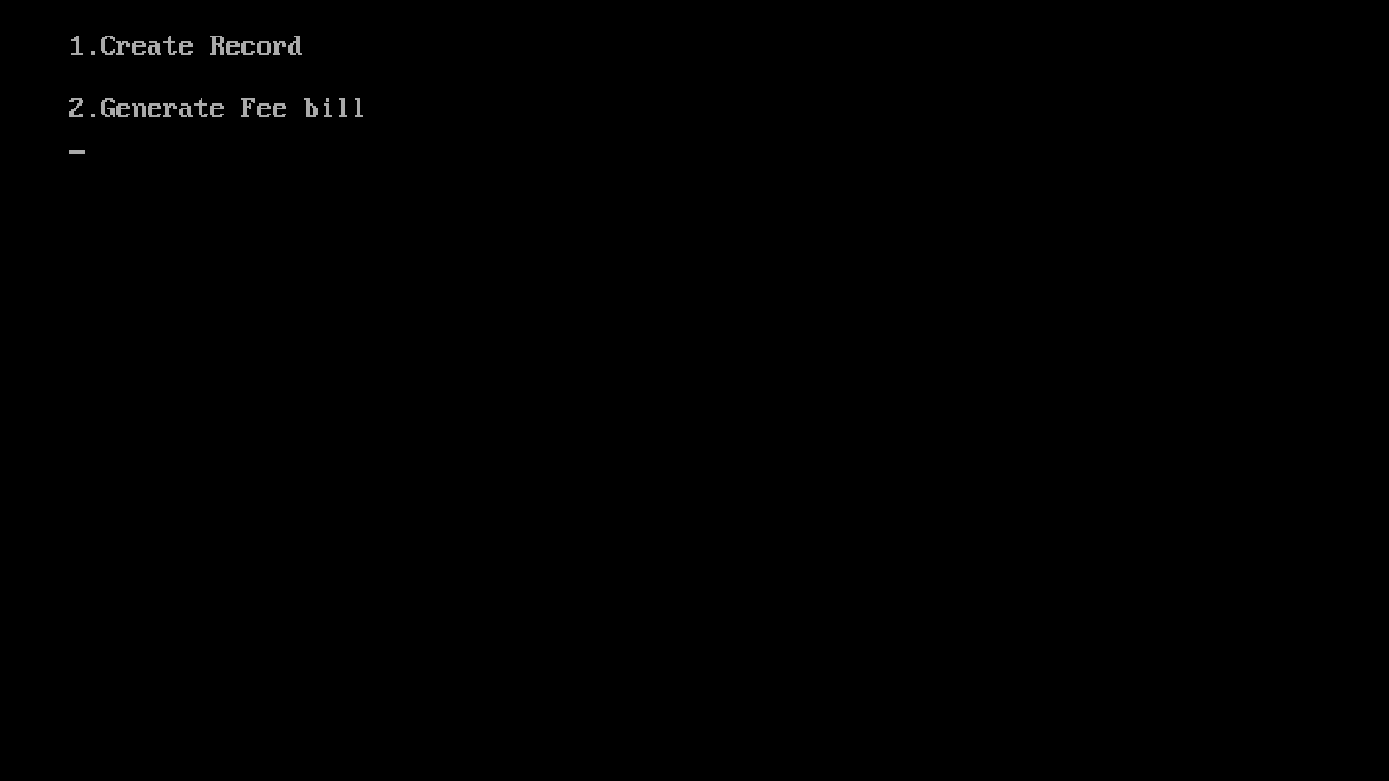
1. CREATE

Slide 6
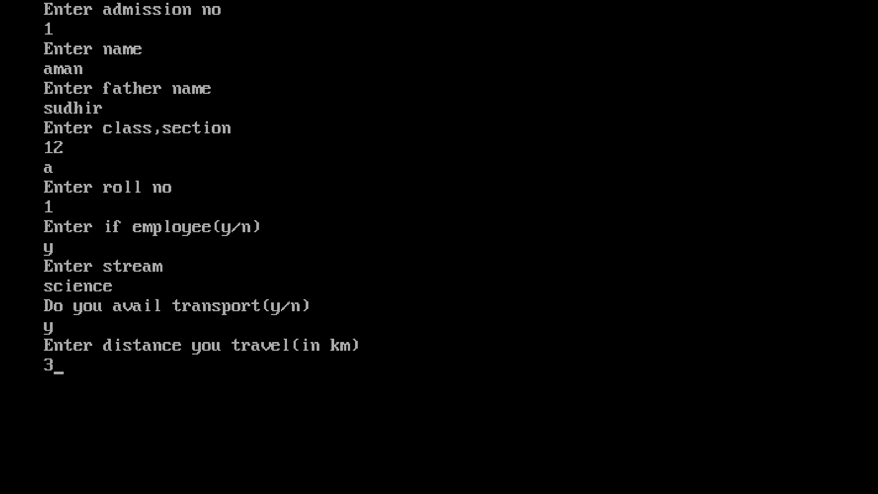
CREATING RECORDS

Slide 7
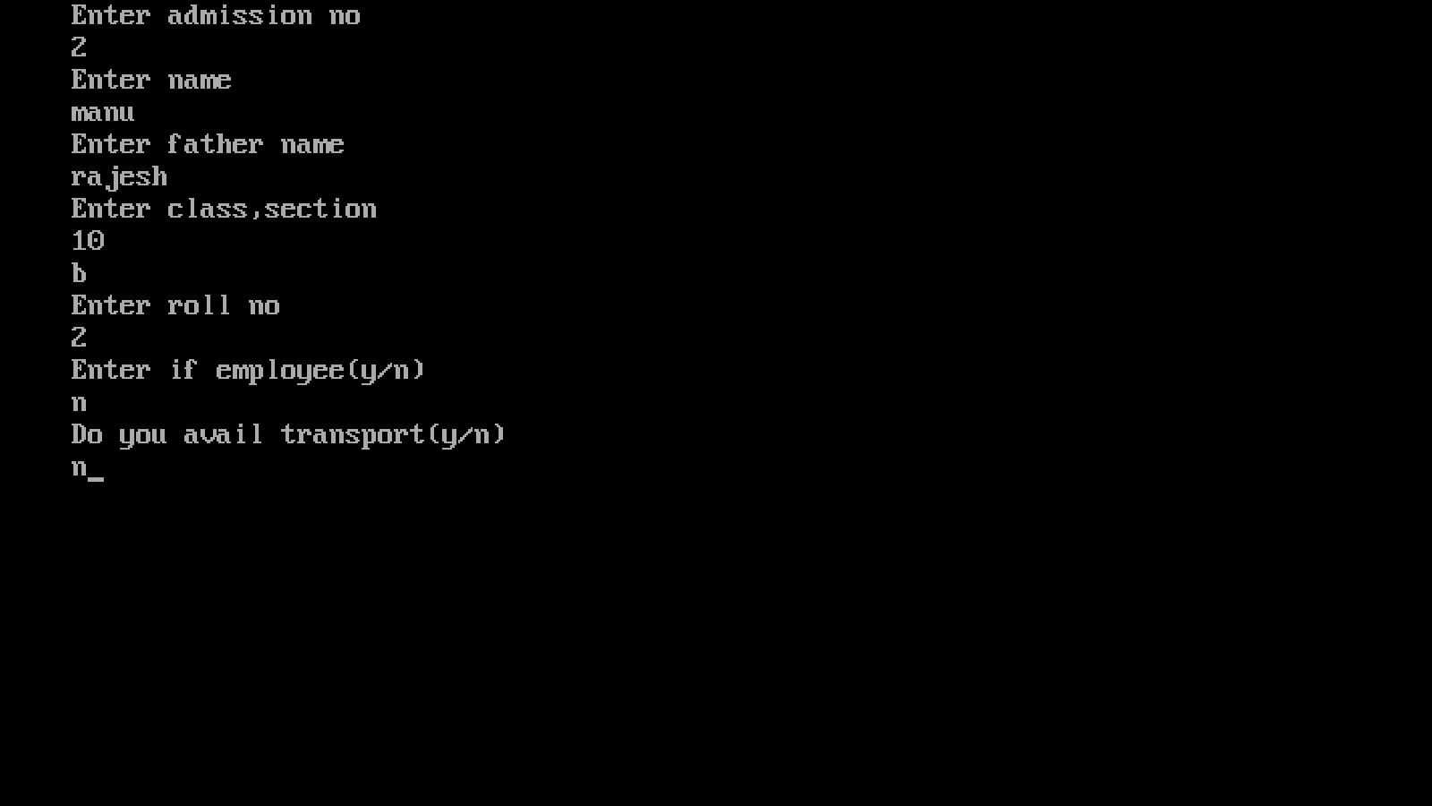
2ND RECORD

Slide 8
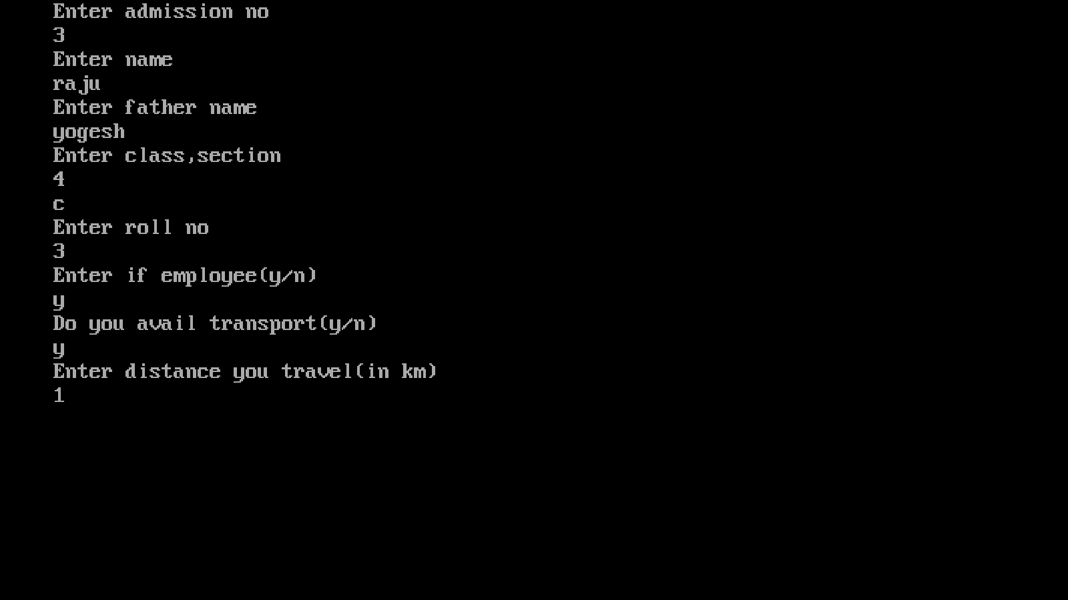

3RD RECORD

Slide 9
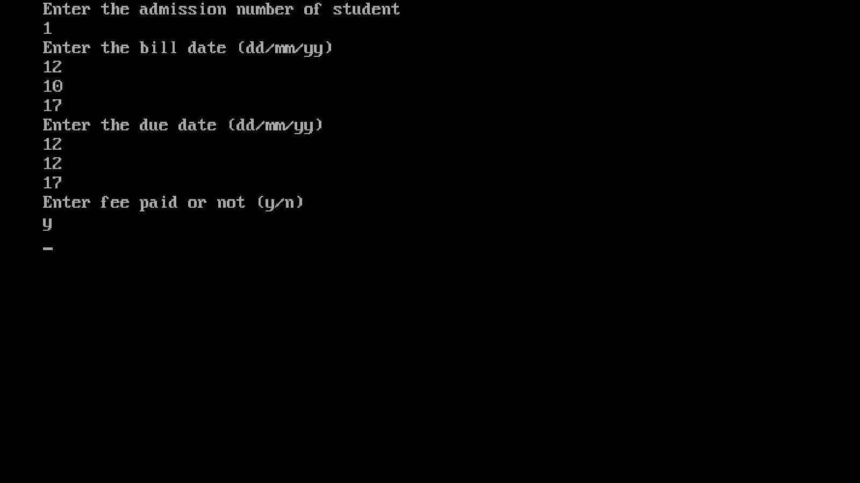
GENERATING FEE BILL

Slide 10
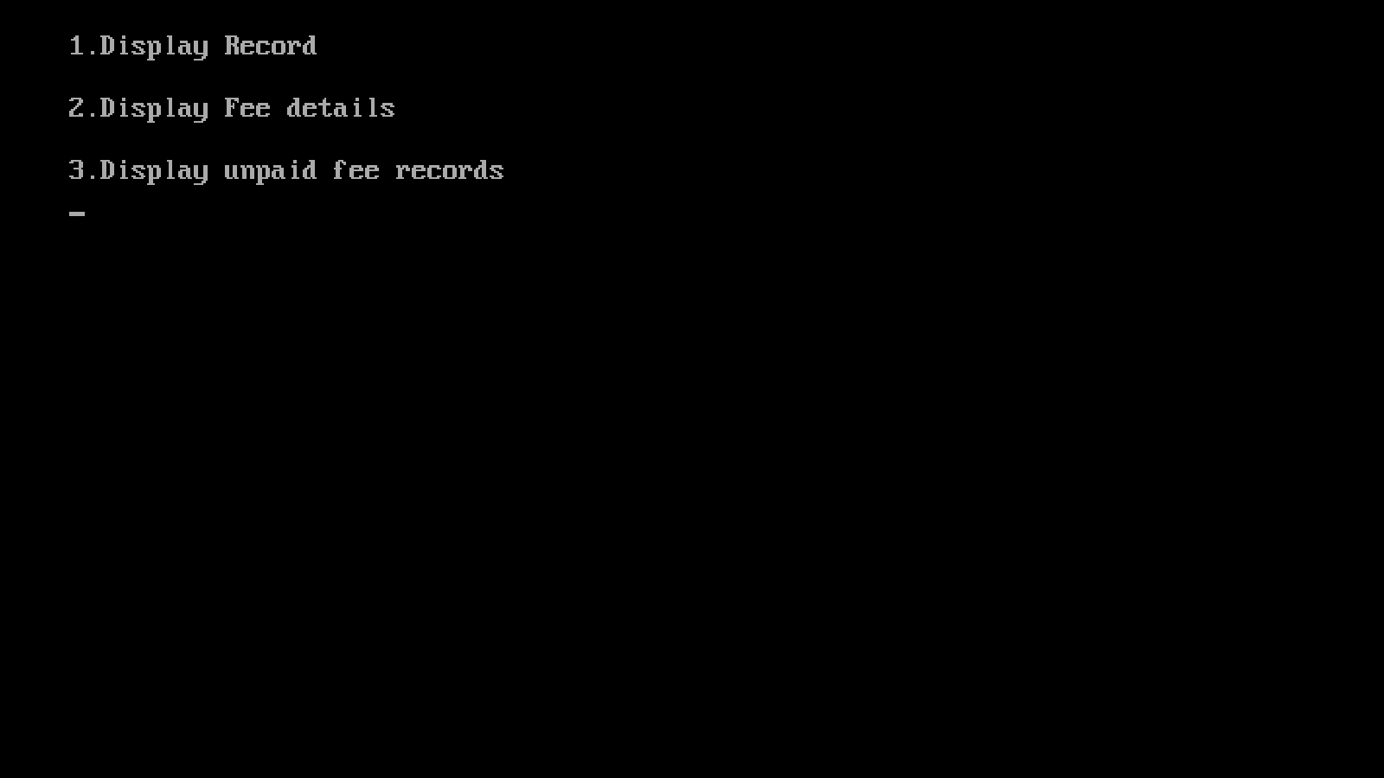
2. DISPLAY

Slide 11
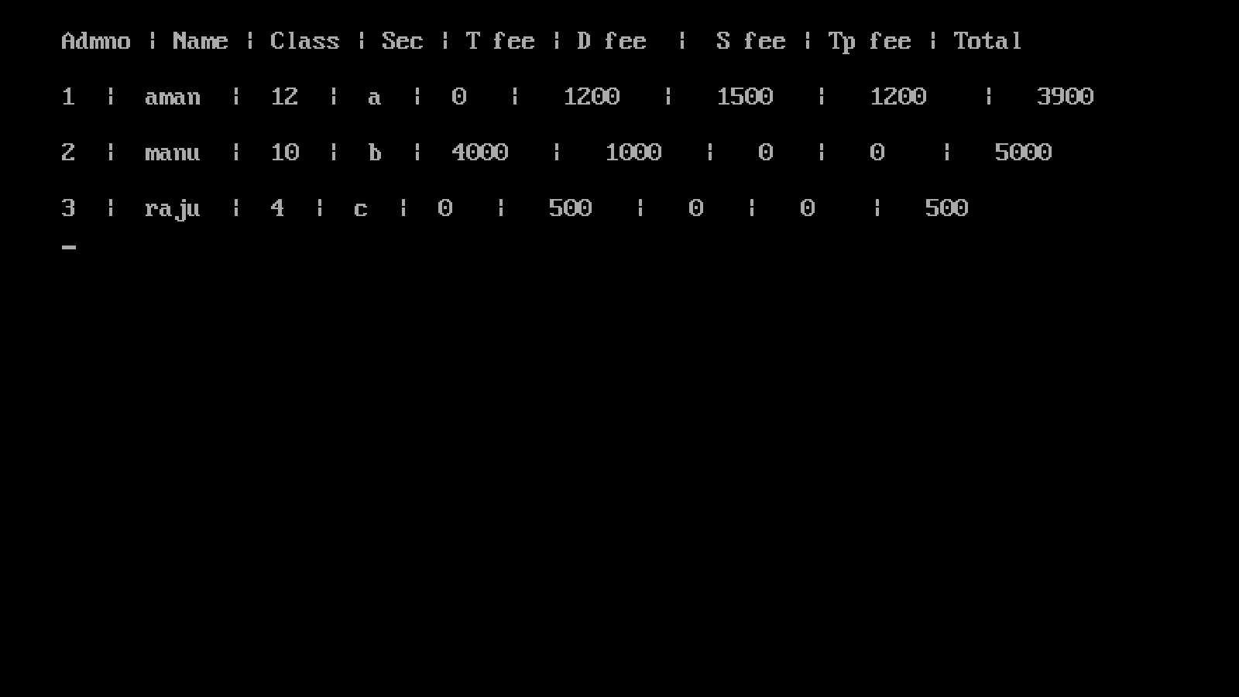
DISPLAYING RECORDS

Slide 12
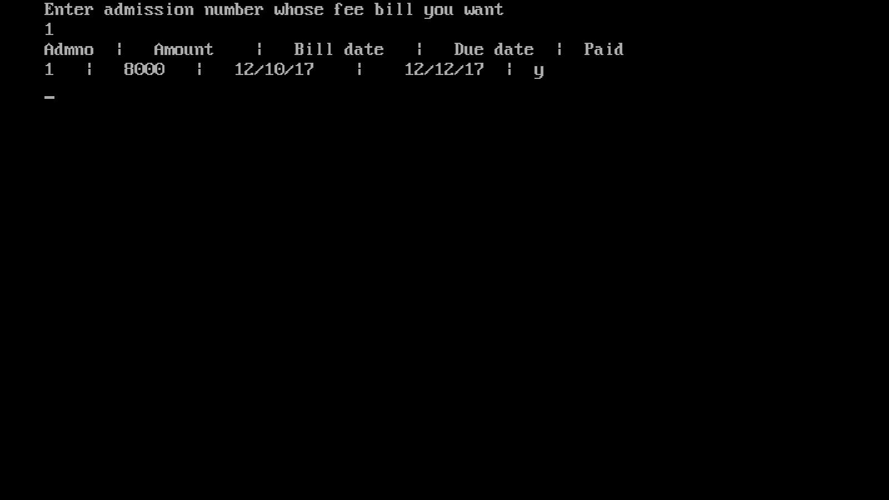
DIPLAYING FEE DETAILS

Slide 13
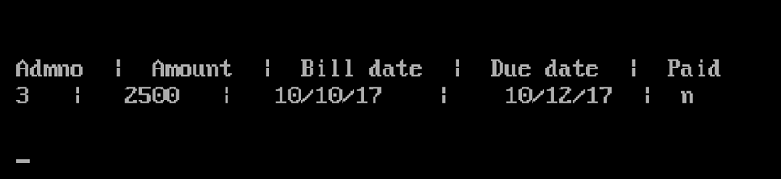

DISPLAYING UNPAID FEE DETAILS

Slide 14
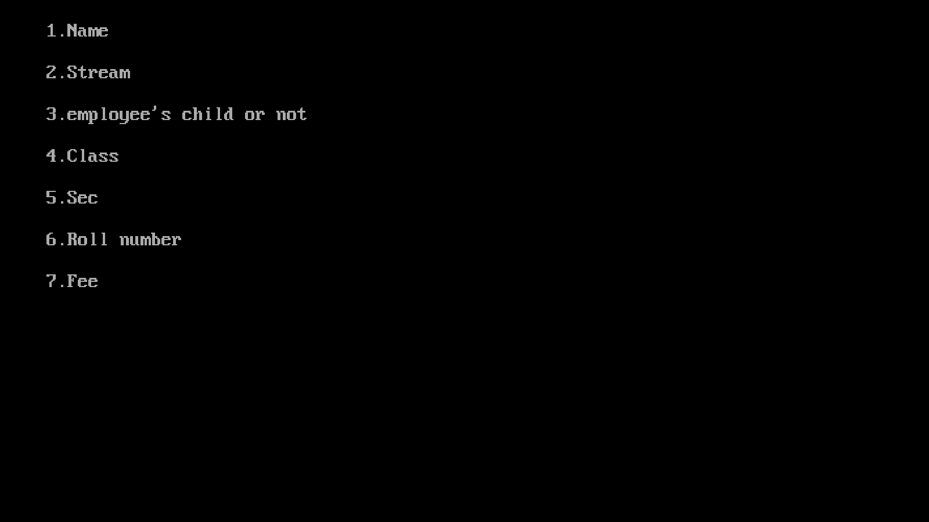
3. MODIFY

Slide 15
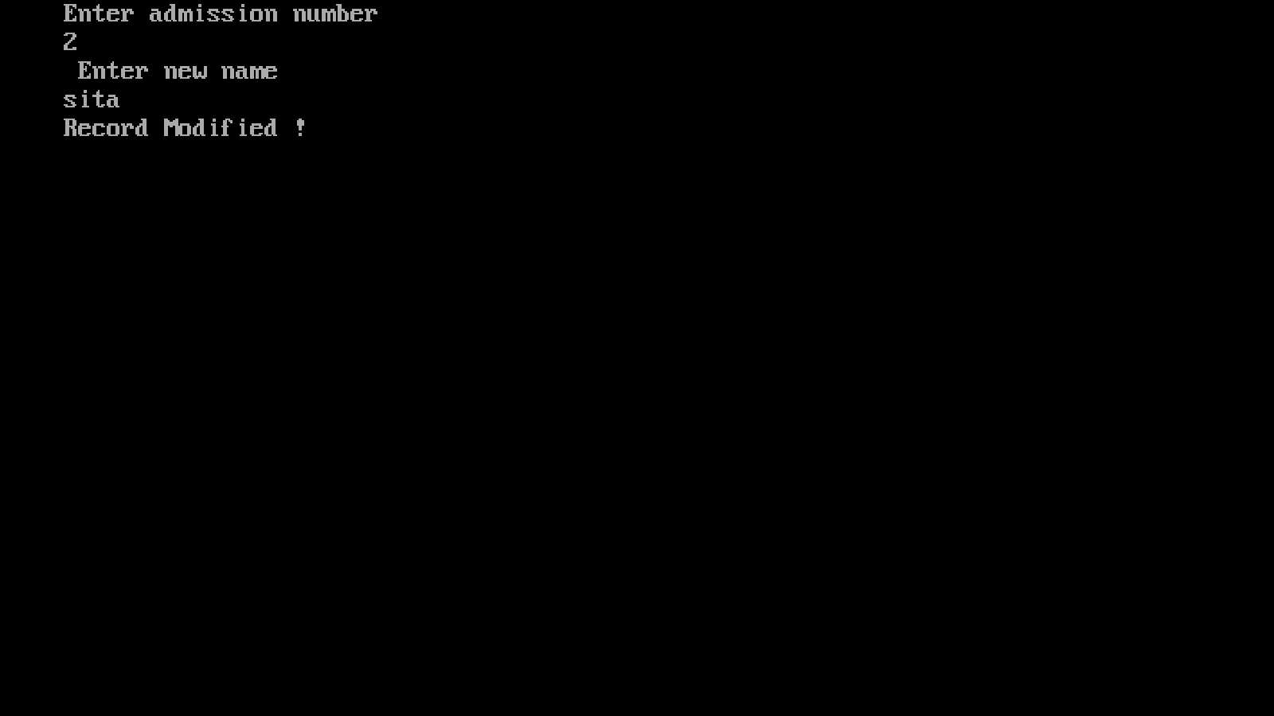
MODIFY :- NAME

Slide 16
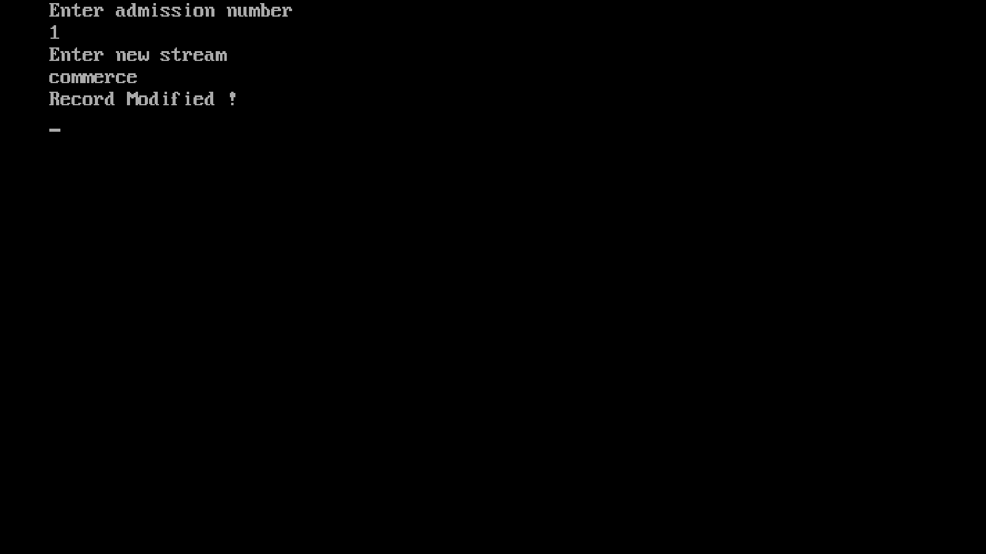
MODIFY :- STREAM

Slide 17
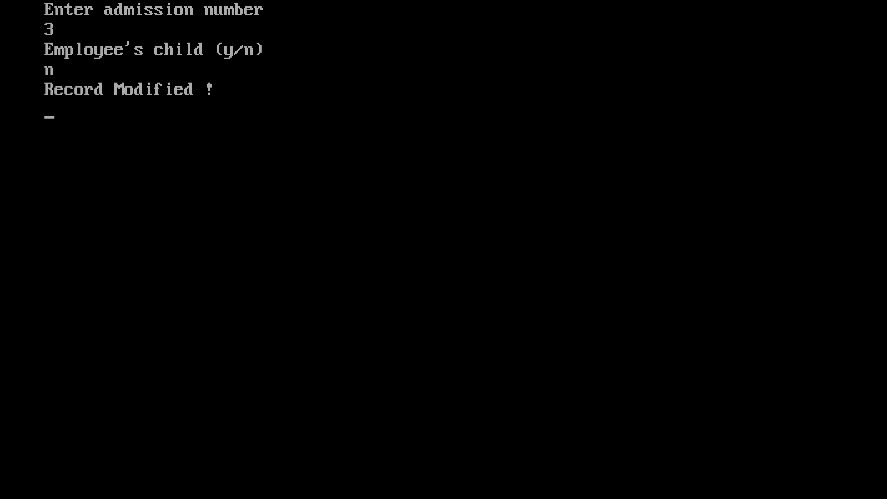
MODIFY :- IF EMPLOYEE

Slide 18
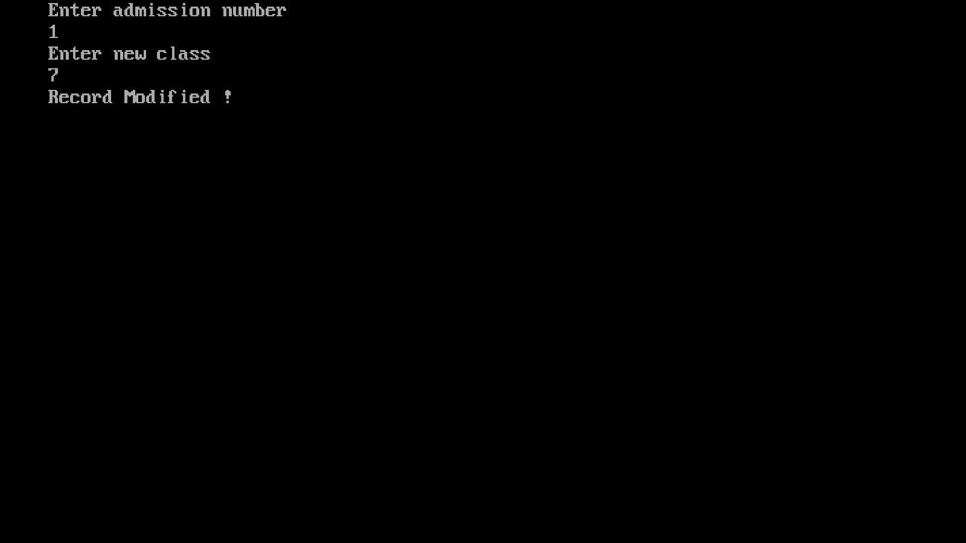
MODIFY :- CLASS

Slide 19
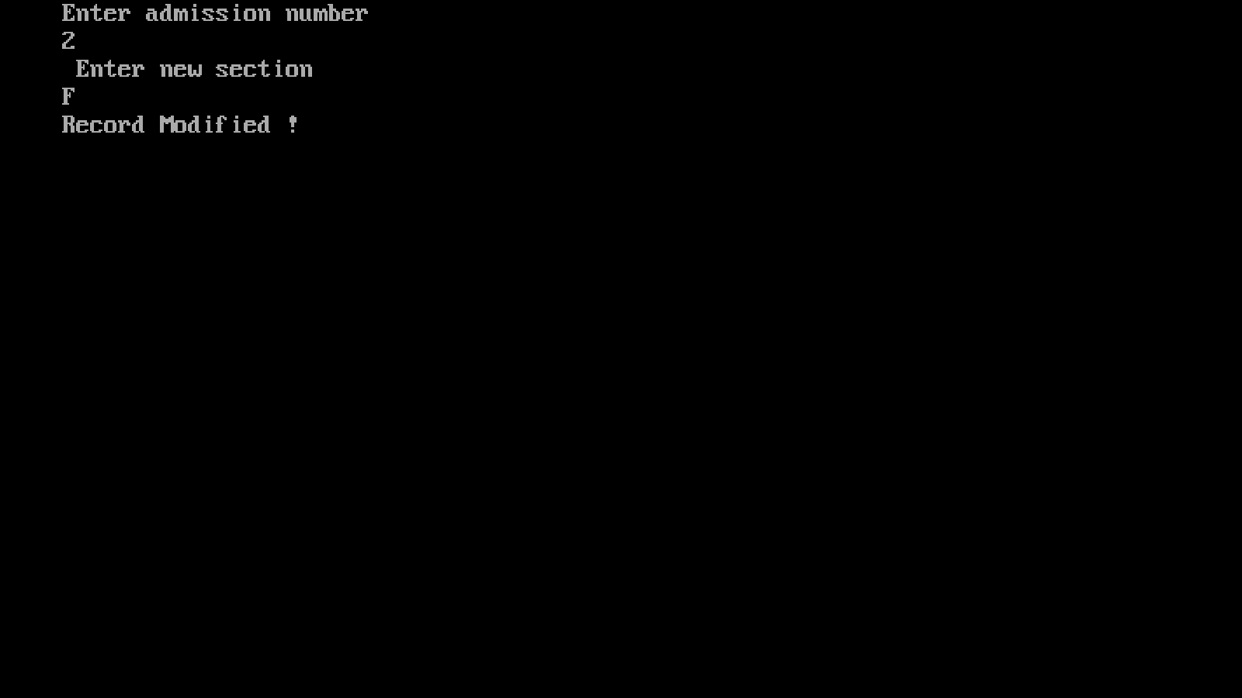
MODIFY :- SECTION

Slide 20

MODIFY :- ROLL NUMBER

Slide 21
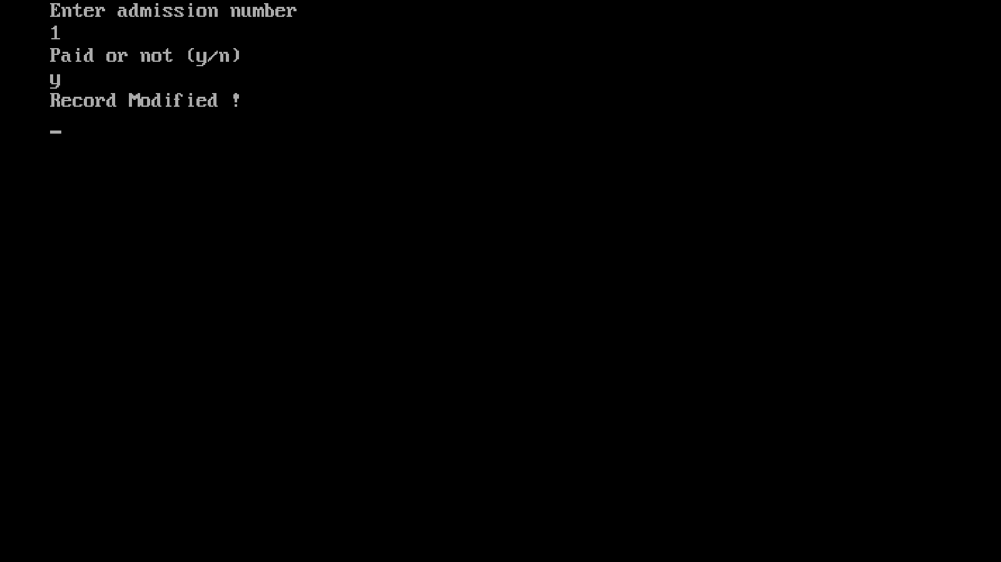
MODIFY :- FEE PAID OR NOT

Slide 22
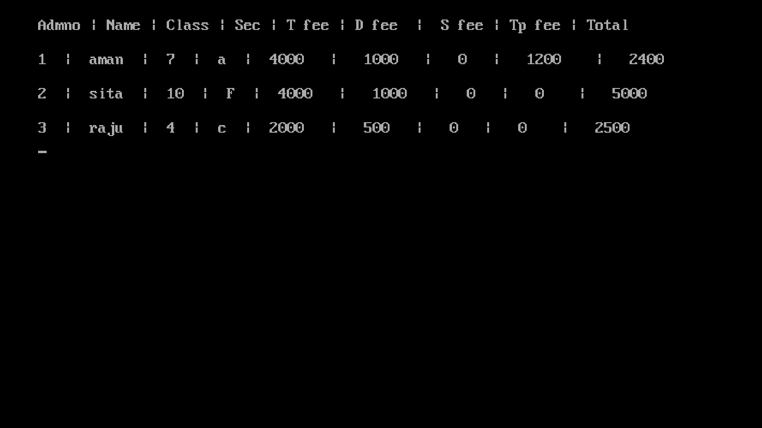

DISPLAYING AFTER MODIFICATION

Slide 23
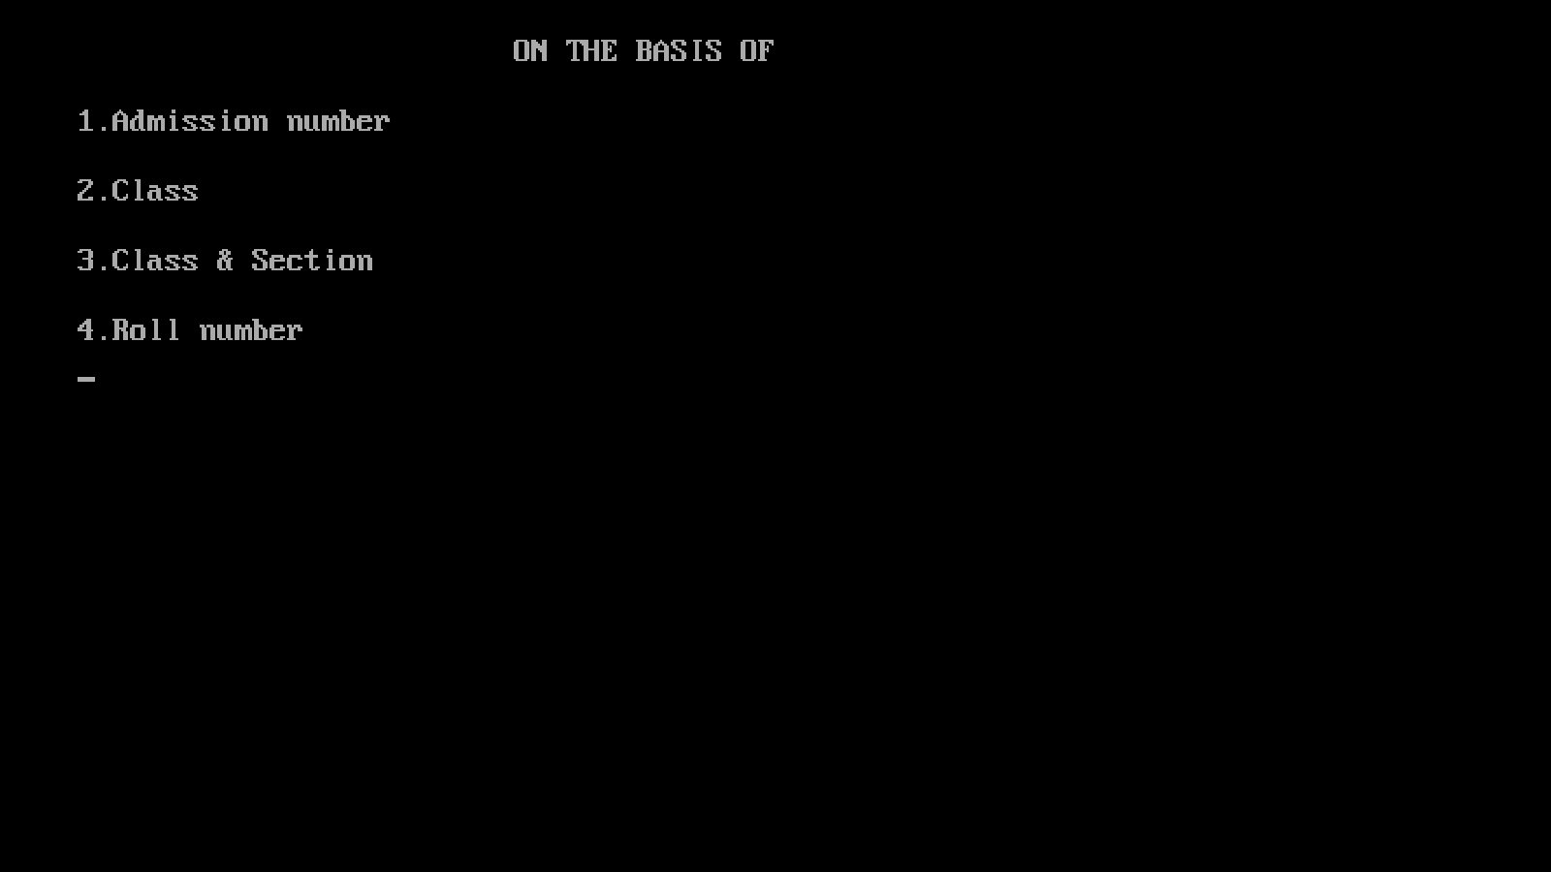
4.SEARCH

Slide 24
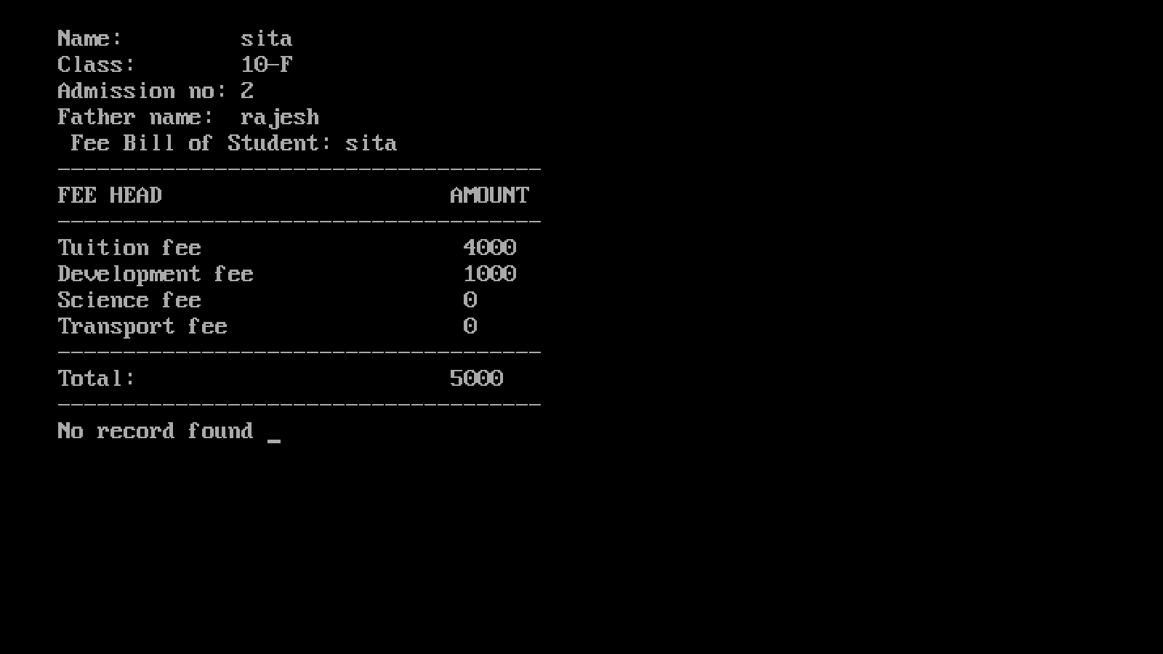
SEARCH BY:- ADMISSION NUMBER

Slide 25
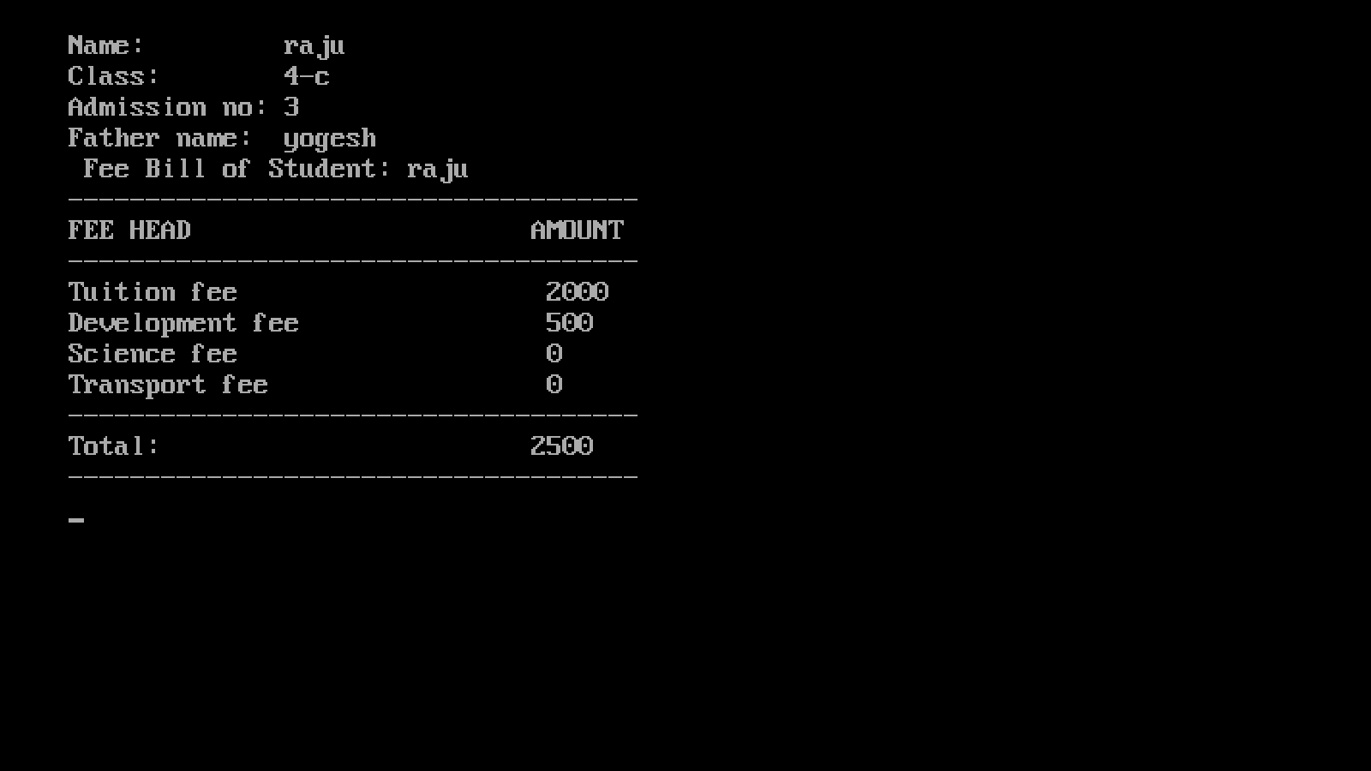
SEARCH BY :- CLASS

Slide 26
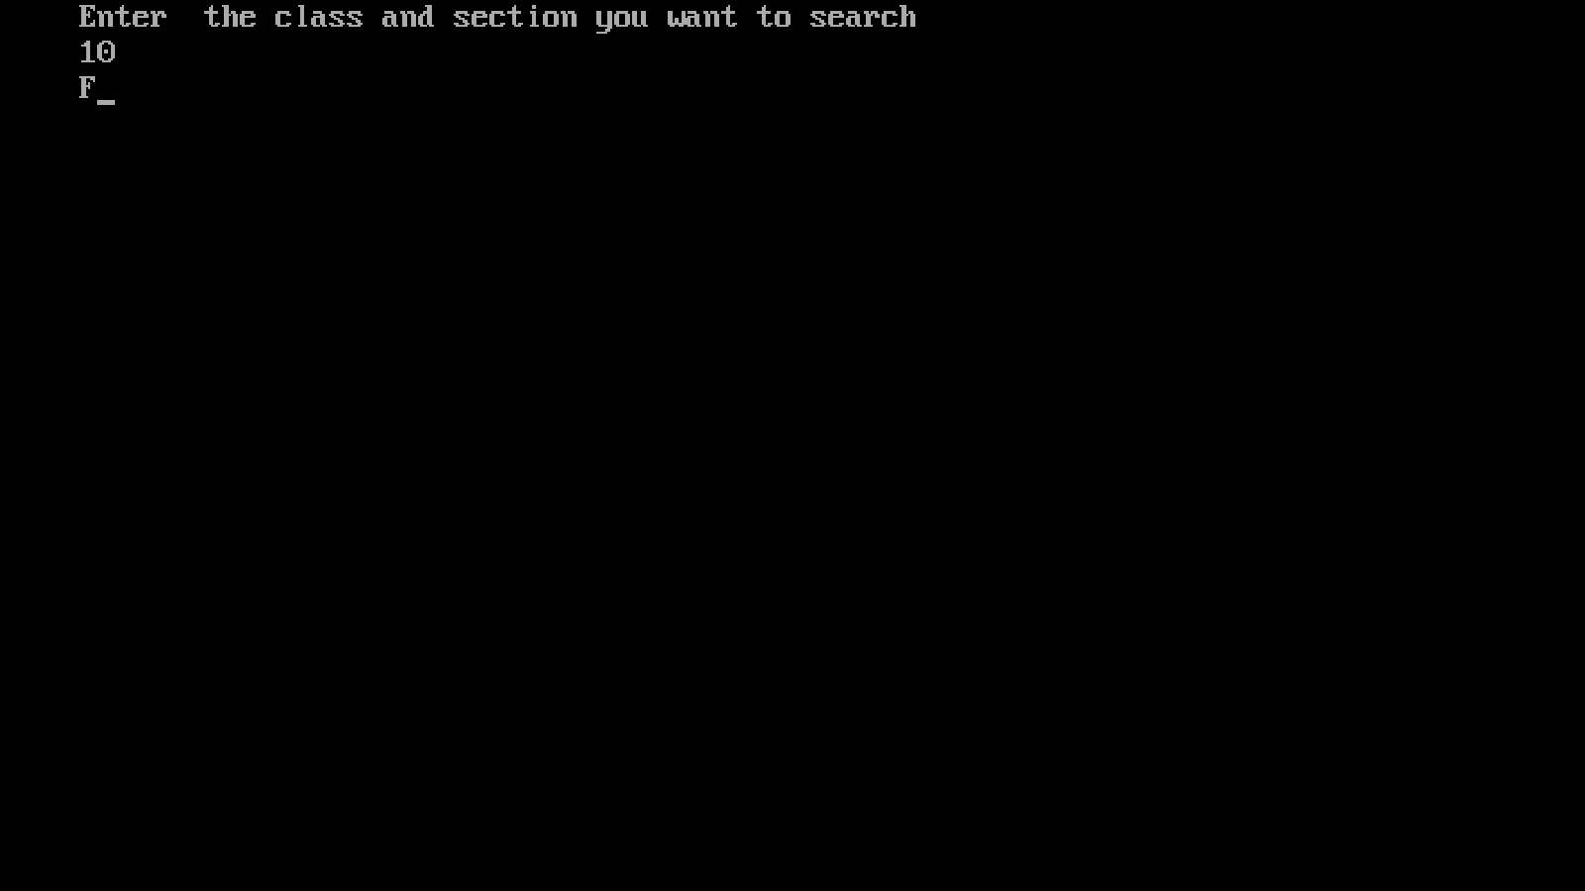
SEARCH BY:- CLASS AND SECTION

Slide 27
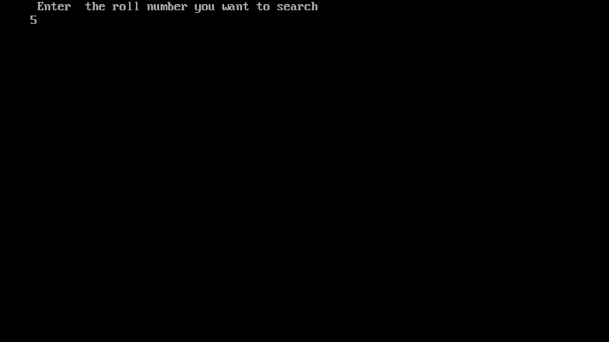
SEARCH BY :- ROLL NUMBER

Slide 28
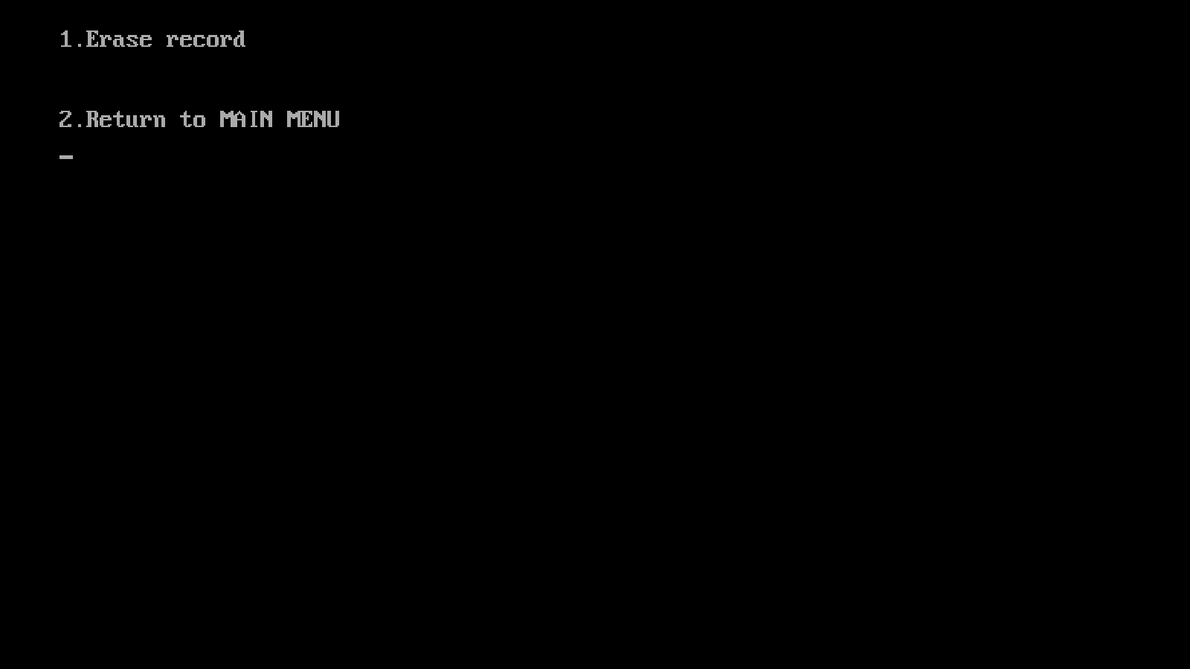
5. DELETE

Slide 29
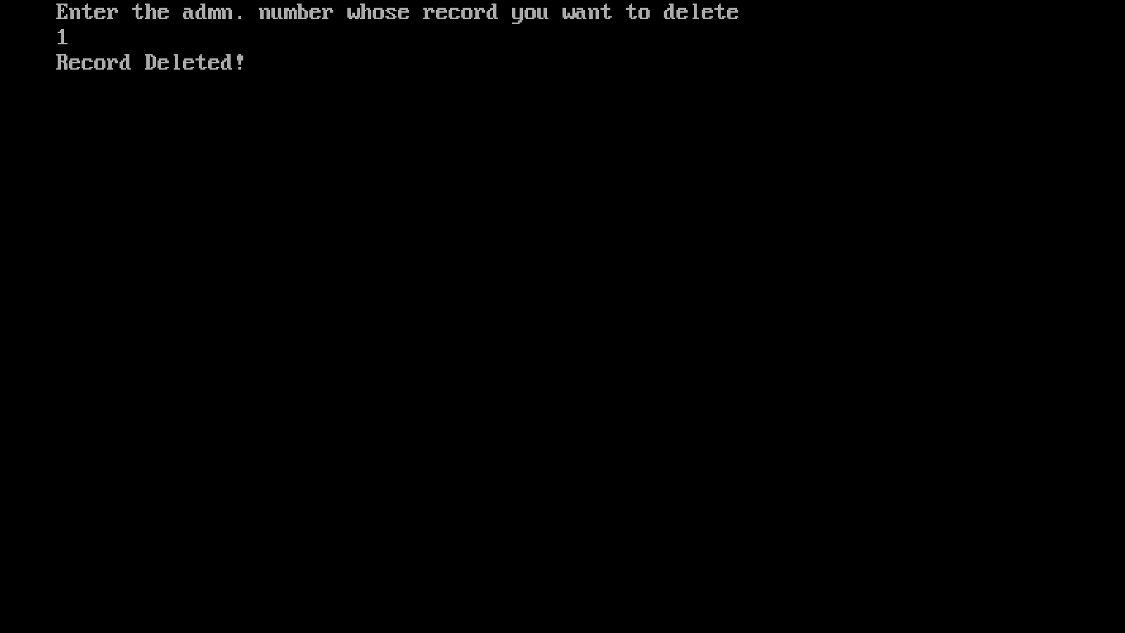
DELETION

Slide 30
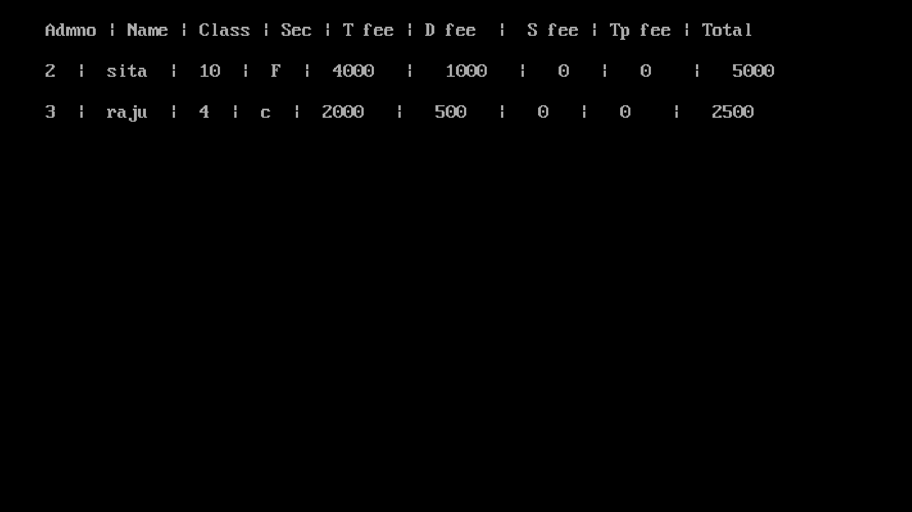
DISPLAYING AFTER DELETION

