Slide 2
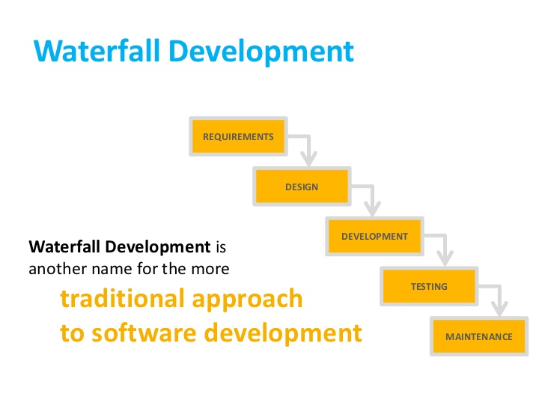

Slide 3
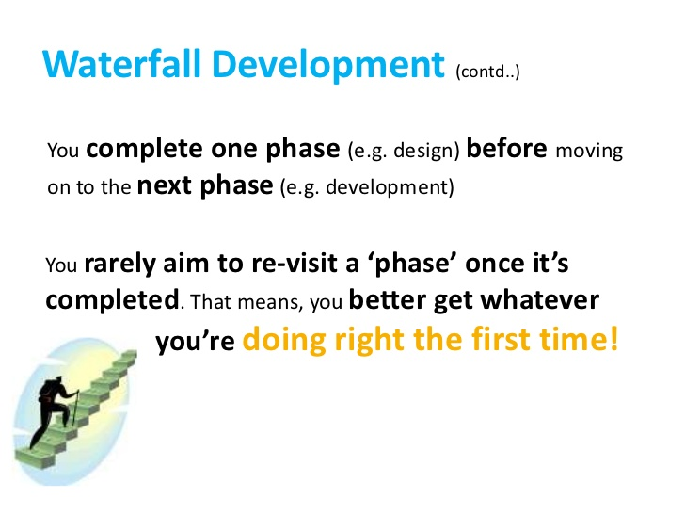

Slide 4
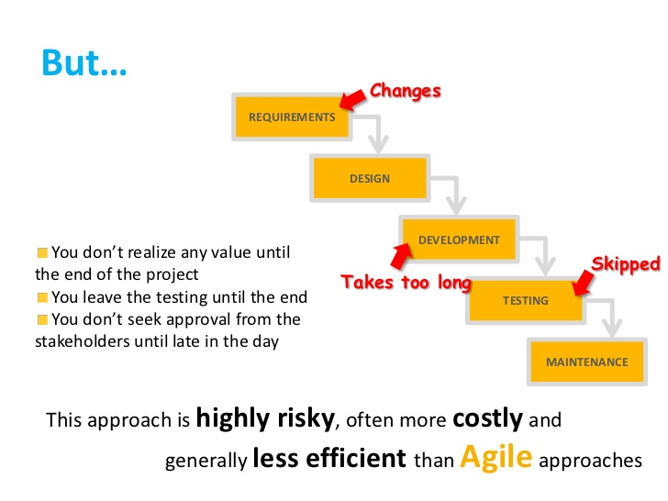

Slide 5
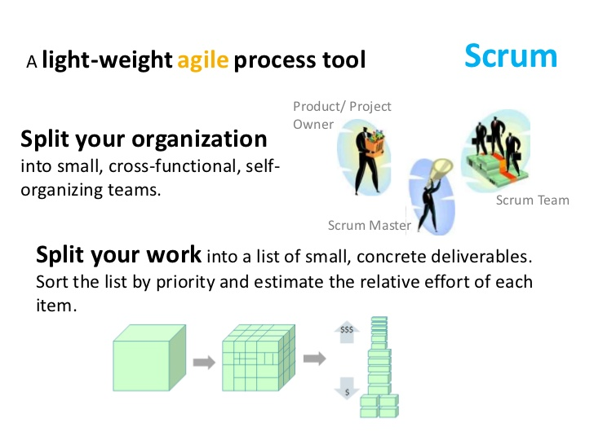

Slide 6
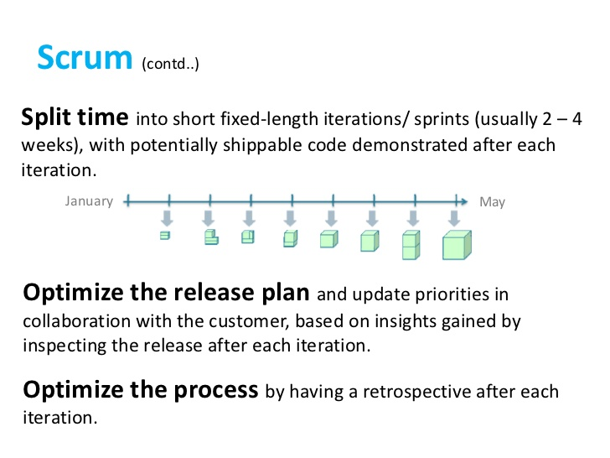

Slide 7
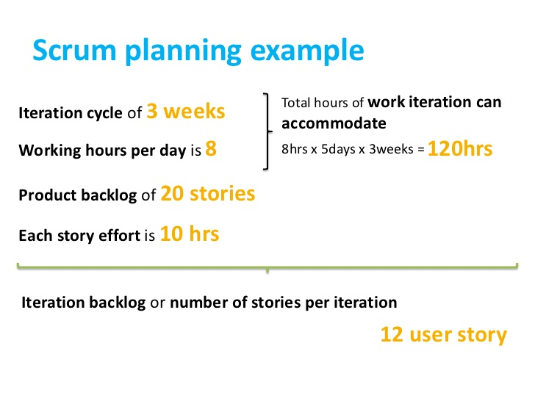

Slide 8
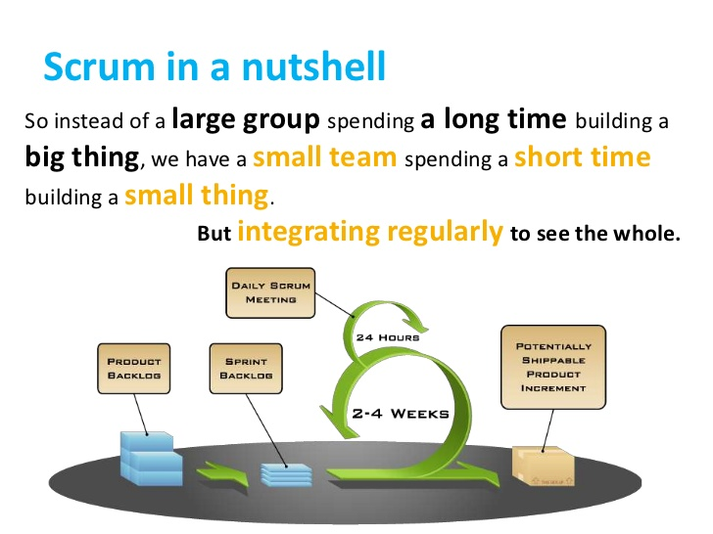

Slide 9
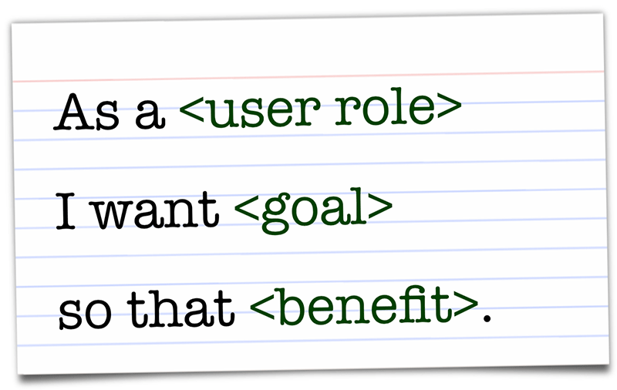
User Story
A user story is a tool used in Agile software development to capture a description of a software feature from an end-user perspective. The user story describes the type of user, what they want and why. A user story helps to create a simplified description of a requirement.

Slide 10
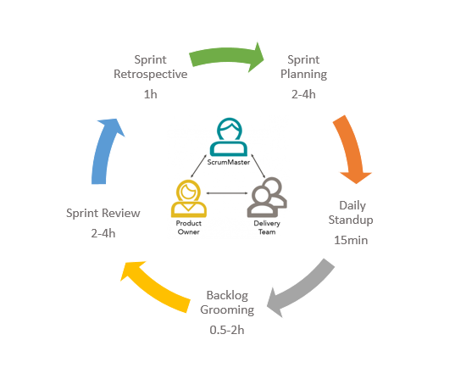
Sprint Client
To involve your client when using Scrum, you'll need to make sure they are monitoring the product backlog. This is a key element in the Scrum methodology process and the client is responsible for making entries or adjustments to the project throughout the project process. While the client is responsible for the upkeep of the product backlog, your team is responsible for developing the client's requests.

Slide 11
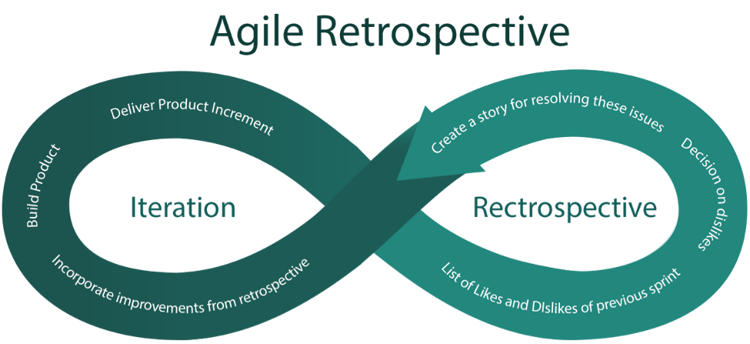
Agile retrospective
An Agile retrospective is a meeting that's held at the end of an iteration in Agile software development (ASD). During the retrospective, the team reflects on what happened in the iteration and identifies actions for improvement going forward.
General questions asked are:-
1. What worked well for us?
2.What did not work well for us?
3.What actions can we take to improve our process going forward?

Slide 12
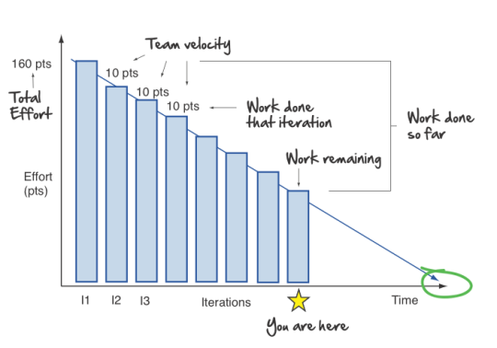
Burn Down Chart
A burn down chart is a graphical representation of work left to do versus time. The outstanding work (or backlog) is often on the vertical axis, with time along the horizontal. That is, it is a run chart of outstanding work. It is useful for predicting when all of the work will be completed. It is often used in agile software development methodologies such as Scrum. However, burn down charts can be applied to any project containing measurable progress over time. Outstanding work can be represented in terms of either time or story points

Slide 13
Scrum product owner
The Product Owner is the sole person responsible for managing the Product Backlog. Product Backlog management includes:
Clearly expressing Product Backlog items.
Ordering the items in the Product Backlog to best achieve goals and missions.
Optimizing the value of the work the Development Team performs.
Ensuring the Development Team understands items in the Product Backlog to the level needed

Slide 14
Poker Planning
Planning Poker is a consensus-based estimating technique.
Agile teams around the world use Planning Poker to estimate their product backlogs.
Planning Poker can be used with story points, ideal days, or any other estimating unit.
To start a poker planning session, the product owner or customer reads an agile user story or describes a feature to the estimators.
A product owner, ScrumMaster or agile coach can log in and preload a set of items to be estimated.
The poker planning process is repeated until consensus is achieved or until the estimators decide that agile estimating and planning of a particular item needs to be deferred until additional information can be acquired.

Slide 15
Daily Standups
A daily stand-up is a daily status meeting among all team members and it is held roughly for 15 minutes.
Daily stand-up is for status update, not for any discussion. For discussion, team members should schedule another meeting at a different time.
The scrum master, the product owner, and the delivery team should attend the stand-up on a daily basis.
Stakeholders and Customers are encouraged to attend the meeting and they can act as an observer, but they are not supposed to participate in stand-ups.

Slide 16
Scrum Board
A Scrum Board is a tool that helps Teams make Sprint Backlog items visible.
The board can take many physical and virtual forms but it performs the same function regardless of how it looks.
The board is updated by the Team and shows all items that need to be completed for the current Sprint.
The board is traditionally divided up into three categories: To Do, Work in Progress and Done.

Slide 17
Kanaban Board
A kanban board is an agile project management tool designed to help visualize work, limit work-in-progress, and maximize efficiency (or flow).
Kanban boards use cards, columns, and continuous improvement to help technology and service teams commit to the right amount of work, and get it done.
kanban boards can be broken down into five components:
Visual signals
Columns
Work-in-progress limits
Commitment point
Delivery point

Slide 18
Velocity
Velocity is a metric that predicts how much work an Agile software development team can successfully complete within a two-week sprint
Velocity is a key feedback mechanism for the Team.
Velocity is a useful planning tool for estimating how fast work can be completed.
Generally, velocity remains somewhat constant during a development project
By knowing Velocity, a product owner can figure out how many Sprints it will take the Team to achieve a desired level of functionality.

Slide 19
Spring Backlog
The Sprint Backlog is the set of Product Backlog items selected for the Sprint.
The Sprint Backlog is a forecast by the Development Team about what functionality will be in the next Increment and the work needed to deliver that functionality.
The Team determines how best to work through the Sprint Backlog.
The Sprint Backlog is a plan with enough detail that changes in progress can be understood in the Daily Scrum.

