Slide 1


Internship Assessment Presentation on IOT
By:
HARSH RAJ (1813331049)
Section- VA
Under the Supervision of
----------------
Designation
Department of Electronics and Communication Engineering
Noida Institute of Engineering and Technology, Greater Noida

Slide 2
Outline
Introduction
Objectives
Internship Assessment Certificate
Internship Assessment Detail
Technical description
Circuit diagram
Coding on the Arduino IDE
Graph
Applications
Bibliography

Slide 3
Introduction
I have completed my training of Developing an IOT Application at CISCO ThingQbator . The name “thingQbator” is a combination of ‘Internet of Things’ and ‘Incubator’.
ThingQbator was started as an internal incubator of IoT ideas coming from Cisco’s engineer community where students can learn about digital technologies in a hands-on environment, turn their ideas into working prototypes.
It was a 4 week Training Program and after the completion of training and project they take a test to give certificates.

Slide 4
Introduction
So in this presentation i will focus on my project work where i will discuss about IOT applications using Node MCU ESP8266.
Over the past few years, the ESP8266 has been a growing star among IoT or Wifi-related projects. It’s an extremely cost-effective Wi-fi module that – with a little extra effort – can be programmed to build an awesome web server projects.
Data logger web server with real time graphs and tables.

Slide 5
Objectives
We will see how ESP8266 will host a web page with real time charts that have new readings added every 30 seconds.
We will access the data on cloud and visualize the outputs , will use internet communication protocols like REST to retrieve data from cloud and develop web application.
We will use AJAX , JSON , HTML and JavaScript.

Slide 6
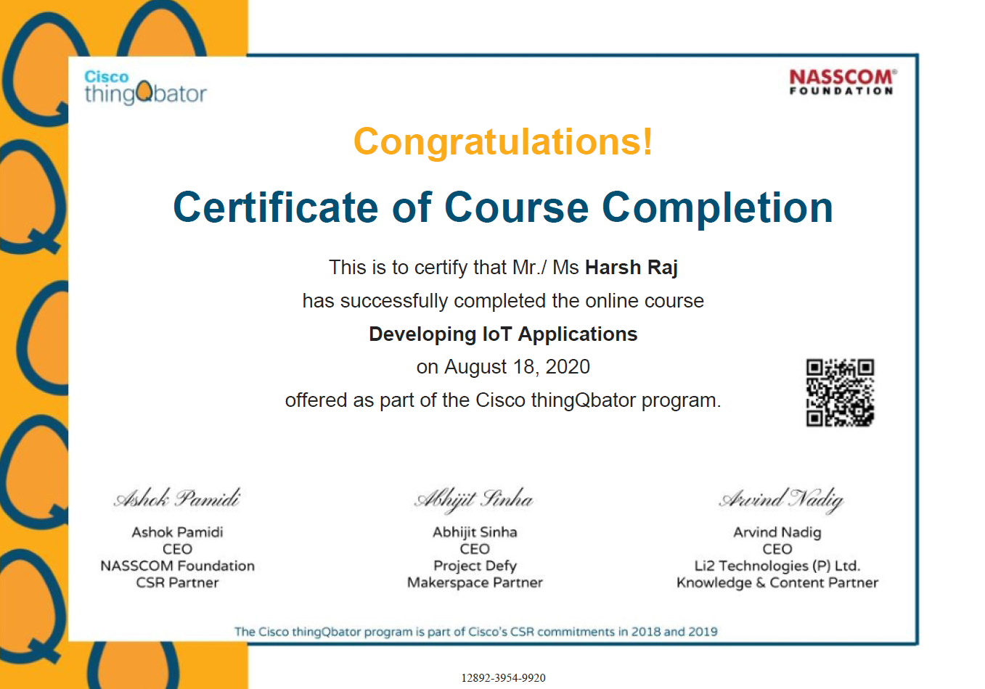
Internship Assessment Certificate

Slide 7
Internship Assessment
Building an IoT based Cloud Application.
Access the data on your cloud and visualize the outputs.
Use internet communication protocols like REST.
Make your web application portable with your ESP8266’s web server.

Slide 8
Technical description
For this project components required :
Node MCU board
Micro USB cable
A Cloud platform
Wifi router connected to the internet
To understand the cloud and visualize the data, I will use NodeMCU and transmit data to the cloud using a readily available IoT analytics platform service. Here, I use ThingSpeak, a service that helps transmit data to the cloud without having to set up servers or develop a web Application.
ThingSpeak is an open source IoT framework and API (Application Program Interface) to store and retrieve data from “things” using the HTTP protocol over the Internet or via a Local Area Network (LAN).

Slide 9
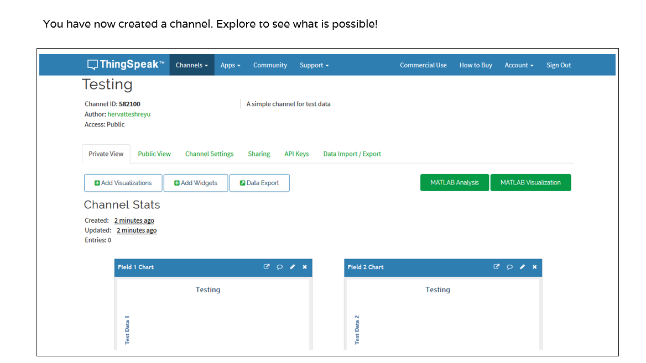
Technical description
Steps to Performed :
1. Creating a channel to transmit data : To transmit data to the cloud, we need to create a transmitting channel. For this project, I have used sample data and transmit it to the cloud

Slide 10
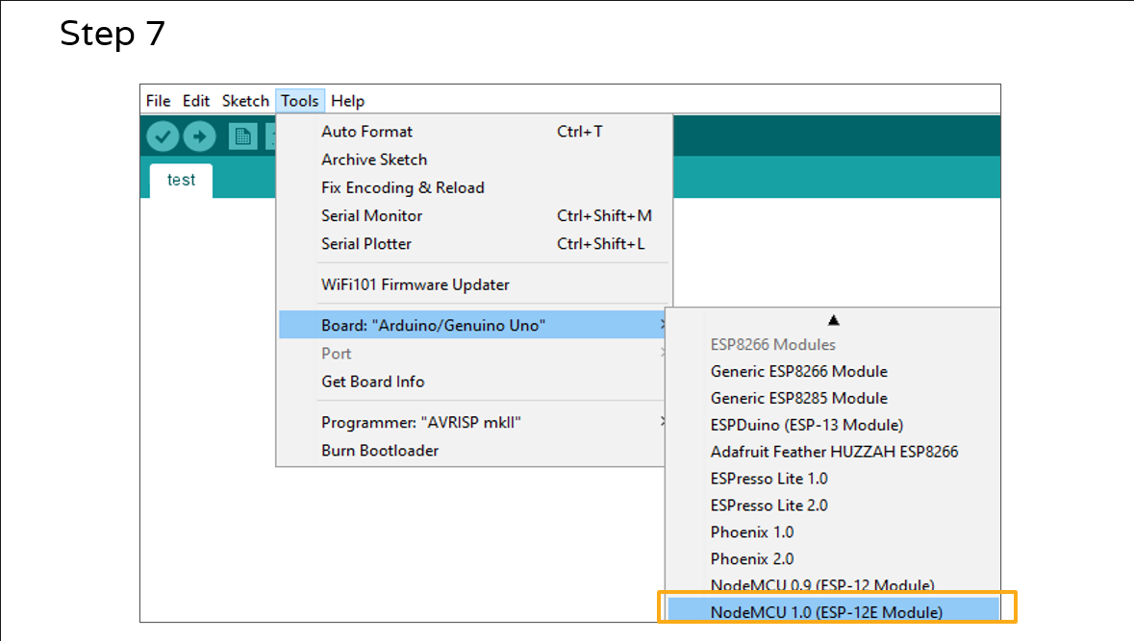
Technical description
2. Installing Arduino IDE and configuring for NodeMCU board functionality

Slide 11
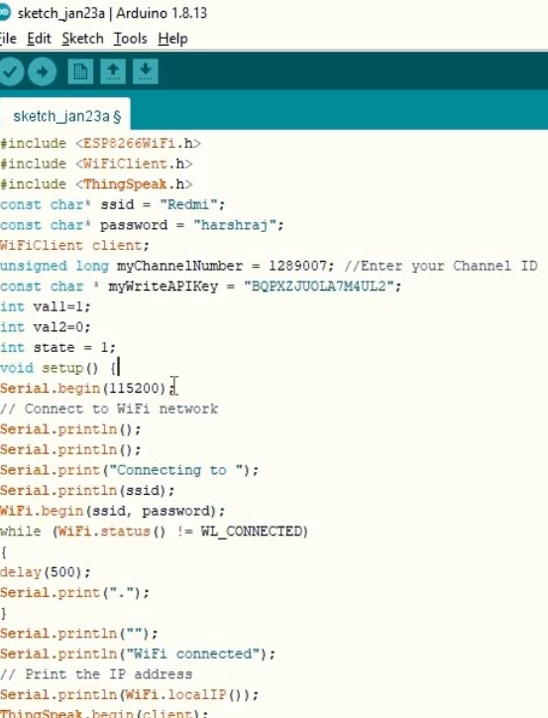
Technical description
3. Coding on the Arduino IDE

Slide 12
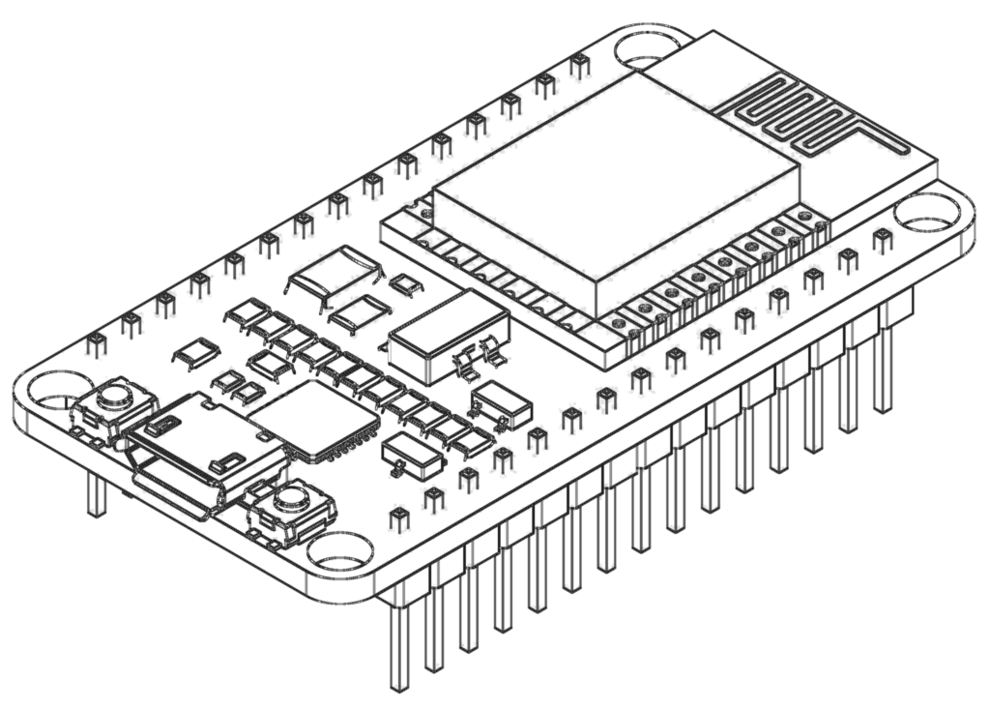
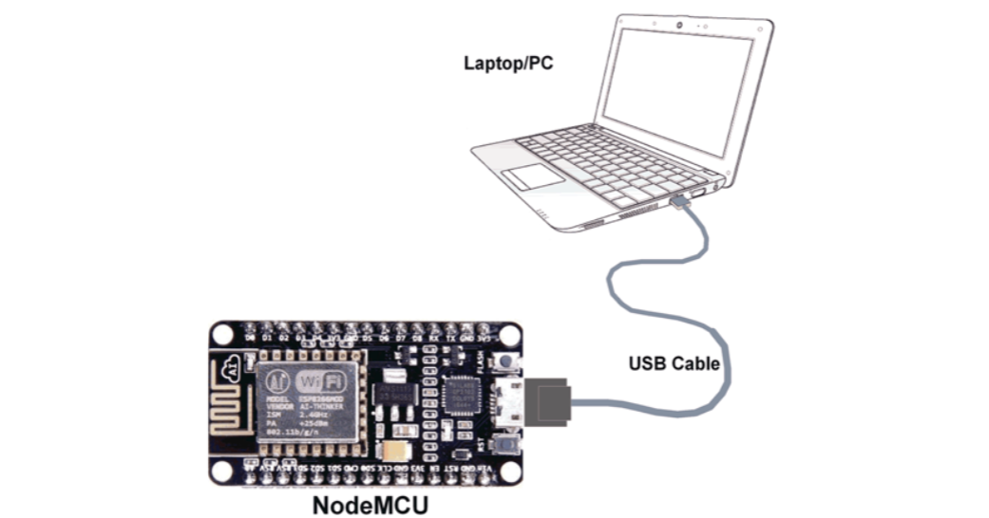
Circuit diagram

Slide 13
Coding on the Arduino IDE

Slide 14
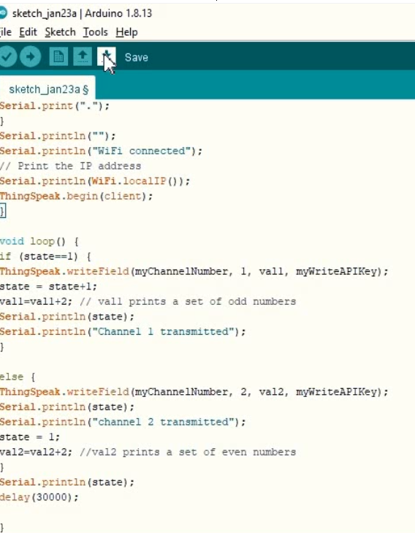
Coding on the Arduino IDE

Slide 15
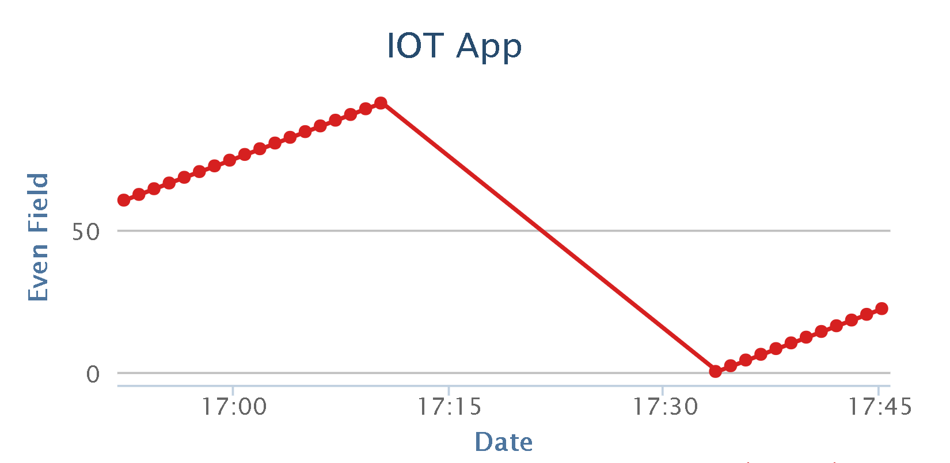
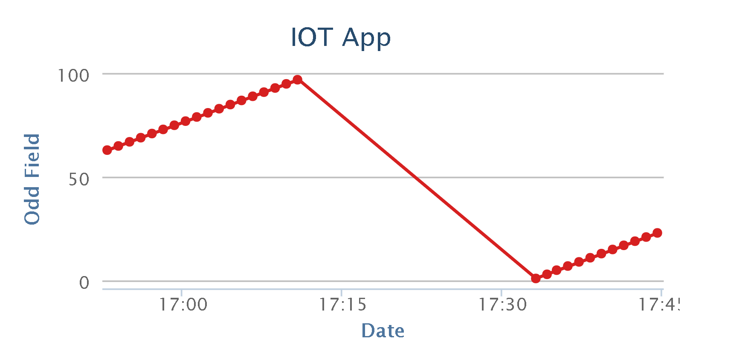
Graph : Data Analysis

Slide 16
Applications
Building an IoT based smart agriculture monitor:
create an IoT based agricultural monitor in which the data of the water content of the soil, and the temperature and humidity of the surrounding environment in which crops grow, is captured and constantly monitored.
Building an IoT based smart irrigation system:
Reading sensor data and selecting thresholds for actuation of a water pump
Interfacing a water pump to a smart farm system using a relay
Automated watering of the soil when the moisture level is low

Slide 17
Bibliography
Circuits4you.com
https://community.thingspeak.com
Cisco thingQbator – Cisco
www.electronicshub.org/connect-esp8266-to-thingspeak/

Slide 18


