Slide 1

CypherBlock
A Decentralized Crowdfunding Platform Using Blockchain over Ethereum Network.
Presented by-
Harsh deep
Harsh Raj

Slide 2
Problem Statement
Projects on popular crowdfunding sites go through little to no vetting, resulting in fraud and scams.
Many projects fail because the creators cannot reach their milestones.
Trust issues of centralized platform.
High commission charged b these platform.

Slide 3
How We Plan to Improve Crowdfunding
Blockchain enables us to add features and create an experience that is not possible today. A healthy crowdfunding ecosystem has three constituents: the creators,the backers,and the community. Currently, there is a single exchange: a backer pledges funds to a campaign. All other interactions are low engagement.
Centralized
CypherBlock
Decentralized
Improving Crowdfunding Platform

Slide 4
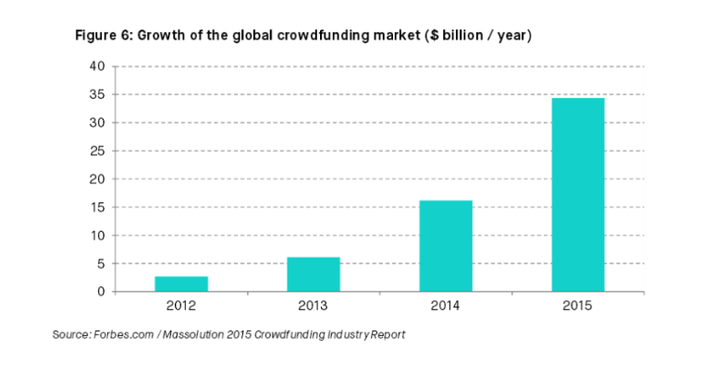
Leveraging the blockchain, we can encourage creators to share regular updates with backers or provide monetary rewards for shipping products on time. For backers, we can build a reputation system or incentivize them for asking questions or helping other backers.
Crowdfunding relies on trust and we believe that we can leverage innovative technical solutions to both align interests and increase the level of truth.

Slide 5

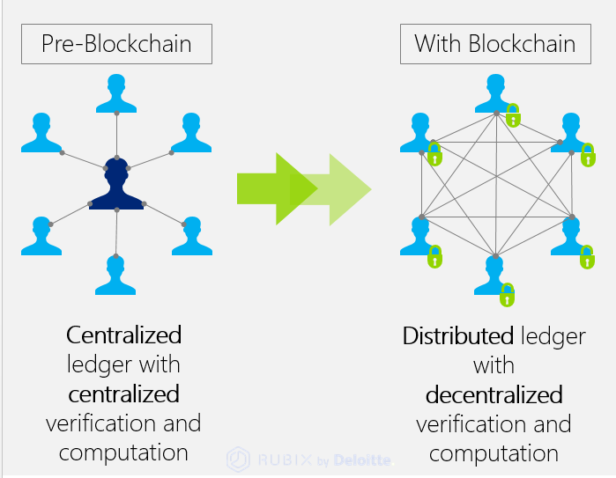
Smart Contracts: Another CypherBlock innovative is Backer Insurance. Leveraging Ethereum’s Smart Contract technology. With Backer Insurance, we hope to better align the interests of creators (building trust and seamlessly raising money) with those of backers (receiving frequent updates and timely product deliveries).
Decentralized Platform: The CypherBlock platform is decentralized, meaning that it’s owned by individual community members, not a private company. Our community members will be able to vote on governance issues, help decide the product direction, and receive benefits for their participation. We understand that a successful crowdfunding platform can only be built on top of a vibrate, engaged community.

Slide 6
Benefits of CypherBlock
CypherBlock is a decentralized crowdfunding platform, which is important for at least five key reasons. Let's explore each of these benefits in detail below:
Online Payments: CypherBlock accepts payments in cryptocurrencies. As a result, we open crowdfunding to millions more around the world,including those who want to use crypto to avoid payment processing fees.
Novel Features: One feature we're particularly excited about is our Market Network, a group of approved investors who can provide services for your campaign. Each investor's reputation and work history is written to an immutable blockchain ledger.

Slide 7
Future Updates
For Creators
Contract charge lower fees, provide more support, and can even be your post-funding storefront. We have the workflow tools and knowledge-base to get your dream project in the hands of your customers.
For Backers
More support for creators means you get your rewards more often, and on time. You also have Backer Protection. Which means you can vote to cancel projects you’ve backed and get a refund-if you lose faith in them.

Slide 8
Thank you

