Slide 1
CipherNet

Slide 2
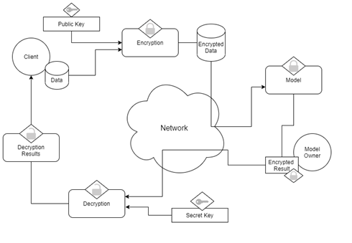
Architecture

Slide 3
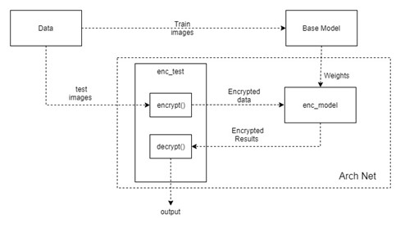
Architecture

Slide 4
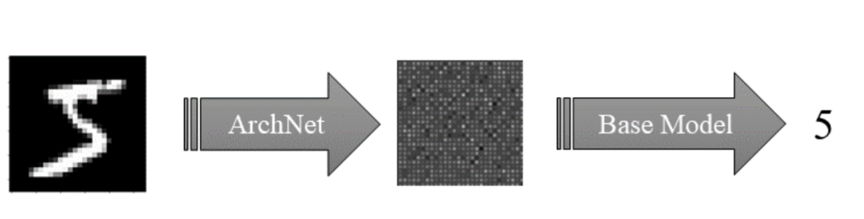
Processing
CipherNet

Slide 5

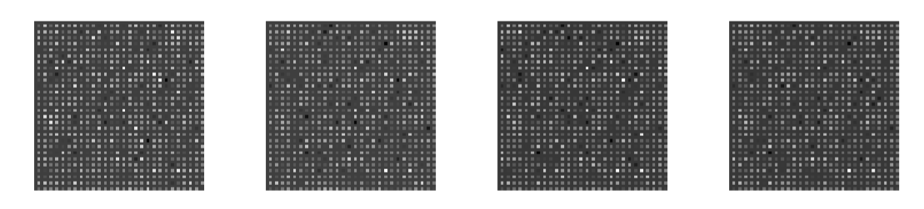
After Passing through the Encryption Model

