Slide 1

HARSH RAJ (24AI06014) ARINDAM PAL (A24CS08003)
Hardware Architecture of Feature Extraction for Real-time Visual SLAM
Under
Dr. Devashree tripathy
Department of Computer Science and Engineering School of Electrical and Computer Sciences
Iit bHUBANESWAR

Slide 2
OUTLINE
Motivation
Problem Statement
Main Contributions
Evaluation Criteria
Experimental Setup
Results & Discussion
Conclusion & Future Work

Slide 3
Motivation
Why Hardware for Visual SLAM?
Software algorithms on general CPUs are not optimized for the intensive, real-time requirements of SLAM.
Task-specific hardware (FPGAs/ASICs) can provide significant gains in speed and energy efficiency, critical for mobile and embedded systems like VR headsets and autonomous robots.
Visual slam enables inside-out tracking, making VR/AR devices more portable and user-friendly.

Slide 4
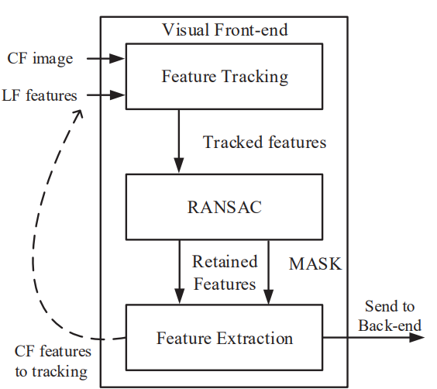
Motivation
Visual SLAM & Feature Extraction
Visual SLAM uses cameras to simultaneously map an environment and localize the agent within it.
Feature extraction is the first and most computationally demanding step in the SLAM pipeline.
Robust feature extraction is essential for accurate mapping and localization, especially in dynamic or low-light environments.

Slide 5
Problem Statement
The Bottleneck in Visual SLAM
Feature extraction (e.g., SIFT, ORB) dominates the computational cost in SLAM pipelines, often consuming over 60% of execution time. Real-time constraints and energy efficiency are not met by CPU-based implementations, especially for high-resolution images or video streams. Without efficient feature extraction, SLAM cannot run in real time on power- and resource-constrained devices.

Slide 6
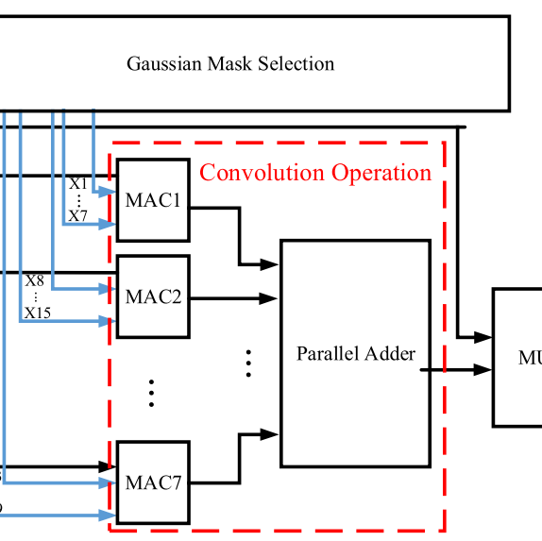
Main Contributions
Project Goals & Contributions
Implemented SIFT feature extraction in both software (Python/C++) and hardware (Verilog).
Designed and simulated a behavioral hardware architecture for SIFT using Xilinx Vivado.
Developed a parallel adder module as a building block for data-parallel operations in SIFT (e.g., convolution).
Outlined a workflow for moving from software to hardware, including simulation and FPGA deployment.

Slide 7
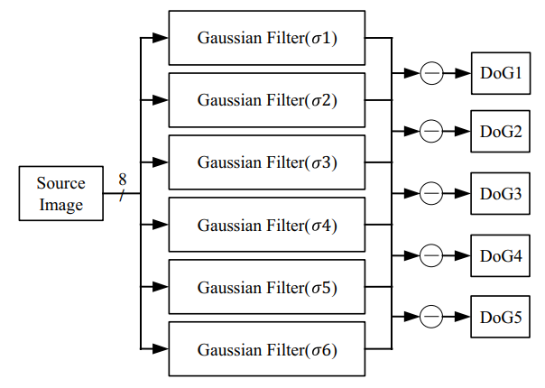
Main Contributions
Technical Innovations
Exploited data parallelism in convolution and other SIFT steps to accelerate processing.
Behavioral Verilog code for parallel adders and other SIFT modules, enabling efficient simulation and future synthesis.
Plan for structural Verilog and FPGA implementation to further optimize performance and resource utilization.

Slide 8
Evaluation Criteria
What Are We Measuring?
Performance: Speedup (execution time per frame)
Energy Efficiency: Estimated or measured power consumption (if FPGA tested)
Accuracy: Number and quality of detected keypoints, matching consistency
Hardware Resource Utilization: Area, memory, and logic usage on FPGA

Slide 9
Evaluation Criteria
Measurement Methods
We compare software (C++/Python) and hardware (Verilog simulation) implementations using the same input images and we use standard test images and sequences for benchmarking.
Collect metrics: number of keypoints, processing time, resource utilization reports from Vivado or FPGA tools.

Slide 10
Experimental Setup
Software Implementation
SIFT implemented using OpenCV in Python and C++ for baseline performance and output validation.
Example code snippets: image loading, grayscale conversion, keypoint detection, and descriptor extraction

Slide 11
Experimental Setup
Hardware Design & Tools
Behavioral Verilog modules for key SIFT operations (e.g., convolution, parallel addition).
Simulation and debugging in Xilinx Vivado; plan for synthesis and FPGA deployment.
Hardware design leverages parallelism for high throughput, as in pipelined FPGA architectures.

Slide 12
Experimental Setup
Testbench & Input Data
Test images: Various resolutions, including high-res (e.g., 1920x1080) and standard (e.g., 384x512).
Testbench for Verilog modules to verify correctness and measure simulated execution time.
Plan for video sequence testing to evaluate real-time capability.

Slide 13
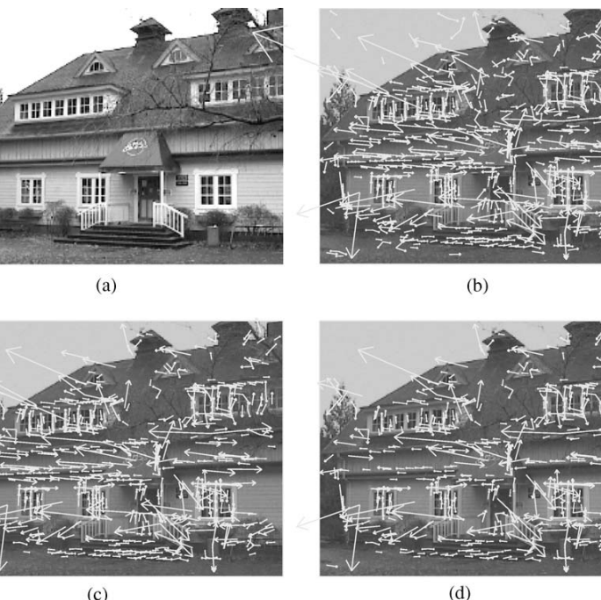
Results and Discussion
Software Results: SIFT Keypoints
Example outputs: Number of keypoints detected, annotated images with keypoints.
Typical performance: SIFT in software can process moderate-sized images at a few frames per second on CPU.

Slide 14
Results and Discussion
Hardware Simulation Results
Behavioral Verilog parallel adder: Demonstrated correct summation of multiple inputs, a key step in convolution.
Simulated SIFT modules show potential for significant speedup due to parallel processing.
Reference: FPGA-based SIFT can process 30 fps at 1920x1080, detecting 1275+ features per frame.

Slide 15
Results and Discussion
Comparative Analysis

Slide 16
Results and Discussion
Discussion: Insights & Challenges
Strengths: Hardware parallelism enables real-time processing and energy savings, crucial for embedded SLAM.
Challenges: Mapping complex algorithms like SIFT to hardware requires careful design (e.g., efficient memory access, pipelining).
Limitations: Current work focuses on behavioral simulation; full structural design and FPGA deployment are next steps

Slide 17
Conclusion and Future Work
Conclusion: Key Takeaways
Hardware acceleration of feature extraction is essential for real-time, energy-efficient SLAM in embedded and mobile devices.
The project demonstrates the feasibility and workflow for moving from software to hardware, with promising simulation results.

Slide 18
Conclusion and Future Work
Next Steps & Future Directions
Complete structural Verilog for SIFT and optimize for FPGA synthesis.
Deploy and benchmark on real FPGA hardware (e.g., Xilinx Zynq).
Extend to other algorithms (ORB, FAST) and integrate with full SLAM pipeline for VR/AR and robotics applications.
Explore further optimizations: memory access patterns, pipelined architectures, low-power design.

Slide 19
Thank you

