Slide 1

Clustering-Based Spectrum Sensing with OFDM Modulation for Cognitive Radio Networks
Presented by - Harsh Raj
DA623(Computing with Signals)

Slide 2
🚀 Motivation
The exponential growth of wireless devices has led to increasing spectrum scarcity.
Cognitive Radio Networks (CRNs) provide a dynamic solution by allowing secondary users to access underutilized frequency bands.
This project explores how unsupervised machine learning can enhance OFDM-based spectrum sensing, making it more adaptive and robust.

Slide 3
🕰️ Historical Context
Traditional spectrum sensing techniques such as:
🔋 Energy Detection
🔍 Matched Filtering
♻️ Cyclostationary Detection
have limitations under noise uncertainty and unknown signal conditions.
📈 Clustering, an unsupervised learning approach, bypasses the need for fixed thresholds, making it suitable for dynamic environments—aligning with the growing use of AI in wireless communications.

Slide 4
🧠 Key Learnings & Contributions
Built a complete OFDM transmitter and receiver using custom FFT/IFFT
Implemented KMeans-based clustering for threshold-free signal detection
Visualized signal energy, clustering output, and performance metrics
Evaluated system using:
✅ ROC Curve
❌ Bit Error Rate (BER)

Slide 5
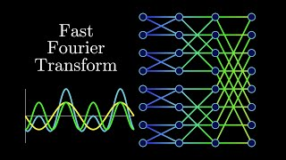
🎮 FFT & IFFT Algorithm Explanation
Following video by Reducible provides a clear and intuitive explanation of FFT and IFFT, crucial to OFDM systems:

Slide 6
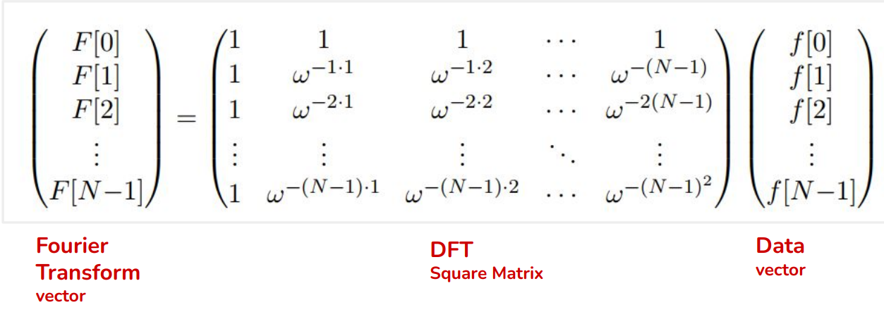
FFT and IFFT algorithm from Scratch
We know that the fourier transform using this method take O(N2) time complexity.
But, in FFT and IFFT algorithm we reduce this complexity to O(NlogN).

Slide 7
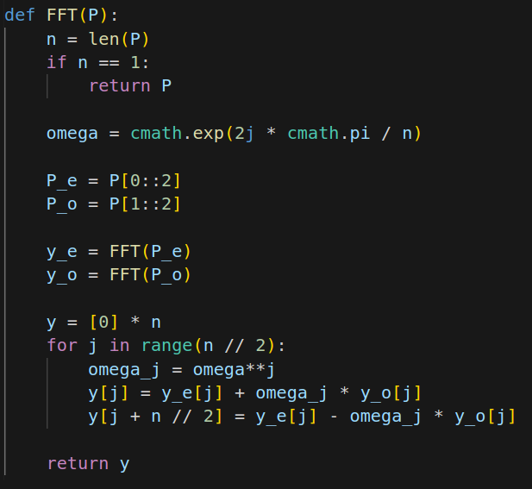
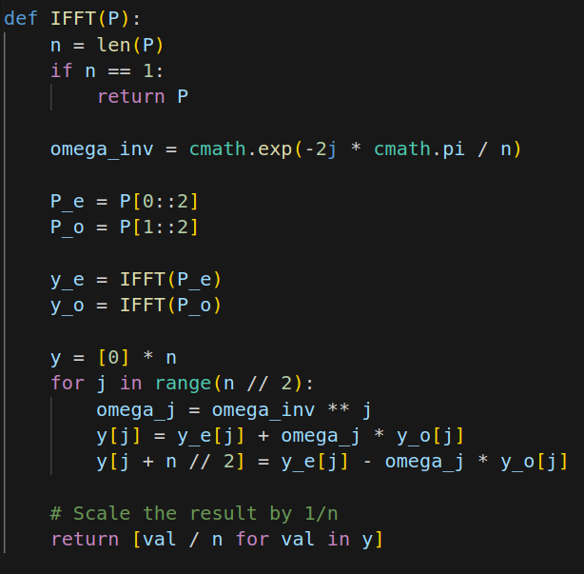
FFT and IFFT algorithm from Scratch

Slide 8
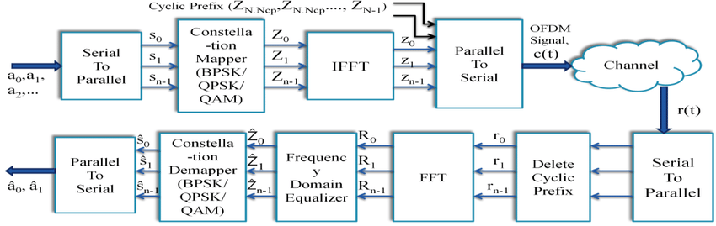
📡 OFDM System Overview
Reference : https://www.researchgate.net/figure/Transmitter-and-Receiver-architecture-of-OFDM_fig2_325283793

Slide 9
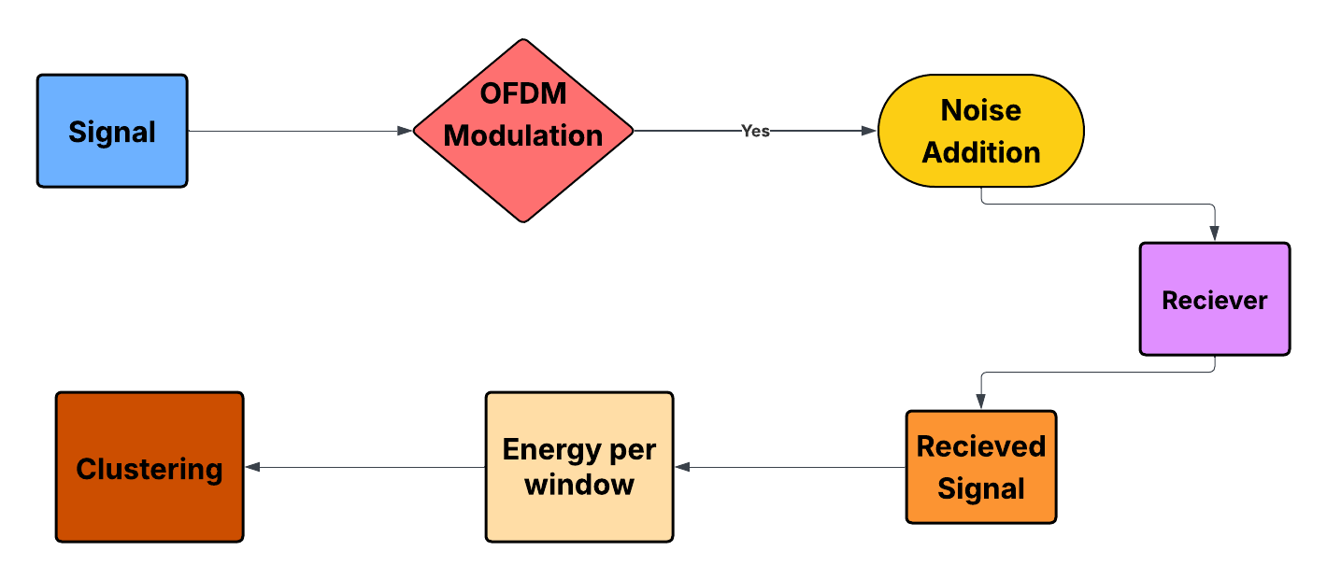
Framework

Slide 10
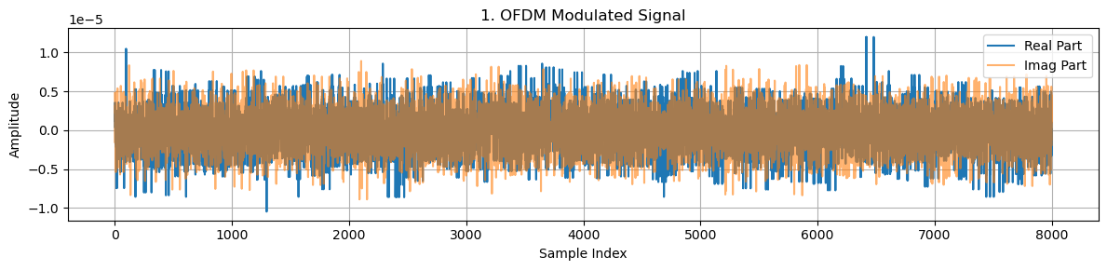
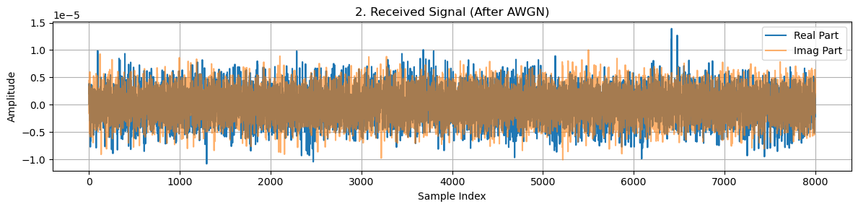
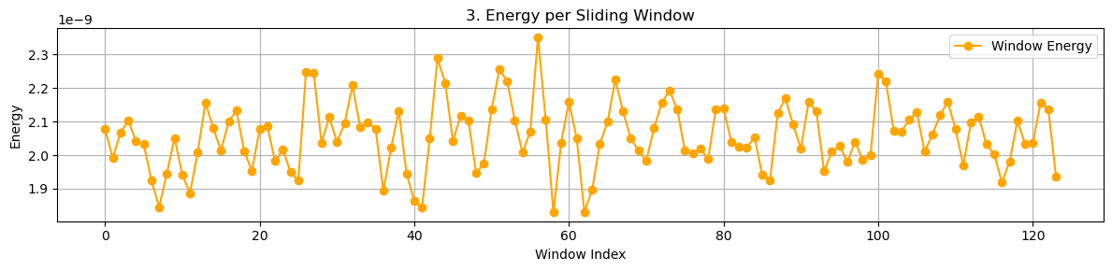
Signals Visualization
🎵 Modulated Signal :
📣 Received Signal :
⚡ Energy per Sliding Window :

Slide 11
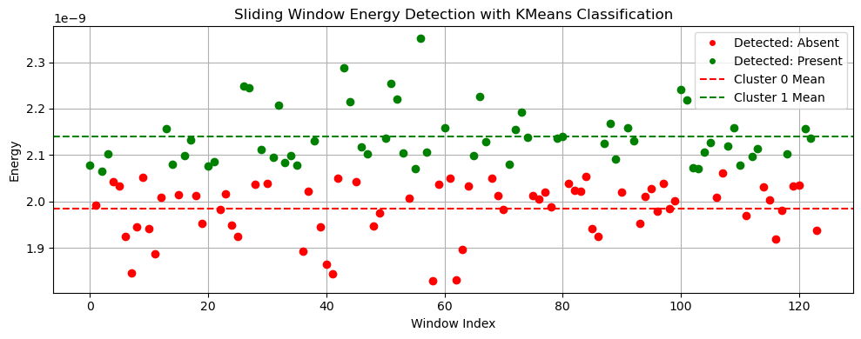
📊 Energy and Clustering Visualization
We can see that above a threshold energy are classified as present and below that is classified as absent. Also the two dotted lines represents mean energy of that class.

Slide 12
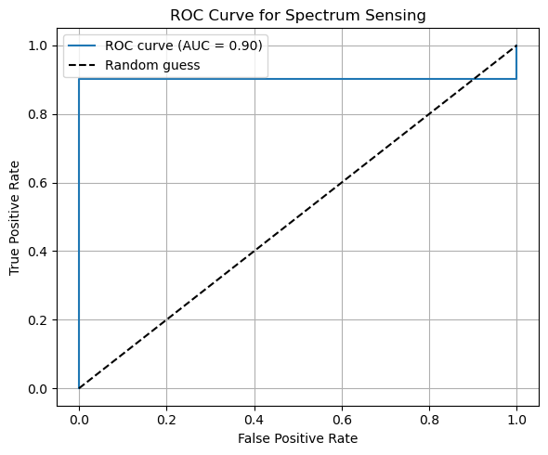
📈 ROC Curve
We can see that Area of ROC curve is 0.9 means our classifier is behaving far better than random guess.

Slide 13
Results and Future Works
We obtained Block Error Rate nearly 0.
Future works :
We can use multiple Reciever to solve real-world problems.
We can use different Fusion Rules like Addition, Max, Majority Rule.
Also co-operative sensing can be implemented using RL to select best neighbors and take all data and then we may use Unsupervised Learning or diff techniques to classify channel is free or busy.

Slide 14

🙏 Thank You!
📘 Colab Notebook: Click to Open
Github Repository : visit github
📬 Contact Me:
📧 harsh.raj@iitg.ac.in
🔗linkedin.com/in/harsh-raj-13b100241

