Slide 2
Banker’s Algorithm
Multiple instances.
Each process must a priori claim maximum use.
When a process requests a resource it may have to wait.
When a process gets all its resources it must return them in a finite amount of time.

Slide 3
Data Structures for the Banker’s Algorithm
Let n = number of processes, and m = number of resources types.
Available: Vector of length m. If available [j] = k, there are k instances of resource type R_{j} available.
Max: n x m matrix. If Max [i,j] = k, then process P_{i} may request at most k instances of resource type R_{j}.
Allocation: n x m matrix. If Allocation[i,j] = k then P_{i} is currently allocated k instances of R_{j.}
Need: n x m matrix. If Need[i,j] = k, then P_{i} may need k more instances of R_{j} to complete its task.
    Need [i,j] = Max[i,j] – Allocation [i,j].

Slide 4
Safety Algorithm
The algorithm for finding out whether or not a system is in a safe state can be described as follows:

Slide 5
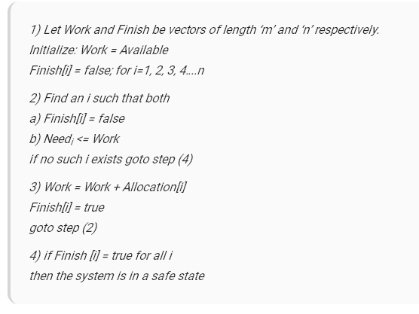

Slide 6
Resource-Request Algorithm
Let Request_{i} be the request array for process P_{i}. Request_{i} [j] = k means process P_{i} wants k instances of resource type R_{j}.
When a request for resources is made by process P_{i}, the following actions are taken:

Slide 7
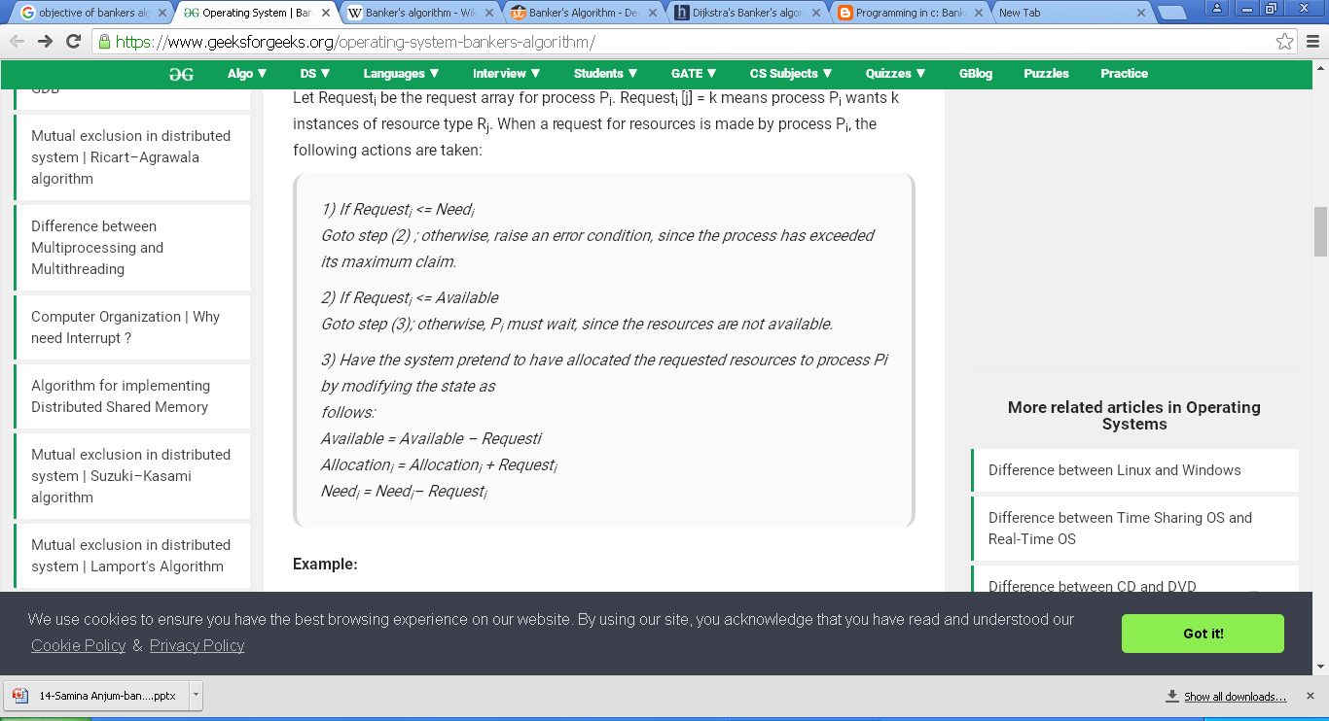

Slide 8
Example:
Considering a system with five processes P₀ through P₄ and three resources of type A, B, C.
Resource type A has 10 instances, B has 5 instances and type C has 7 instances.
Suppose at time t₀ following snapshot of the system has been taken:

Slide 9
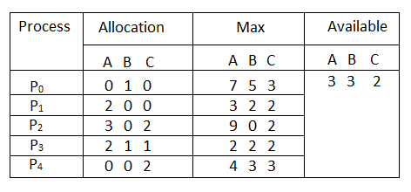

Slide 10
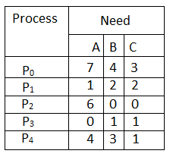
Question1. What will be the content of the Need matrix?
Need [i, j] = Max [i, j] – Allocation [i, j]
So, the content of Need Matrix is:

Slide 11
Question2. Is the system in a safe state? If Yes, then what is the safe sequence?
Applying the Safety algorithm on the given system,

Slide 12
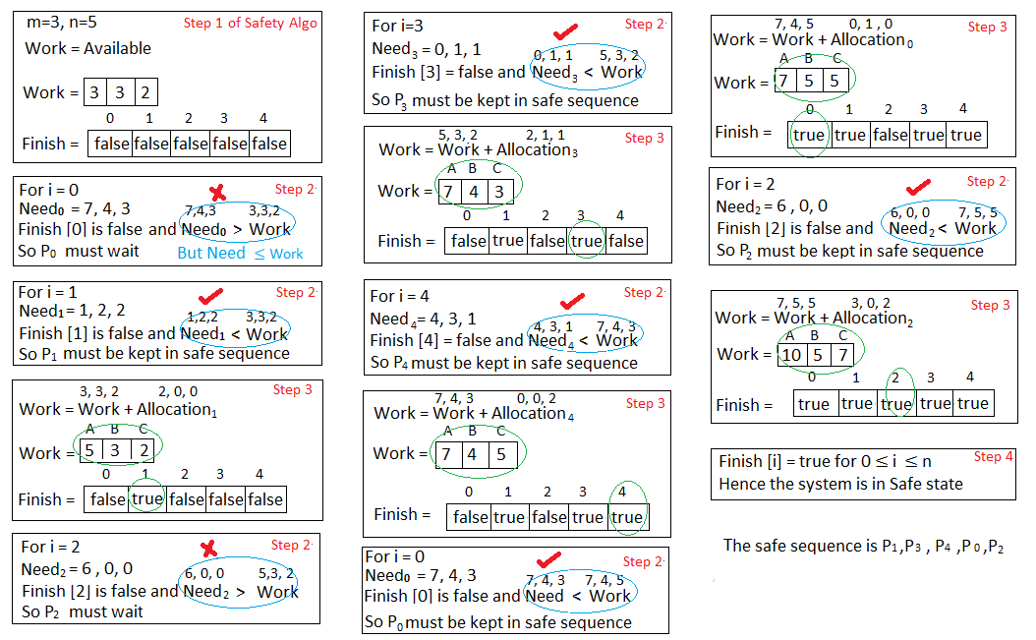

Slide 13
Question3.
What will happen if process P₁ requests one additional instance of resource type A and two instances of resource type C?

Slide 14
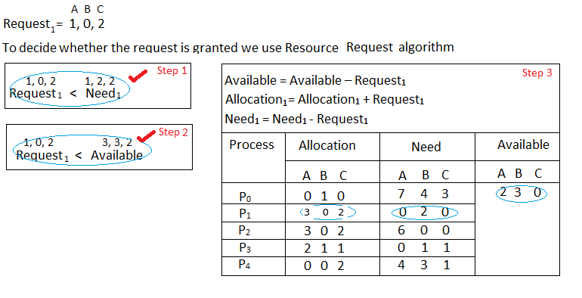

Slide 15
We must determine whether this new system state is safe.
To do so, we again execute Safety algorithm on the above data structures.

Slide 16
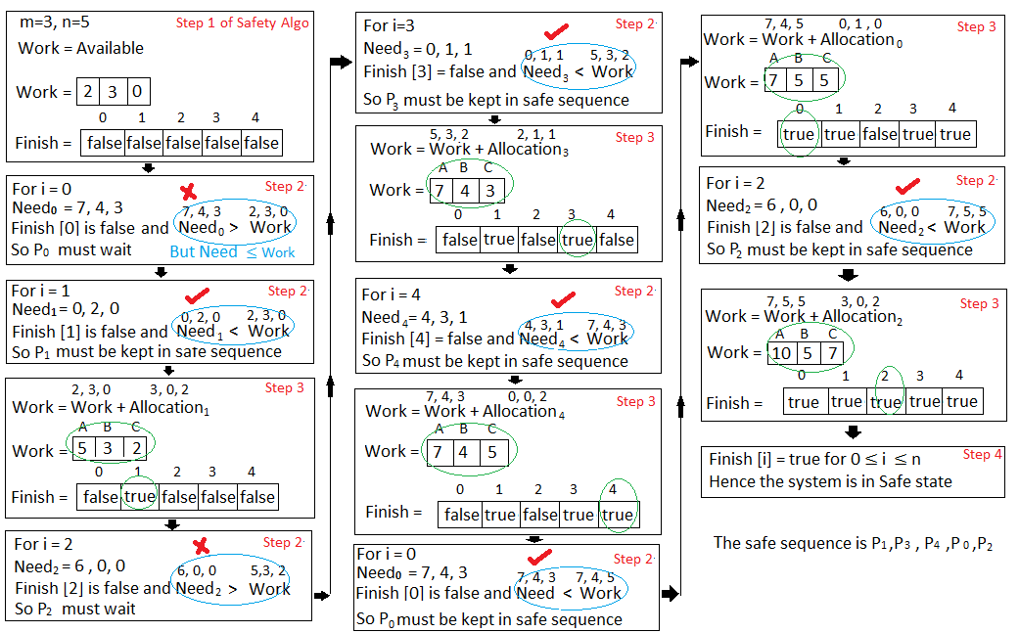

Slide 17
Hence the new system state is safe, so we can immediately grant the request for process P_{1 .}

Slide 18
Program:
import java.util.Scanner;
public class Bankers{
private int need[][],allocate[][],max[][],avail[][],np,nr;
private void input(){
Scanner sc=new Scanner(System.in);
System.out.print("Enter no. of processes and resources : ");
np=sc.nextInt(); //no. of process
nr=sc.nextInt(); //no. of resources
need=new int[np][nr]; //initializing arrays
max=new int[np][nr];
allocate=new int[np][nr];
avail=new int[1][nr];

Slide 19
System.out.println("Enter allocation matrix -->");
for(int i=0;i<np;i++)
for(int j=0;j<nr;j++)
allocate[i][j]=sc.nextInt(); //allocation matrix

Slide 20
System.out.println("Enter max matrix -->");
for(int i=0;i<np;i++)
for(int j=0;j<nr;j++)
max[i][j]=sc.nextInt(); //max matrix
System.out.println("Enter available matrix -->");
for(int j=0;j<nr;j++)
avail[0][j]=sc.nextInt(); //available matrix
sc.close();
}

Slide 21
private int[][] calc_need(){
for(int i=0;i<np;i++)
for(int j=0;j<nr;j++) //calculating need matrix
need[i][j]=max[i][j]-allocate[i][j];
return need;
}

Slide 22
private boolean check(int i){
//checking if all resources for ith process can be allocated
for(int j=0;j<nr;j++)
if(avail[0][j]<need[i][j])
return false;
return true;
}

Slide 23
public void isSafe(){
input();
calc_need();
boolean done[]=new boolean[np];
int j=0;
while(j<np){ //until all process allocated
boolean allocated=false;

Slide 24
for(int i=0;i<np;i++)
if(!done[i] && check(i)){ //trying to allocate
for(int k=0;k<nr;k++)
avail[0][k]=avail[0][k]-need[i][k]+max[i][k];
System.out.println("Allocated process : "+i);
allocated=done[i]=true;
j++;
}
if(!allocated) break; //if no allocation
}

Slide 25
if(j==np) //if all processes are allocated
System.out.println("\nSafely allocated");
else
System.out.println("All proceess cant be allocated safely");
}
public static void main(String[] args) {
new Bankers().isSafe();
}
}

Slide 26
Output:
Enter no. of processes and resources : 3 4
Enter allocation matrix -->
1 2 2 1
1 0 3 3
1 2 1 0
Enter max matrix -->
3 3 2 2
1 1 3 4
1 3 5 0
Enter available matrix -->
3 1 1 2
Allocated process : 0
Allocated process : 1
Allocated process : 2
Safely allocated

