Slide 1

Sauchalaya.in

Slide 2

OUR BIG IDEA
Sauchalaya.in is first of its kind web portal that lists availability of public toilets ready to use which helps travelers and citizens to get helped in crucial situation.
*Solving GH152 >> Citizens and travellers need to be informed about the location of multiple common toilets

Slide 3

Awareness
Availability
Cleanliness
Current Problems
Women Friendly

Slide 4
NEEDS
Less Information about such public toilets leads people to go for toilet in open, which then makes the city dirty and polluted.
To improve cleaning efficiency.
Increasing user adoption.
For women it's much harder to find a public toilet.
You always run risk of getting an infection using dirty toilets.
We are using lots of money in Swachh Bharat campaign but rarely checking the grass root of this, which decreases the impact of the Campaign !

Slide 5

OUR OFFERINGS
Review Data
User Friendly
Add/Update Data
Feedback/Rating System
Locate nearby toilets
Interactive Chat Bot
Multi - lingual
Realtime Availability
Just 10 sec away

Slide 6
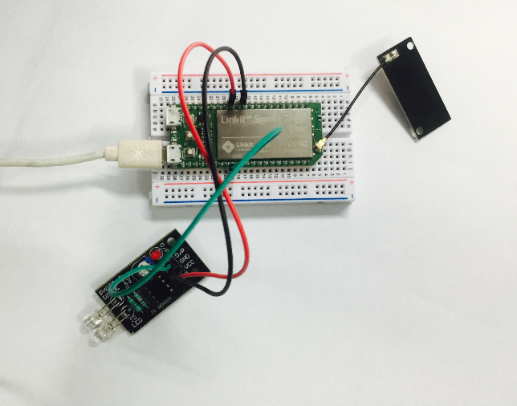
Realtime Availability
Adding new approach to check the real time availability of the public toilets available nearby.
We are using Micro Controller (eg , NodeMCU) & IR Sensor.
Advantages:
Accurate Data with no Human errors.
24*7 Real-Time Status
Cheaper Hardware (approx. INR 200)
Disadvantages:
Hardware Maintenance.

Slide 7
Future Enhancement
Android / ios App
Analytics
Robust Rating system
Facebook Messenger Bot

Slide 8

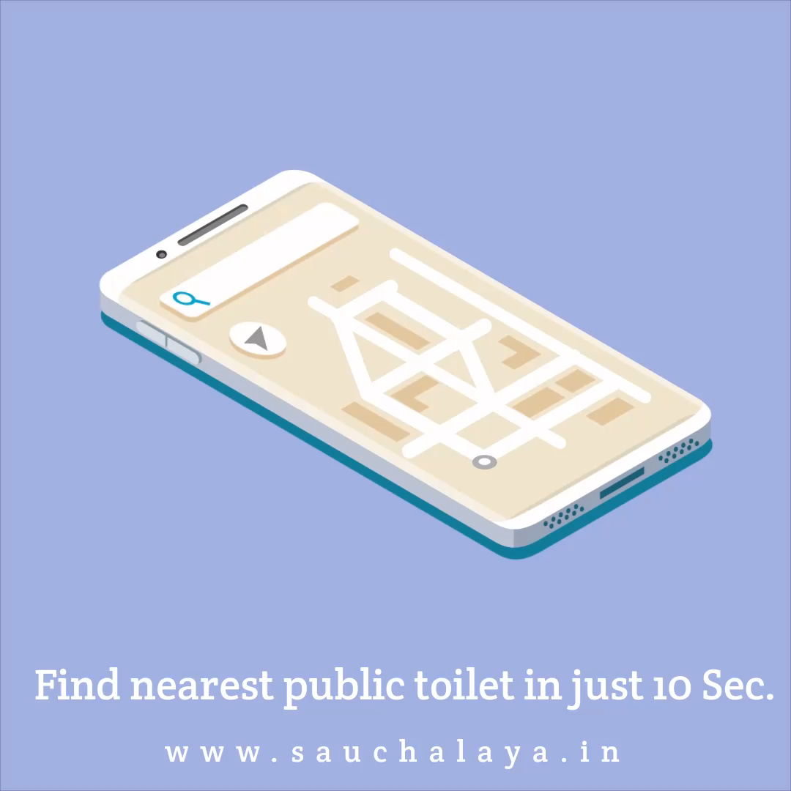
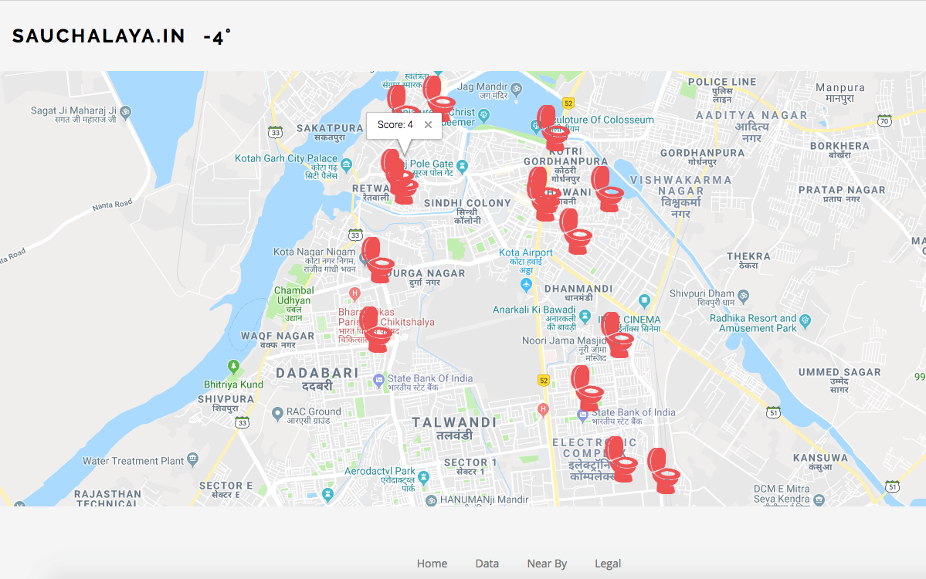
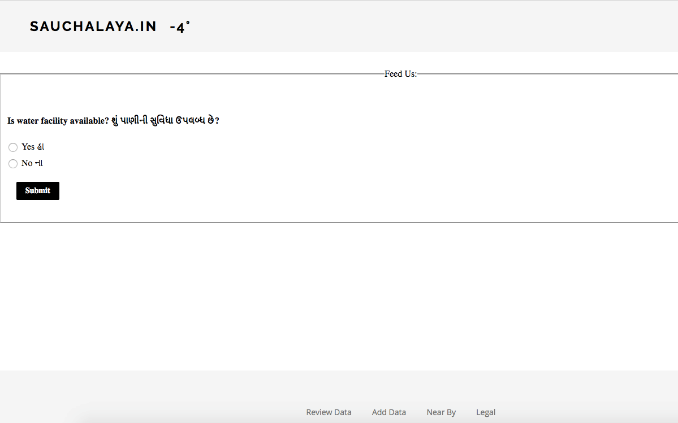
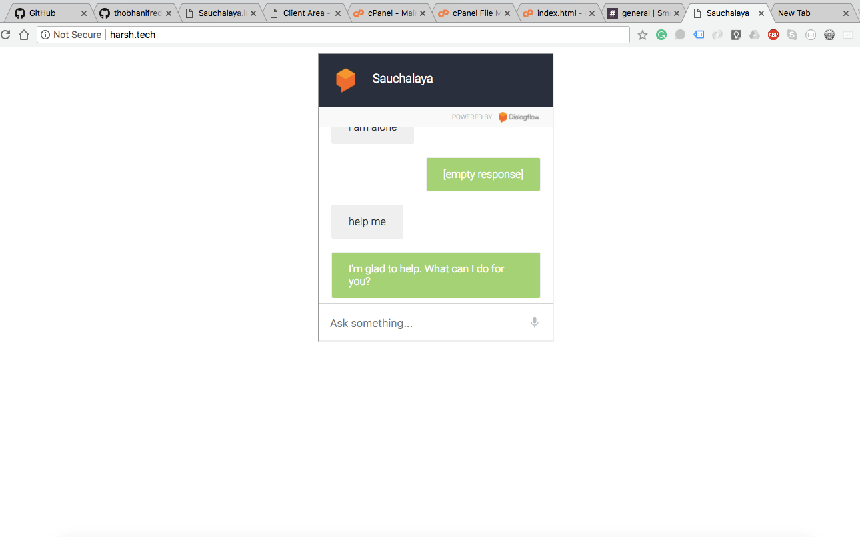
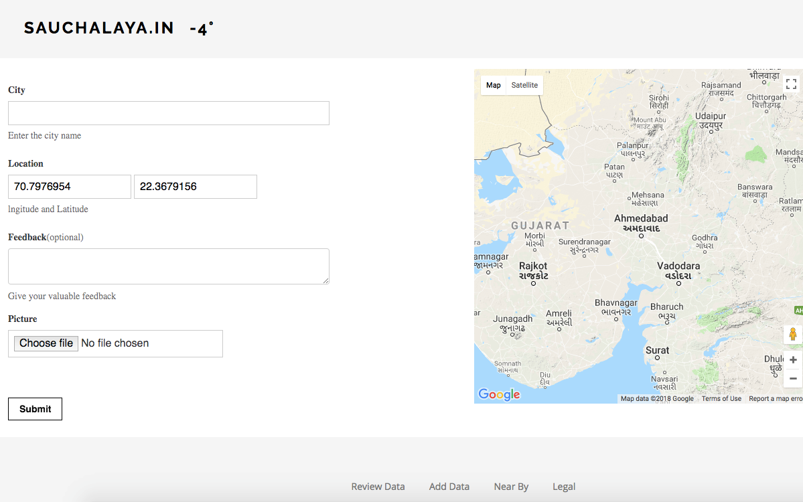
Web UI
Mobile App UI

Slide 9

THANK YOU!
CONTACT US AT :
harshranpariya@gmail.com
+91 8866493758

