Slide 1
c ++ language
Presented by gayatri bharti

Slide 2

Introduction
- Importance of learning about examples and codes
- Overview of the presentation
Keywords: Introduction, Examples and Codes

Slide 3

Importance of Examples
- Understanding the significance of using examples in learning
- Benefits of learning through real-life scenarios
Keywords: Importance, Examples

Slide 4

Types of Examples
- Different types of examples (e.g., case studies, demonstrations)
- Explanation of each type and its purpose
Keywords: Types, Examples

Slide 5

Uses of Codes
- Exploring the various applications of codes
- How codes are used in different industries and fields
Keywords: Uses, Codes

Slide 6
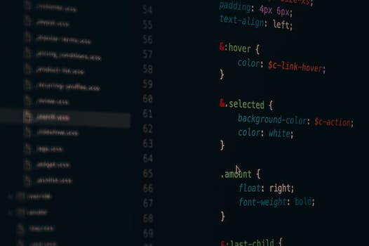
Importance of Learning Codes
- Understanding the value of learning codes in the digital age
- How coding skills can enhance career opportunities
Keywords: Importance, Learning Codes

Slide 7

Basic Coding Concepts
- Introducing fundamental coding concepts
- Simple explanations of terms like variables, functions, and loops
Keywords: Basic Coding, Concepts

Slide 8

Example 1: Case Study
- Presenting a detailed case study to illustrate the use of codes
- Discussing the problem, solution, and code implementation
Keywords: Example 1, Case Study

Slide 9

Example 2: Code Demonstration
- Showing a live demonstration of coding in action
- Step-by-step breakdown of the code and its functionality
Keywords: Example 2, Code Demonstration

Slide 10
Credits
Images provided by Pexels: https://www.pexels.com

