Slide 1
M&H Website
UI Showcase & Design Presentation

Slide 2

Home Page

Slide 3
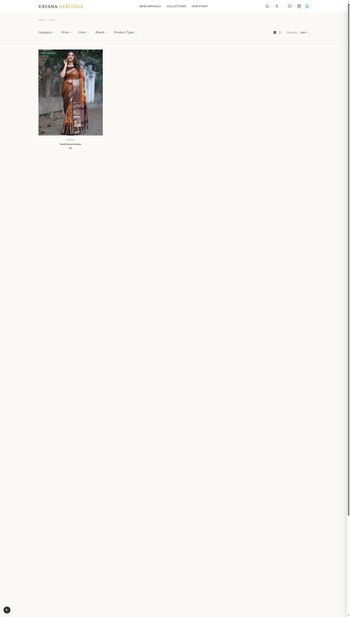
Product Listing (Shop)

Slide 4
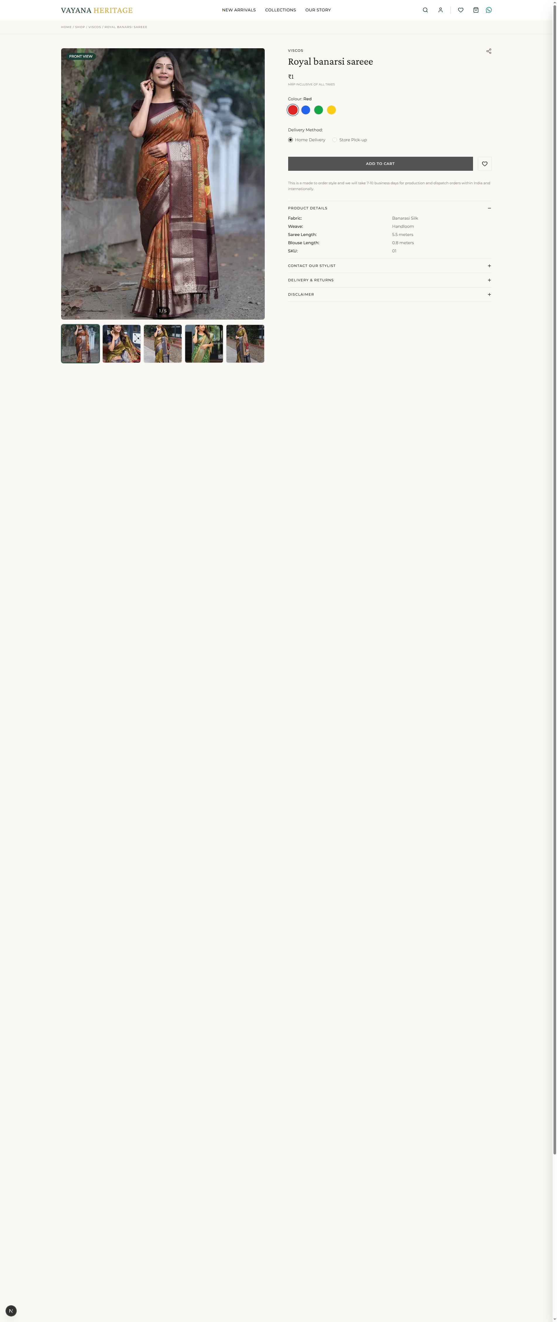
Product Detail Page

Slide 5
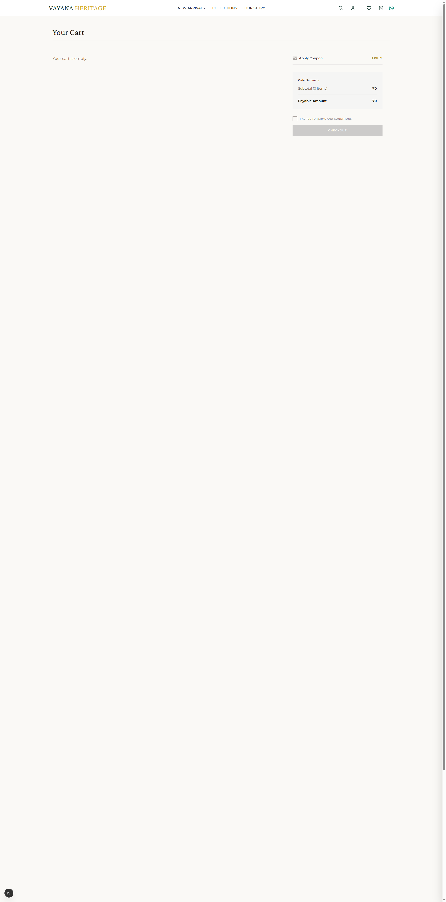
Shopping Cart

Slide 6

Checkout

Slide 7

User Profile

Slide 8
Thank You

