Slide 1

COMP8700 | INTRO: ARTIFICIAL INTELLIGENCE
Title Of The Paper
Real-Time Parking Space Detection and Management with Artificial Intelligence and Deep Learning System
Authors: Shukla, S., Gupta, R., Garg, S., Harit, S., & Khan, R.
HARSHKUMAR SABHAYA
Sabhayah@uwindsor.ca
March 6, 2024

Slide 2
Key elements of summary
Introduction
Problem
Methodology
Experiments
Result
Discussion
Conclusion
References

Slide 3
Introduction
Parking space management in urban areas remains a persistent challenge as the demand for cars continues to surge, but there aren't enough places to park them.
Existing solutions such as barriers and ground sensors placed on every parking space, are expensive and mostly not feasible in every scenario.
But author's innovative solution utilizes live video streams to simultaneously monitor parking spaces, predict availability, and detect anomalies in real-time [2].
Solution combines Convolutional Neural Networks (CNN) and Long Short-Term Memory (LSTM) models with deep learning techniques for cost-effective and comprehensive urban parking management, improving public safety [1]

Slide 4
Problem
What are the challenges of urban parking management ?
Limited Parking Space: Urban areas often face a shortage of parking spaces due to the increasing number of vehicles.
Inefficient Management: Conventional parking management systems rely on manual methods, leading to inefficiencies in space utilization and allocation.
High Costs: Implementing and maintaining traditional parking systems, such as manned parking lots or physical ticketing systems, can be expensive for both authorities and users.
Traffic Congestion: Poorly managed parking contributes to traffic congestion as drivers circle around in search of parking spaces, leading to environmental and economic impacts.

Slide 5
Methodology
Parking Occupancy Detection
Methodology aims to address parking space congestion through a deep learning-based framework.
The process involves utilizing surveillance cameras installed in parking spaces to provide real-time footage
This footage is fed into a system, and it will detect as slot are classified as free or occupied spaces, with live updates sent to a hosted server connected to mobile and web applications.
Parking Space Prediction
The Recurrent Neural Network (RNN) model processes the data over time, incorporating factors such as day, time, and weather conditions. While initial accuracy may vary, the accumulation of a large dataset with diverse conditions is expected to improve predictive results through a LSTM model [6].

Slide 6
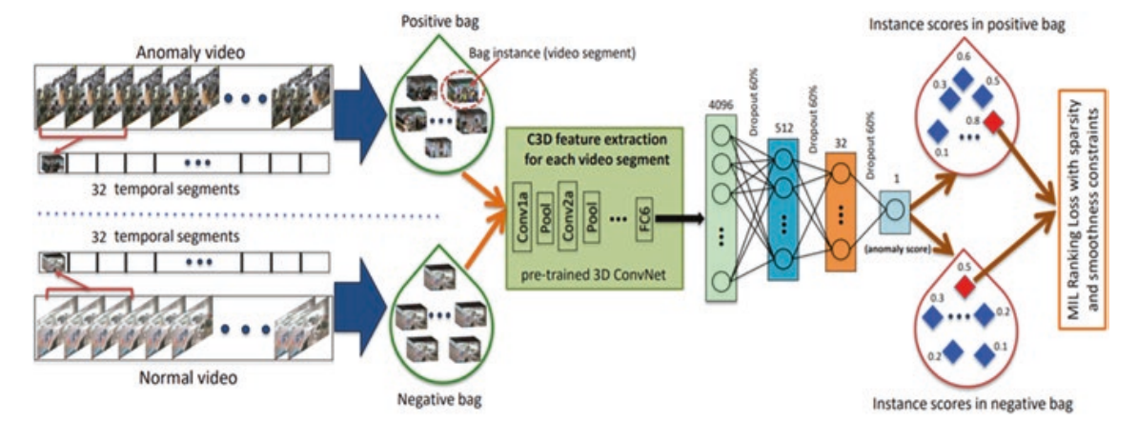
Methodology
Anomaly detection using Deep learning
The live stream frames are input into an anomaly detection model to identify parking space anomalies, including theft, accidents, explosions, and fights [4, 5].
Notifications about these activities are sent to the administrator in real time, enabling quick action.

Slide 7
Experiments
The authors performed experiments using the CNRPark datasets, particularly CNRPark+EXT, consisting of approximately 150,000 labeled images [1, 2].
Training and validation were conducted on a Convolutional Neural Network (CNN) model, utilizing 70% of the data for training and 30% for validation.
The dataset, collected from November 2015 to February 2016, includes various weather conditions and nine cameras with different perspectives capturing diverse situations, including partial occlusion patterns caused by obstacles like trees and lampposts.

Slide 8
Results
The authors say they made a smart parking system which can tell if a parking space is taken or not with about 97.5% accuracy. It works well in different weather like sunny or rainy days.
The system is quick, taking only 2 seconds to check all parking spaces in one picture.
The system can even predict when traffic will be busiest, so people can plan and book parking spots in advance.
The authors made sure the system runs by itself without needing people to help. They also added a smart security system to watch for 13 different issues like Accident, Stealing, Fighting, Explosion, and many more.

Slide 9
Discussion
The research introduces a promising solution for urban parking challenges through the integration of Convolutional Neural Networks (CNN) and Long Short-Term Memory (LSTM) models.
However, this research does not provide the potential challenges may arise from factors like varying camera heights and image clarity, impacting detection accuracy.
Moreover, research falls short in addressing critical aspects such as real-world implementation challenges, potential issues with user acceptance and the adaptability of the proposed system to diverse scenarios.

Slide 10
Conclusion
In conclusion, Smart Parking Management System, utilizing deep learning models for occupancy detection, space prediction, and anomaly detection, offers an efficient and automated solution.
The system provides a cost-effective and reliable approach to address the challenges of urban parking, ensuring user convenience and enhancing overall parking space management.

Slide 11
References
Amato, G., et al. (2017). Deep learning for decentralized parking lot occupancy detection. Expert Systems with Applications, 72, 327–334.
Amato, G., et al. (2016). Car parking occupancy detection using smart camera networks and deep learning. In 2016 IEEE symposium on computers and communication (ISCC). IEEE.
Sultani, W., Chen, C., & Shah, M. (2018). Real-world anomaly detection in surveillance videos. In Proceedings of the IEEE conference on computer vision and pattern recognition. IEEE
Yadav, S. P., Mahato, D. P., & Linh, N. T. D. (2020). Distributed artifcial intelligence: A modern approach (1st ed.). CRC Press.
Tran, D., et al. (2015). Learning spatiotemporal features with 3d convolutional networks. In Proceedings of the IEEE international conference on computer vision. IEEE.
Yadav, S. P. (2020). Vision-based detection, tracking and classifcation of vehicles. IEIE Transactions on Smart Processing and Computing, 9(6), 427–434.

Slide 12

Thank you

Slide 13

Any Questions?

