Slide 1
Medical & Blood-bank

Slide 2
Group N0:- 40630
Member:-
Sahil (160770107184)
Rajshree (160770107185)
Jully (160770107175)
Sarthak (160770107160)

Slide 3
Our topic is “MEDICAL AND BLOOD-BANK” which is related with a normal person’s life and their problems related to choose proper medications in the life.
Why This Topic:-
We decided this topic because in our country more than half of the population faces problems in the medical field here most of the people fail to choose a proper doctor or get a proper medication other than this people also fail to get blood at an emergency.

Slide 4
Problem:-
In medical environment at that time if one person need blood or medicines then he/she wait in line at blood-bank or medical store.
That waiting time at blood-bank or medical store is waste, and because of that waste of time sometime person is dead because of lack of blood or medicines.
Sometimes every person does not have full knowledge of disease. Because of that person not understand his/her problem very well and that person not for doctor's help.

Slide 5
Solution:-
we are developing one website as a solution of that, in this web-site we are providing some details about medical store and blood-bank and their name, location on map, address, phone number.
We are also providing information about different type of medical disease with the help of documentation file and images. So every person have batter understanding of different disease.
In network, there are some Website is already hosted about medical and blood-bank. But, that website providing information only for one like medical or blood-bank.
In our website medical and blood-bank information is both provided at the same time and also doctor’s information and documentation file and images on different disease.

Slide 6
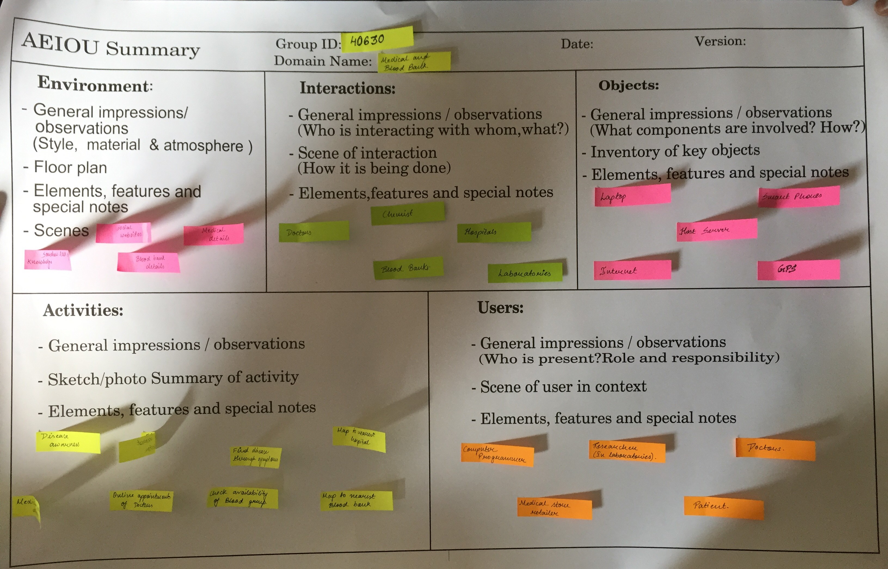
A.E.I.O.U

Slide 7
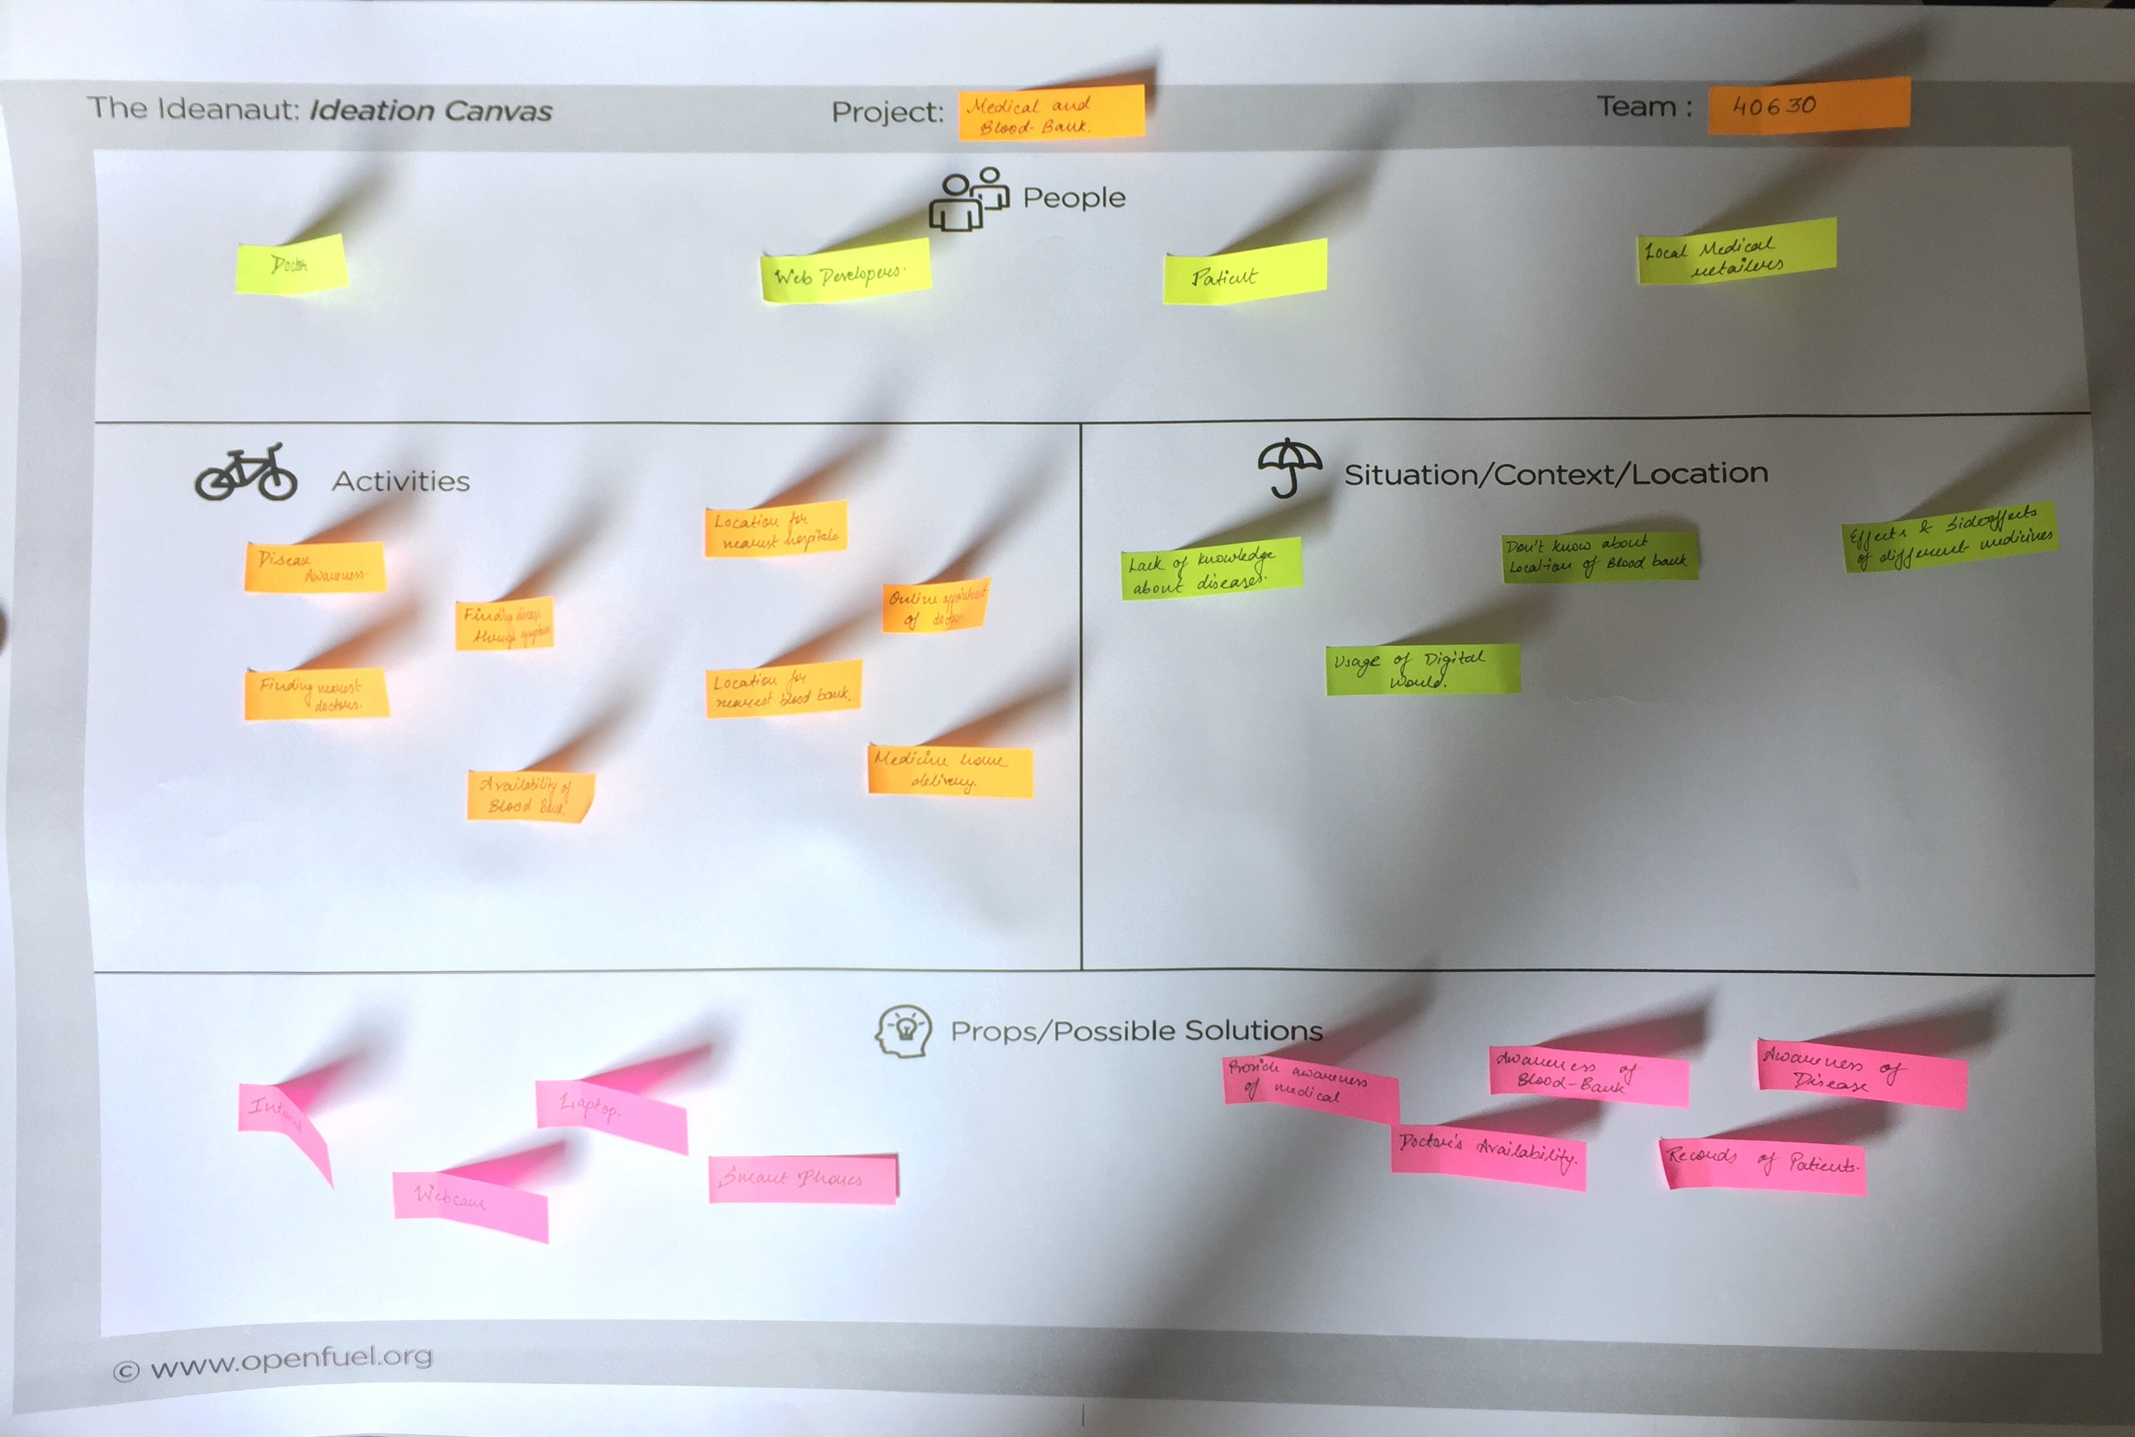
Ideation

Slide 8
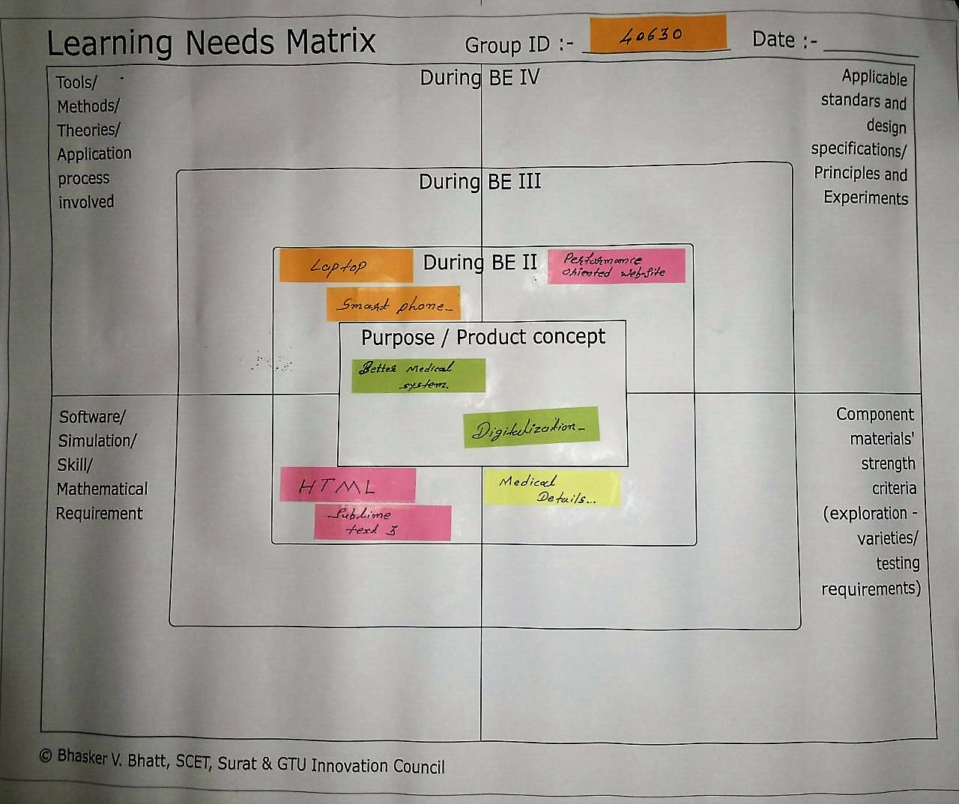
L.N.M

Slide 9
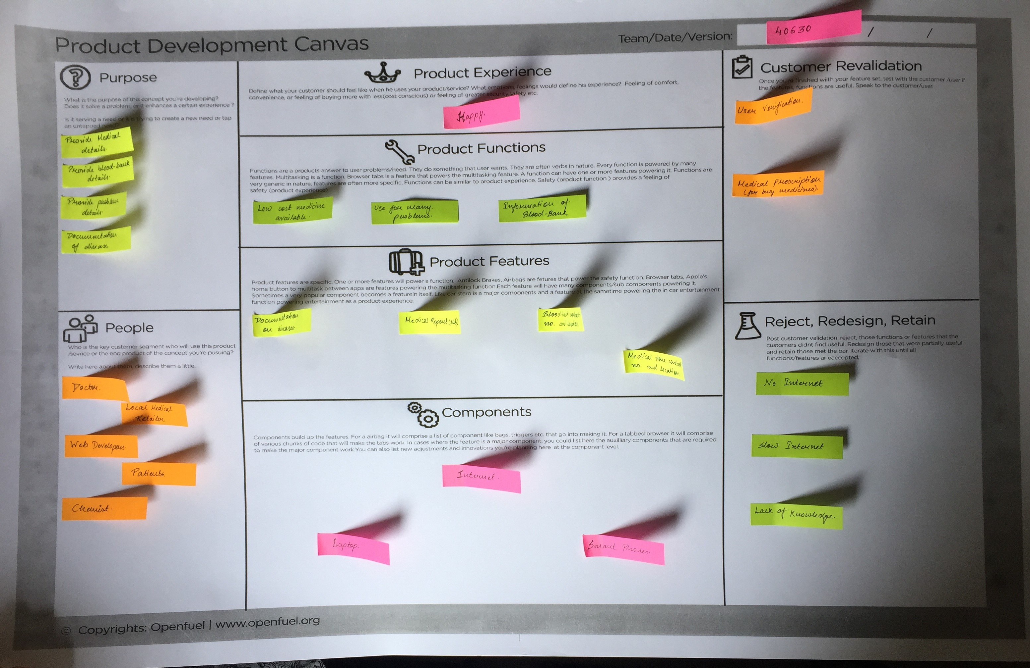
P.D.C

Slide 10
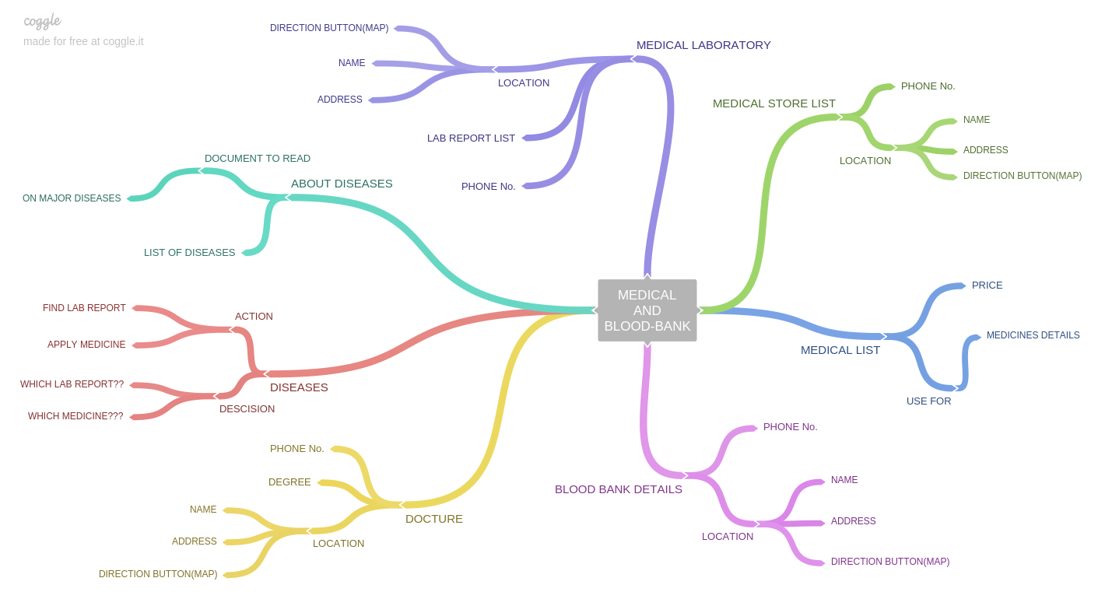
MIND-MAP

Slide 11
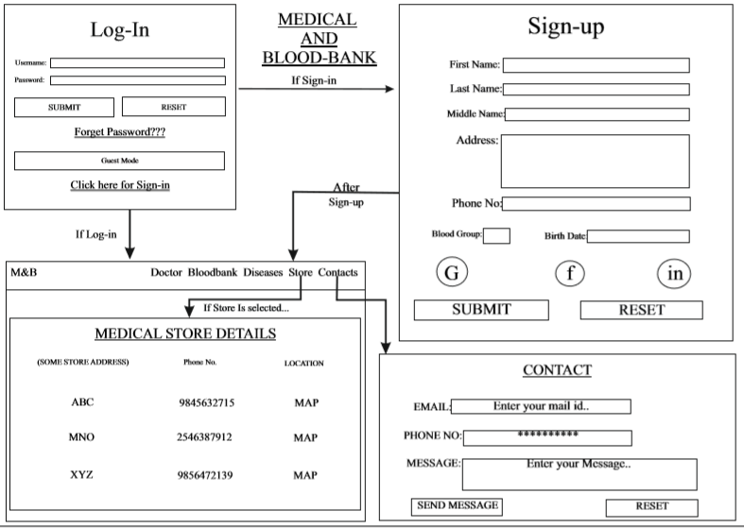
PROTOTYPE

Slide 12
We not be able to solve all the problems related this but we could start a new process where we would try to solve as much as problems related to medicine and try to prevent as much as suffering that is happening in our country.
This website is made as user friendly as possible so that a normal person can also operate it and would not any external help. Also a rating area will be kept so that other users would get an idea of the experience of other users.

Slide 13
THANK YOU

