Slide 1


Slide 2
Group Members
Ashima Lalwani 160770107069
Sahil Patel 160770107158
Sahil Rajput 160770107184
Shivangi Goel 160770107215
Krupa Patel 160770107129
Harsh Sabhaya 160770107191
Team ID - 83802

Slide 3
Engineering Tools

Slide 4
INTRODUCTION
Many websites are available in web-world.
The main objective for doing this project is, there is no such website which provides all engineering related tools for all engineering fields at one place.
We are also providing information for tools,
To understand how that tool works ?
What kind of things can be made from those tool.
Tutorials for those tools.
To provide information we are providing pdfs, ppts, videos, and blogs etc.

Slide 5
OBJECTIVES:
Single place for engineer
Less time consuming
Provide information

Slide 6
TOOLS & TECHNOLOGIES :
Front End: | Html, CSS, JavaScript, JQuery, Bootstrap
Back End: | Python-Django, SQL
Database: | SqlLite3

Slide 7
Software Development Life Cycle Model
Here, we are using rapid application development (RAD) model
There are total five stages of RAD model
Business modelling
Data modelling
Process modelling
Application modelling
Testing and turnover

Slide 8
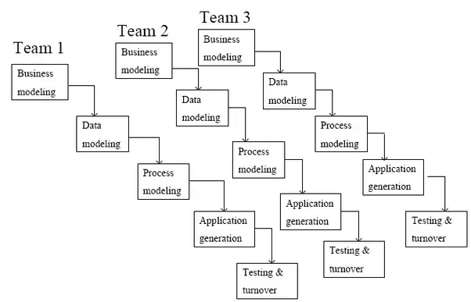
Rapid application development

Slide 9
Why Rad Sdlc Model …
Advantages of rad model,
Fast application development and delivery.
Visualization of progress.
Less resources required.
Very flexible if any changes required.
Cost effective.
Good for small projects.

Slide 10
Disadvantages of RAD model
Difficult to manage.
Not a good process for long term and big projects.
Proper modularization of project required.
Feedback always required
When rad model should be used
When it’s easy to modularize the project.
If development needed to complete in specified time.
Rad model is suitable if the functionality have less dependencies on other functionality.

Slide 11
Modules in project
Customer
Seller
Admin

Slide 12
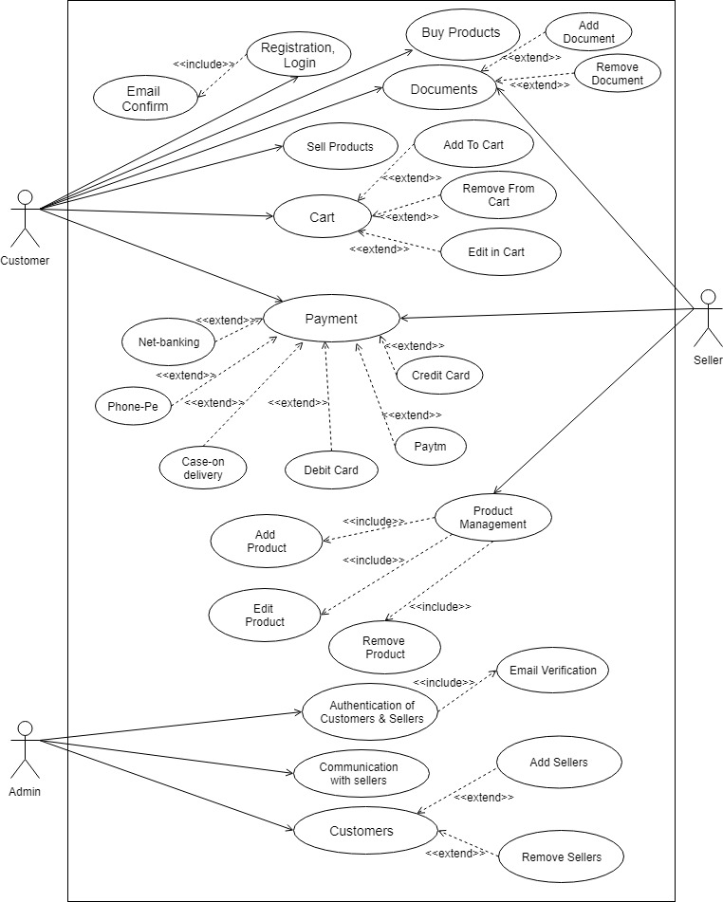
USE-CASE DIAGRAM

Slide 13
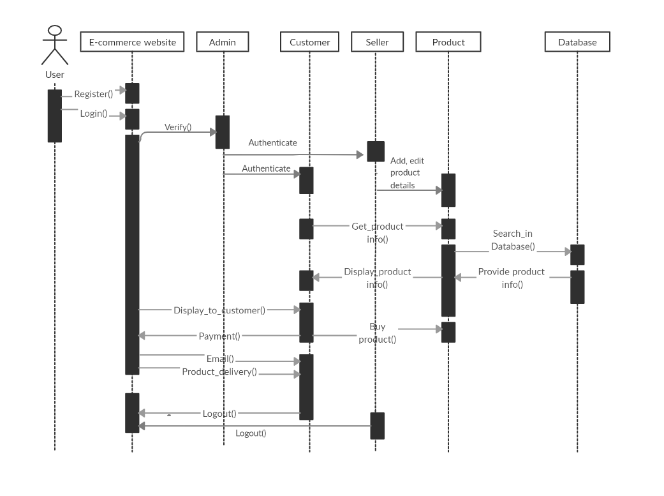
SEQUENCE DIAGRAM

Slide 14
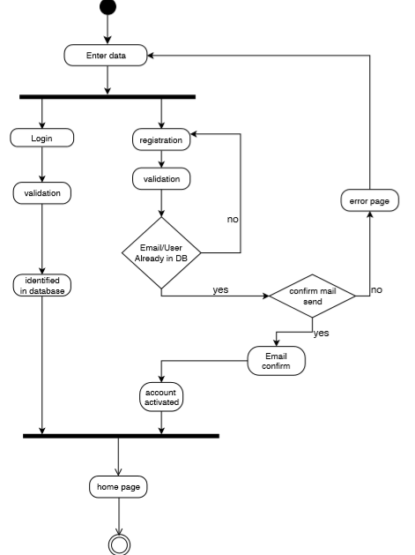
ACTIVITY DIAGRAM-authentication

Slide 15
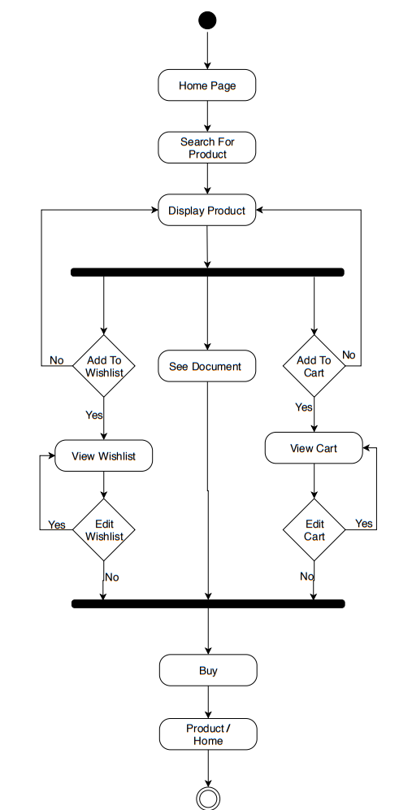
ACTIVITY DIAGRAM-customer

Slide 16
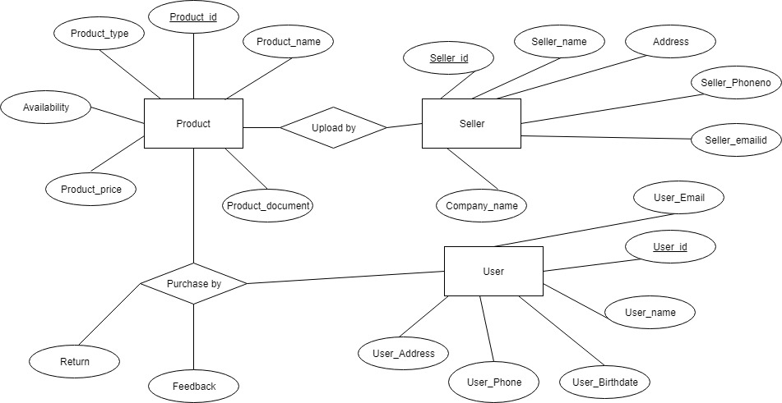
E-r diagram

Slide 17
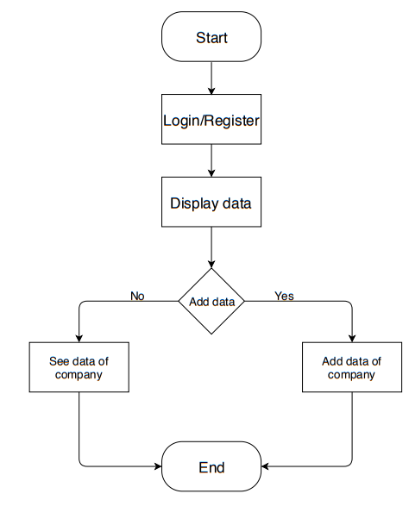
FLOW DIAGRAM- ADMIN

Slide 18
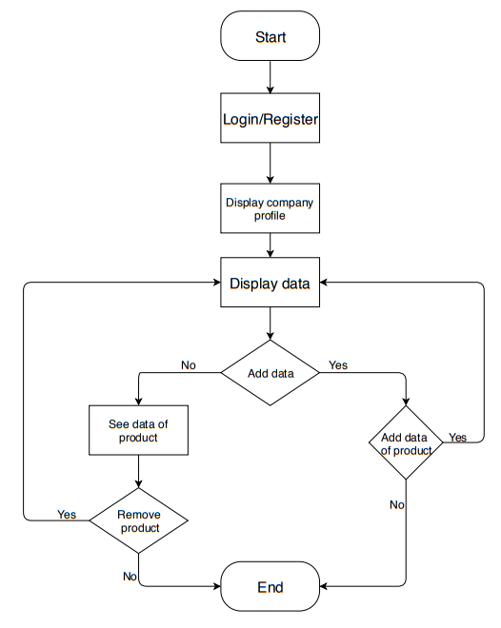
FLOW DIAGRAM- SELLER

Slide 19
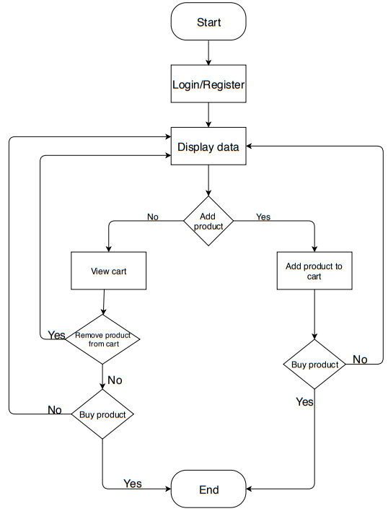
FLOW DIAGRAM- CUSTOMER

Slide 20
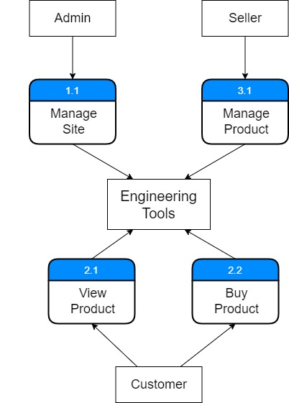
DFD – Level 0

Slide 21
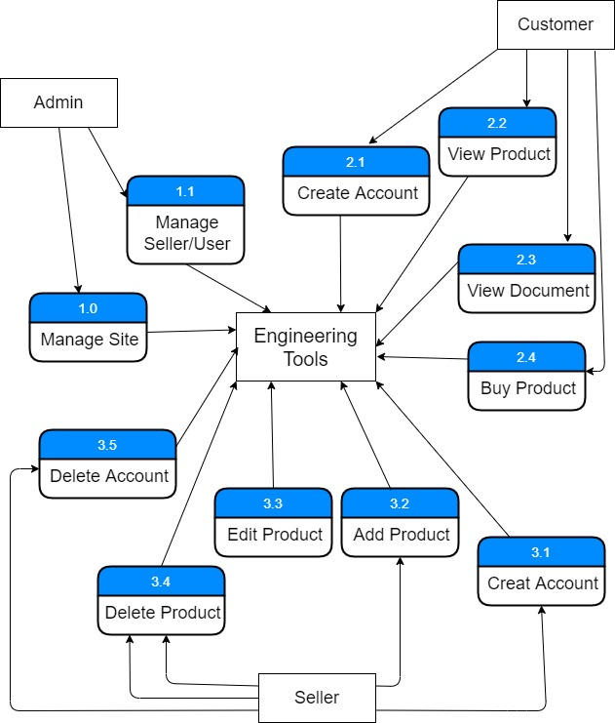
DFD – level 1

Slide 22
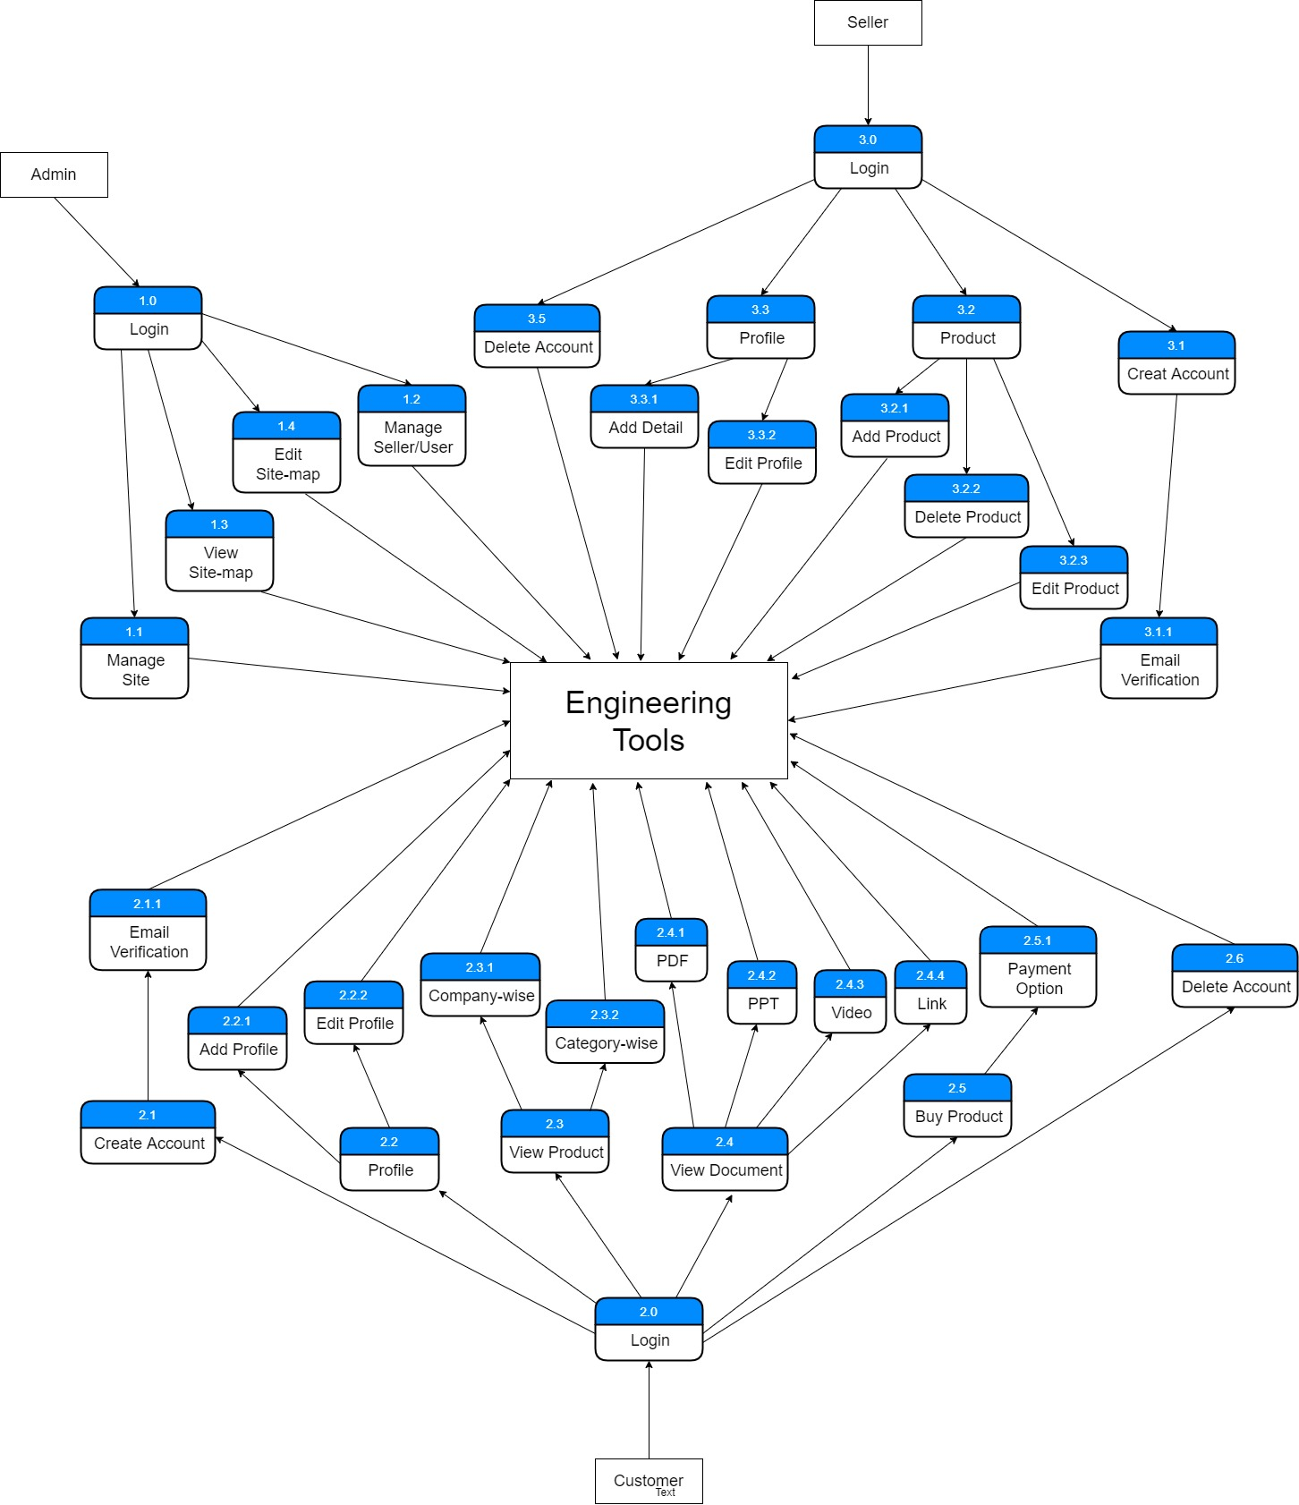
DFD – level 2

Slide 23
Conclusion
This portal will make online shopping for customers easier as they can buy devices at a cheaper rate & can view the documents uploaded by the sellers and other user.
Documents include the procedure of using devices and what all tools can be made from those devices.

Slide 24
Thank you

