Slide 1
MANET Simulator
PROJECT REPORT
Team GR1
Greg Moser, Matt Roberts,
James Woo, Yali Zhao
Dec 14, 2010

Slide 2
Project Info
  Team Members & Member Roles (who did what)
  How did team operate?
    Meetings during or after class
    Communication via email
    Task assignment = ?
  Development Process Used
    Random paradigm
    Wiki for developmental notes
  What tools did you use for the development effort?
    Eclipse, Subclipse
    Subversion under Google Code

Slide 3
Accomplished Work
This project provides a GUI demonstration of an ad-hoc wireless network simulation that exercises specific protocols using different scenarios and presents results in a user friendly format.
Added 6 classes, 1161 LOC, 592 lines of comments
Modified countless lines
Total: 56 classes, 3670 LOC, 1270 lines of comments
Hours of effort: ?
The simulator is developed in a platform independent manner. The codebase is in Java which is also platform independent.

Slide 4
Lessons learned
  What went right
    Replays, DSDV
    multiple code changes and additions before it was operational.
  What went wrong
    UI Layout on multiple platforms
    Once installed by a user the application could not access the logs which implement simulation replays.
  What would we do differently
Try and start from scratch
  What do we learn
How to modify/extend code.
To revise the existing software is better than create a software from scratch.
Trying things out sooner than later.

Slide 5
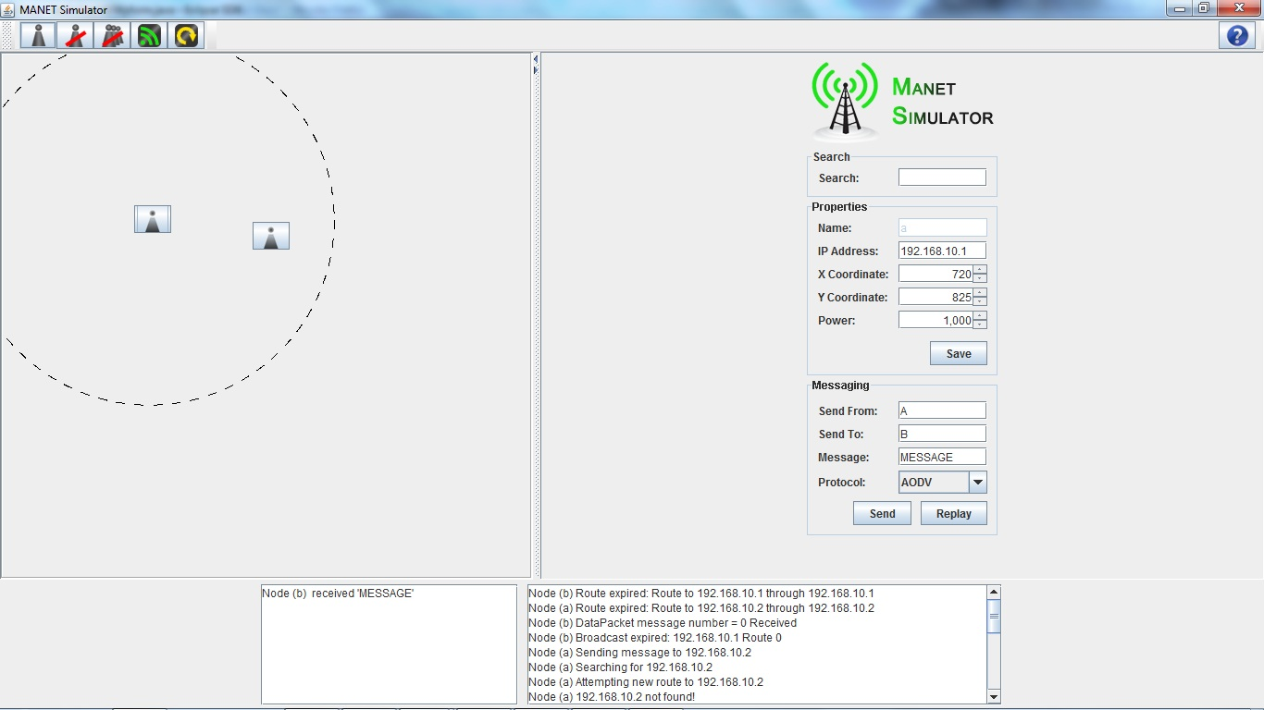

Slide 6
Demo

