Slide 1


Evaluation Warning : The document was created with Spire.Presentation for .NET
Review Meeting
March 2018

Slide 2
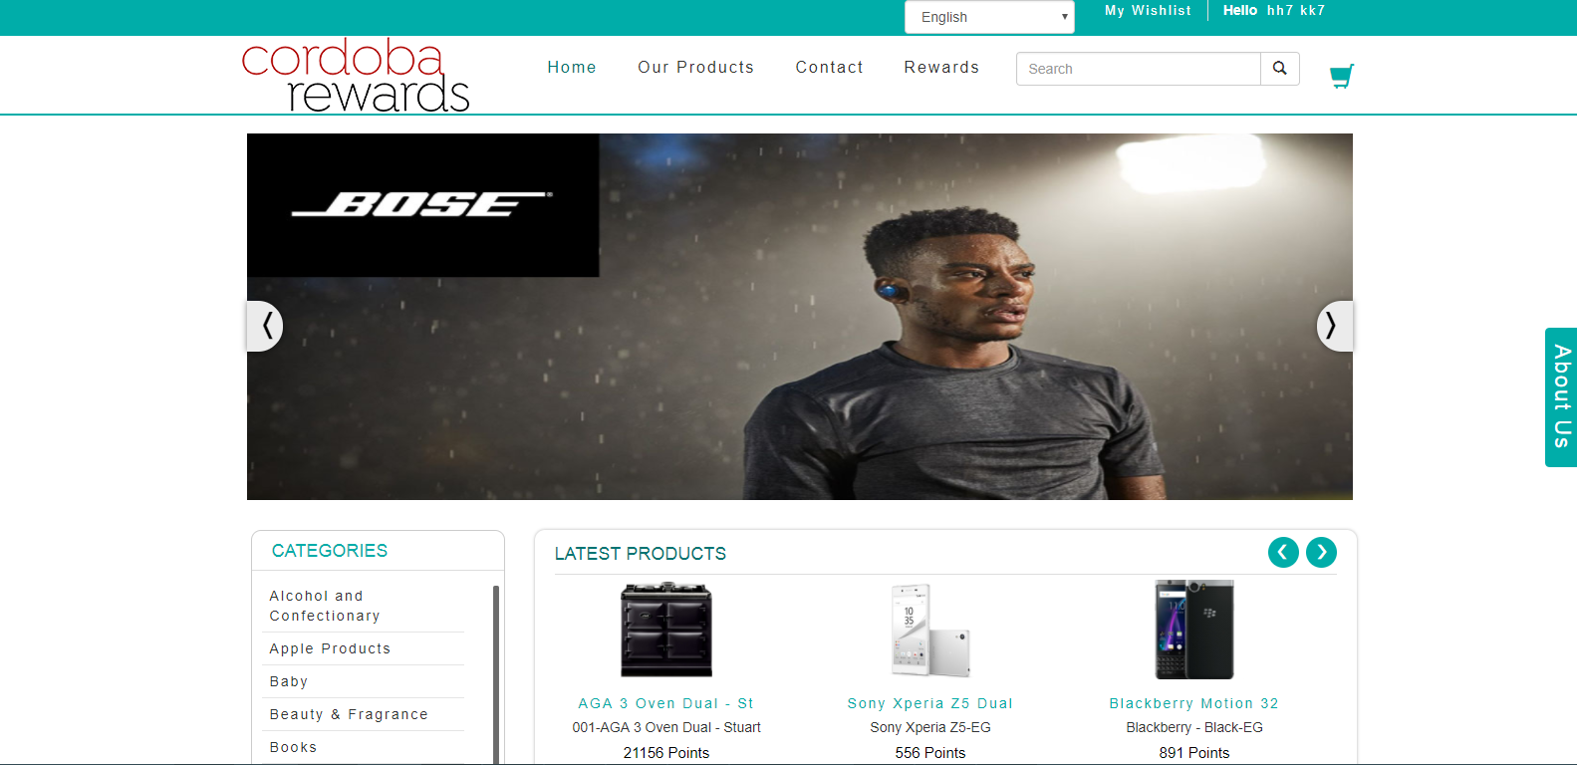
Evaluation Warning : The document was created with Spire.Presentation for .NET

Slide 3
Evaluation Warning : The document was created with Spire.Presentation for .NET

Slide 4
Evaluation Warning : The document was created with Spire.Presentation for .NET

Slide 5
Evaluation Warning : The document was created with Spire.Presentation for .NET

Slide 6
Evaluation Warning : The document was created with Spire.Presentation for .NET
FullName | Email | Points | Status | Activated | DateAdded
Ruben Pritchard | ruben.pritchard@unipart.com | 5000 | Enabled | 1 | 3/9/2018 3:10:42 PM
test test | nitinp@live.co.uk | 909 | Enabled | 1 | 1/15/2018 3:08:08 PM
James Greenaway | james.greenaway@outlook.com | 833 | Enabled | 1 | 11/13/2014 2:35:43 PM
Test First Name Updated 2... Test Last Name | abcd@gmail.com | 255 | Enabled | 1 | 1/18/2018 1:57:22 PM
Claire Pinfold | mrmiles@cordoba.com | 104 | Enabled | 1 | 10/6/2017 11:44:38 AM
hh7 kk7 | harsh.k@shaligraminfotech.com | 20 | Enabled | 1 | 1/24/2018 8:13:35 AM
hh8 kk8 | brijesh.k@shaligraminfotech.com | 20 | Enabled | 1 | 1/24/2018 8:13:35 AM
htest test | hh@kk.so | 10 | Enabled | 1 | 1/19/2018 11:34:09 AM
13 Customer Customer Last | customer@gmail.com | 2 | Enabled | 1 | 1/5/2018 2:02:10 PM
Heidi Berry | Heidi@cordobarewards.co.uk | 0 | Enabled | 1 | 6/15/2018 5:59:00 PM

Slide 7
Evaluation Warning : The document was created with Spire.Presentation for .NET
Points Loaded By Month

Slide 8
Evaluation Warning : The document was created with Spire.Presentation for .NET
Points Reedemed By Month

