Slide 1


VADODARA HACKATHON 2025
TITLE PAGE
Problem Statement ID – SIH25049
Problem Statement Title – AI-Driven Public Health Chatbot for Disease Awareness
Theme – AI-Driven Conversational Chatbot for Public Health Awareness.
PS Category – Software
Team ID – VH6_PIET_072
Team Name (Registered on portal) –
Coder365

Slide 2

IDEA TITLE
Coder 365
Solution : “AI-driven multilingual health chatbot”
We propose an AI-driven multilingual health chatbot for rural and semi-urban communities, accessible via WhatsApp, SMS, and voice calls. It will:
Guide preventive healthcare with info on symptoms, vaccines, hygiene, and govt. schemes.
Use a gamification engine (quizzes, rewards, discounts) to boost awareness and engagement.
Provide voice support (STT & TTS) in local languages for easy use by all, including illiterate users.
Enable doctor-patient connect, offering discounts on check-ups, consultations, and vaccinations.
Deliver outbreak alerts with a dashboard for health workers to enable early interventions.
Innovation & Uniqueness : “What Makes Us Stand Out?”
Gamified health education to drive active participation.
Voice-first AI for semi-literate users in local languages.
Doctor-patient marketplace offering personalized health discounts.
Predictive analytics to detect outbreaks early.
Offline support via SMS/USSD for low-connectivity areas.
Impact : “How It Solves Patients’ Challenges
Accessible on low-end phones (SMS/IVR) and WhatsApp.
Engaging & memorable through gamification.
Trust-building via doctor offers and real benefits.
Scalable with cloud deployment across regions.
Empowers health workers with real-time data for interventions.

Slide 3

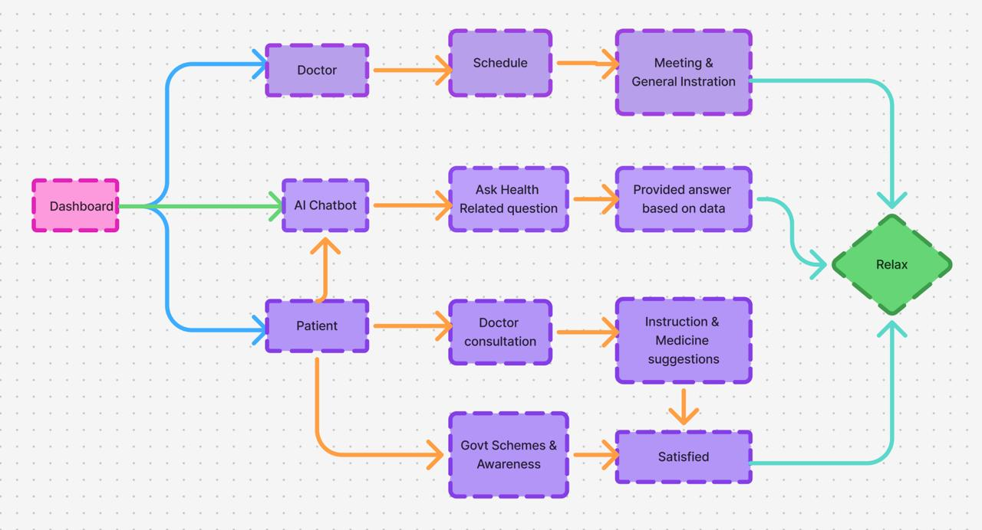
TECHNICAL APPROACH
Coder 365
Tech Stack :
Frontend
HTML
React.js
Tailwind CSS
Backend
Python
SQL / MongoDB
AI/ML
Pandas/Numpy/ Matplotlib
scikit-learn
Vision & Data
OpenCV
NLP Chatbot Voice Assistant

Slide 4
FEASIBILITY AND VIABILITY
Coder 365
Feasibility : “Why This Idea Can Work”
Technical Feasibility
APIs for WhatsApp/SMS are well-documented and easy to integrate
Real-time government database integration possible via REST APIs
Cloud deployment ensures scalability to rural and semi- urban populations
Operational Feasibility
Can be deployed by Government with existing health infrastructure
Minimal training required for ASHA workers and health volunteers
Works on low-end devices via SMS (no dependency on smartphones only)
Economic Feasibility
Low-cost cloud hosting & open APIs make it affordable.
Revenue opportunities from marketplace & partnerships.
Challenges & Risks : “What Could Go Wrong”
Multilingual NLP Accuracy
Low Connectivity & Device Limitations
Limited Training Data
Real-Time Health Data Integration
Data Privacy & Security
User Trust & Adoption
Risks :
Misinformation or Wrong Diagnosis
Misuse of Data
Scalability Issues
Strategies : “How We Overcome Challenges”
Use mBERT, IndicBERT, fine-tune with local data
Support SMS, WhatsApp, voice interface
Translation, back-translation, data augmentation
Use mock APIs, cache data, handle API failures
Encrypt data, anonymize, follow NDHM/GDPR
Involve ASHA workers, simple UX, human fallback

Slide 5

IMPACT AND BENEFITS
Coder 356
Potential Impact on Target Audience
Patients & Citizens: Reduced misinformation, instant answers to minor health queries, improved preventive care & vaccination awareness, better decision-making, and stronger trust in verified health information.
Doctors & Clinics: Wider reach through chatbot referrals, more patients via exclusive offers, reduced load of repetitive queries, improved doctor-patient relationship, and enhanced visibility in local communities.
Communities: Higher health literacy, early outbreak detection for safer villages, stronger trust in healthcare systems, digital inclusion for rural populations, and healthier community environments.
Government & Health Workers: Easier rollout of health schemes, real-time outbreak tracking, better vaccination compliance, data-driven decision-making, and stronger citizen-government engagement.
Benefits of the Solution
1. Social
Reduces misinformation exposure with accurate health guidance.
Boosts preventive healthcare awareness and engagement.
Builds stronger trust in healthcare through consistent responses.
2. Economic
Saves time and cost of visiting clinics for minor queries.
Reduces unnecessary medical expenses with early self-care guidance.
Encourages timely check-ups via affordable offers from doctors.
3. Health & Community Impact
Increases vaccination compliance and preventive care adoption.
Strengthens community health literacy.
Enables early disease detection, reducing outbreak risks.

Slide 6
RESEARCH AND REFERENCES
Coder 365
RESEARCH & INITIATIVE
Links
World Health Organization (WHO)
National Health Authority (NHA)
Govt of India (Health Ministry)
UNICEF (United Nations International Children's Emergency Fund)
ICMR (Indian Council of Medical Research)
AIIMS (All India Institute of Medical Sciences)Red Cross Society
https://www.who.int/
https://nha.gov.in/
https://dghs.mohfw.gov.in/
https://www.unicef.org/
https://www.icmr.gov.in/
https://www.redcross.org/

