Slide 1



SMART INDIA HACKATHON 2026
HIMVAJRA
High-Altitude Integrated Monitoring, Validation And Junction-thermal Resilience Architecture
Predict the failure. Prove it in a chamber. Prevent it with a retrofit.
Problem Statement ID – 26049
Problem Statement Title – Reliability, efficiency, and lifespan in subzero, low-pressure Ladakh conditions
Theme – [Fill from SIH portal]
PS Category – Hardware
Team ID – [Fill]
Team Name – [Fill]
ILLUSTRATIVE — PROPOSED SYSTEM · Hypobaric-cryo validation chamber and bolt-on Guard controller

Slide 2
[Team Name]
IDEA TITLE
Propose the validation loop, not another modification list
HIMVAJRA is a failure-physics platform to validate and harden electronics for 3,000–6,000 m.
Current: sea-level-qualified equipment is deployed at 5,000 m with no intermediate verification.
Limit: combined altitude, cold, and cycling testing is concentrated in a few national labs; commercial chambers are estimated at ₹15–40 lakh.
Consequence: “high-altitude hardened” remains a claim, while deployed equipment has no adaptive protection.
Closed cycle: FORGE predicts → CHAMBER measures → GUARD prescribes hardening → FLEET uses telemetry for maintenance and feeds the model.
Cooling · arcing · batteries · thermal cycling · radiation mitigation
PROPOSED · ILLUSTRATIVE ARCHITECTURE · ~₹68,000 proposed validation rig · physics-first uncertainty band · state-of-power cutoff · retrofit with no cloud or PII
@SIH Idea submission- Template
2

Slide 3
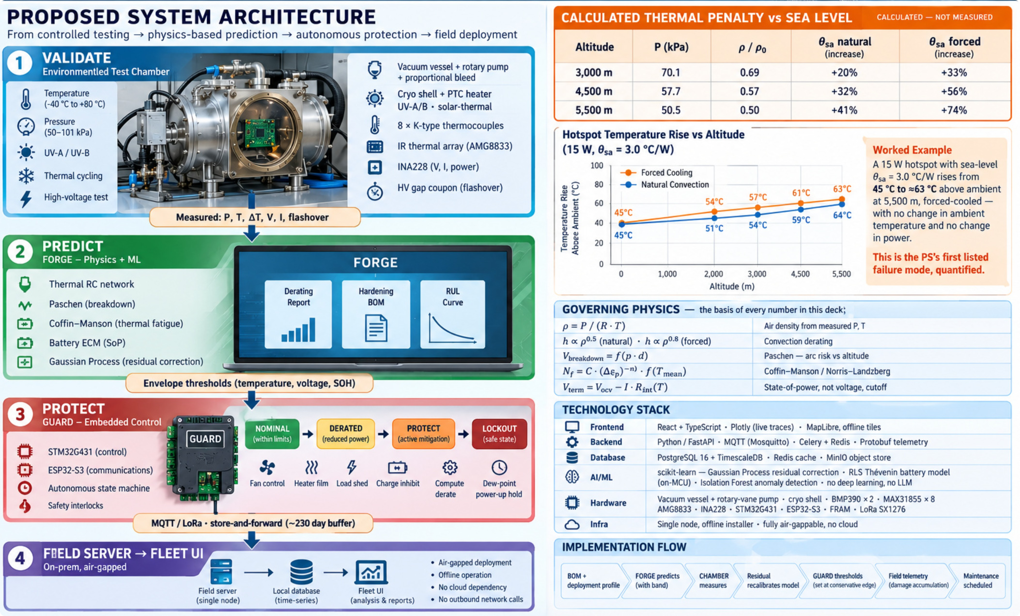
TECHNICAL APPROACH
[Team Name]
@SIH Idea submission- Template
3

Slide 4
FEASIBILITY AND VIABILITY
[Team Name]
PROPOSED validation path • ₹68,000 estimated prototype budget • 5-week plan
ILLUSTRATIVE BUILD BUDGET
5-WEEK PROPOSED VALIDATION FLOW
Hardware & enclosure ................................ ₹28,000
Sensors, power & connectivity ........ ₹18,000
Prototype fabrication ........................ ₹12,000
Field-test contingency ....................... ₹10,000
Week 1 — Define Requirements, safety assumptions and test matrix
Week 2 — Build Assemble MVP, enclosure and offline workflow
Week 3 — Simulate Run calculated thermal and power scenarios
Week 4 — Test Controlled usability and environmental checks
Week 5 — Review Compare expected vs observed behavior; refine scope
TECHNICAL
OPERATIONAL
ESTIMATED TOTAL: ₹68,000
Vacuum PID, thermocouple DAQ, FreeRTOS firmware and FastAPI are standard undergraduate engineering. Hardest: leak-tight cryo-vacuum integration—mechanical patience, not exotic skill. All components are off-the-shelf from Indian suppliers.
Guard runs autonomously with no operator input. Fleet UI is read-and-acknowledge for a signals NCO. Mission-critical assets are never shut down autonomously; the system recommends and logs, a human acts.
FINANCIAL
DEPLOYMENT
Budget is proposed; vendor quotes and actual costs remain to be validated.
No performance claim is made until controlled testing is completed.
Prototype ₹68,000; floor ₹21,500. Guard at volume ₹8,000–15,000/unit (planning estimate — NEEDS VERIFICATION). No recurring cloud cost.
Retrofit over CAN / RS-485. No re-procurement of fielded equipment. Air-gapped, offline installer, no outbound network calls, zero PII.
GO / NO-GO GATE (PROPOSED): Continue only if calculated alerts, battery assumptions and user comprehension meet pre-defined acceptance criteria.
All figures and timelines are planning estimates — not measured outcomes.
@SIH Idea submission- Template
4

Slide 5
IMPACT AND BENEFITS
[Team Name]
Retrofit shifts maintenance from winter failure to planned action
IMPACT TREE
FIELD BENEFITS
DRONE LOSS BUDGET
Operational — keep equipment inside a safe envelope
Economic — avoid re-procurement and schedule maintenance
Strategic — move validation capability closer to unit workshops
Predictable performance under degraded cooling
Planned convoy-window maintenance rather than winter failure
Battery energy recovery via preconditioning and state-of-power cutoff — magnitude to be measured
Per-rail arc and insulation risk assessment before commissioning
Guard retrofit for existing radars, base stations, gensets, and payload computers
Sovereign, air-gapped operation with no cloud or PII
60 min → 22 min
Aero loss is MODELLED · NOT RECOVERABLE.
Cold capacity loss and voltage-sag cutoff are proposed recovery paths.
Proportions require measurement.
BENEFICIARIES
Primary · Secondary · Tertiary
@SIH Idea submission- Template
5

Slide 6
RESEARCH AND REFERENCES
[Team Name]
Every proposed decision traces to a standard or physical law
STANDARDS AND OFFICIAL GUIDANCE
RESEARCH BASIS
TECHNOLOGY DOCUMENTATION
PROPOSED DATA SOURCES
SYSTEMS REVIEWED
Paschen, Coffin–Manson/Norris–Landzberg, Miner’s rule, and convection correlations govern the physics models.
Component datasheets govern θJA, θJC, and ESR-versus-temperature inputs.
Target ≥300 labelled in-house measurements after build.
Keep it sparse, exact, and visibly evidence-led.
Flag JSS 55555, DIHAR partnership, IMD baseline data, and specific paper DOIs as NEEDS VERIFICATION before submission.
MIL-STD-810H Methods 500.6, 502.7, and 503.7 govern low-pressure and thermal profiles.
IEC 60664-1 governs insulation coordination; JEDEC JESD89A governs the soft-error mitigation approach.
@SIH Idea submission- Template
6

