Slide 1


CP610 – Data Analysis
Credit Card Fraud Detection
Prepared by: Harsh Shah (205805610)

Slide 2
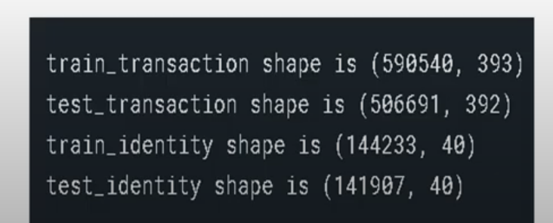
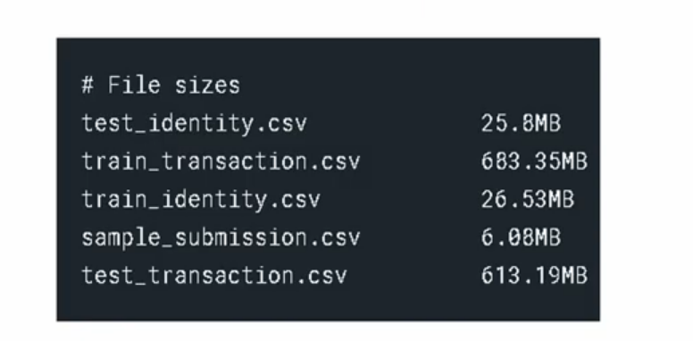
Dataset Information

Slide 3
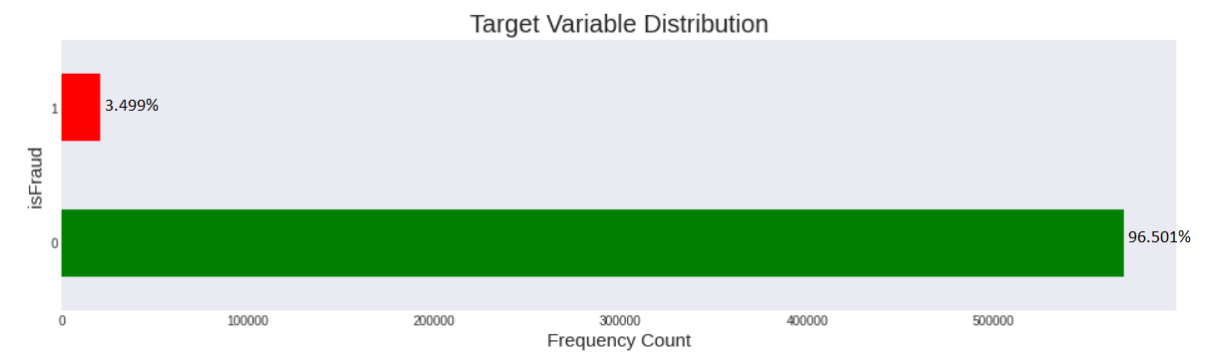
Target Variable

Slide 4
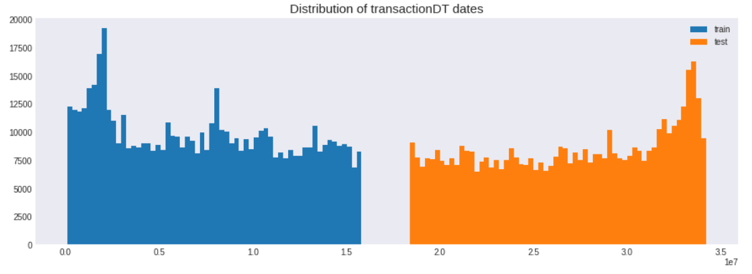
TransactionDT and Transaction hour

Slide 5
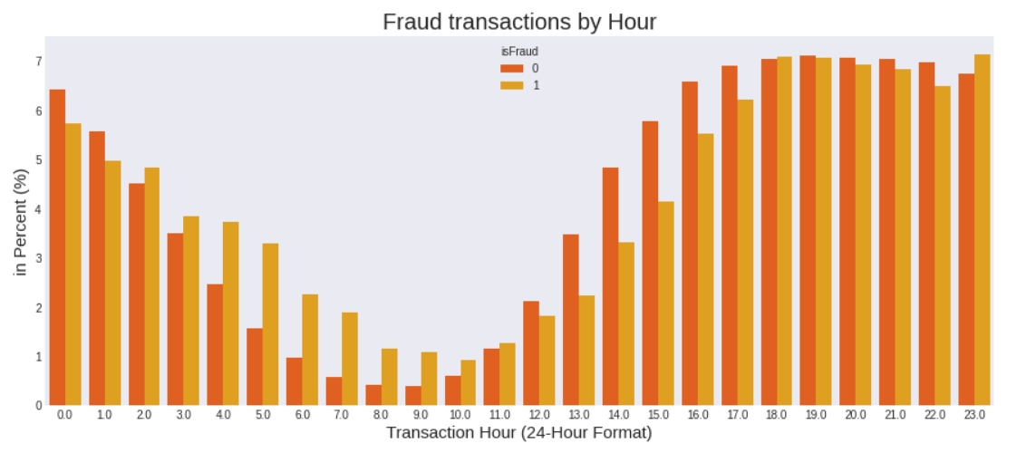
TransactionDT and Transaction hour

Slide 6
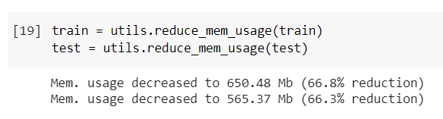
Reduce Memory Usage
The integer datatypes have the following ranges:
int8: -128 to 127 | range = 255
int16: -32,768 to 32,767 | range = 65,535
int32: -2,147,483,648 to 2,147,483,647 | range = 4,294,967,295
int64: -9,223,372,036,854,775,808 to 9,223,372,036,854,775,807 | range = 18,446,744,073,709,551,615
By default all numerical columns in pandas are in int64 or float64.
This means that when we find a numerical integer column whose values do not exceed one of the ranges shown above, we can then convert this datatype down to a smaller one.

Slide 7
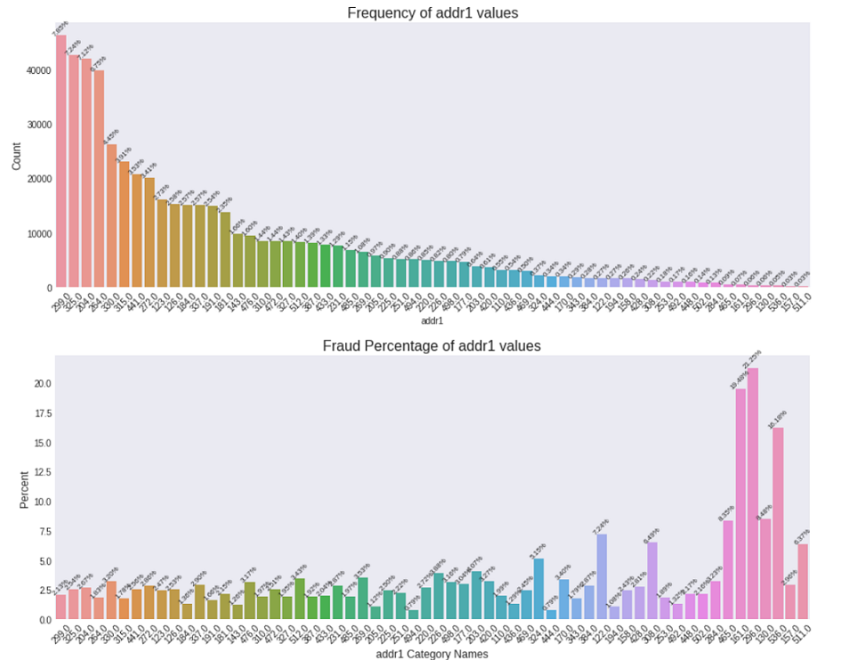
Addr1 - Insights

Slide 8
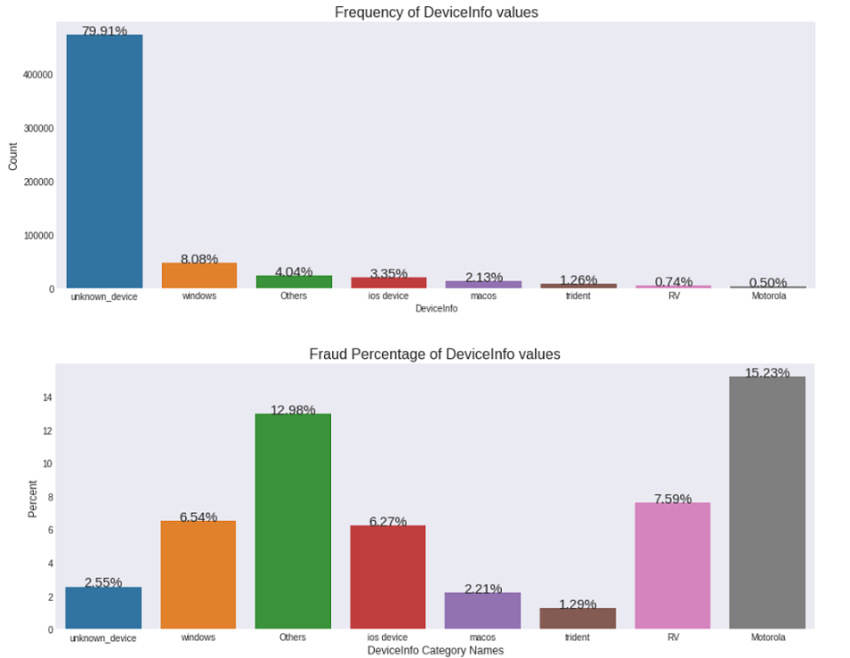
Device Info - Insights

Slide 9
Model Selection
Total 4 models used…
Linear regression
Decision Tree
Random Forest
Light GBM (with and without K-Fold Cross Validation)

Slide 10
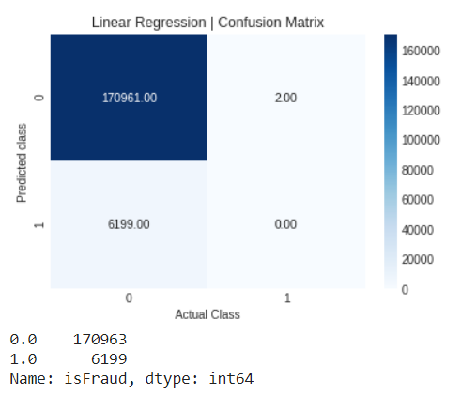
Linear Regression

Slide 11
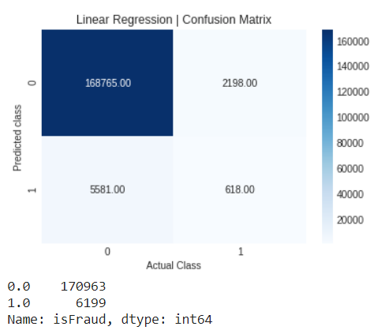
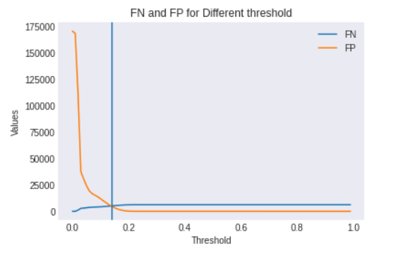
Linear Regression

Slide 12
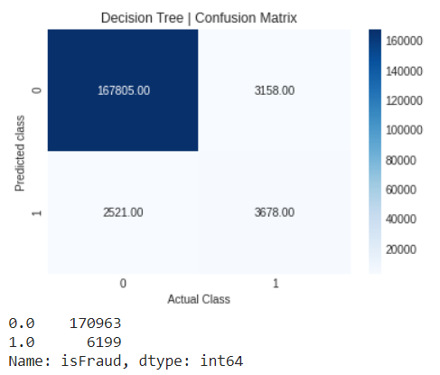
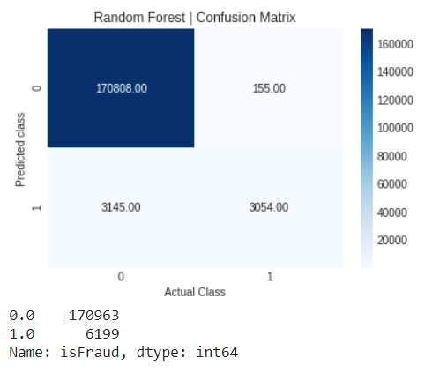
Decision Tree and Random Forest

Slide 13
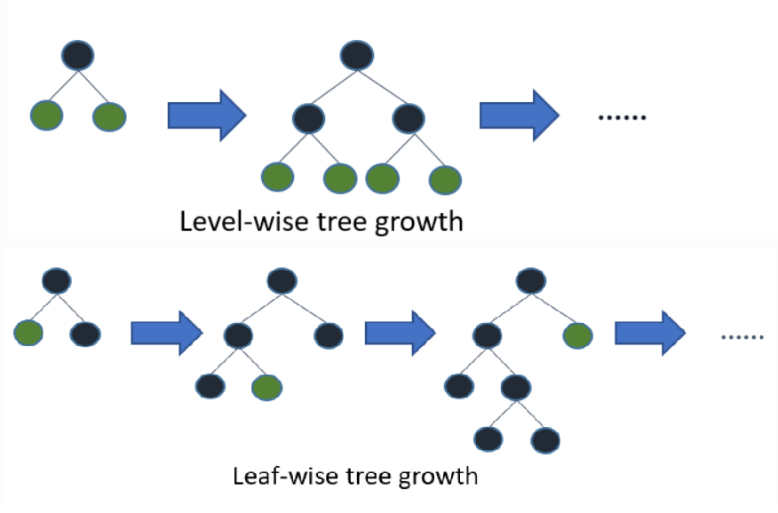
Light GBM

Slide 14
Light GBM – Parameters Tuning
Core parameters:
boosting: defines the type of algorithm, for my model I have selected default=gdbt (Gradient boosting)
learning rate: This is a crucial parameter that can affect final outcome. Generally, GBM starts with it as an initial estimate of learning which gets updated using output of each tree. By setting up this parameter we can control the magnitude of this change. Commonly 0.1, 0.01,0.001 are used.
num_leaves: this is total number of leaves in full tree. By default is is set to 31 but as for my work
objective: used ’binary’ as this is classification problem
metric: ’auc’ as we need roc auc score.

Slide 15
Light GBM – Parameters Tuning
Control Parameters:
max-depth: it dictates the maximum depth of the tree and generally used to deal with overfitting for small data. Default value is -1 which means no limit.
feature fraction: Typically ranges from 0 to 1 and it means the percent fraction that Light GBM will select randomly in each iteration for construction of tree. As, for this work, I have used 0.85 means 85% of parameters will be selected randomly. I have used near to 1 value to speed up the training time.
bagging fraction: default=1.0 just like feature fraction, this parameter specifies the fraction of data to be utilized at each iteration. Purpose of this parameter is to fasten up the training time and avoid overfitting.
early stopping round: This is really useful parameter as it helps to speed up the analysis. If one metric of one validation data is not able to improve from last iteration then the model will stop training. So, excessive iterations can be avoided.

Slide 16
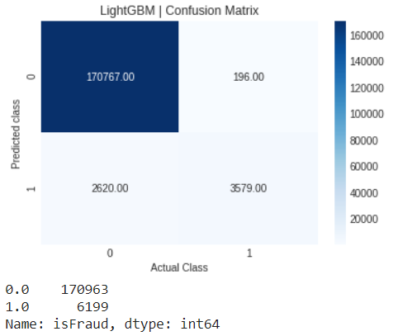
Light GBM – Performance – Trial 1
params=
{'learning_rate': 0.01,
'objective': 'binary',
'metric': 'auc',
'num_threads': -1,
'num_leaves': 200,
'verbose': 100,
'random_state': 42,
'bagging_fraction': 0.8,
'feature_fraction': 0.85}
N_estimators = 1000
Training Time : 725 Seconds
ROC_AUC_Score : 78%

Slide 17
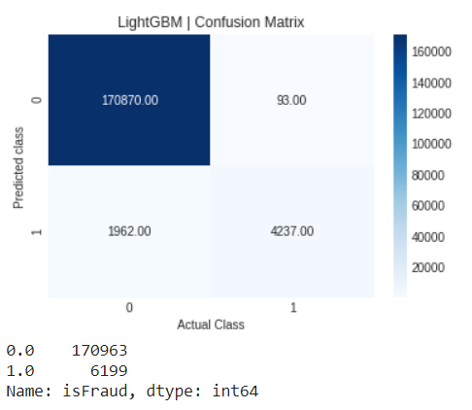
Light GBM – Performance – Trial 2
params=
{'learning_rate': 0.03,
'objective': 'binary',
'metric': 'auc',
'num_threads': -1,
'num_leaves': 256,
'verbose': 400,
'random_state': 42,
'bagging_fraction': 0.7,
'feature_fraction': 0.85}
N_estimators = 2000
Training Time : 1262 Seconds
ROC_AUC_Score : 84%

Slide 18
Light GBM – Performance – Trial 3
params=
{'learning_rate': 0.03,
'objective': 'binary',
'metric': 'auc',
'num_threads': 2,
'num_leaves': 256,
'verbose': 200,
'random_state': 42,
'bagging_fraction': 0.95,
'feature_fraction': 0.85}
N_estimators = 1500
Training Time : 948 Seconds
ROC_AUC_Score : 84%

Slide 19
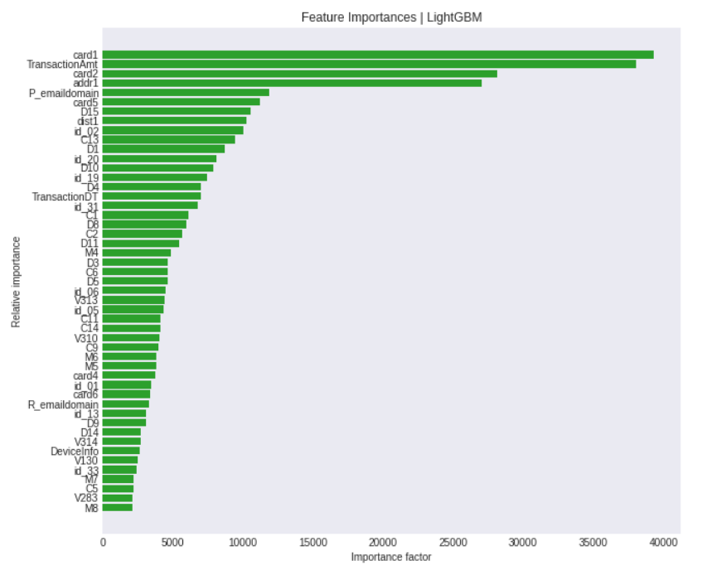
Light GBM – Performance
ROC_AUC_Score : 84%

Slide 20
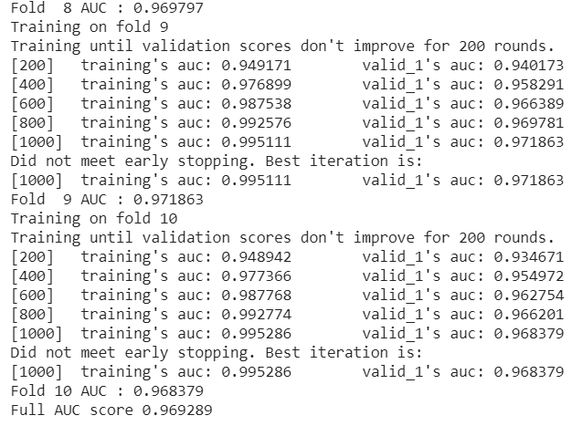
Light GBM – Parameters Tuning

Slide 21
Thank You

