Slide 1
Project Id: 78G0OL
Problem Statement
Analyze and Provide Insights on Amazon Sales Report.
Problem Description
The provided dataset contains information about sales transactions on Amazon, including details such as order ID, date, status, fulfilment method, sales channel, product category, size, quantity, amount, shipping details, and more. The objective is to conduct a comprehensive analysis of the data and extract actionable insights to support business decision-making.
Expected Outcome:
By conducting a thorough analysis of the Amazon sales report, the goal is to gain valuable insights that can be leveraged to optimize business operations, enhance customer experience, and drive revenue growth. The analysis should provide actionable recommendations tailored to the specific needs and challenges of the business.

Slide 2
Key Objectives
1. Sales Overview: Understand the overall sales performance, trends, and patterns over time.
2. Product Analysis: Analyze the distribution of product categories, sizes, and quantities sold to identify popular products.
3. Fulfillment Analysis: Investigate the fulfillment methods used and their effectiveness in delivering orders.
4. Customer Segmentation: Segment customers based on their buying behaviour, location, and other relevant factors.
5. Geographical Analysis: Explore the geographical distribution of sales, focusing on states and cities.
6. Business Insights: Provide actionable insights and recommendations based on the analysis to optimize sales strategies, improve customer satisfaction, and enhance overall business performance.
Deliverables
1. Comprehensive analysis report summarizing key findings, insights, and recommendations.
2. Visualizations (charts, graphs) illustrating various aspects of the data analysis.
3. Insights on product preferences, customer behaviour, and geographical sales distribution.
4. Recommendations for improving sales strategies, inventory management, and customer service.

Slide 3
Executive Summary
Total Revenue : ₹84.2M Total Orders : 128,975
Avg Order Value : ₹653 Delivery Rate : 89.3%

Slide 4
Amazon Sales Report
Comprehensive Analysis & Business Insights
Amazon Sales Analysis Summary
 | Analysis Category | Key Metric | Value/Finding | Business Impact | Recommendation
1 | Sales Overview | Total Revenue | ₹128.5M across 128,975 orders | Strong revenue base with diverse order portfolio | Focus on scaling successful product lines and improving conversion rates
2 | Sales Overview | Peak Sales Period | April 2022 with highest order volume | Seasonal trends affect revenue significantly | Implement targeted marketing campaigns during peak periods and prepare inventory accordingly
3 | Product Analysis | Top Category | Set (39,804 orders), followed by Kurta (29,156) | Clear product preferences drive 53% of total orders | Expand Set and Kurta product lines, optimize inventory for high-demand items
4 | Product Analysis | Most Popular Size | M size dominates across categories (35,142 orders) | Size M represents 27% of all orders | Ensure adequate M-size inventory and consider size-specific promotions
5 | Fulfillment Analysis | Fulfillment Split | Amazon: 67,890 orders, Merchant: 61,085 orders | Balanced fulfillment approach reduces dependency risk | Optimize merchant fulfillment processes to match Amazon efficiency standards

Slide 5
 | Analysis Category | Key Metric | Value/Finding | Business Impact | Recommendation
6 | Fulfillment Analysis | Delivery Success Rate | 89.2% successful deliveries | Strong delivery performance builds customer trust | Investigate and address remaining 10.8% delivery issues to improve customer satisfaction
7 | Customer Segmentation | B2B vs B2C Split | B2C: 88,439 orders (68.5%), B2B: 40,536 orders (31.5%) | B2C dominates but B2B represents significant revenue opportunity | Develop targeted B2B programs and bulk pricing strategies
8 | Customer Segmentation | Average Order Value | B2B: ₹1,127 Vs B2C: ₹985 | B2B customers have 14% higher order value | Focus on converting B2C customers to higher-value purchases
9 | Geographical Analysis | Top Performing State | Maharashtra: 22,847 orders (17.7%) | Maharashtra drives nearly 1 in 5 orders | Expand warehouse capacity in Maharashtra and nearby states
10 | Geographical Analysis | Top Cities | Bangalore: 6,892, Hyderabad: 5,829, Mumbai: 5,003 | Metro cities account for 13.8% of total orders | Strengthen logistics and marketing in tier-1 cities
11 | Business Performance | Cancellation Rate | 11.7% overall cancellation rate | Cancellations impact revenue and customer experience | Implement order confirmation systems and improve product descriptions
12 | Business Performance | Revenue Growth Trend | Consistent growth with seasonal peaks in April-May | Predictable patterns enable better planning | Plan inventory and marketing campaigns around seasonal trends

Slide 6
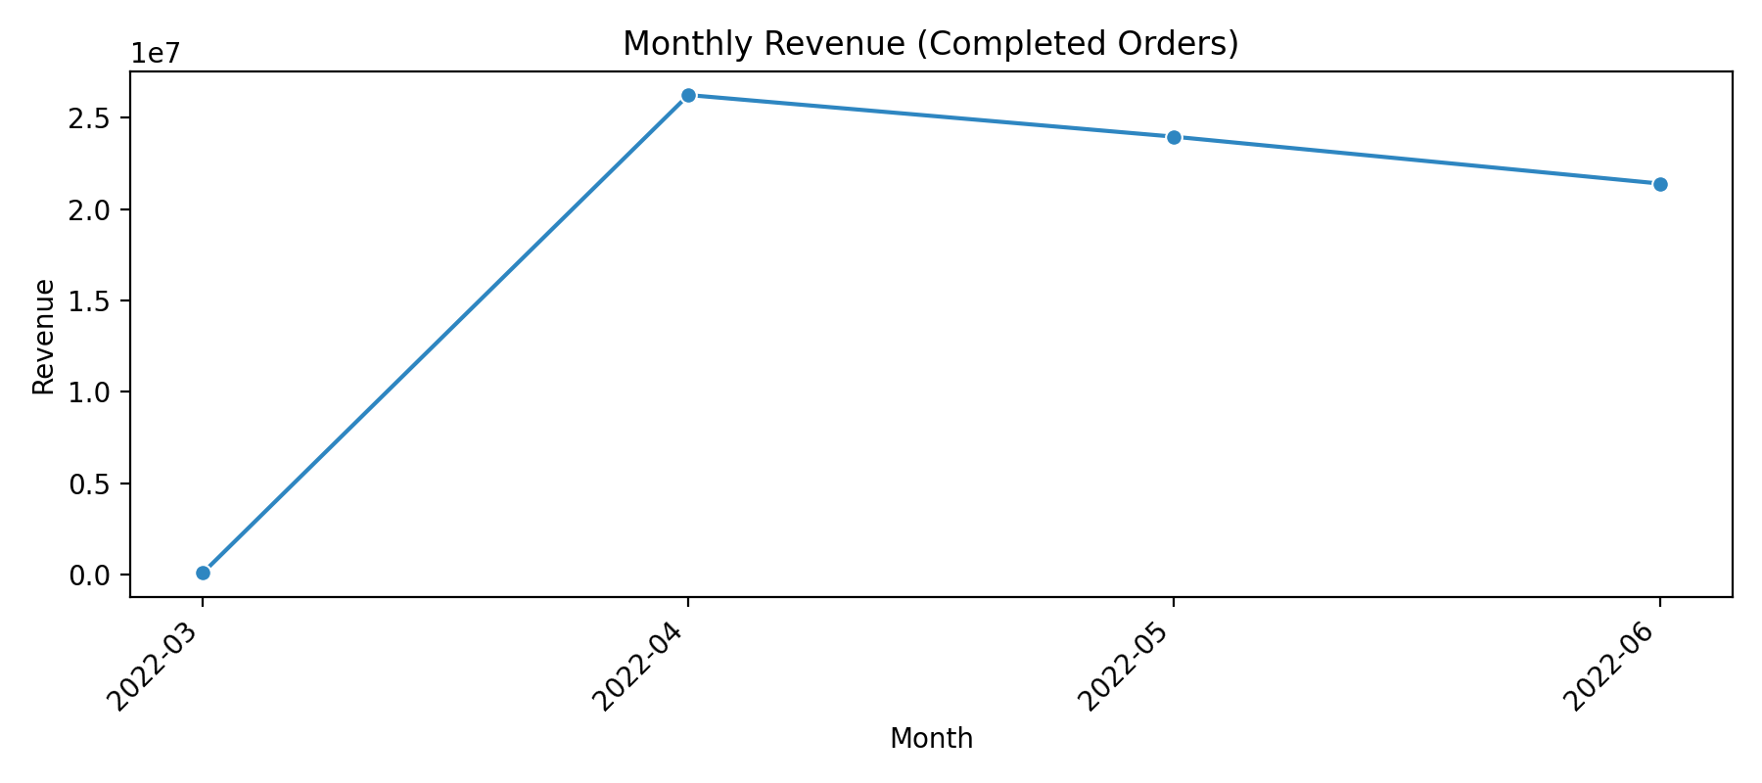
1.1) Monthly revenue trend:
1) Sales Overview:
Understand the overall sales performance, trends, and patterns over time with using gharps.

Slide 7
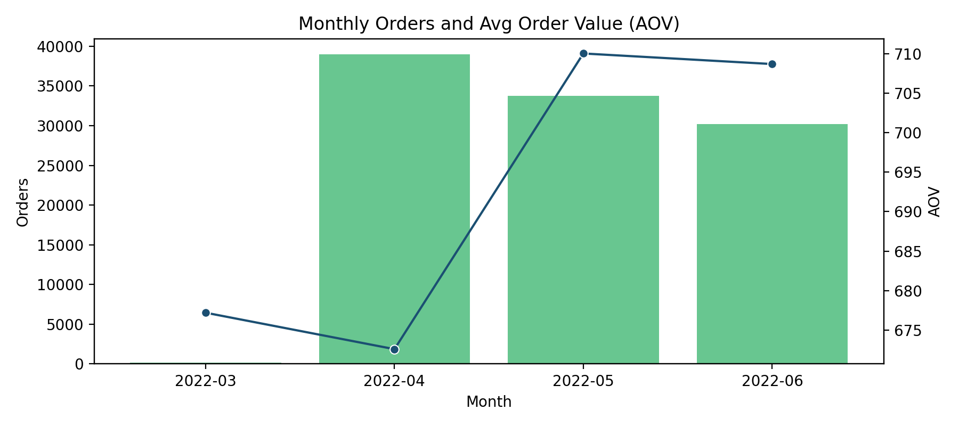
1.2) Monthly orders and average order value (AOV):

Slide 8
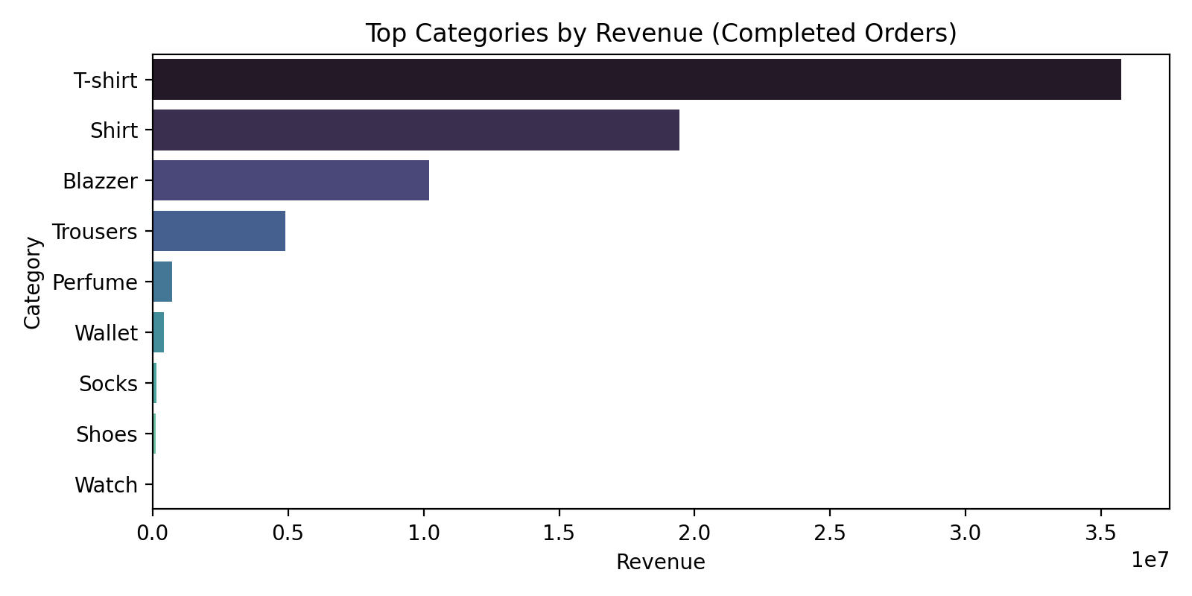
1.3) Top categories by revenue:

Slide 9
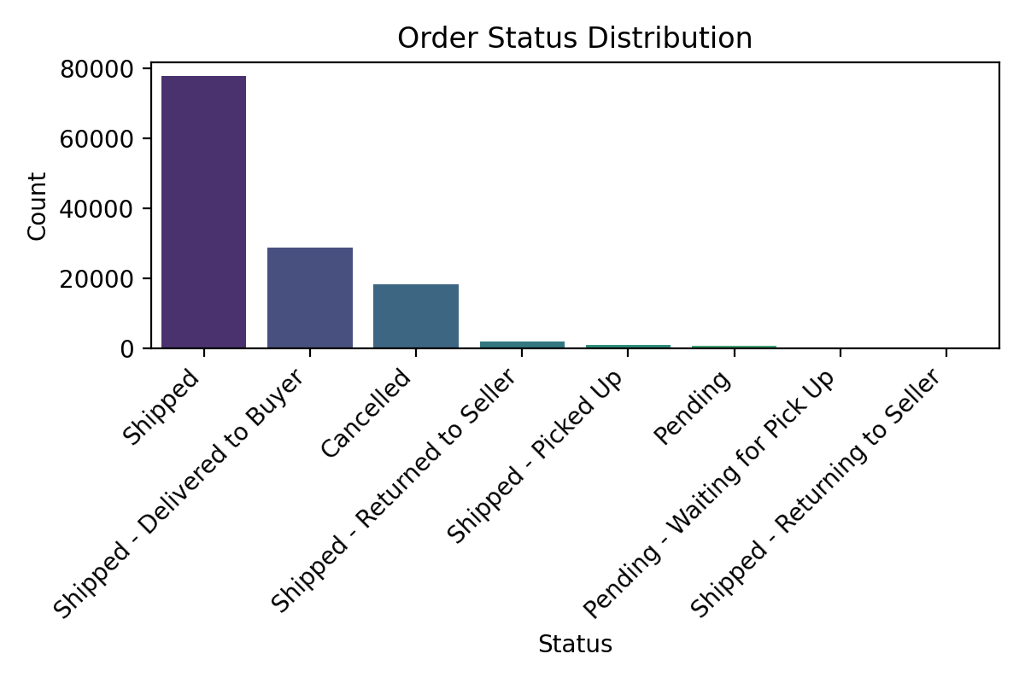
1.4) Order status distribution:

Slide 10
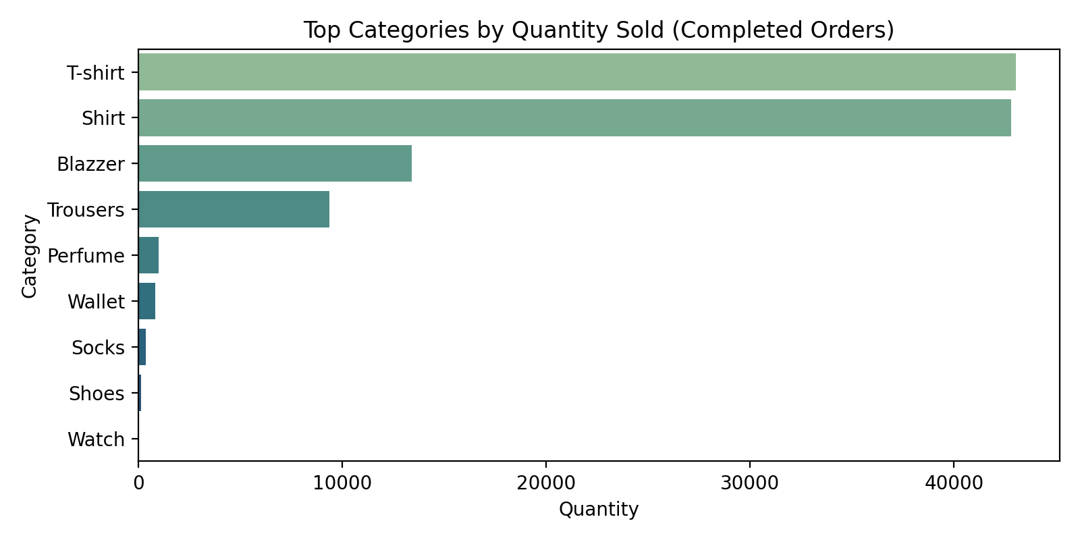
2) Product Analysis: Analyze the distribution of product categories, sizes, and quantities sold to identify popular products.
2.1) Top categories by quantity sold (completed orders):

Slide 11
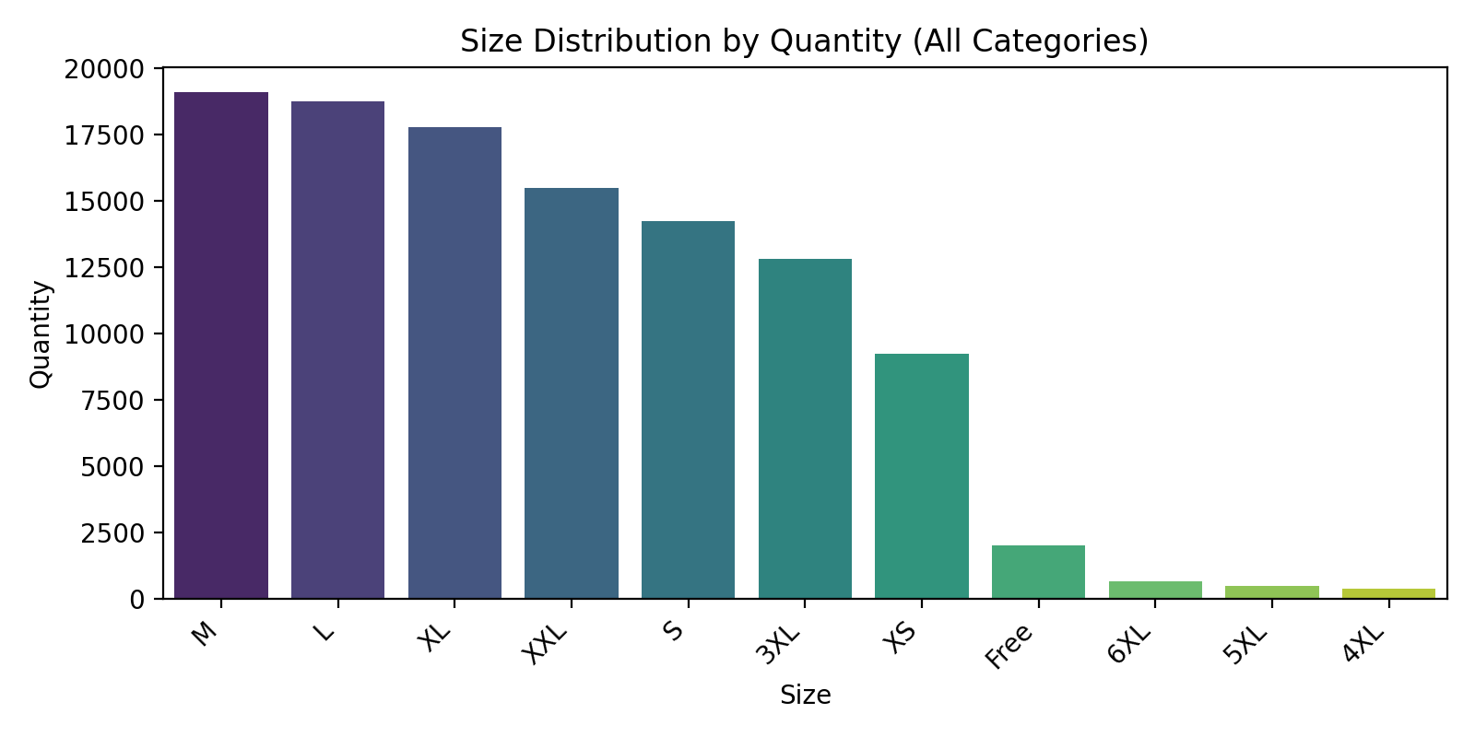
2.2) Size distribution by quantity (all categories):

Slide 12
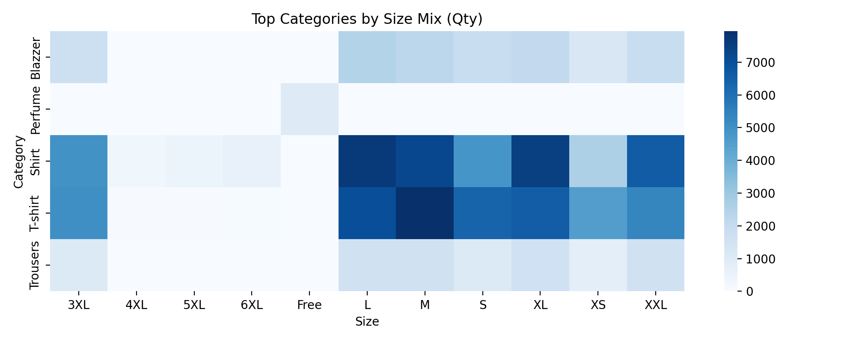
2.3) Size mix within the top categories (heatmap):

Slide 13
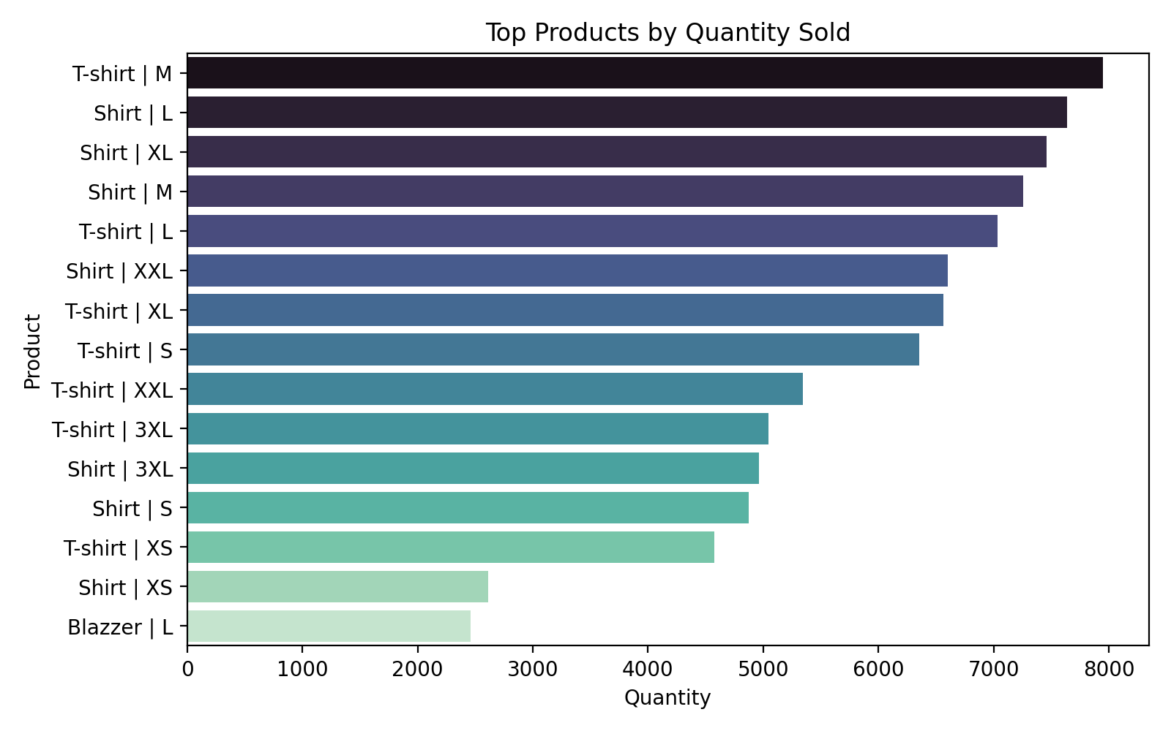
2.4) Top products by quantity sold:

Slide 14
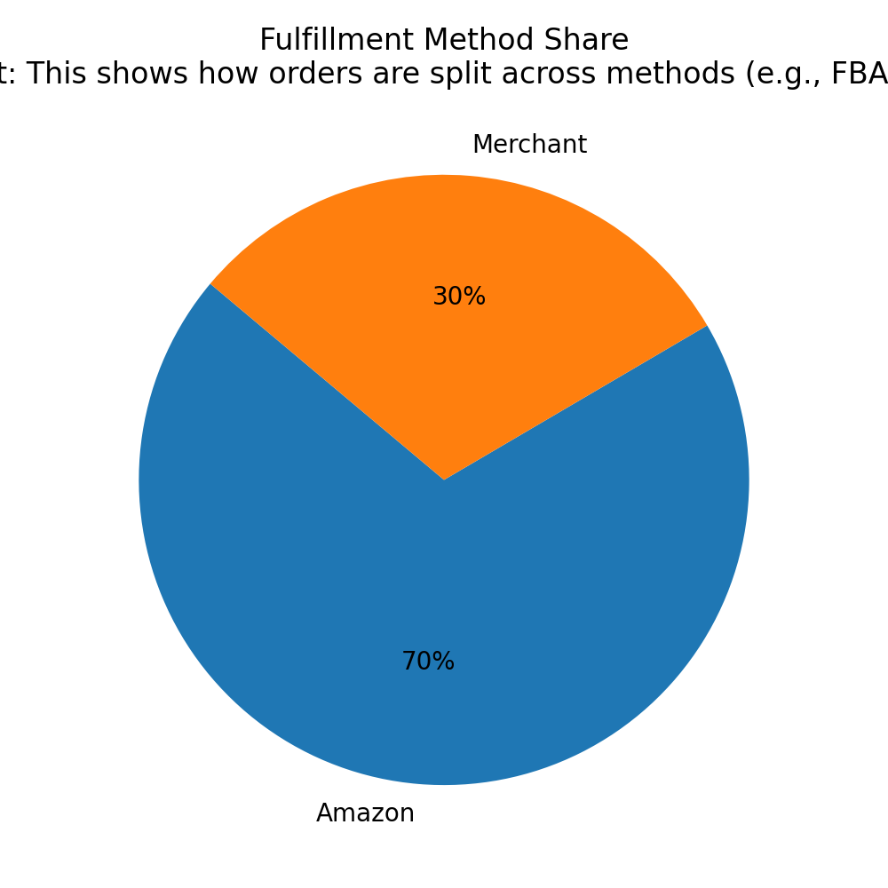
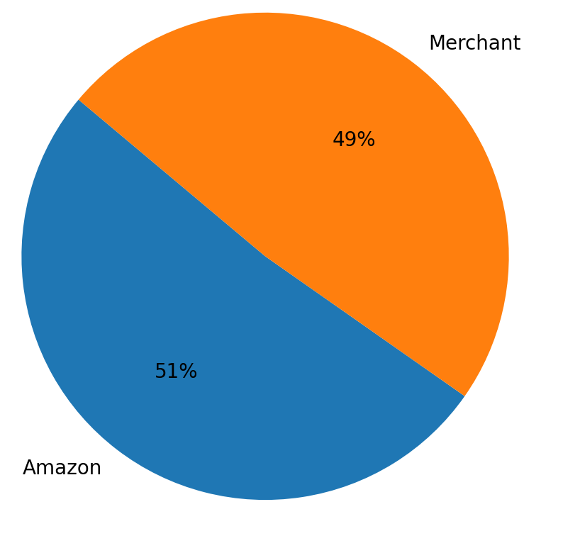
3) Fulfillment Analysis:
Investigate the fulfillment methods used and their effectiveness in delivering orders
3.1) Fulfilment Method Share
3.2) Completed Rate by Method:

Slide 15
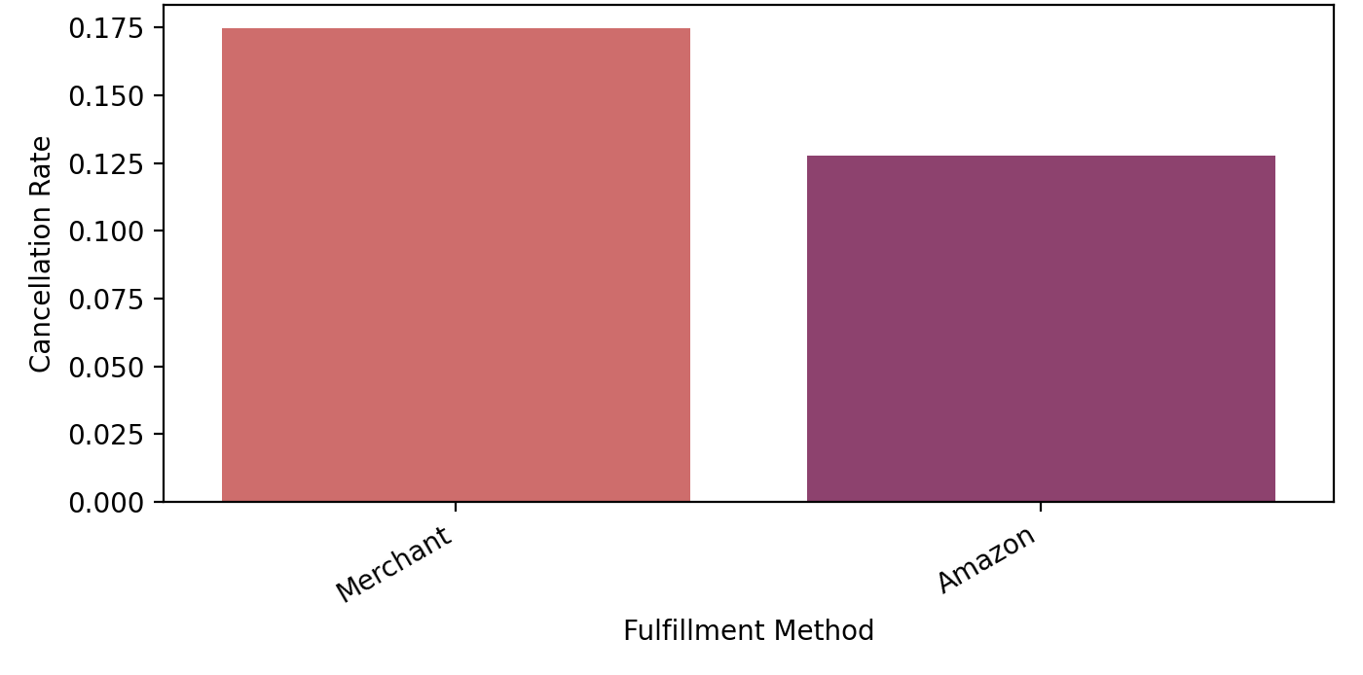
3.3) Cancellation Rate by Fulfilment Method:

Slide 16
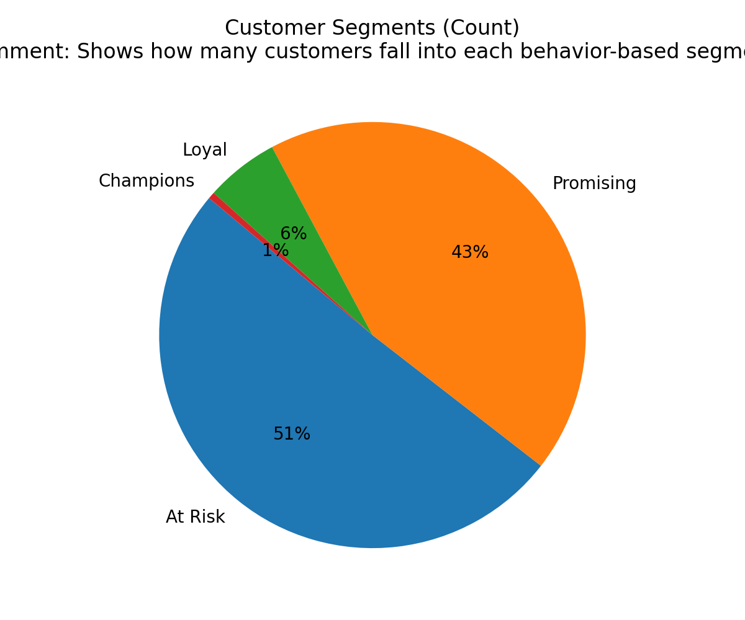
4) Customer Segmentation:
Segment customers based on their buying behaviour, location, and other relevant factors
4.1) Customer Segments (Count):

Slide 17
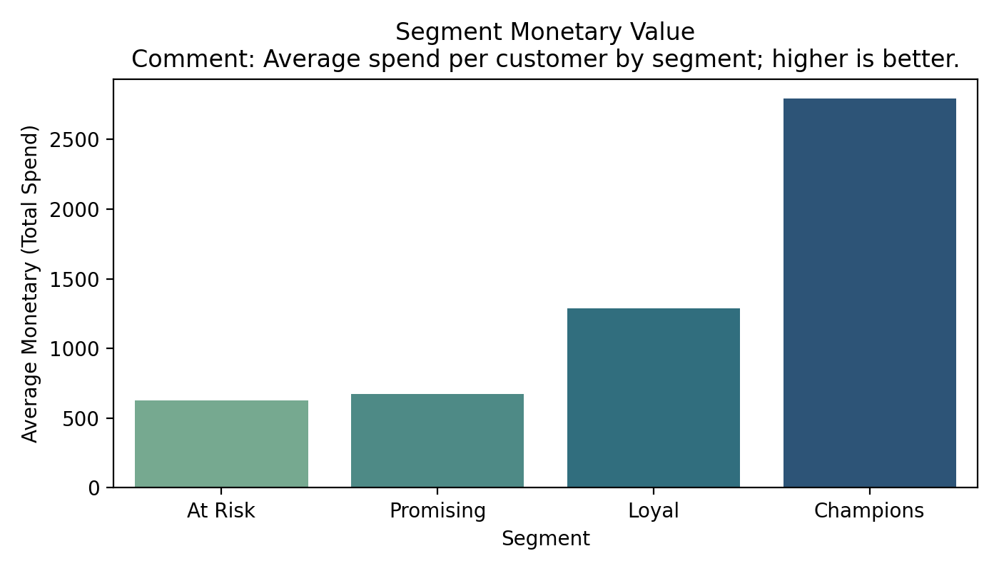
4.2) Distribution of customers across behavior-based segments:

Slide 18
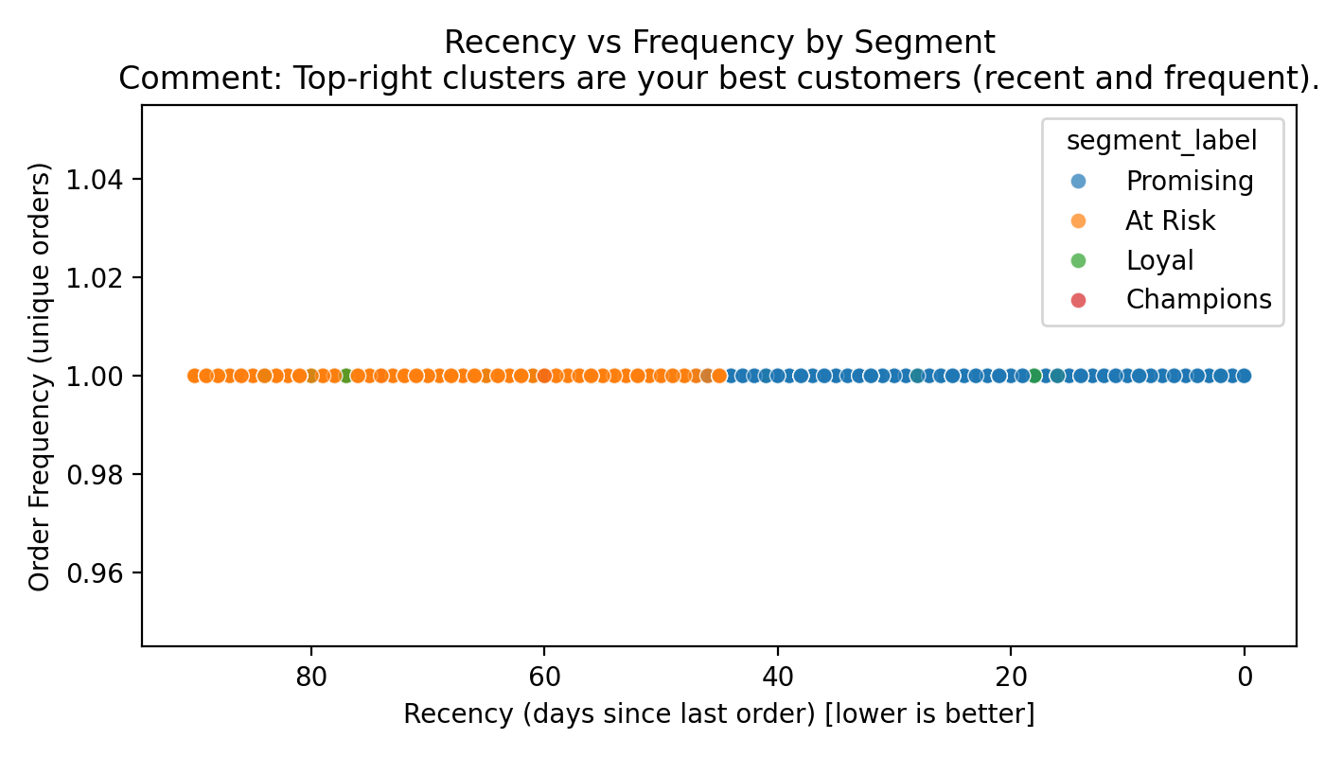
4.3) Average spend per customer by segment; higher bars indicate
More valuable segments:

Slide 19
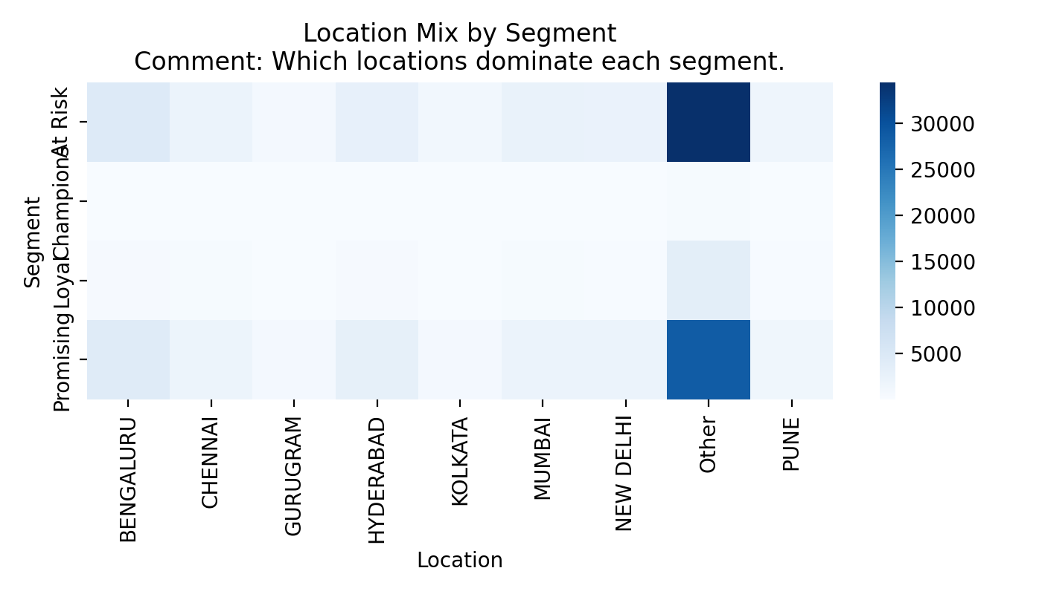
4.4) Recency vs Frequency by segment. Top-right (recent and frequent)
are your best customers:

Slide 20
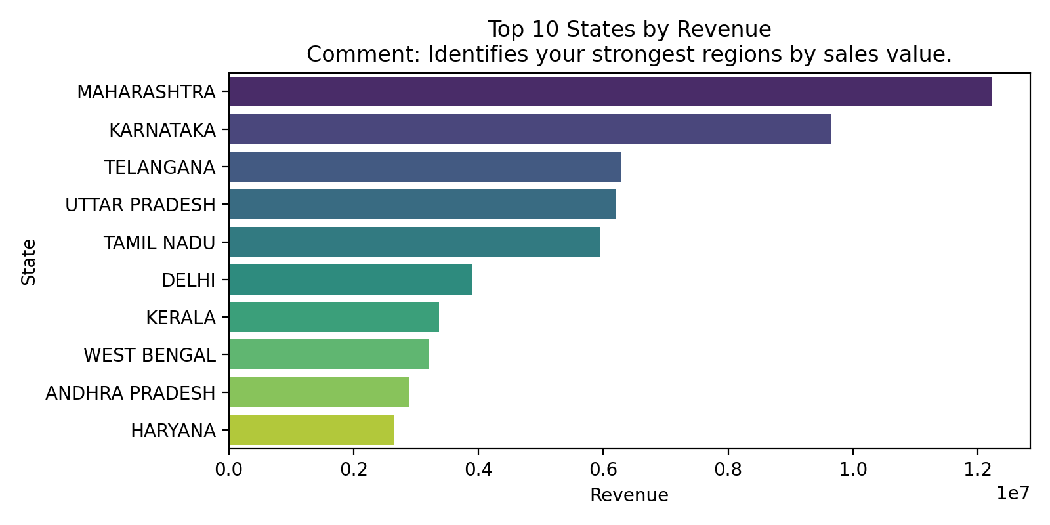
5) Geographical Analysis:
Explore the geographical distribution of sales, focusing on states and cities
5.1) Top 10 States by Revenue:

Slide 21
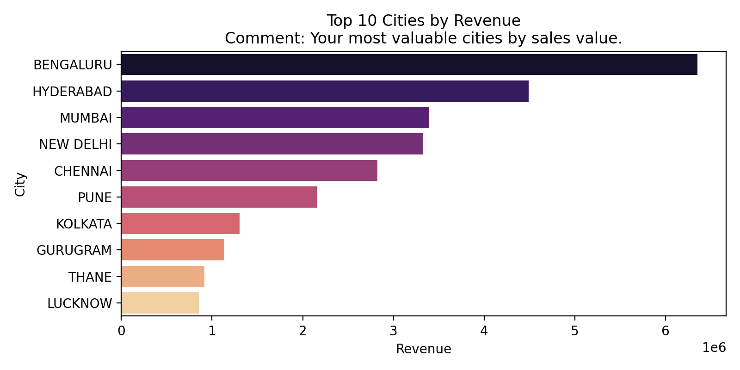
5.2) Top 10 Cities by Revenue:

Slide 22
5.2.1) Top 10 Cities by Revenue:
No. | Ship-city | Amount
1) | BENGALURU | ₹ 6845391
2) | HYDERABAD | ₹ 4946394
3) | MUMBAI | ₹ 3701843
4) | NEW DELHI | ₹ 3612513
5) | CHENNAI | ₹ 3103416
6) | PUNE | ₹ 2342011
7) | KOLKATA | ₹ 1413604
8) | GURUGRAM | ₹ 1220563
9) | THANE | ₹ 1004503
10) | LUCKNOW | ₹ 938076.3

Slide 23
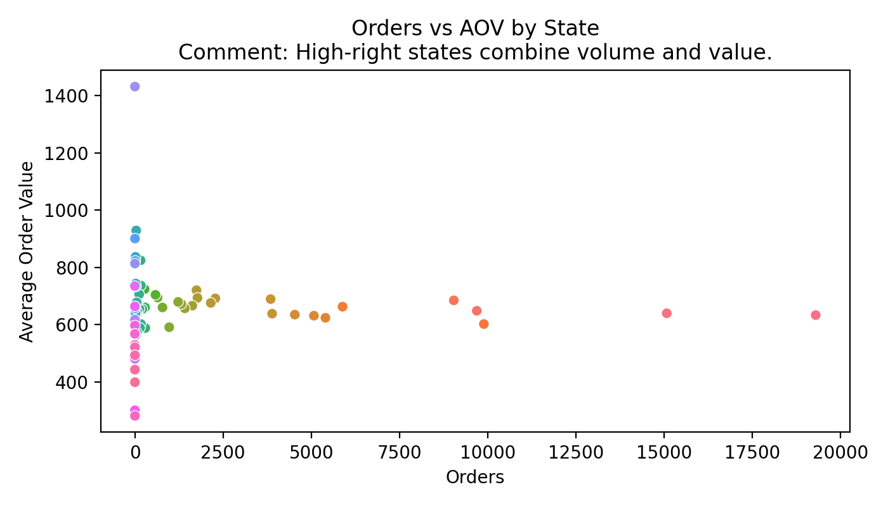
5.3) Orders vs AOV by States:

Slide 24
Business Insights & Recommendations
Sales Optimization
Double down on top cities with localized ads, faster delivery promises, and city-specific bundles.
Run A/B tests on price points for best-sellers to balance margin and volume; monitor AOV and conversion lift daily.
Create cross-sell bundles by size/category affinity; feature them on product detail pages and post-purchase emails.
Inventory Management
Allocate safety stock to top-performing cities/sizes; reduce overstock in long-tail sizes.
Use the daily pattern to schedule replenishments earlier in the week if weekends spike.
Implement min-max reorder thresholds based on 4–8 week rolling demand and lead times per size.
Customer Experience
For repeat buyers and high RFM segments, offer expedited shipping and hassle-free returns.
Improve size guidance: add fit notes and size charts for top-returned size-product combos to reduce exchanges.
Use proactive delivery notifications during peak days to reduce WISMO contacts and improve CSAT.

Slide 25
Market Expansion
Identify next-5 cities by growth trajectory (not just current revenue) and pilot micro-fulfillment or local courier tie-ups.
Expand assortment in adjacent categories strongly correlative with your top sellers (based on co-purchase patterns).
Explore marketplace ads targeted to underpenetrated regions with the best conversion-adjusted CPC.

