Slide 1
COMPILER DESIGN
COMP 442/6421 – Compiler Design
Lexical analysis
Joey Paquet, 2000-2023

Slide 2
Lexical analysis
COMP 442/6421 – Compiler Design
Lexical analysis is the process of converting a sequence of characters into a sequence of tokens.
A program or function which performs lexical analysis is called a lexical analyzer, a lexer or a scanner.
A scanner often exists as a single function which is called by the parser, whose functionality is to extract the next token from the source code.
The lexical specification of a programming language is defined by a set of rules which defines the scanner, which are understood by a lexical analyzer generator such as lex or flex. These are most often expressed as regular expressions.
The lexical analyzer (either generated automatically by a tool like lex, or hand-crafted) reads the source code as a stream of characters, identifies the lexemes in the stream, categorizes them into tokens, and outputs a token stream.
This is called "tokenizing."
If the scanner finds an invalid token, it will report a lexical error.
Joey Paquet, 2000-2023

Slide 3
Roles of the scanner
COMP 442/6421 – Compiler Design
Removal of comments
  Comments are not part of the program’s meaning
    Multiple-line comments?
    Nested comments?
Case conversion
  Is the lexical definition case sensitive?
    For identifiers
    For keywords
Joey Paquet, 2000-2023

Slide 4
Roles of the scanner
COMP 442/6421 – Compiler Design
Removal of white spaces
  Blanks, tabulars, carriage returns
  Is it possible to identify tokens in a program without spaces?
Interpretation of compiler directives
  #include, #ifdef, #ifndef and #define are directives to “redirect the input” of the compiler
  May be done by a pre-compiler
Initial creation of the symbol table
  A symbol table entry is created when an identifier is encountered
  The lexical analyzer cannot create the whole entries
  Can convert literals to their value and assign a type
Convert the input file to a token stream
  Input file is a character stream
  Lexical specifications: literals, operators, keywords, punctuation
Joey Paquet, 2000-2023

Slide 5
Lexical specifications: tokens and lexemes
COMP 442/6421 – Compiler Design
Token: An element of the lexical definition of the language.
Lexeme: A sequence of characters identified as a token.
Token | Lexeme
id | distance,rate,time,a,x
relop | >=,<,==
openpar | (
if | if
then | then
assignop | =
semi | ;
Joey Paquet, 2000-2023

Slide 6
COMP 442/6421 – Compiler Design
Design of a lexical analyzer
Joey Paquet, 2000-2023

Slide 7
Design of a lexical analyser
COMP 442/6421 – Compiler Design
Procedure
  Construct a set of regular expressions (REs) that define the form of any valid token
  Derive an NFA from the REs
  Derive a DFA from the NFA
  Translate the DFA to a state transition table
  Implement the table
  Implement the algorithm to interpret the table
This is exactly the procedure that a scanner generator is implementing.
Scanner generators include:
  Lex, flex
  Jlex
  Alex
  Lexgen
  re2c
Joey Paquet, 2000-2023

Slide 8
Regular expressions
COMP 442/6421 – Compiler Design
ε : { }
s : {s | s in s^}
a : {a}
r | s : {r | r in r^} or {s | s in s^}
s* : {s^{n} | s in s^ and n>=0}
s⁺ : {s^{n} | s in s^ and n>=1}
id ::= letter(letter|digit)*
Joey Paquet, 2000-2023

Slide 9
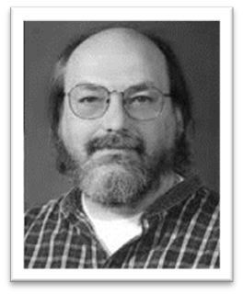
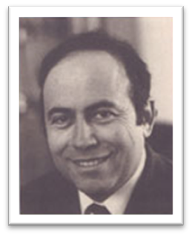
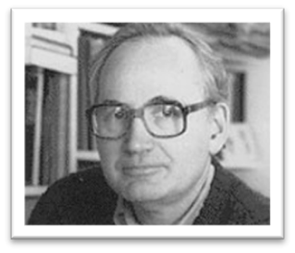
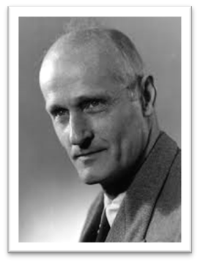
Deriving DFA from REs
COMP 442/6421 – Compiler Design
Thompson’s construction is an algorithm invented by Ken Thompson in 1968 to translate regular expressions into an NFA.
Rabin-Scott powerset construction is an algorithm invented by Michael O. Rabin and Dana Scott in 1959 to transform an NFA to a DFA.
Kleene’s algorithm, is an algorithm invented by Stephen Cole Kleene in 1956 to transform a DFA into a regular expression.
These algorithms are the basis of the implementation of all scanner generators.
Ken Thompson
Dana Scott
Michael O. Rabin
Stephen Cole Kleene
Joey Paquet, 2000-2023

Slide 10
COMP 442/6421 – Compiler Design
Thompson’s construction
Joey Paquet, 2000-2023

Slide 11
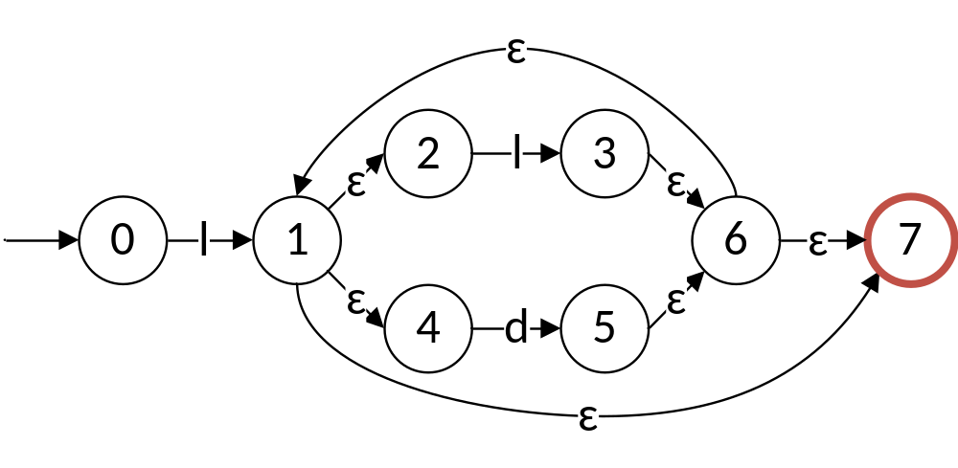
REs to NDFA: Thompson’s construction
COMP 442/6421 – Compiler Design
id ::= letter(letter|digit)*
Joey Paquet, 2000-2023

Slide 12

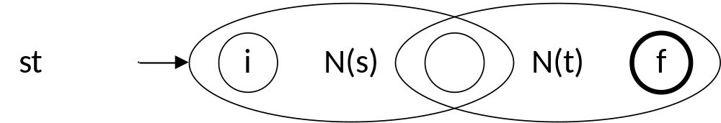
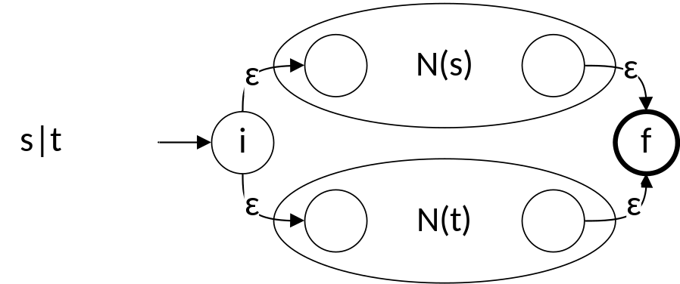
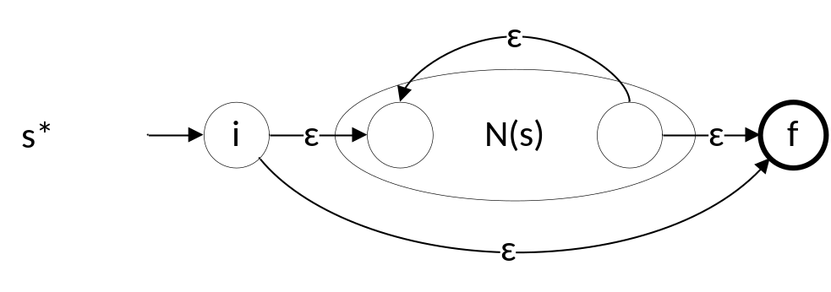
Thompson’s construction
COMP 442/6421 – Compiler Design
Thompson’s construction works recursively by splitting an expression into its constituent subexpressions.
Each subexpression corresponds to a subgraph.
Each subgraph is then grafted with other subgraphs depending on the nature of the composed subexpression, i.e.
  An atomic lexical symbol
  A concatenation expression
  A union expression
  A Kleene star expression
Joey Paquet, 2000-2023

Slide 13




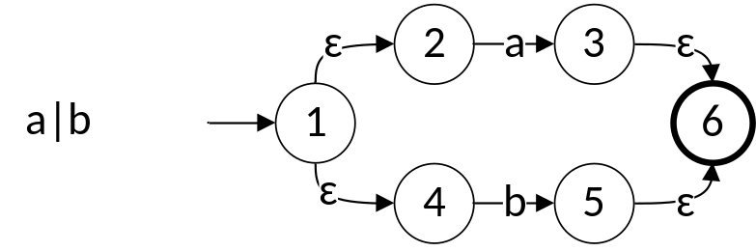
Thompson’s construction: example
COMP 442/6421 – Compiler Design
(a|b)*abb
Joey Paquet, 2000-2023

Slide 14

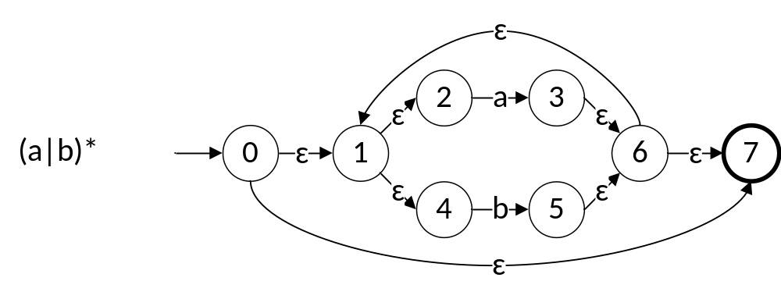
Thompson’s construction: example
COMP 442/6421 – Compiler Design
(a|b)*abb
Joey Paquet, 2000-2023

Slide 15
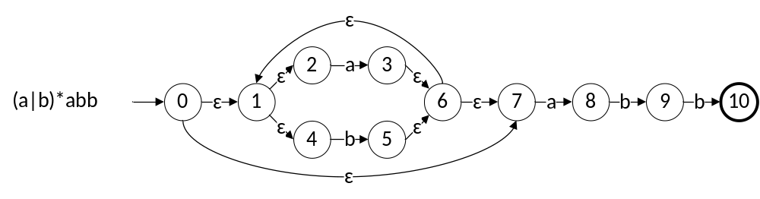
Thompson’s construction: example
COMP 442/6421 – Compiler Design
(a|b)*abb
Joey Paquet, 2000-2023

Slide 16
COMP 442/6421 – Compiler Design
Rabin-Scott powerset construction
Joey Paquet, 2000-2023

Slide 17
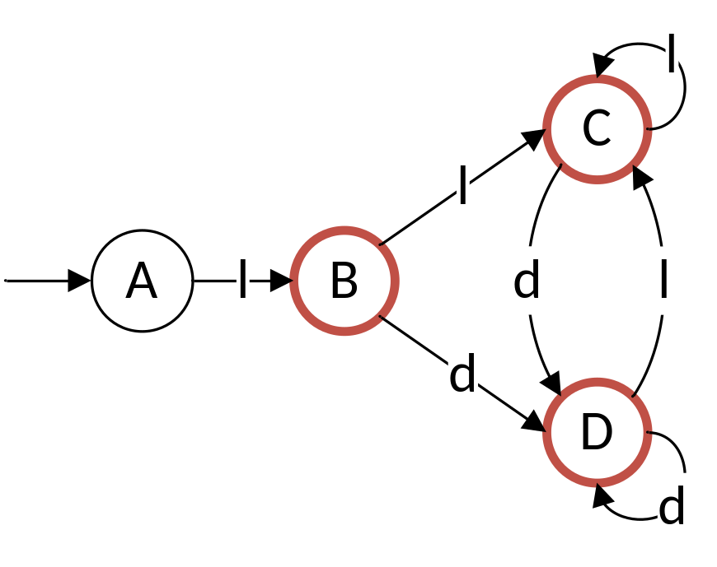
Rabin-Scott powerset construction: concepts
COMP 442/6421 – Compiler Design
S_{DFA}: set of states in the DFA
S_{NFA}: set of states in the NFA
Σ: set of all symbols in the lexical specification (alphabet).
ɛ-closure(S): set of states in the NFA that can be reached with ɛ transitions from any element of the set of states S, including the state itself.
Move_{NFA}(T,a): state in S_{NFA} to which there is a transition from one of the states in states set T, having encountered symbol a.
Move_{DFA}(T,a): state in S_{DFA} to which there is a transition from one of the states in states set T, having encountered symbol a.
id ::= letter(letter|digit)*
Joey Paquet, 2000-2023

Slide 18
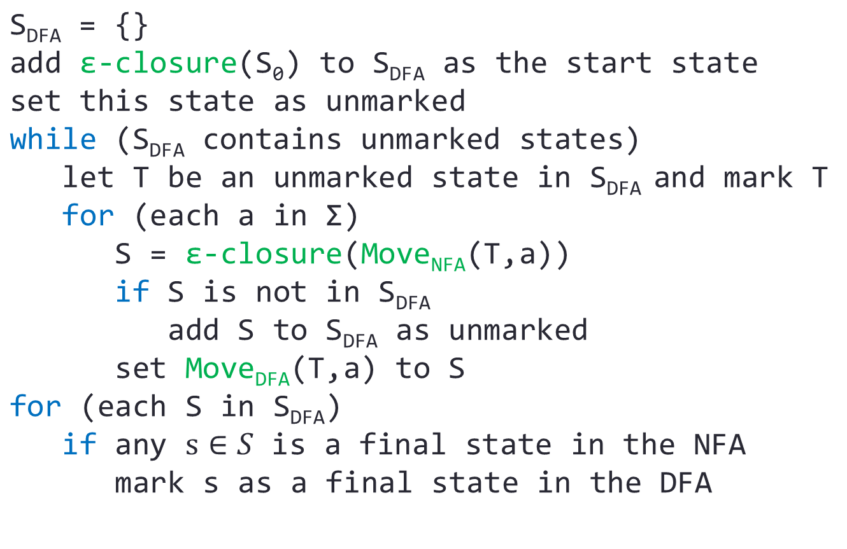
Rabin-Scott powerset construction: algorithm
COMP 442/6421 – Compiler Design
Joey Paquet, 2000-2023

Slide 19
Rabin-Scott powerset construction: example
COMP 442/6421 – Compiler Design
Joey Paquet, 2000-2023

Slide 20

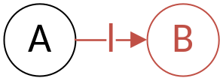
Rabin-Scott powerset construction: example
COMP 442/6421 – Compiler Design
Starting state A = ɛ-closure(0) = {0}
S_{DFA} = {A:{0}}
State A:{0}
  move_{DFA}(A,l)
  = ɛ-closure(move_{NFA}(A,l))
  = ɛ-closure({1})
  = {1,2,4,7}
  = B
  S_{DFA} = {A:{0},B:{1,2,4,7}}
  move_{DFA}(A,d)
  = ɛ-closure(move_{NFA}(A,d))
  = ɛ-closure({})
  = {}
  S_{DFA} = {A:{0},B:{1,2,4,7}}
{0}
{1,2,4,7}
Joey Paquet, 2000-2023

Slide 21
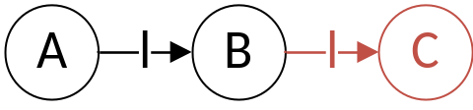
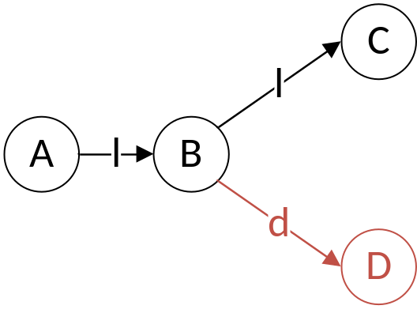
Rabin-Scott powerset construction: example
COMP 442/6421 – Compiler Design
State B:{1,2,4,7}
  move_{DFA}(B,l)
  = ɛ-closure(move_{NFA}(B,l))
  = ɛ-closure({3})
  = {1,2,3,4,6,7}
  = C
  S_{DFA}={A:{0},B:{1,2,4,7},C:{1,2,3,4,6,7}}
  move_{DFA}(B,d)
  = ɛ-closure(move_{NFA}(B,d))
  = ɛ-closure({5})
  = {1,2,4,5,6,7}
  = D
  S_{DFA}={A:{0},B:{1,2,4,7},C:{1,2,3,4,6,7},D:{1,2,4,5,6,7}}
{1,2,3,4,6,7}
{1,2,4,5,6,7}
Joey Paquet, 2000-2023

Slide 22
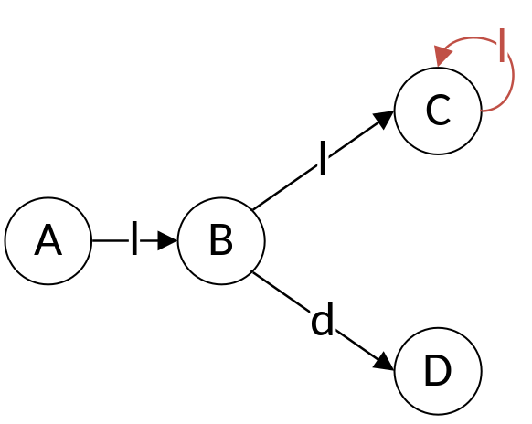
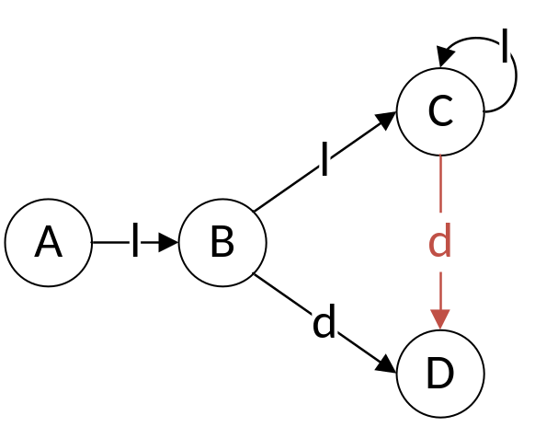
Rabin-Scott powerset construction: example
COMP 442/6421 – Compiler Design
State C:{1,2,3,4,6,7}
  move_{DFA}(C,l)
  = ɛ-closure(move_{NFA}(C,l))
  = ɛ-closure({3})
  = {1,2,3,4,6,7}
  = C
  S_{DFA}={A:{0},B:{1,2,4,7},C:{1,2,3,4,6,7},D:{1,2,4,5,6,7}}
  move_{DFA}(C,d)
  = ɛ-closure(move_{NFA}(C,d))
  = ɛ-closure({5})
  = {1,2,4,5,6,7}
  = D
  S_{DFA}={A:{0},B:{1,2,4,7},C:{1,2,3,4,6,7},D:{1,2,4,5,6,7}}
{1,2,3,4,6,7}
{1,2,4,5,6,7}
Joey Paquet, 2000-2023

Slide 23
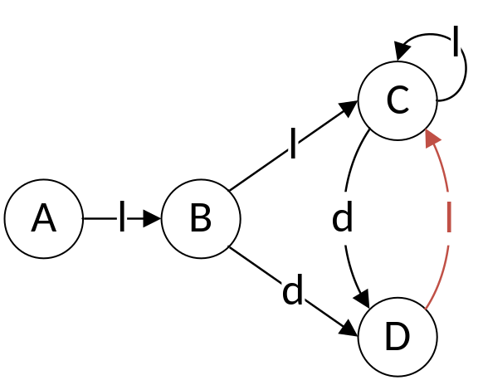
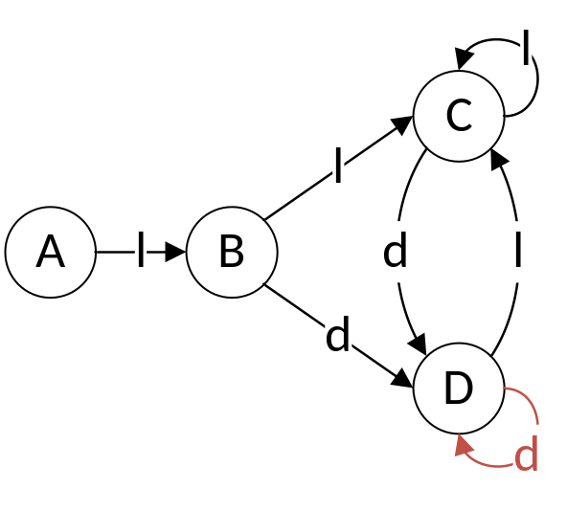
Rabin-Scott powerset construction: example
COMP 442/6421 – Compiler Design
State D:{1,2,4,5,6,7}
  move_{DFA}(D,l)
  = ɛ-closure(move_{NFA}(D,l))
  = ɛ-closure({3})
  = {1,2,3,4,6,7}
  = C
  S_{DFA}={A:{0},B:{1,2,4,7},C:{1,2,3,4,6,7},D:{1,2,4,5,6,7}}
  move_{DFA}(D,d)
  = ɛ-closure(move_{NFA}(D,d))
  = ɛ-closure({5})
  = {1,2,4,5,6,7}
  = D
  S_{DFA}={A:{0},B:{1,2,4,7},C:{1,2,3,4,6,7},D:{1,2,4,5,6,7}}
{1,2,3,4,6,7}
{1,2,4,5,6,7}
Joey Paquet, 2000-2023

Slide 24
Rabin-Scott powerset construction: example
COMP 442/6421 – Compiler Design
Final states:
{1,2,3,4,6,7}
{0}
{1,2,4,7}
{1,2,4,5,6,7}
Joey Paquet, 2000-2023

Slide 25
Generate state transition table
COMP 442/6421 – Compiler Design
state | letter | digit | final
A | B |  | N
B | C | D | Y
C | C | D | Y
D | C | D | Y
Joey Paquet, 2000-2023

Slide 26
COMP 442/6421 – Compiler Design
Implementation
Joey Paquet, 2000-2023

Slide 27
Implementation concerns
COMP 442/6421 – Compiler Design
Backtracking
  Principle : A token is normally recognized only when the next character is read.
  Problem : Maybe this character is part of the next token.
  Example : x<1 “<“ is recognized only when “1” is read. In this case, we have to backtrack one character to continue token recognition without skipping the first character of the next token.
  Solution : include the occurrence of these cases in the state transition table.
Ambiguity
  Problem : Some tokens’ lexemes are subsets of other tokens.
  Example :
    n-1. Is it <n><-><1> or <n><-1>?
  Solutions :
    Postpone the decision to the syntactic analyzer
    Do not allow sign prefix to numbers in the lexical specification
    Interact with the syntactic analyzer to find a solution. (Induces coupling)
Joey Paquet, 2000-2023

Slide 28
Example
COMP 442/6421 – Compiler Design
Alphabet :
  {:, *, =, (, ), <, >, {, }, [a..z], [0..9]}
Simple tokens :
  {(, ), :, <, >}
Composite tokens :
  {:=, >=, <=, <>, (*, *)}
Words :
  id ::= letter(letter | digit)*
  num ::= digit⁺
  {…} or (*…*) represent comments
Joey Paquet, 2000-2023

Slide 29
Example
COMP 442/6421 – Compiler Design
Ambiguity problems
Solution: Backtracking
  Must back up a character when we read a character that is part of the next token.
  Each case is encoded in the table
character | possible tokens
: | :, :=
> | >, >=
< | <, <=, <>
( | (, (*
* | *, *)
Joey Paquet, 2000-2023

Slide 30
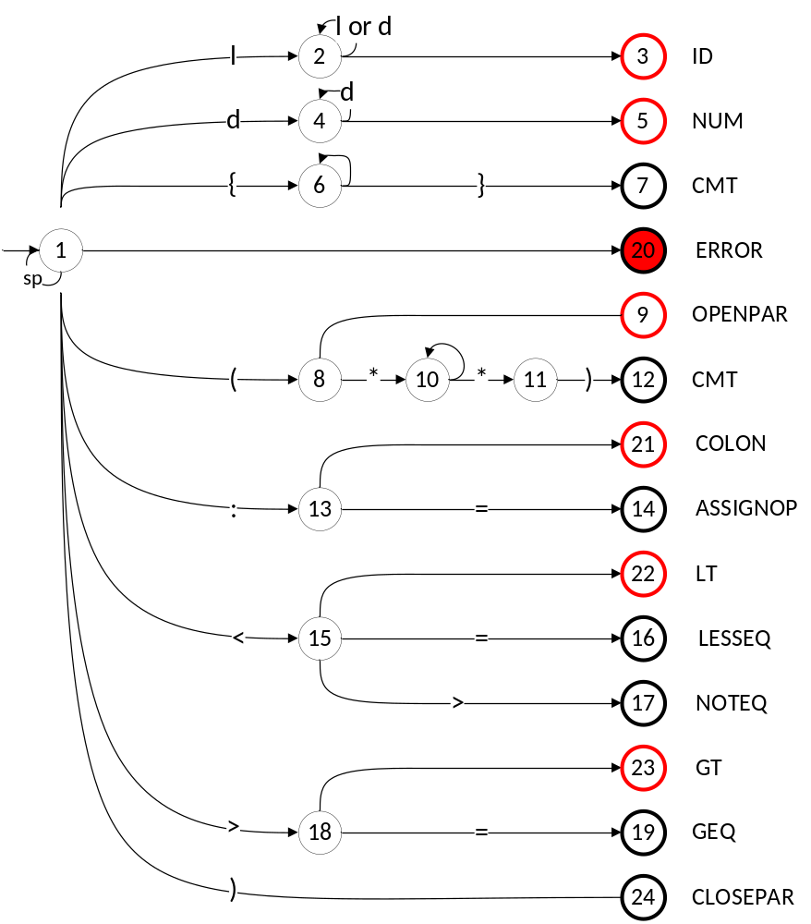
Example - DFA
COMP 442/6421 – Compiler Design
Joey Paquet, 2000-2023

Slide 31
Table-driven scanner – state transition table
COMP 442/6421 – Compiler Design
 | l | d | { | } | ( | * | ) | : | = | < | > | sp | final [token] | Backtrack
1 | 2 | 4 | 6 | 20 | 8 | 20 | 20 | 13 | 20 | 15 | 18 | 1
2 | 2 | 2 | 3 | 3 | 3 | 3 | 3 | 3 | 3 | 3 | 3 | 3
3 | 1 | 1 | 1 | 1 | 1 | 1 | 1 | 1 | 1 | 1 | 1 | 1 | yes [ id ] | yes
4 | 5 | 4 | 5 | 5 | 5 | 5 | 5 | 5 | 5 | 5 | 5 | 5
5 | 1 | 1 | 1 | 1 | 1 | 1 | 1 | 1 | 1 | 1 | 1 | 1 | yes [ num ] | yes
6 | 6 | 6 | 6 | 7 | 6 | 6 | 6 | 6 | 6 | 6 | 6 | 6
7 | 1 | 1 | 1 | 1 | 1 | 1 | 1 | 1 | 1 | 1 | 1 | 1 | yes [ cmt ] | no
8 | 9 | 9 | 9 | 9 | 9 | 10 | 9 | 9 | 9 | 9 | 9 | 9
9 | 1 | 1 | 1 | 1 | 1 | 1 | 1 | 1 | 1 | 1 | 1 | 1 | yes [ openpar ] | no
10 | 10 | 10 | 10 | 10 | 10 | 11 | 10 | 10 | 10 | 10 | 10 | 10
11 | 10 | 10 | 10 | 10 | 10 | 10 | 12 | 10 | 10 | 10 | 10 | 10
12 | 1 | 1 | 1 | 1 | 1 | 1 | 1 | 1 | 1 | 1 | 1 | 1 | yes [ cmt ] | yes
13 | 21 | 21 | 21 | 21 | 21 | 21 | 21 | 21 | 14 | 21 | 21 | 21
14 | 1 | 1 | 1 | 1 | 1 | 1 | 1 | 1 | 1 | 1 | 1 | 1 | yes [ assgn ] | no
15 | 22 | 22 | 22 | 22 | 22 | 22 | 22 | 22 | 16 | 22 | 17 | 22
16 | 1 | 1 | 1 | 1 | 1 | 1 | 1 | 1 | 1 | 1 | 1 | 1 | yes [ lesseq ] | no
17 | 1 | 1 | 1 | 1 | 1 | 1 | 1 | 1 | 1 | 1 | 1 | 1 | yes [ noteq ] | no
18 | 23 | 23 | 23 | 23 | 23 | 23 | 23 | 23 | 19 | 23 | 23 | 23
19 | 1 | 1 | 1 | 1 | 1 | 1 | 1 | 1 | 1 | 1 | 1 | 1 | yes [ gt ] | no
20 | 1 | 1 | 1 | 1 | 1 | 1 | 1 | 1 | 1 | 1 | 1 | 1 | yes [ err ] | no
21 | 1 | 1 | 1 | 1 | 1 | 1 | 1 | 1 | 1 | 1 | 1 | 1 | yes [ colon ] | yes
22 | 1 | 1 | 1 | 1 | 1 | 1 | 1 | 1 | 1 | 1 | 1 | 1 | yes [ lt ] | yes
23 | 1 | 1 | 1 | 1 | 1 | 1 | 1 | 1 | 1 | 1 | 1 | 1 | yes [ gt ] | yes
24 | 1 | 1 | 1 | 1 | 1 | 1 | 1 | 1 | 1 | 1 | 1 | 1 | yes [ closepar ] | no
Joey Paquet, 2000-2023

Slide 32
Table-driven scanner - algorithm
COMP 442/6421 – Compiler Design
nextToken()
state = 1
token = null
do
lookup = nextChar()
state = table(state, lookup)
if (isFinalState(state))
token = createToken(state)
if (table(state, “backup”) == yes)
backupChar()
until (token != null)
return (token)
Joey Paquet, 2000-2023

Slide 33
Table-driven scanner – functions
COMP 442/6421 – Compiler Design
nextToken()
  Extract the next token in the program (called by syntactic analyzer)
nextChar()
  Read the next character in the input program
backupChar()
  Back up one character in the input file in case we have just read the next character in order to resolve an ambiguity
isFinalState(state)
  Returns TRUE if state is a final state
table(state, column)
  Returns the value corresponding to [state, column] in the state transition table.
createToken(state)
  Creates and returns a structure that contains the token type, its location in the source code, and its value (for literals), for the token kind corresponding to a state, as found in the state transition table.
Joey Paquet, 2000-2023

Slide 34
Hand-written scanner
COMP 442/6421 – Compiler Design
nextToken()
c = nextChar()
case (c) of
"[a..z],[A..Z]":
c = nextChar()
while (c in {[a..z],[A..Z],[0..9]}) do
s = makeUpString()
c = nextChar()
if ( isReservedWord(s) )then
token = createToken(RESWORD,null)
else
token = createToken(ID,s)
backupChar()
"[0..9]":
c = nextChar()
while (c in [0..9]) do
v = makeUpValue()
c = nextChar()
token = createToken(NUM,v)
backupChar()
Joey Paquet, 2000-2023

Slide 35
Hand-written scanner
COMP 442/6421 – Compiler Design
"{":
c = nextChar()
while ( c != "}" ) do
c = nextChar()
"(":
c = nextChar()
if ( c == "*" ) then
c = nextChar()
repeat
while ( c != "*" ) do
c = nextChar()
c = nextChar()
until ( c != ")" )
else
token = createToken(LPAR,null)
":":
c = nextChar()
if ( c == "=" ) then
token = createToken(ASSIGNOP,null)
else
token = createToken(COLON,null)
backupChar()
Joey Paquet, 2000-2023

Slide 36
Hand-written scanner
COMP 442/6421 – Compiler Design
"<":
c = nextChar()
if ( c == "=" ) then
token = createToken(LEQ,null)
else if ( c == ">" ) then
token = createToken(NEQ,null)
else
token = createToken(LT,null)
backupChar()
">":
c = nextChar()
if ( c == "=" ) then
token = createToken(GEQ,null)
else
token = createToken(GT,null)
backupChar()
")":
token = createToken(RPAR,null)
"*":
token = createToken(STAR,null)
"=":
token = createToken(EQ,null)
end case
return token
Joey Paquet, 2000-2023

Slide 37
COMP 442/6421 – Compiler Design
Error-recovery in lexical analysis
Joey Paquet, 2000-2023

Slide 38
Possible lexical errors
COMP 442/6421 – Compiler Design
Depends on the accepted conventions:
  Invalid character
  letter not allowed to terminate a number
  numerical overflow
  identifier too long
  end of line before end of string
  Are these lexical errors?
  123a
    <Error> or <num><id>?
  123456789012345678901234567
    <Error> related to machine’s limitations
  “Hello <CR> world”
    Either <CR> is skipped or <Error>
  ThisIsAVeryLongVariableNameThatIsMeantToConveyMeaning = 1
    Limit identifier length?
Joey Paquet, 2000-2023

Slide 39
Lexical error recovery techniques
COMP 442/6421 – Compiler Design
Finding only the first error and stopping the compilation is not acceptable
Panic Mode:
  Skip characters until a valid character is read
Guess Mode:
  do pattern matching between erroneous strings and valid strings
  Example: (beggin vs. begin)
  Rarely implemented
Joey Paquet, 2000-2023

Slide 40
COMP 442/6421 – Compiler Design
Conclusions
Joey Paquet, 2000-2023

Slide 41
Possible implementations
COMP 442/6421 – Compiler Design
Lexical Analyzer Generator (e.g. Lex)
  safe, quick
  Must learn software, often unable to handle unusual situations
Table-Driven Lexical Analyzer
  general and adaptable method, same function can be used for all table-driven lexical analyzers
  Building transition table can be tedious and error-prone – should use tools to generate the table from regular expressions or DFA.
Hand-written
  Can be optimized, can handle any unusual situation, easy to build for most languages
  Error-prone, not adaptable or maintainable
Joey Paquet, 2000-2023

Slide 42
Lexical analyzer’s modularity
COMP 442/6421 – Compiler Design
Why should the Lexical Analyzer and the Syntactic Analyzer be separated?
  Modularity/Maintainability : system is more modular, thus more maintainable
  Efficiency : modularity = task specialization = easier optimization
  Reusability : can change the whole lexical analyzer without changing other parts
Joey Paquet, 2000-2023

Slide 43
References
COMP 442/6421 – Compiler Design
C.N. Fischer, R.K. Cytron, R.J. LeBlanc Jr., Crafting a Compiler, Adison-Wesley, 2010 – Chapter 3.
R. McNaughton, H. Yamada (Mar 1960). "Regular Expressions and State Graphs for Automata". IEEE Trans. on Electronic Computers 9 (1): 39–47. doi:10.1109/TEC.1960.5221603
Ken Thompson (Jun 1968). "Programming Techniques: Regular expression search algorithm". Communications of the ACM 11 (6): 419–422. doi:10.1145/363347.363387
Rabin, M. O.; Scott, D. (1959). "Finite automata and their decision problems". IBM Journal of Research and Development 3 (2): 114–125. doi:10.1147/rd.32.0114
Russ Cox. Implementing Regular Expressions.
Russ Cox. Regular Expression Matching Can Be Simple And Fast.
CyberZHG. Regular Expression to NFA, to DFA.
Joey Paquet, 2000-2023

