Slide 1
⚡ MAHARERA REAL ESTATE PLATFORM
BuildIntel
Automated Data Collection, Exploration, and Intelligence Platform
A modern full-stack web application designed to collect, organize, and analyze real-estate project filings across all 36 districts of Maharashtra.
✓ Automated Scraper
Collects projects & builders on demand
✓ Live Dashboard
Tracks filings across 36 districts
✓ Developer Portfolios
Maps projects to builder entities
✓ Excel Export
Multi-sheet formatted offline reports
Live Website Demo & Visual Walkthrough • Developed by Harsh Shrivastava

Slide 2
PROJECT BACKGROUND
The Real-Estate Data Challenge & Our Solution
Transforming a slow public registry into high-speed, structured intelligence.
⚠️ The Problem: Government Portal Bottlenecks
• Slow & Clunky Navigation: The official MahaRERA portal is often sluggish, requiring manual paginated browsing across hundreds of slow web pages.
• No Cross-District Search: Users cannot easily compare filings or search across multiple districts at the same time.
• No Developer Portfolio View: Projects are listed individually. Finding all projects registered by a single builder requires tedious repeated searches.
• No Bulk Export: Researchers and investors have to manually copy-paste data with no direct Excel or CSV download options.
💡 The Solution: BuildIntel Intelligence Platform
✓ Automated Python Scraper: Dispatches polite background jobs that parse, clean, and store project filings with automatic deduplication.
✓ Sub-Second Search & Filters: Instantly search by project name, registration ID, district, and pincode with server-side pagination.
✓ Builder Entity Intelligence: Normalizes promoter entities so you can inspect an entire developer portfolio in one click.
✓ 1-Click Excel Workbooks: Generates clean, styled Microsoft Excel files with frozen headers and clickable MahaRERA links.

Slide 3
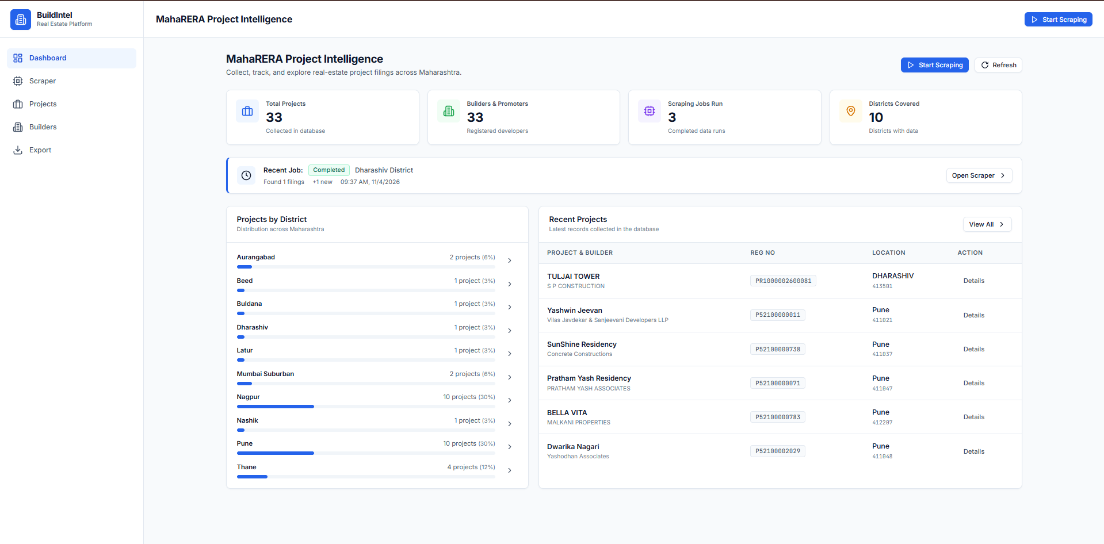
SCREEN 1 • DASHBOARD
Executive Dashboard — Real-Time Platform Overview
A central command center displaying key metrics, recent scrape jobs, and district distributions.
1
4 Real-Time Metric Counters
Monitors Total Projects (33+), Registered Builders (33), Scraping Jobs Executed (3), and Maharashtra Districts covered (10).
🔒 localhost:4200/dashboard
2
Recent Job Status Banner
Displays the outcome of the latest scrape run (e.g., Dharashiv District) with quick action to open the scraper control panel.
3
District Distribution & Recent Feeds
Visual progress bars showcase filings by region (Pune, Nagpur, Thane, etc.) along with the latest collected project filings.
✓ Live platform screenshot captured from local BuildIntel instance

Slide 4
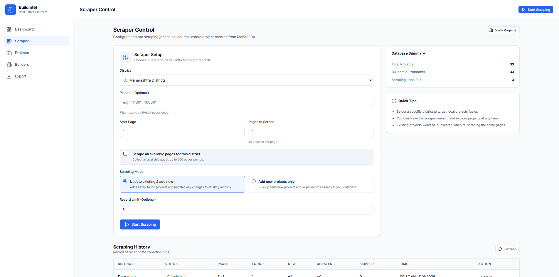
SCREEN 2 • SCRAPER CONTROL
Scraper Control — Automated On-Demand Data Collection
Trigger background scraping tasks directly from the web interface without touching the command line.
1
Customizable District & Pincode Filters
Select from all 36 Maharashtra districts or specify a 6-digit postal code to pinpoint specific regional projects.
🔒 localhost:4200/scraper
2
Flexible Modes & Page Limits
Choose 'Update Existing & Add New' (upsert) or 'Add New Only'. Set custom start pages and safety record limits.
3
Live Scraping History & Logs
Track previous scraping runs, including pages processed, new projects added, updated records, and timestamps.
✓ Live platform screenshot captured from local BuildIntel instance

Slide 5
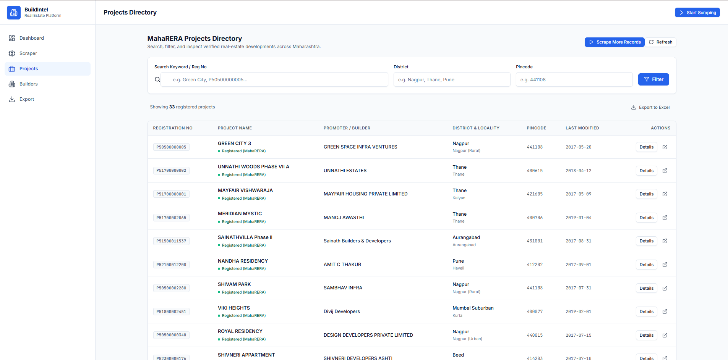
SCREEN 3 • PROJECTS EXPLORER
Projects Directory — Multi-Filter Search & Inspection
Browse verified real-estate projects with instant server-side search and official links.
1
Instant Multi-Criteria Search
Search by project name, official registration number (e.g., P50500000005), district name, or postal pincode.
🔒 localhost:4200/projects
2
Official MahaRERA Status Badges
Every row displays the certified MahaRERA registration number, promoter legal name, location, and last modified date.
3
1-Click Deep Dive & External Portal Link
Open the project detail modal inside BuildIntel, or click the external icon to visit the official government filing page.
✓ Live platform screenshot captured from local BuildIntel instance

Slide 6
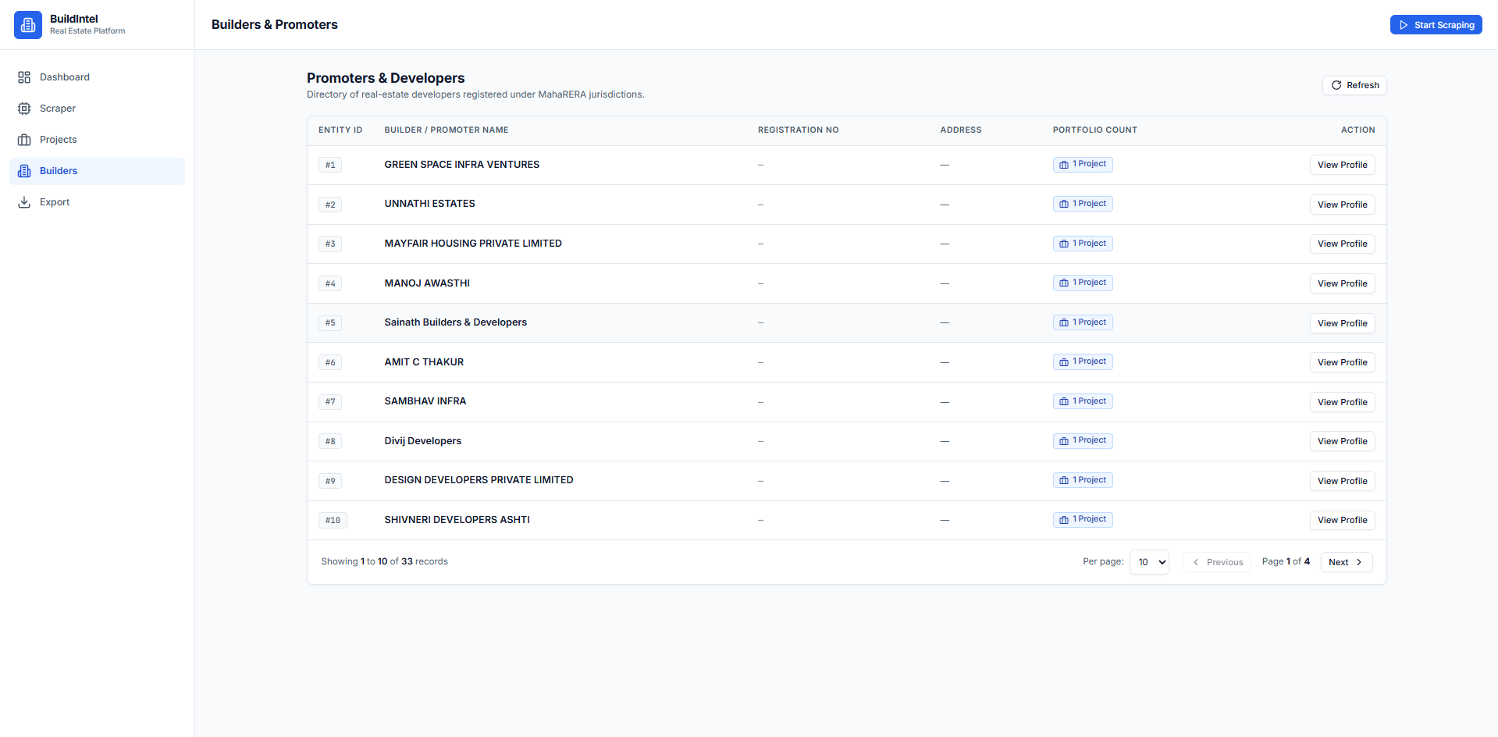
SCREEN 4 • BUILDERS DIRECTORY
Builders & Promoters — Developer Portfolio Intelligence
Track real-estate developer companies and inspect all their registered developments.
1
Normalized Developer Entities
Eliminates duplicate builder records by automatically linking newly scraped projects to existing builder profiles.
🔒 localhost:4200/builders
2
Portfolio Project Badges
Quickly view how many total projects each builder has registered across different regions of Maharashtra.
3
Direct Developer Profile View
Click 'View Profile' on any developer to see their complete history, registered address, and active project list.
✓ Live platform screenshot captured from local BuildIntel instance

Slide 7
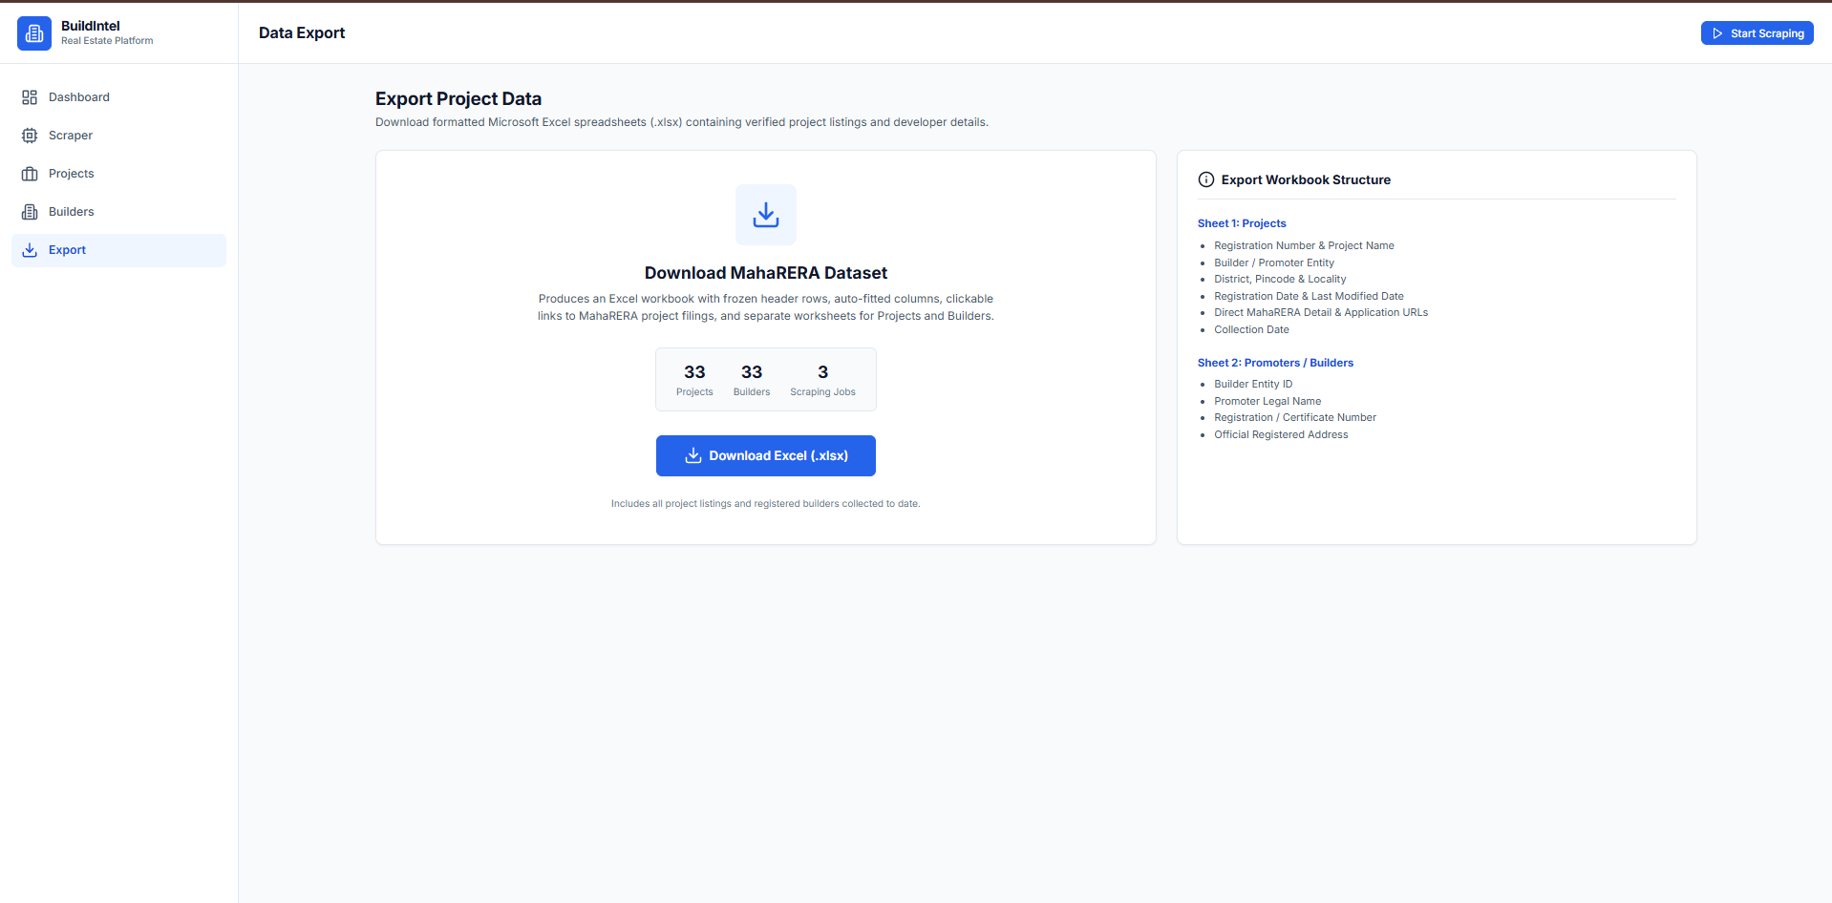
SCREEN 5 • EXPORT WORKBOOKS
Excel Data Export — Offline Due Diligence & Reporting
Generate beautifully styled Microsoft Excel workbooks ready for financial modeling and offline review.
1
1-Click Instant Excel Download
Produces a clean .xlsx spreadsheet directly from PostgreSQL with a single click from the browser.
🔒 localhost:4200/export
2
Dual-Worksheet Architecture
Separates data into two dedicated tabs: 'Projects' (full property records) and 'Builders' (company legal entities).
3
Executive Spreadsheet Formatting
Features frozen header rows, auto-fitted columns, professional color styling, and clickable hyperlinks to MahaRERA filings.
✓ Live platform screenshot captured from local BuildIntel instance

Slide 8
TECHNICAL ARCHITECTURE
System Architecture & Production Technology Stack
Engineered with clean separation of concerns, containerization, and enterprise standards.
FRONTEND UI
Angular 21 (SPA)
• Modern standalone components
• Reactive state with signals
• Tailwind-inspired clean CSS
• Reverse proxy via Nginx Alpine
REST API BACKEND
Spring Boot 4 / Java 25
• Spring Data JPA & Hibernate
• RESTful pagination & DTO mapping
• Asynchronous subprocess runner
• Global exception handling & CORS
SCRAPER ENGINE
Python 3 + BeautifulSoup
• Requests-based HTML parsing
• SQLAlchemy 2.0 ORM models
• Psycopg v3 PostgreSQL connector
• Rate-limited & idempotent upserts
DATABASE & DEVOPS
PostgreSQL 16 + Docker
• PostgreSQL indexed tables
• 1-command: docker compose up
• Persistent database volumes
• Automated init.sql migrations

Slide 9
CONCLUSION & HIGHLIGHTS
Why BuildIntel Stands Out
Real-World Business Impact
Solves a real public data transparency issue by turning slow government filings into fast, searchable, and exportable business intelligence.
✓
Enterprise-Grade Quality
Backed by 33 automated tests (21 Spring Boot + 12 Python), zero hardcoded secrets, and turnkey Docker orchestration.
✓
Modern & Accessible UX
Designed with simple, clear English and an intuitive interface that non-technical users and analysts can navigate effortlessly.
✓
GitHub Repository: https://github.com/harshshri44/BuildIntel • Thank You!

