Slide 1

Customer Shopping Behavior Analysis
Uncovering spending patterns, customer segments, product preferences, and subscription behavior from 3,900 transactions across multiple product categories — to guide strategic business decisions.

Slide 2
Dataset at a Glance
3,900
18
37
Transactions
Features
Missing Ratings
Key Data Dimensions
Demographics: Age, Gender, Location, Subscription Status
Purchase Details: Item, Category, Amount, Season, Size, Color
Behavior: Discounts, Promo Codes, Purchase Frequency, Review Rating, Shipping Type

Slide 3

Data Preparation in Python
01
Load & Explore
Imported dataset with pandas; used df.info() and .describe() for structure and statistics.
02
Clean & Standardize
Imputed missing Review Ratings with category median; renamed columns to snake_case.
03
Feature Engineering
Created age_group and purchase_frequency_days columns; dropped redundant promo_code_used.
04
Database Integration
Loaded cleaned DataFrame into PostgreSQL for structured SQL analysis.

Slide 4
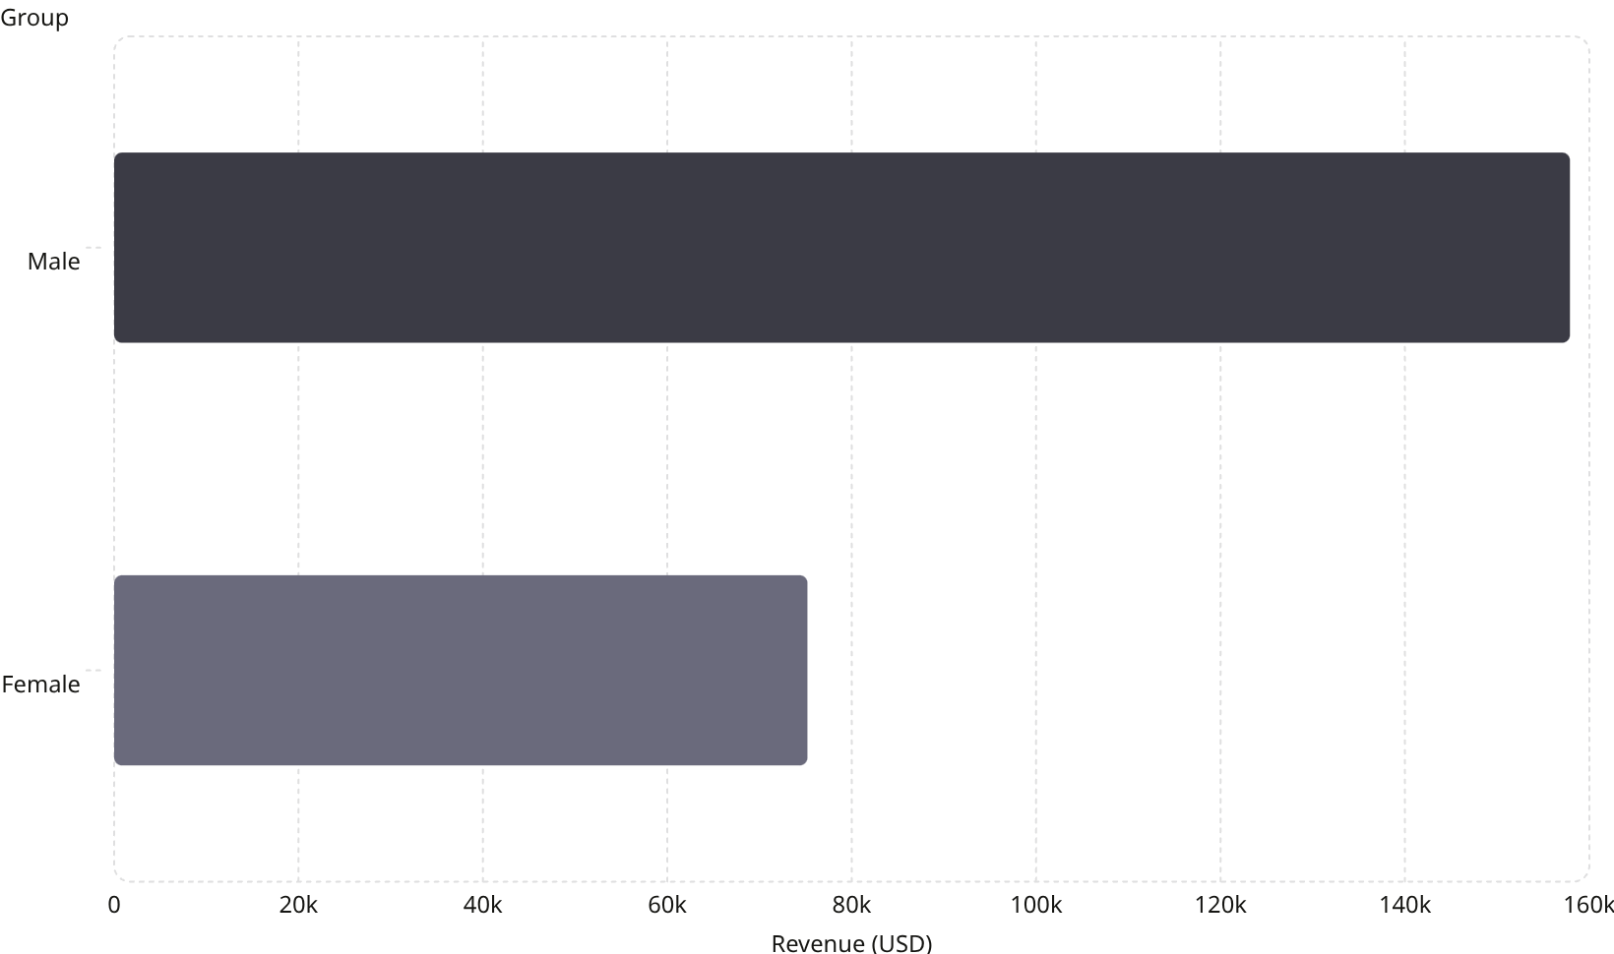
Revenue & Spending Insights
Key Findings
Male customers generated $157,890 vs. female customers' $75,191 in total revenue.
839 customers used discounts yet still spent above the average purchase amount.
Express shipping users averaged $60.48 vs. Standard at $58.46 — slightly higher spend.

Slide 5
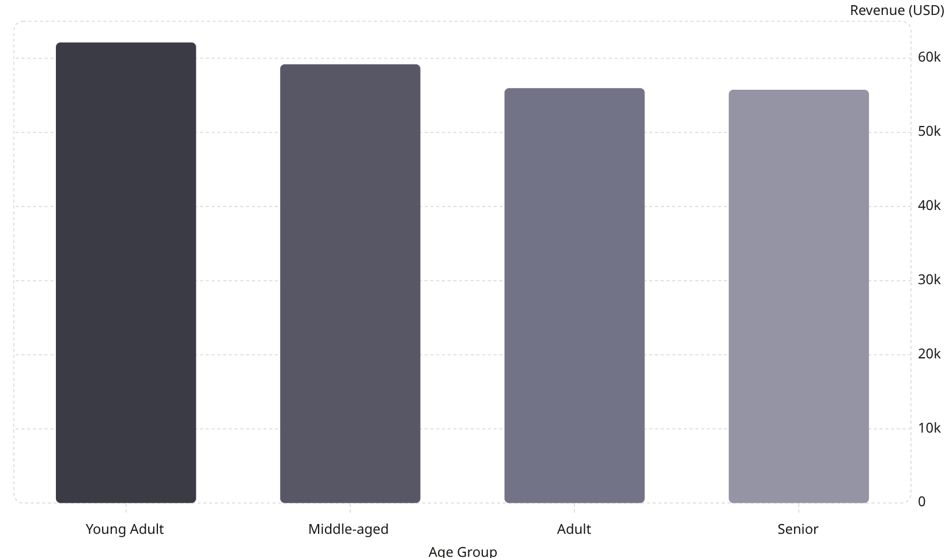

Revenue by Age Group
Age-Driven Revenue
Young Adults lead with $62,143 in total revenue, followed closely by Middle-aged customers at $59,197. Revenue is relatively balanced across all age groups, suggesting broad market appeal.
Young Adults and Middle-aged customers together account for over 52% of total revenue.

Slide 6
Product Performance
Top 5 Products by Rating
Most Discount-Dependent Products
Product
Avg Rating
Product
Discount Rate
Gloves
3.86
Hat
50.00%
Sandals
3.84
Sneakers
49.66%
Boots
3.82
Coat
49.07%
Hat
3.80
Sweater
48.17%
Skirt
3.78
Pants
47.37%

Slide 7

Customer Segmentation
Segment Breakdown
The vast majority of customers — 3,116 (80%) — are classified as Loyal, with 701 Returning and only 83 New customers.
Loyal·79.9%
·79.9%
·
Returning·17.97%
·17.97%
·
Repeat Buyers & Subscriptions
New·2.13%
·2.13%
·
Among customers with more than 5 purchases: 2,518 are non-subscribers and 958 are subscribers — indicating a significant opportunity to convert repeat buyers.

Slide 8
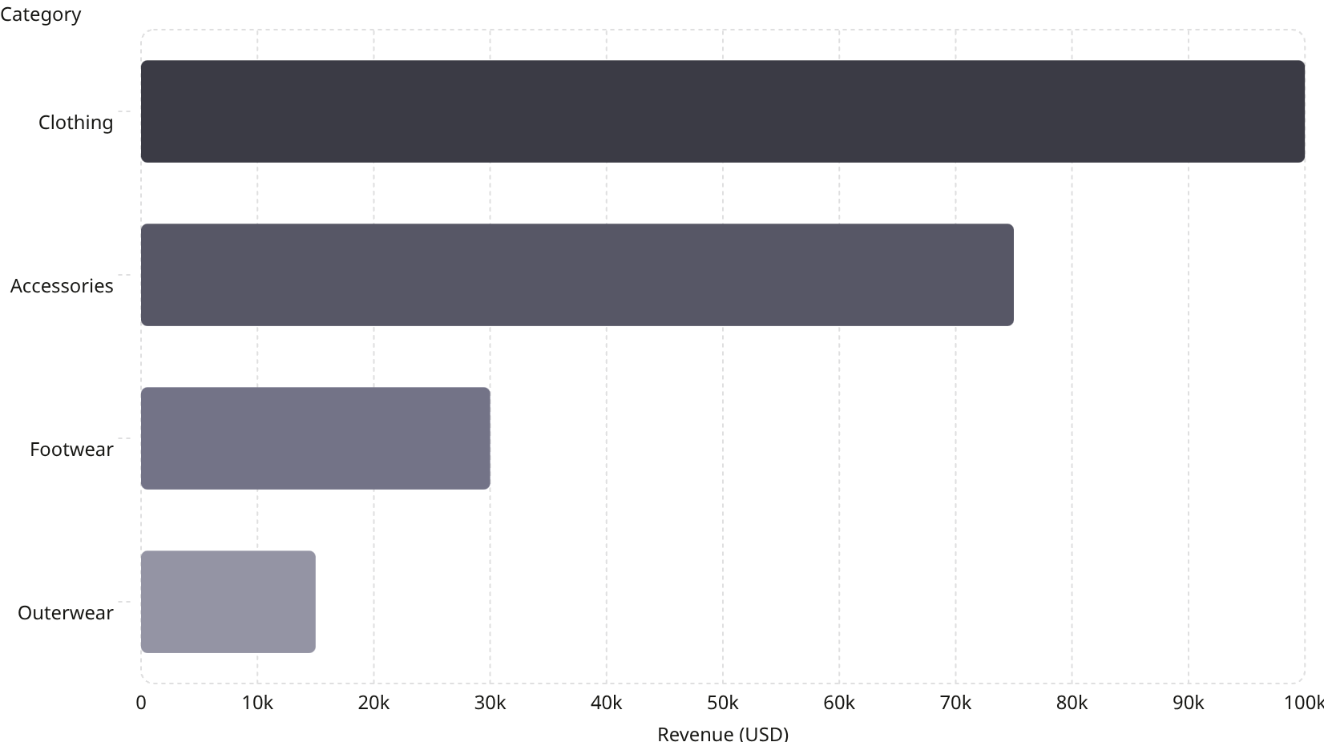

Subscription & Category Analysis
Subscribers vs. Non-Subscribers
Status
Customers
Avg Spend
Total Revenue
Subscribers
1,053
$59.49
$62,645
Non-Subscribers
2,847
$59.87
$170,436
Average spend is nearly identical — subscription status does not significantly affect individual purchase size.

Slide 9
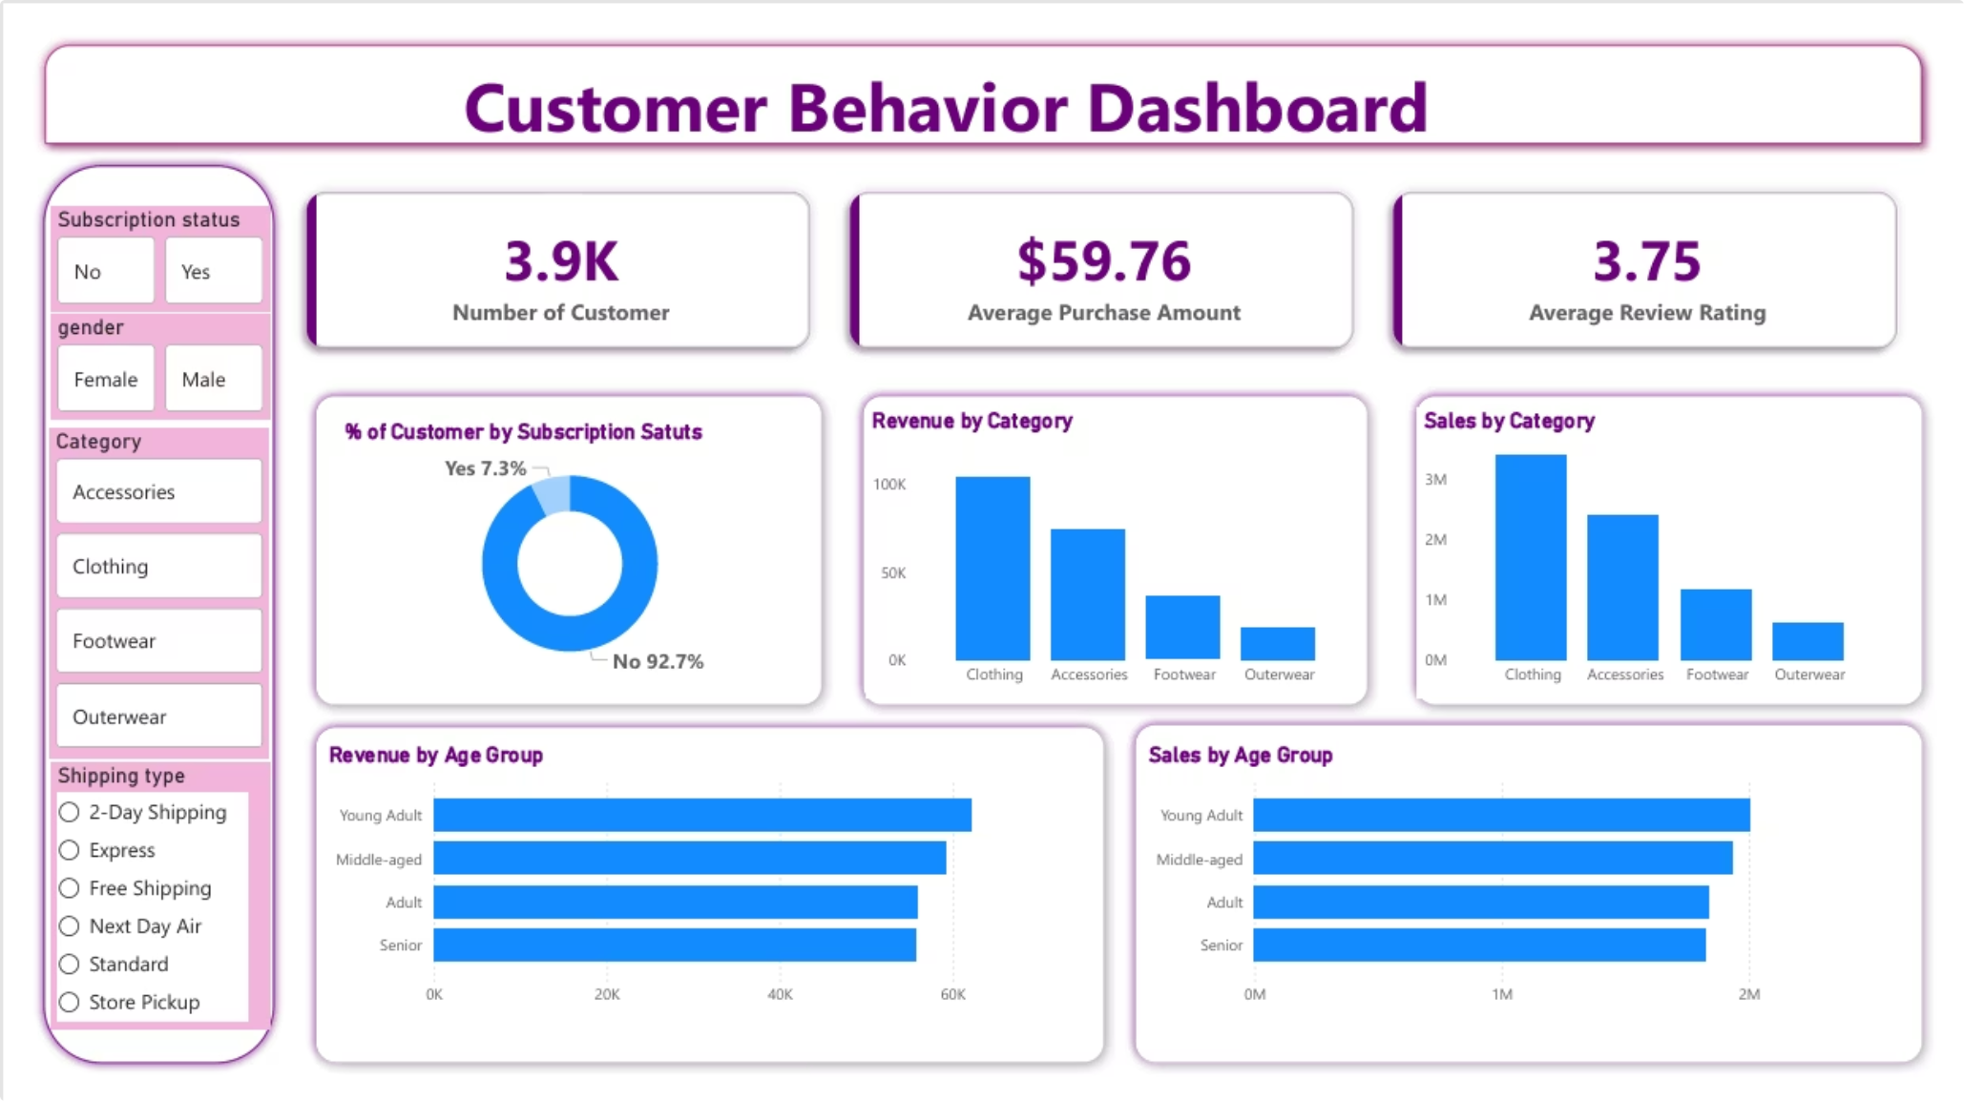
Power BI Dashboard
3.9K
$59.76
Total Customers
Avg Purchase Amount
3.75
27% Yes
Avg Review Rating
Subscription Rate

Slide 10

Business Recommendations
Boost Subscriptions
Promote exclusive benefits to convert the 73% of non-subscribers.
Loyalty Programs
Reward repeat buyers to deepen engagement and move them into the Loyal segment.
Review Discount Policy
Balance sales boosts with margin control — especially for high-discount items like Hats and Sneakers.
Targeted Marketing
Focus on Young Adults, high-revenue age groups, and express-shipping users for maximum ROI.

