Slide 1
NETFLIX CATALOG
Intelligence
Classification · segmentation · forecasting · automated analytics
Dataset-backed project presentation | October 2026
01

Slide 2
Dataset overview
Observed catalog snapshot from the supplied Netflix CSV
8,786
Unique titles
69.7%
Movie share
14
Ratings represented
8,787
Catalog-add dates
Original release years: 1925–2021
Observed date_added coverage: Jan 2008 to Sep 2021
Movies: 6,124 | TV Shows: 2,663
Rating labels describe content suitability, not audience satisfaction or viewing success.
NETFLIX CATALOG INTELLIGENCE
02

Slide 3
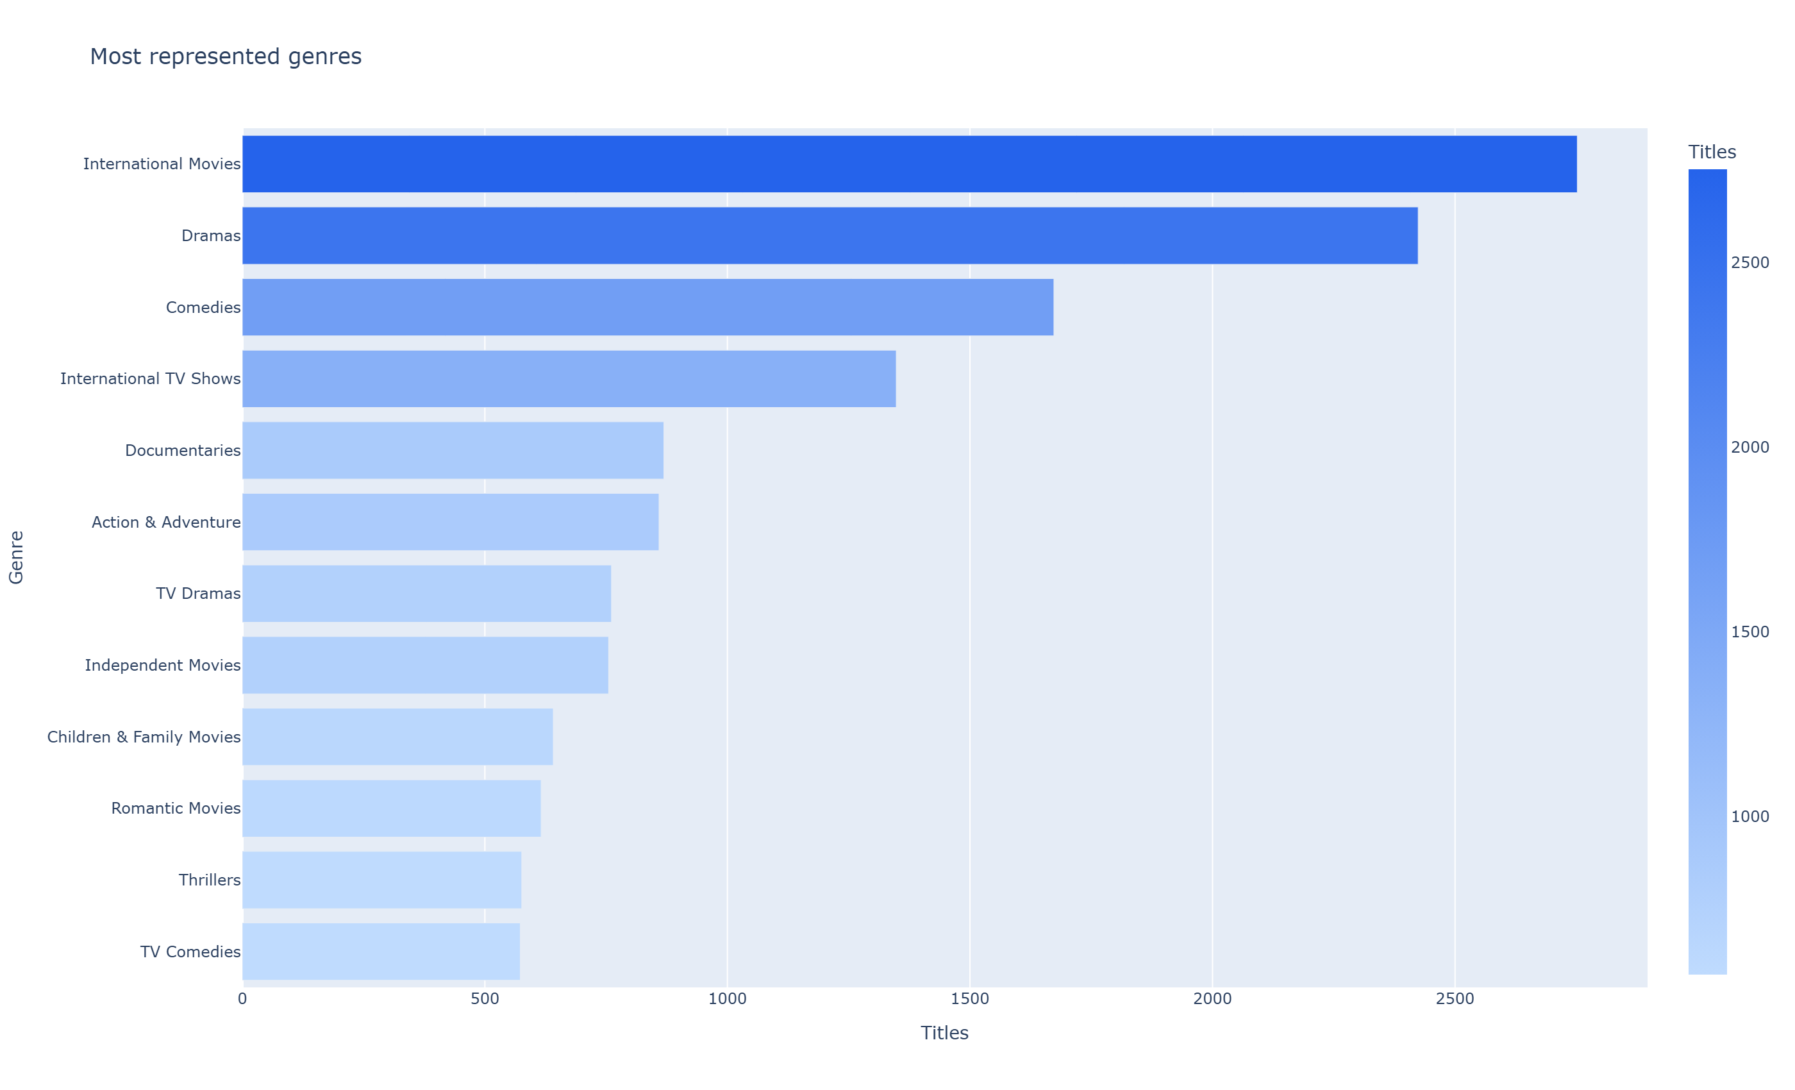
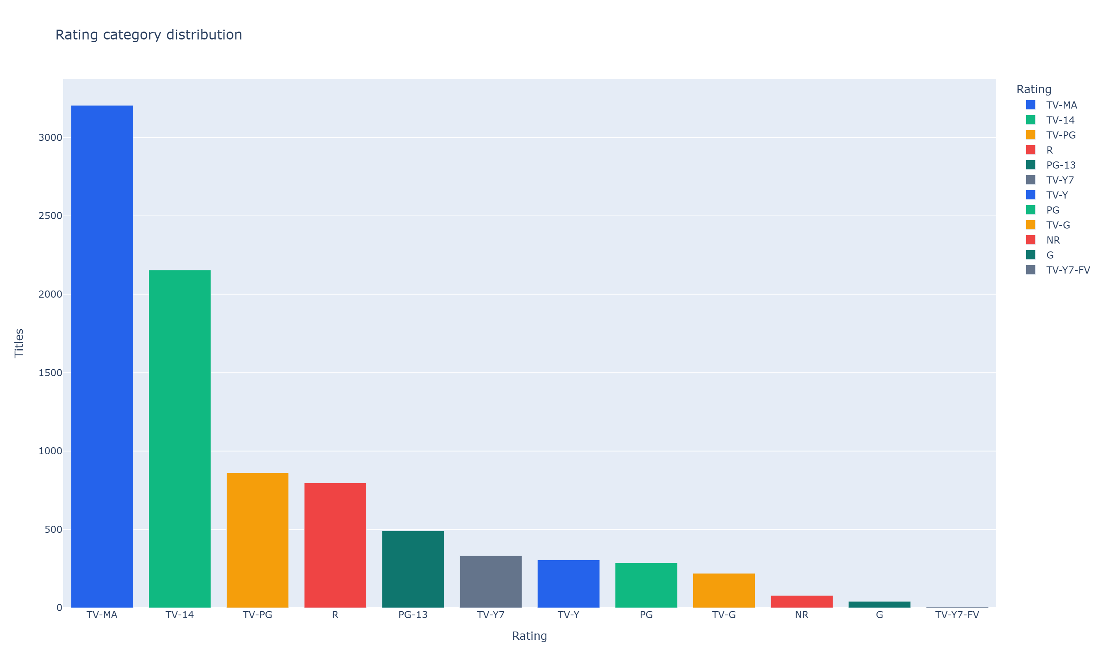
Catalog composition
Genre and rating patterns are counted from the uploaded rows
Largest genre group: International Movies (2,752 tagged titles).
NETFLIX CATALOG INTELLIGENCE
03

Slide 4
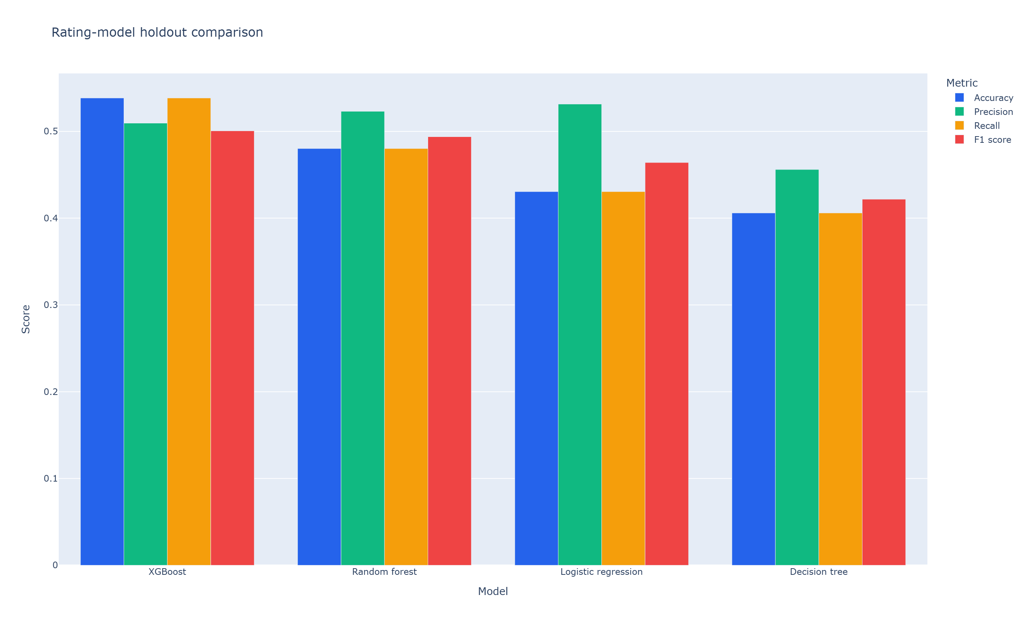
Rating classification
Stratified holdout evaluation · best measured model highlighted
XGBoost
Best model
0.538
Accuracy
0.501
Weighted F1
6,590 train rows · 2,197 holdout rows
The target is the existing rating category, not content popularity.
NETFLIX CATALOG INTELLIGENCE
04

Slide 5
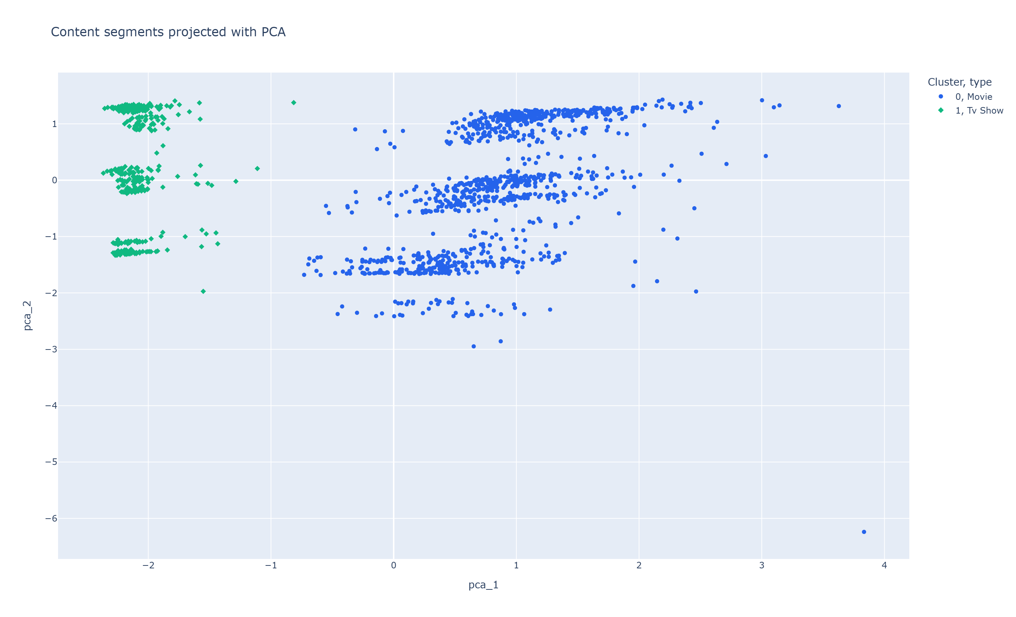
Content segmentation
KMeans selected by silhouette score · cluster profiles from encoded metadata
2
Selected K
0.291
Silhouette
45.0%
PCA variance
Clusters are exploratory groups, not official Netflix categories.
NETFLIX CATALOG INTELLIGENCE
05

Slide 6
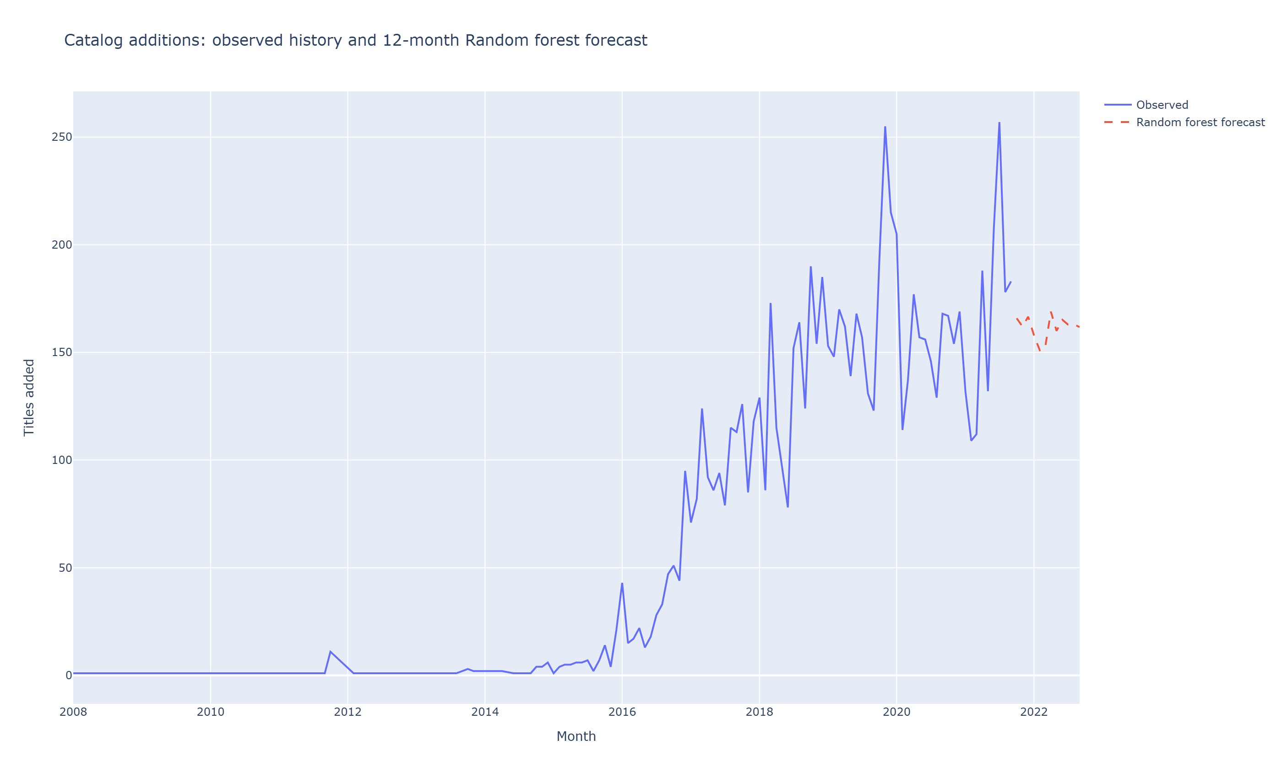
Catalog-add forecasting
Forecasts extend observed date_added history; they are not company guidance
Random forest
Best holdout model
40.88
RMSE
31.76
MAE
R² -0.028 · chronological holdout
NETFLIX CATALOG INTELLIGENCE
06

Slide 7
Insights and next steps
Automated findings with interpretation guardrails
International Movies is the largest genre group with 2,752 tagged titles.
Movie is the most common format (69.7% of the catalog).
TV-MA is the most frequent audience rating (3,205 titles).
United States appears most often in country credits (3,240 titles).
International Movies grew fastest across the observed catalog-add periods (+68600.0%).
Catalog additions changed -20.3% from 2020 to 2021.
Interpretation
Negative forecast R² means the model did not beat the holdout mean baseline.
Catalog-add forecasts are extrapolations, not Netflix plans.
Add licensed viewing outcomes before using the analysis to claim content success.
NETFLIX CATALOG INTELLIGENCE
07

