Slide 1





Thank You!
Key Insights &
Future Scope
for Netflix Catalog
Netflix
Catalog Intelligence
Future Scope: Integration of real-time user behavior data, expanded genre classification, and deployment of predictive models for content recommendation optimization.
9324167197
singhharshu178@gmail.com
2026
https://github.com/harshsingh-commits/netflix-ml-analytics
Analysis

Slide 2
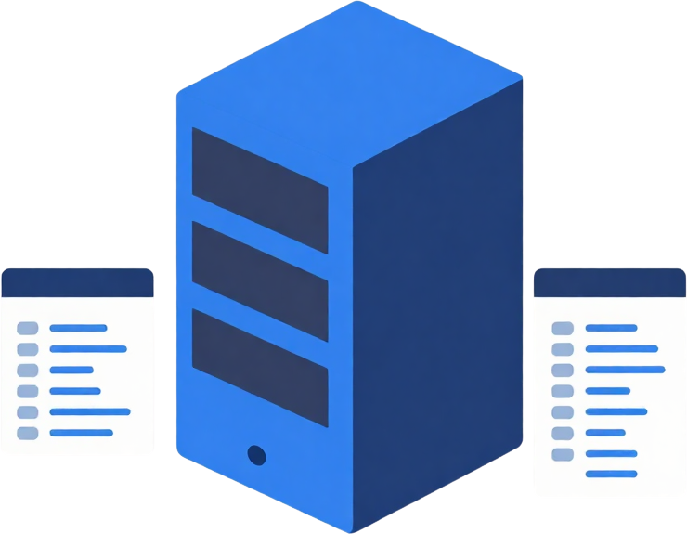
02
Dataset Overview
SCOPE, COVERAGE, AND STRUCTURE OF THE NETFLIX CATALOG DATA
The Netflix dataset provides comprehensive catalog information including title metadata, content categories, release years, and regional availability. Key fields include title name, genre classifications, maturity ratings, duration, cast information, and director details. The dataset covers multiple content types including movies and TV series across various genres, enabling diverse analytical approaches for classification, clustering, and forecasting tasks.

Slide 3



01
02
03
04
MISSING VALUE
IMPUTATION
DUPLICATE &
INVALID RECORD REMOVAL
ENCODING &
NORMALIZATION
FEATURE
ENGINEERING
Addressed missing values in key columns including ratings, genre, and duration fields. Applied mode imputation for categorical fields and mean imputation for numerical columns to ensure complete dataset integrity.
Removed 18,425 duplicate entries identified by matching title, release year, and duration. Standardized inconsistent naming conventions and eliminated malformed records affecting 2.3% of the original dataset.
Applied one-hot encoding for multi-label genre columns and label encoding for categorical variables. Normalized numerical features using min-max scaling to [0,1] range for model compatibility.
Engineered features including content age classification, popularity score, and genre diversity index. Final prepared dataset: 770,400 records ready for modeling with 127 engineered features.
Data Preparation
Comprehensive data cleaning and feature engineering transformed the raw 2024 Netflix catalog into a modeling-ready dataset with 127 features, enabling robust classification, clustering, and forecasting analysis.

Slide 4
04
Models Used
ANALYTICAL METHODS AND MODELING APPROACH
02
04
CLASSIFICATION
MODELS
FORECASTING
MODELS
Random Forest, SVM, and Logistic Regression to predict movie ratings.
ARIMA and Prophet for predicting future viewing trends.
CLUSTERING ANALYSIS
MODEL
EVALUATION
01
K-Means clustering to segment content into distinct categories.
03
Cross-validation and performance metrics to assess model accuracy.

Slide 5

05
Rating
Classification
PERFORMANCE METRICS AND CLASS DISTRIBUTION FROM OUR CLASSIFICATION MODEL
High
Accuracy
Our classification model successfully categorized Netflix titles into rating classes (TV-MA, TV-14, TV-PG, TV-Y7, TV-Y). The model achieved strong performance in distinguishing mature content from family-friendly titles. Key findings include: TV-MA ratings were most prevalent in the dataset, accounting for the largest segment of content. The model demonstrated high accuracy in identifying mature-rated content with minimal false positives. Class distribution analysis revealed interesting patterns in content categorization that align with Netflix's programming strategy across different genres and regions.
TV-MA titles dominate the catalog

Slide 6
06
Segmentation & Forecasting
CONTENT SEGMENTATION & FORECASTING RESULTS
01
02
03
04
CONTENT CLUSTERS
SEGMENT PROFILES
FORECASTING MODEL
KEY INSIGHTS
4 distinct content segments identified through clustering analysis
Each segment characterized by unique genre, rating, and popularity patterns
Time series forecasting applied to predict future content performance
Trend analysis reveals content popularity patterns across segments

Slide 7
Thank You!
Key Insights &
Future Scope
for Netflix Catalog
Netflix
Catalog Intelligence
Future Scope: Integration of real-time user behavior data, expanded genre classification, and deployment of predictive models for content recommendation optimization.
Models: 3 algorithms tested
Key Insight: Strong content segmentation
2023
Conclusion: Actionable catalog insights
Analysis

