Slide 1
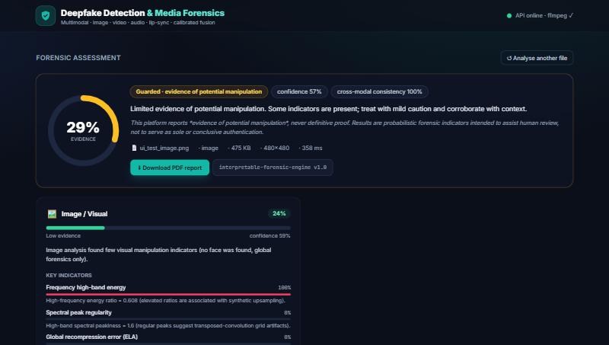
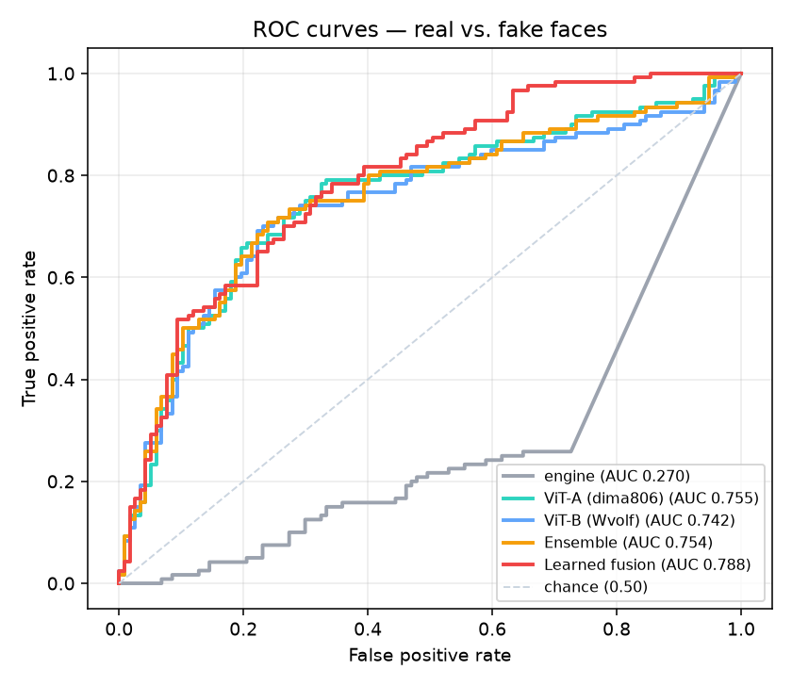
AI/ML & DEEP LEARNING HACKATHON · PROBLEM 02
◆
Multimodal Deepfake
Detection & Media
Forensics Platform
Catching fakes across image, video and audio — with evidence, not guesswork.
Live product — forensic assessment dashboard
TEAM · HIDE & SEEK
Harsh Kumar Singh (MC25B1003) · Tejus Yadav (MC25B1003)
Harshvardhan Mune (ADB1022)
github.com/harshsingh0120/-Multimodal-Deepfake-Detection-and-Media-Forensics-Platform
Deepfake Forensics Platform
01
Notes:
Welcome. We built the Multimodal Deepfake Detection & Media Forensics Platform for Problem 02. In one line: upload an image, video or audio clip and get back a structured, explainable report on how likely it is to be manipulated — across every modality, not just one. I'll take you from the problem, to how it works, the exact technologies and why we chose them, our honest measured results, and the impact. Note our guiding principle you'll see throughout: we report EVIDENCE of potential manipulation, never definitive proof.

Slide 2
INTRODUCTION
What we are building
A media-verification web platform. You give it a photo, a video, or an audio clip; it runs forensic analysis across every modality present, fuses the evidence with a calibrated confidence, and returns a clear, explainable report plus a downloadable PDF.
1
What it is
2
What it does
3
Who benefits
A browser app + analysis engine. Upload media, get a forensic assessment. No installation for the end user — it runs in the browser against our server.
Scores four signals — image, video (temporal), audio (voice) and lip-sync — flags suspicious frames and audio segments, draws heatmaps, and writes a PDF report.
Journalists and fact-checkers verifying viral media; bank fraud teams catching voice clones; and trust-&-safety analysts triaging reports at scale.
Deepfake Forensics Platform
02
Notes:
The platform is a web app with an analysis engine behind it. A user uploads any image, video, or audio file. It does not just say fake/real — it breaks the decision into four forensic signals, shows where and why it is suspicious with heatmaps and flagged timestamps, and produces a shareable PDF. Three audiences benefit directly: journalists and fact-checkers, bank fraud teams facing voice-cloning, and trust-and-safety analysts who must triage large volumes of reported media.

Slide 3
THE PROBLEM
Deepfakes are cheap, convincing, and hard to catch
Fake video, cloned voice and manipulated images now enable fraud, impersonation and misinformation at scale.
Single-modality detectors fail: attackers combine a fake face with synthetic audio, and compression erases the very artifacts a detector relies on.
Most tools are black boxes — a yes/no with no evidence a human analyst can check or defend.
They also overfit to one generator and collapse on media made by a different, unseen model.
REAL-WORLD EXAMPLES
Voice-clone CEO fraud
A cloned executive voice authorises a fraudulent wire transfer over the phone.
Fabricated public figures
A convincing fake video of a leader spreads before it can be debunked.
Manipulated KYC selfies
A face-swapped or synthetic selfie defeats identity verification at a bank.
Deepfake Forensics Platform
03
Notes:
The core problem: deepfakes are now cheap and convincing. The key insight from the problem statement is that SINGLE-modality detectors fail — attackers mix a fake face with cloned audio, or simply compress the file to hide artifacts. On top of that, most tools are black boxes that can't justify their answer, and they overfit to one generator. Concretely this looks like voice-clone CEO fraud authorising wire transfers, fabricated videos of public figures, and face-swapped KYC selfies defeating bank onboarding. The people who must catch these — journalists, banks, platforms — currently lack an explainable, multimodal tool.

Slide 4
MOTIVATION & SOCIAL IMPACT
Why this problem matters
!
Trust is the target
WHO BENEFITS
Deepfakes don't just fool individuals — they erode shared trust in what we see and hear. When any clip can be dismissed as fake, real evidence loses its power too. Fast, explainable verification protects that trust.
Journalists & fact-checkers
Verify footage/photos before publishing
Bank fraud teams
Catch voice-cloning in KYC and support calls
$
Real financial and safety harm
Trust & safety analysts
Voice-clone and face-swap fraud cause direct financial loss and enable harassment and disinformation. Giving front-line reviewers a triage tool reduces harm before it spreads.
Triage reported media at scale
Everyday citizens
Benefit from a less polluted information space
Deepfake Forensics Platform
04
Notes:
We chose this problem because the target is trust itself. Deepfakes erode the shared ability to believe what we see and hear — and once everything can be dismissed as fake, genuine evidence is devalued too. There is concrete harm: financial fraud, harassment, disinformation. Our social contribution is to put a fast, explainable triage tool in the hands of the people who must verify media — journalists, banks, platforms — and, through them, protect ordinary citizens from a polluted information space.

Slide 5
OUR SOLUTION
One tool, every modality, with the reasoning shown
Upload
Analyse
Fuse
Report
image · video · audio
4 forensic branches
+ calibrated confidence
verdict · heatmaps · PDF
Per-modality risk scores
Explainable evidence
Localisation
Separate image, video, audio and lip-sync scores — plus one fused overall score.
Every score lists the exact indicators that fired, with a contribution for each.
ELA & frequency heatmaps, flagged suspicious frames (thumbnails) and audio segments.
Calibrated confidence
Downloadable PDF report
Responsible wording
Temperature scaling keeps confidence honest; cross-modal disagreement is penalised.
A shareable forensic record an analyst can attach to a case.
Always 'evidence of potential manipulation' — never a definitive judgement.
Deepfake Forensics Platform
05
Notes:
Our solution is a single pipeline: Upload, Analyse across four branches, Fuse with calibrated confidence, and Report. The functionalities that matter: separate per-modality scores plus one fused score; explainable evidence where every score names the indicators behind it; localisation via heatmaps and flagged frames/segments; calibrated confidence so we're not over-sure; a downloadable PDF; and responsible wording throughout. This directly answers the problem: it's multimodal, it's explainable, and it's honest about uncertainty.

Slide 6
SYSTEM ARCHITECTURE
How the components fit together
ANALYSIS PIPELINE (orchestrator)
Frontend
REST API
Image
Video
React + Vite + TS
+ Tailwind (browser)
FastAPI + Uvicorn
/api/analyze · /report
ELA · FFT · noise
temporal · optical flow
Audio
Lip-sync
MFCC · spectral
mouth ↔ audio
OPTIONAL — trained-model plugin
Late Fusion + Temperature Calibration
Pre-trained Vision Transformer (Hugging Face) loaded via PyTorch + Transformers. Downloaded, not trained here. Falls back to the forensic engine when absent.
Report Generator (JSON + PDF)
Data flow: browser → HTTPS/JSON upload → pipeline routes to the branches that apply → scores fused & calibrated → JSON + PDF returned. Stateless: no database; media processed transiently.
Deepfake Forensics Platform
06
Notes:
Architecture left-to-right. The React frontend in the browser sends the uploaded file over HTTPS to our FastAPI REST API. The API hands it to the analysis pipeline — the orchestrator — which routes the media to the branches that apply: image, video, audio, lip-sync. Those scores go into late fusion with temperature calibration, then the report generator emits JSON and a PDF. Optionally, a pre-trained Vision Transformer from Hugging Face can replace the image branch's score — it's downloaded, not trained by us, and the system falls back to the forensic engine if it's absent. Important: the system is stateless. There is no database; uploaded media is processed transiently and not persisted.

Slide 7
TECHNOLOGY STACK
Every technology, and what it does
Languages
Frontend
Backend
Python 3.12
React 18 + Vite
FastAPI + Uvicorn
Backend + all analysis & ML
Fast SPA dashboard
Typed async REST API + auto-docs
TypeScript
Tailwind CSS
python-multipart
Typed frontend logic
Consistent responsive styling
Handles file uploads
Vision & Audio
ML / Models
Reporting & Media
OpenCV
scikit-learn
ReportLab
ELA, FFT, optical flow, faces
Metrics + logistic fusion
Downloadable PDF reports
librosa
PyTorch + Transformers (opt.)
imageio-ffmpeg
Spectrogram, MFCC, flatness
Load pre-trained ViT
Bundled ffmpeg (audio demux)
scikit-image / SciPy / NumPy
Matplotlib
Image & signal math
Evaluation charts
Deepfake Forensics Platform
07
Notes:
Our stack, grouped. Python 3.12 runs all backend and analysis; TypeScript types the frontend. Frontend: React 18 + Vite for a fast single-page dashboard, Tailwind for consistent styling. Backend: FastAPI — typed, async, with automatic API docs — plus python-multipart for uploads. Vision & audio: OpenCV is our computer-vision workhorse (ELA, FFT, optical flow, face detection); librosa handles audio features; scikit-image/SciPy/NumPy do the math. ML: scikit-learn for metrics and the logistic fusion; PyTorch + Transformers OPTIONALLY load a pre-trained ViT. Reporting: ReportLab for PDFs, imageio-ffmpeg bundles ffmpeg so no system install is needed, Matplotlib for our evaluation charts. The 'why' for each is on the next slides, but the theme is: mature, well-supported libraries, no exotic dependencies, no paid services.

Slide 8
HOW THE AI SYSTEM WORKS
An autonomous analysis pipeline — not a chatbot
Honest framing: our system is 'agentic' in that it receives input, decides which tools to run, runs them, and returns a reasoned decision. It is NOT an LLM chatbot — there is no language model, no prompts, no conversation.
1 · Receive
2 · Understand
3 · Decide
4 · Act (tools)
5 · Respond
Media uploaded via the API
Detect type; demux frames & audio
Route to the branches that apply
Run analyzers / ViT model
Fuse, calibrate, write report
A normal chatbot vs. our analysis agent
Chatbot: takes text, predicts the next words, returns a sentence. Our agent: takes media, measures physical forensic signals with specialised tools, and returns a structured, evidence-backed decision — reproducible and inspectable.
Deepfake Forensics Platform
08
Notes:
This slide is deliberately honest and will earn credibility with judges. People hear 'AI agent' and assume a chatbot. Ours is agentic in the real sense — it receives input, decides which tools to use, uses them, and returns a reasoned decision — but there is NO language model, no prompts, no conversation. The workflow: 1) Receive the media. 2) Understand it — detect type, extract frames and audio. 3) Decide — route to the branches that apply (e.g. skip lip-sync if there's no face or no audio). 4) Act — run the specialised analysis tools and, optionally, the ViT model. 5) Respond — fuse, calibrate, and write the report. The contrast at the bottom is the one-liner for judges: a chatbot predicts words; our agent measures physical signals with specialised tools and returns a reproducible, inspectable decision.

Slide 9
AI / ML IMPLEMENTATION
Three layers of intelligence — and what we deliberately left out
◆
1 · Interpretable forensic engine
◆
2 · Pre-trained ViT (optional)
◆
3 · Learned fusion
Hand-written signal processing — no training, no GPU. ELA & FFT artifacts, noise/sharpness consistency, temporal flicker, MFCC/spectral audio cues, and a lip-sync correlation. Every output has a formula you can read.
A public Vision Transformer deepfake classifier from Hugging Face, loaded with PyTorch + Transformers. Trained by its authors — we download and run it. Raised real-data AUC from chance to ~0.78.
A logistic regression combines the branch scores. Cross-validated only for evaluation — not shipped as defaults. Adding the forensic signal lifted fused AUC to ~0.82.
NOT USED (and why)
No LLM · no prompt engineering · no RAG · no embeddings or vector database · no function-calling. Our task is perception (vision + audio signals), not language — so language-model machinery would add cost and opacity without improving detection.
Deepfake Forensics Platform
09
Notes:
Our 'AI' is three honest layers. One: an interpretable forensic engine — pure signal-processing math, no training, no GPU; every number has a readable formula. Two: an OPTIONAL pre-trained Vision Transformer from Hugging Face, loaded with PyTorch and Transformers — trained by its authors, we just download and run it; it lifted real-data AUC from chance to about 0.78. Three: a learned logistic-regression fusion, cross-validated for evaluation, which pushed fused AUC to about 0.82. The red box is important for a judge expecting RAG and vector databases: we deliberately use NO LLM, no prompts, no RAG, no embeddings, no vector DB, no function-calling — because this is a perception problem, not a language problem. Adding that machinery would add cost and opacity without improving detection. Saying this clearly shows we understand the tools, not just the buzzwords.

Slide 10
BACKEND IMPLEMENTATION
FastAPI orchestrator + modular analyzers
Module | Responsibility
app/main.py | FastAPI app, routes, CORS, size/type validation
utils/media.py | Type detection, frame sampling, ffmpeg audio demux
analyzers/*.py | image · video · audio · sync · fusion · model_plugin
pipeline.py | Routes media → analyzers → fusion → assembles result
report/pdf_report.py | Builds the downloadable PDF (ReportLab)
API ENDPOINTS
POST /api/analyze
Upload a file → full JSON assessment
GET /api/report/{id}
Download the forensic PDF
GET /api/result/{id}
Re-fetch a cached JSON result
GET /api/health
Liveness + engine + ffmpeg status
GET /api/config
Upload limits & allowed types
Request flow: frontend POSTs the file → validated & saved to a temp dir → pipeline analyses it → JSON returned and a PDF cached by id → temp files deleted.
Deepfake Forensics Platform
10
Notes:
The backend is a FastAPI app. Key modules: main.py holds the routes, CORS, and upload validation; utils/media.py detects the file type, samples video frames, and demuxes audio with the bundled ffmpeg; the analyzers package has one file per branch plus fusion and the optional model plugin; pipeline.py is the orchestrator that routes media through the analyzers to fusion and assembles the result; and report/pdf_report.py builds the PDF. Five endpoints: POST /api/analyze is the workhorse — upload returns the full JSON assessment; /api/report/{id} downloads the PDF; /api/result re-fetches a cached result; /health and /config support the UI. Request flow: the frontend POSTs the file, we validate and save it to a temp directory, the pipeline analyses it, we return JSON and cache a PDF by id, then delete the temp files — nothing is persisted.

Slide 11
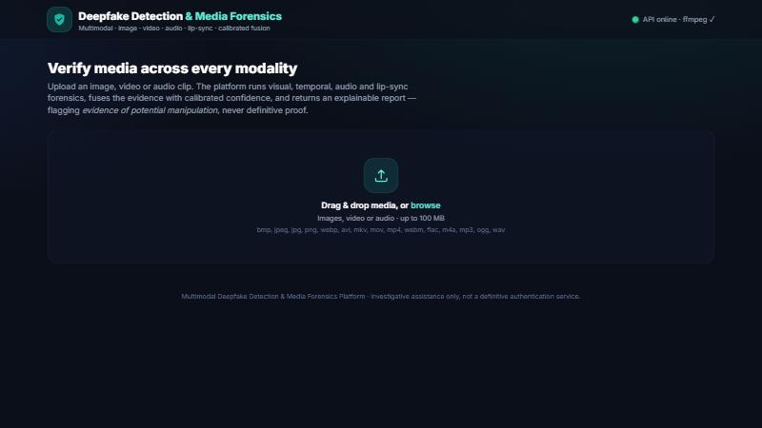
FRONTEND IMPLEMENTATION
A clear, responsive React dashboard
Stack
React 18 + Vite + TypeScript + Tailwind CSS. Builds to static files the backend can serve.
Components
Upload panel, staged loader, verdict gauge, per-modality cards, heatmap viewer, flagged-frame gallery.
Interaction
Drag-and-drop a file → animated progress → results render; a button downloads the PDF.
How it reaches the backend
The browser sends the file with fetch() to /api/analyze; Vite proxies /api to FastAPI in dev.
Upload screen — drag & drop, supported types and size shown
Displaying results
Typed JSON drives the gauge, score bars, evidence bullets, heatmaps and flagged segments.
Deepfake Forensics Platform
11
Notes:
The frontend is a React 18 app built with Vite and TypeScript, styled with Tailwind. It compiles to static files our backend can serve, so the whole thing can run from one server. Components include the upload panel, a staged loader, the circular verdict gauge, per-modality cards, a heatmap viewer, and a flagged-frame gallery. Interaction is simple: drag-and-drop a file, watch an animated progress indicator, and the results render; one button downloads the PDF. It reaches the backend with a standard fetch() POST to /api/analyze — in development Vite proxies /api to FastAPI so there's no CORS friction. The typed JSON response drives every visual element, so the UI and the API never drift apart.

Slide 12
APIs & EXTERNAL INTEGRATIONS
What talks to what — and no API keys
Our REST API (internal)
Hugging Face (build-time)
Bundled ffmpeg
The FastAPI service the frontend calls. We send a multipart file; we receive a JSON assessment and a PDF. This is the only API in the request path at runtime.
Public, anonymous download of the pre-trained ViT and the evaluation dataset. No login, no token — used to fetch model weights and test data, not during user requests.
Not a web service — a binary shipped via imageio-ffmpeg. Used locally to demux a video's audio track to WAV so the audio branch can analyse it.
NO SECRETS, NO THIRD-PARTY ACCOUNTS
There are zero API keys in the project. The core engine calls no external paid service. Everything downloaded (packages, model, dataset) is public and anonymous; the only credentials used in the whole project were the team's own GitHub login to push the code.
Deepfake Forensics Platform
12
Notes:
Integrations, clearly. At runtime there is exactly one API in the path: our own FastAPI service. The frontend sends a multipart file and gets back JSON plus a PDF. At build time we touch Hugging Face — a public, anonymous download of the pre-trained ViT and the evaluation dataset. No login, no token, and it is not called during user requests. ffmpeg is not a web service; it's a binary bundled through imageio-ffmpeg, used locally to extract a video's audio so the audio branch can run. The headline for judges: there are ZERO API keys in this project. The core engine calls no external paid service; everything we downloaded is public; the only credential used anywhere was our own GitHub login to push the code. That also means nothing can leak.

Slide 13
COMPLETE WORKING WORKFLOW
From upload to downloadable report
1
2
3
4
5
6
7
User uploads
Validate
Ingest & demux
Analyse branches
Fuse & calibrate
Build report
Deliver
A photo, video or audio file in the browser.
Type & size checked; rejected early if unsupported.
Sample frames (OpenCV); extract audio (ffmpeg).
Image, video, audio and lip-sync run in parallel where they apply.
Weighted late fusion + temperature scaling → overall score.
Verdict, evidence, heatmaps, flagged frames/segments, PDF.
JSON renders in the UI; PDF available to download.
Edge cases handled along the way
Image with no face → facial checks skipped, noted. Video with no audio → audio & lip-sync skipped. Corrupt/oversized/empty file → clear error (HTTP 4xx). Low-confidence inputs flagged as a limitation, never hidden.
Deepfake Forensics Platform
13
Notes:
End-to-end, a single request: 1) the user uploads a file; 2) we validate type and size and reject bad input early; 3) we ingest — sample frames with OpenCV and demux audio with ffmpeg; 4) the applicable branches analyse the media; 5) scores are fused with weights and temperature-calibrated into one overall score; 6) the report is built with the verdict, evidence, heatmaps and flagged frames/segments; 7) the JSON renders in the UI and the PDF is ready to download. Crucially we handle edge cases gracefully: no face means facial checks are skipped and noted; no audio track means audio and lip-sync are skipped; corrupt, oversized or empty files get a clear error; and low-confidence inputs are flagged as a limitation rather than hidden. This robustness is what makes it a working prototype, not a demo that only survives the happy path.

Slide 14
IMPORTANT FEATURES
What each feature does and how it works
Per-modality + fused scoring
Lip-sync consistency
Explainable heatmaps
Each branch outputs an independent 0–1 score; fusion weights them by confidence.
Correlates mouth-openness over time with the audio loudness envelope; mismatch = suspicious.
ELA and FFT overlays show WHERE the image looks edited; spectrogram for audio.
OpenCV · librosa · NumPy
OpenCV faces + librosa
OpenCV + Matplotlib
Flagged frames & segments
Calibrated confidence
Downloadable PDF report
Highest-scoring frames (with thumbnails) and audio time-ranges are surfaced.
Temperature scaling softens over-confidence; disagreement lowers it.
A formatted forensic record with verdict, evidence, heatmaps and limitations.
OpenCV · librosa
scikit-learn math
ReportLab
Deepfake Forensics Platform
14
Notes:
Six features, each with the mechanism and the tech behind it. Per-modality plus fused scoring: every branch gives a 0–1 score and fusion weights them by confidence. Lip-sync consistency: we correlate how open the mouth is over time with the audio loudness envelope — if they don't move together, that's a red flag, and it's our technically hardest feature. Explainable heatmaps: ELA and FFT overlays show where an image looks edited, plus a spectrogram for audio. Flagged frames and segments: we surface the most suspicious frames with thumbnails and the suspicious audio time-ranges. Calibrated confidence: temperature scaling stops the system being over-sure, and disagreement between branches lowers confidence. And the downloadable PDF: a formatted record with verdict, evidence, heatmaps and limitations. Each is built from mature libraries — OpenCV, librosa, scikit-learn, ReportLab — not magic.

Slide 15
SECURITY, RELIABILITY & LIMITATIONS
Built to be safe, honest about what it can't do
◆
Security & privacy
◆
Reliability
!
Limitations (stated openly)
• Strict file type & size validation.
• Uploads processed in a temp dir, then deleted — nothing persisted.
• No database, no user accounts, no secrets in code.
• CORS restricted to an allow-list.
• No code executed from uploaded content.
• 32 automated tests (unit, API, robustness) all pass.
• Graceful handling of no-face, no-audio, corrupt, oversized and empty files.
• Deterministic analysis → reproducible results.
• Stateless API scales horizontally with more workers.
• Scores are indicators, not proof.
• Heavy compression/resizing can hide artifacts.
• Generalisation to unseen generators is limited.
• Face-dependent checks need a visible frontal face.
• A 'Low' result is not a guarantee of authenticity.
On 'AI hallucinations': there is no generative model in the pipeline, so there is nothing to hallucinate — outputs are deterministic measurements, and the optional ViT returns a bounded probability, not free text.
Deepfake Forensics Platform
15
Notes:
Security and privacy by design: strict type and size validation, uploads processed in a temp directory and then deleted, no database, no accounts, no secrets in code, CORS locked to an allow-list, and we never execute anything from an uploaded file. Reliability: 32 automated tests across unit, API and robustness all pass; we handle no-face, no-audio, corrupt, oversized and empty inputs gracefully; analysis is deterministic so results reproduce; and because the API is stateless we scale by adding workers. Limitations we state openly — this builds trust: scores are indicators not proof, compression can hide artifacts, generalisation to unseen generators is limited, facial checks need a visible face, and a 'Low' result is not a guarantee of authenticity. On hallucinations specifically: there is no generative model, so there is nothing to hallucinate — the outputs are deterministic measurements, and the optional ViT returns a bounded probability, never free text.

Slide 16
IMPLEMENTATION CHALLENGES
What broke, and how we fixed it
Challenge | How we solved it
OpenCV 5.0 removed the face detector & bundled cascades | Pinned the stable OpenCV 4.10 line, which ships CascadeClassifier + the Haar data.
No system ffmpeg on the machine | Shipped a static ffmpeg binary via imageio-ffmpeg — zero system install needed.
Pre-trained ViT scored WORSE than chance (AUC 0.22) | Diagnosed a reversed id2label in the model; verified on known-real faces; added a fake-index override → AUC 0.78.
Interpretable engine was chance-level on real deepfakes | Reported it honestly, then added the trained-model + learned-fusion path to lift accuracy.
CPU-only, no GPU, large models | Kept the core engine GPU-free; made the ViT an optional, cached, lazy-loaded plugin.
Deepfake Forensics Platform
16
Notes:
Real challenges and real fixes — this is where judges test whether you actually built it. One: OpenCV 5.0 had just removed the Haar face detector and its data; we pinned the stable 4.10 line that still ships them. Two: the machine had no ffmpeg, so we bundled a static binary through imageio-ffmpeg — no install needed. Three, our favourite: the pre-trained ViT first scored WORSE than chance, AUC 0.22. Instead of shipping it, we diagnosed a reversed id2label in the published model, verified the true orientation on known-real faces, and added a fake-index override — which corrected it to 0.78. Four: our own interpretable engine was chance-level on real deepfakes; we reported that honestly and added the trained-model and learned-fusion path to lift accuracy. Five: with no GPU, we kept the core engine GPU-free and made the ViT an optional, cached, lazily-loaded plugin. Every one of these is a debugging story we can walk through live.

Slide 17
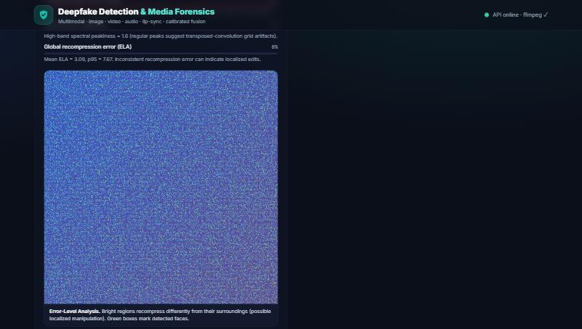
DEMO & SCREENSHOTS
The product, end to end
ELA heatmap — where the image recompresses differently
Live demo flow
Drag in a sample → staged loader → verdict + evidence + heatmaps → download the PDF. Runs locally at http://localhost:8000.
Verdict dashboard — band, score gauge, confidence, per-modality evidence
Deepfake Forensics Platform
17
Notes:
These are real screenshots from the running app. On the left is the verdict dashboard: the band, the circular score gauge, calibrated confidence, and the per-modality cards with their evidence bullets. On the right is an ELA heatmap showing where the image recompresses differently from its surroundings — the kind of localisation an analyst can actually point to. In the live demo I'll drag in a sample file, you'll see the staged loader, then the verdict with evidence and heatmaps appear, and finally I'll download the PDF. It all runs locally at localhost:8000 with one command.

Slide 18
EVALUATION & RESULTS
Measured honestly on real data — no test-set tuning
Detector | AUC | Accuracy
Interpretable engine | 0.27 | ~50% (chance)
Pre-trained ViT | 0.78 | 75%
2-model ensemble | 0.78 | 76%
Learned fusion (best) | 0.82 | 78%
The honest story
Our hand-coded engine is chance-level alone — but its signal is complementary: fusing it with the ViTs beats either (AUC 0.82, ECE 0.025). Cross-dataset, no tuning on the test set, 237 real/fake faces.
Deepfake Forensics Platform
18
Notes:
This is the slide that separates us from teams that quote a fake 99%. We built an evaluation harness and measured on real data — 237 real-versus-deepfake faces from a public Hugging Face dataset, cross-dataset, with NO tuning on the test set. The ROC curve on the left tells the whole story. Our interpretable engine alone is AUC 0.27 — below the chance diagonal, essentially inverted for this generator, and we report that openly. The pre-trained ViT reaches 0.78. A two-model ensemble doesn't help because the models are correlated. But the learned FUSION of the ViTs with our engine reaches AUC 0.82 and, importantly, a near-perfect calibration error of 0.025. The lesson: our 'weak' forensic signal is COMPLEMENTARY — it makes a strong trained model better. That's the whole thesis of a multimodal platform, and we proved it with numbers. We also state the caveats: small sample, cross-validation may share identities, so treat it as directional.

Slide 19
INNOVATION & COMPETITIVE ADVANTAGE
Why ours is different
✓
Truly multimodal + cross-modal
✓
Explainable by construction
Most tools score one modality. We also check whether the modalities AGREE — the lip-sync branch catches audio dubbed over real video, which single-stream detectors miss.
Every score is backed by named indicators and heatmaps. An analyst can defend the result — not just trust a black box.
✓
Complementary fusion, proven
✓
Honest & responsible
We measured that a transparent forensic signal lifts a trained model (AUC 0.78 → 0.82). Interpretability AND accuracy, not a trade-off.
Calibrated confidence, 'evidence not proof' wording, and openly reported failure cases — exactly what trust-&-safety work requires.
✓
Zero lock-in, runs anywhere
✓
Agentic pipeline
No GPU, no paid APIs, no keys, no database. A pluggable slot accepts stronger trained models when available.
It routes, selects tools, and decides autonomously per file — the right 'agent' shape for a perception task.
Deepfake Forensics Platform
19
Notes:
What makes us different. First, we're truly multimodal AND cross-modal — we don't just score each stream, we check whether they AGREE; the lip-sync branch catches audio dubbed over real video, which single-stream detectors miss entirely. Second, we're explainable by construction — named indicators and heatmaps mean an analyst can defend the result. Third, we proved complementary fusion: a transparent signal lifting a trained model from 0.78 to 0.82 — interpretability and accuracy together, not a trade-off. Fourth, we're honest and responsible: calibrated confidence, 'evidence not proof', openly reported failures — exactly what trust-and-safety demands. Fifth, zero lock-in: no GPU, no paid APIs, no keys, no database, plus a pluggable slot for stronger models. And the agentic pipeline shape is the right one for a perception task. Why is an agent useful here? Because the right analysis depends on the file — it must decide which tools to run.

Slide 20
FUTURE SCOPE
Where we take it next
Fine-tuned & cross-generator models
Trained audio & video plugins
Train the detectors on FaceForensics++/ASVspoof with identity-disjoint splits to push accuracy well past 0.82.
Drop wav2vec2/AASIST (audio) and video models into the existing plugin slots for end-to-end deep detection.
Attention-based fusion
Scale & deployment
Replace late fusion with a learned attention head that weighs modalities per sample.
Containerised workers behind a queue for batch/stream triage; a hosted API for partners.
Richer localisation
Case management
Landmark-based lip-sync and PRNU sensor-fingerprint analysis for finer evidence.
Accounts, history and collaboration for analyst teams handling many items.
The architecture was designed for this: every heavy model is an optional, pluggable component.
Deepfake Forensics Platform
20
Notes:
Future scope, and note the architecture was designed for it — every heavy model is an optional plugin. First and biggest: fine-tune the detectors on FaceForensics++ and ASVspoof with identity-disjoint, cross-generator splits to push accuracy well past 0.82. Add trained audio and video plugins — wav2vec2 or AASIST for voice, a video model — into the slots that already exist. Upgrade late fusion to a learned attention head. For scale, containerised workers behind a queue for batch and stream triage, and a hosted API for partners. Richer localisation with landmark-based lip-sync and PRNU sensor fingerprints. And case management — accounts, history, collaboration — for analyst teams. None of this requires re-architecting; it slots into what we built.

Slide 21
CONCLUSION
The problem
Deepfakes defeat single-modality, black-box detectors and erode public trust.
Our solution
A multimodal, explainable forensic platform: image + video + audio + lip-sync, fused and calibrated, with a shareable report.
The technology
FastAPI + OpenCV + librosa + ReportLab, with an optional pre-trained ViT and learned fusion — no GPU, no keys, fully open.
The proof
32/32 tests pass; measured cross-dataset AUC 0.82 with honest, reported limitations.
The impact
A practical triage tool for journalists, banks and platforms — protecting trust in what we see and hear.
We don't just claim a number — we show the evidence, the limits, and the reasoning. That's what forensics should be.
Deepfake Forensics Platform
21
Notes:
To conclude, the through-line: the problem is that deepfakes defeat single-modality black-box detectors and erode trust. Our solution is a multimodal, explainable forensic platform — image, video, audio and lip-sync, fused and calibrated, with a shareable report. The technology is mature and open — FastAPI, OpenCV, librosa, ReportLab, an optional pre-trained ViT and learned fusion — with no GPU, no keys. The proof is real: all tests pass and we measured a cross-dataset AUC of 0.82 with honest limitations. And the impact is a practical triage tool for the people defending the information space. Closing line: we don't just claim a number — we show the evidence, the limits, and the reasoning. That is what forensics should be. Thank you.

Slide 22
◆
Thank you
Multimodal Deepfake Detection & Media Forensics Platform
We'd love your questions.
TEAM · HIDE & SEEK
Harsh Kumar Singh (MC25B1003) · Tejus Yadav (MC25B1003) · Harshvardhan Mune (ADB1022)
github.com/harshsingh0120/-Multimodal-Deepfake-Detection-and-Media-Forensics-Platform
Deepfake Forensics Platform
22
Notes:
Thank you — we're happy to take questions. If a judge is quiet, prompt them: would you like to see the live demo, dig into the lip-sync math, or discuss how we measured accuracy honestly? Have the repo open and the local server running at localhost:8000 so you can show anything on request.

