Slide 1

Iteration-Enhanced PPCA for Synchrophasor Compression
By → Harsh Singhal(2022EEB1172)

Slide 2
Background & Motivation
Challenges
Limitations
PMUs generate huge amount of data [60-120 samples/sec → 1TB/day per 500 PMUs]
EPCA treats magnitude/phase separately → loses correlations
Need for real-time compression without losing dynamic information
Fixed compression ratios → either over-compression or inaccuracy
IEEE Standard C37.118.1:
Requires TVE ≤ 1% for steady-state measurements
Power grids generate massive data streams. Real-time compression is essential for efficient monitoring. Traditional methods have limitations, especially for dynamic accuracy. This work addresses these challenges with an enhanced PPCA approach.

Slide 3







Theoretical Foundations
key Equations :
Phasor Representation
Covariance Matrix
Eigenvalue Decomposition
The method uses complex domain analysis. Complex domain preserves V-α coupling. This coupling is critical for fault analysis. The approach relies on key equations for phasor representation. These includes the covariance matrix and eigenvalue decomposition.

Slide 4





Workflow Diagram
Input
Raw phasor matrix (M×N complex)
Preprocessing
Normalize amplitudes → mean = 1
PPCA Core
Compute covariance → Eigenvalue decomposition
Iteration
Add components until TVE ≤ 0.8%
Output
Compressed scores (P) and eigenvectors (U)

Slide 5

Parameter Checking & Validation
Parameter
Symbol
Value
Purpose
Time samples
M
1000
Data window size
PMUs
N
14
Measurement points
TVE threshold
-
0.8%
Accuracy control
Components
k
3-6
Data reduction level
Validation Metrics:
TVE: mean(abs(D_rec - D_orig)./abs(D_orig))
NRMSE: Normalized by data range

Slide 6







Code Explanation: Core MATLAB Snippets
Normalization
Calculate mean amplitudes per channel. Normalize data to ensure mean amplitude equals one for stability.
Eigenvalue Decomposition
Perform PCA manually by decomposing normalized data covariance. Sort eigenvectors for data reduction.
Iterative TVE Check
Loop incrementally adds components until Total Vector Error is below the 0.8% threshold, ensuring accuracy.

Slide 7
Important Model Features
Adaptive Compression
Computational Efficiency
Compliance
Automatically selects components based on TVE levels.
Reuses eigenvectors until disturbances appear.
Ensures TVE remains below 1%, meeting IEEE C37.118.1 standard.
Example: 3 PCs for steady-state, 6 during faults.
Delivers 40% faster processing than traditional EPCA.

Slide 8
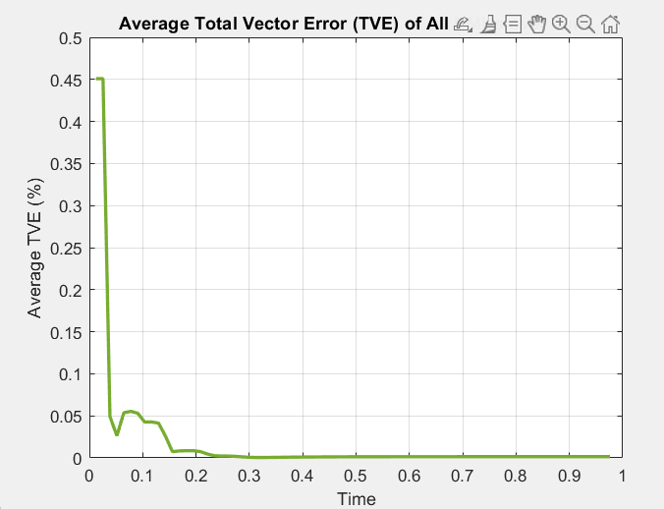
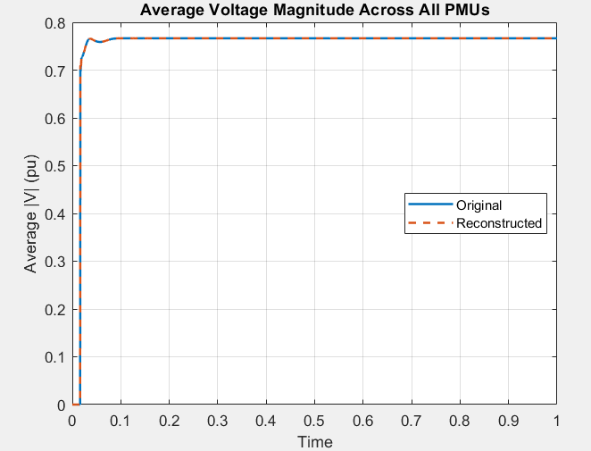
Visualization of Results
Compression Results:
Voltage phasors compressed using 3 out of 14 components (78.6% reduction)
Maximum TVE: 0.7127%
Frequency data compressed using 1 out of 14 components (92.9% reduction)
Maximum Frequency Error: 0.470706 Hz
Compression Ratio: 6.77:1

Slide 9
Summary of Key Innovations and Applications
Key innovations →
Complex-domain PCA:
Maintains critical phasor relationships for accurate analysis.
TVE-driven iteration:
Enables adaptive control of accuracy during compression.
Overlapping windows:
Optimizes computations while preserving data integrity.
Applications →
Real-time grid monitoring
Historical data archiving

