Slide 1



PREDPOL INDIA
AI-POWERED PREDICTIVE POLICING FOR SMARTER CRIME PREVENTION
TEAM NAME: UPLIFTERS
TEAM-LEADER NAME: ADITYA SRIVASTAVA
THEME: OPEN INNOVATION

Slide 2
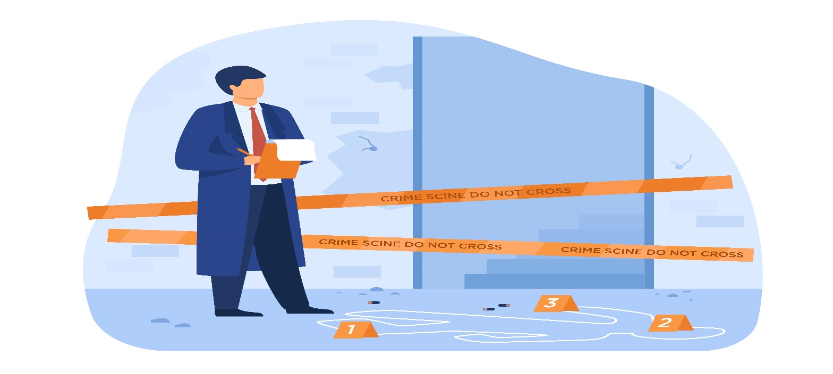
PROBLEM STATEMENT
Current Challenges in Indian Policing:
Reactive Systems: Crimes addressed after occurrence, not prevented.
Fragmented Data: No central platform for crime trend analysis.
No Real-Time Insights: Delayed response due to lack of predictive analytics.
Resource Wastage: Manual patrols, no hotspot visualization or smart deployment.
Women safety zones and high-risk areas are not dynamically monitored or prioritized.
Increased risk of people falling victim to crimes in unfamiliar areas.
Need for tools to analyze and visualize crime patterns effectively.
Impact: Rising crime rates, inefficient resource use, public distrust.

Slide 3
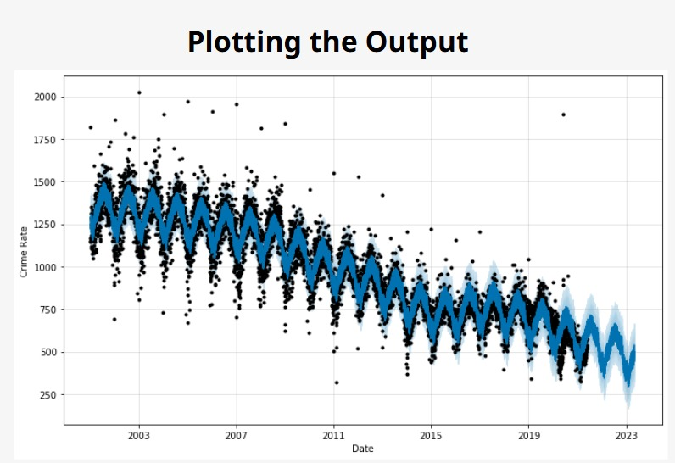

SOLUTION
PREDPOL INDIA is a smart, AI-driven interface that consists of:
Real-Time Crime Hotspot Visualization (GIS-based heatmaps).
Predictive Analytics (AI/ML models to forecast crime trends).
Smart Patrol Planning (Optimal route suggestions for officers).
Unified Dashboard (Centralized crime data with behavioral insights).
Public Reporting Integration (Citizen app for crowdsourced data).
Value Proposition:
Proactive policing → Reduced crime rates.
Faster response times → Improved public safety.
Data-driven decisions → Optimal resource allocation.
Future Scope:
Real-Time Behavior Detection (CCTV-Based) :Detects loitering, sudden running, and unusual vehicle activity using OpenCV + YOLO/MediaPipe.
Deployable on cloud or edge devices (like Raspberry Pi) with real-time alerts sent to control room/app.

Slide 4
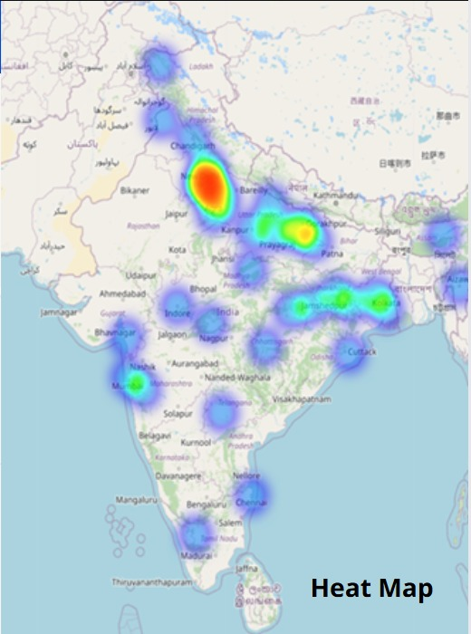
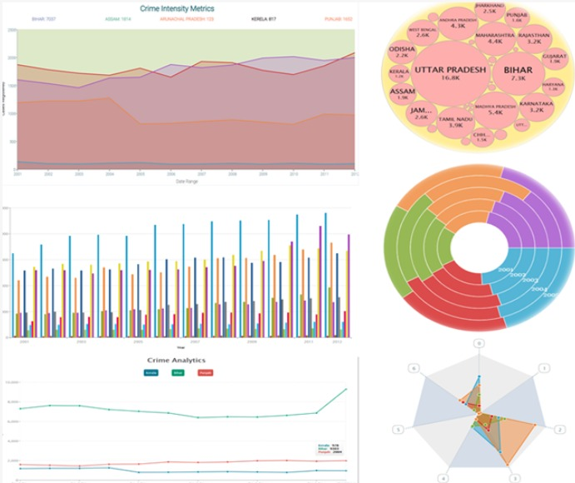
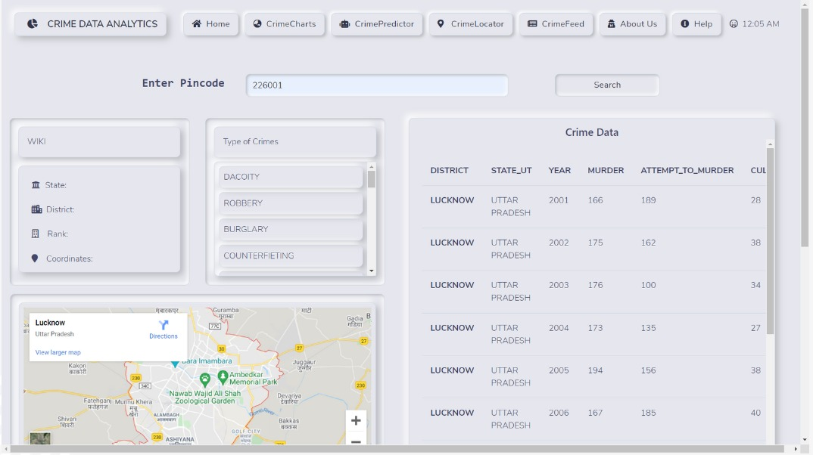
IMPLEMENTATION SCOPE
Availability of Public Crime Data: Many regions provide open access to crime statistics through government portals or APIs.
Integration with Maps APIs: Google Maps can be used to visualize crime data effectively by location.
Cross-platform Development: Can be built as a responsive web app or mobile app using modern frameworks (e.g., MERN, Flutter).
Collaboration with Law Enforcement: Possible tie-ups for real-time data sharing and credibility enhancement.
User-generated Reports: Allows community members to report incidents, enriching data accuracy and engagement.

Slide 5
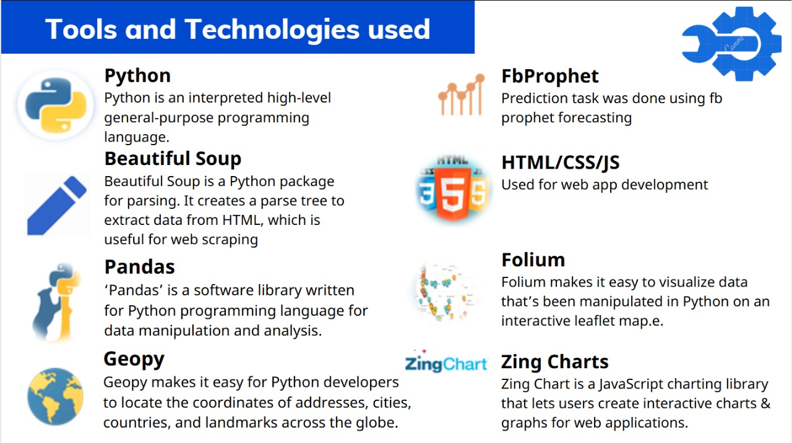

TECH STACK

Slide 6
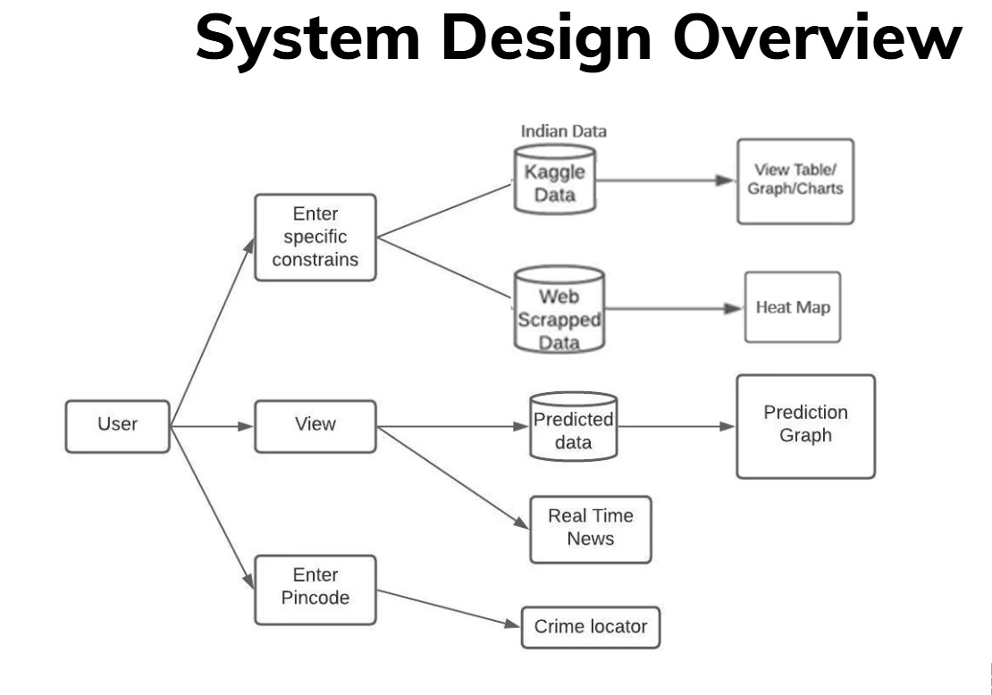
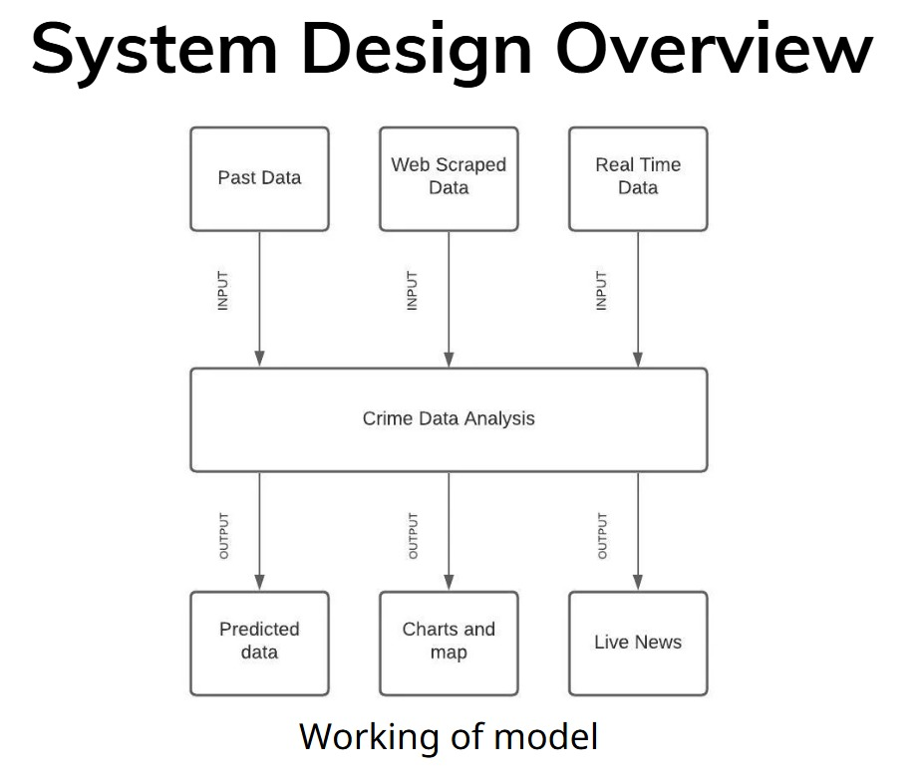
BASIC SYSTEM DESIGN

Slide 7
Thank YOU

