Slide 1

01 · THE HUMAN PROBLEM
PRANAGUARD
What happens when a
patient’s breathing begins to
deteriorate — but the change is
not recognised early enough?
In COPD, the weeks between two consultations
are usually the least visible part of the disease.
THE PATH FROM A BAD DAY TO A HOSPITAL VISIT
01
EVERYDAY BREATHING
02
WORSENING SYMPTOMS
03
HEALTHCARE INTERVENTION
Good days and bad days,
A change the patient
A consultation, a
managed at home
feels — rarely written
prescription, a hospital
down
visit
3rd
LEADING CAUSE OF DEATH
3.4 million deaths in 2023 — about 6% of all deaths
WORLDWIDE
globally. COPD is not rare, and it is not curable.
Source: WHO COPD fact sheet, 10 June 2026.
ILLUSTRATIVE PHOTOGRAPH · SYNTHETIC PATIENT DATA ONLY
Notes:
SLIDE 1 — THE HUMAN PROBLEM
PRESENTER 1 · 0:00 – 0:35
MAIN MESSAGE
COPD deterioration happens between appointments, not inside them.
SCRIPT · 35 SECONDS · STAND CENTRE STAGE, NOT BEHIND T
----------------------------------------------------------
Before we show you anything we built, picture one person.
This is someone's father. He has COPD. On a good day he can breathe. On a bad day he cannot walk to the window.
What happens when a patient's breathing begins to deteriorate — but the change is not recognised early enough?
The pattern is almost always the same. Everyday breathing at home. Symptoms the patient feels but rarely writes down. Then a healthcare intervention.
COPD is the third leading cause of death worldwide — 3.4 million deaths in 2023. But rarity isn't our point. Visibility is.
INTERACTION · OPTIONAL, 10 SECONDS
------------------------------------
“Quick show of hands — who here has a relative who was told their lungs were fine when they didn't feel fine?” Accept two seconds of hands. “That gap between what a person feels and what a system records is the space we work in.” Do not wait for stories.
TRANSITION
----------
To understand why that gap exists, look at how COPD care is actually assembled.
SOURCES FOR FACTUAL CLAIMS
• Third leading cause of death worldwide; 3.4 million deaths in 2023 (≈6% of global deaths); COPD is not curable — WHO COPD fact sheet, 10 June 2026.
• The photograph is an illustrative image, labelled as such on the slide. Never imply he is a real PranaGuard patient.
Full script, timings and evidence table: PranaGuard_5_Minute_Speaker_Script.docx

Slide 2
02 · THE HEALTHCARE GAP
THREE POINTS ON THE PATH WHERE THE PICTURE BREAKS DOWN
Care is built from
01
INFORMATION IS FRAGMENTED
Results, letters, prescriptions and self-reported symptoms sit in different places and rarely join up.
snapshots.
COPD is not a
DAILY EXPERIENCE IS RARELY CAPTURED
02
snapshot disease.
Symptoms are under-reported by patients — and clinicians do not systematically ask about them.
68%
03
CHANGE IS DIFFICULT TO SEE
OF EXACERBATIONS
With a snapshot at each visit, an individual’s baseline and drift between visits are hard to judge.
GO UNREPORTED
In a longitudinal cohort, 68% of exacerbations
A SNAPSHOT IS NOT A TRAJECTORY
recorded by patients in daily diaries were never
reported to a health professional (327 of 486).
A single spirometry value or one saturation reading describes a moment. It does not describe how a person has been breathing since the last visit.
Langsetmo et al., AJRCCM 2008
A SINGLE MEASUREMENT
A LONGITUDINAL UNDERSTANDING
BETWEEN TWO ROUTINE VISITS
Valid for that moment. Weak at describing
Repeated records against a personal baseline.
direction.
Visit
Next visit
THE RISKIEST PATIENTS CAN LOOK ORDINARY
Ninety days of lived experience. Two recorded
Hurst et al., NEJM 2010: a history of exacerbations was the single best predictor of future exacerbations across all GOLD stages.
observations.
Schematic, not to scale. Illustrative interval — not a measured statistic.
Sources: Langsetmo et al. 2008; GOLD 2026; Elliott-Button et al. 2024.
Notes:
SLIDE 2 — THE HEALTHCARE GAP
PRESENTER 1 · 0:35 – 1:40
MAIN MESSAGE
COPD care is built from snapshots. COPD is a disease of trajectory.
SCRIPT · 65 SECONDS
---------------------
Think about how COPD care is recorded. A consultation, a spirometry value, a prescription — notes in one system, a letter in another, the patient's memory holding the rest.
Three things break. Information is fragmented. Daily experience is rarely captured — GOLD tells us these symptoms are under-reported, and a primary-care study found clinicians do not routinely ask about breathlessness. And change is hard to see when every contact is a snapshot.
Here is the number that should worry us. In one longitudinal cohort, 68 percent of the exacerbations patients recorded in their own diaries were never reported to a clinician. Two out of three. Not because they were mild — they looked like the reported ones. They simply never reached the record.
And this matters clinically: the best single predictor of future exacerbations is the history of past ones. Risk lives in history — a snapshot carries none.
A single measurement isn't useless. It is a measurement of a moment. Longitudinal understanding is what shows direction.
INTERACTION · 15 SECONDS
--------------------------
“If a COPD patient feels worse between two hospital visits, how much of that change is visible to the clinician?” Pause three seconds. If nobody answers: “Usually very little — and that is not a criticism of any clinician. It is a property of the record we give them.”
HANDOVER · 1:40 · HAND OVER THE CLICKER ON THIS SENTEN
----------------------------------------------------------
My colleague will now show you what we built for that.
SOURCES FOR FACTUAL CLAIMS
• Symptoms may be under-reported by patients — GOLD 2026 report.
• Breathlessness normalised and under-reported; clinicians do not routinely ask about it — Elliott-Button et al., npj Primary Care Respiratory Medicine 2024;34:37.
• 68% unreported (327 of 486 diary-recorded exacerbations) — Langsetmo L, Platt RW, Ernst P, Bourbeau J. Am J Respir Crit Care Med 2008;177:396-401.
• History of exacerbations is the best single predictor of future events across GOLD stages — Hurst JR et al., N Engl J Med 2010;363:1128-38; restated in GOLD 2026.
• The 90-day timeline on the slide is a labelled schematic, not a measured statistic.
Full script, timings and evidence table: PranaGuard_5_Minute_Speaker_Script.docx

Slide 3
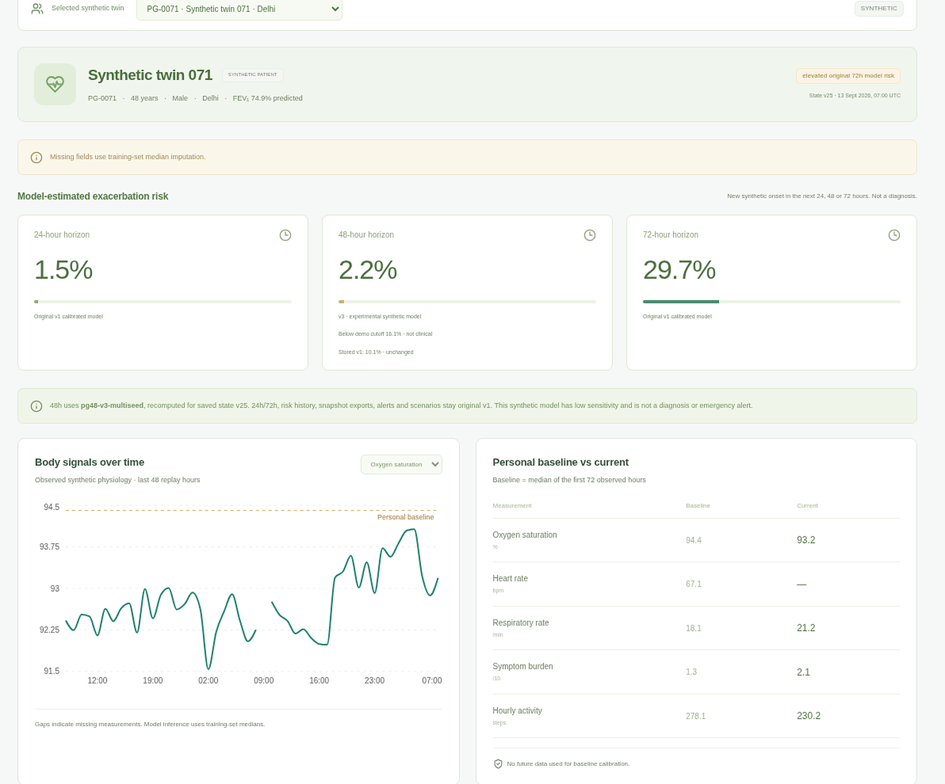
03 · THE PRANAQUARD APPROACH
PRANAGUARD
From isolated observations
to a longitudinal COPD
digital twin
A research prototype that keeps each patient’s COPD story in one
place — and labels every model output for what it is.
THE INFORMATION FLOW · CLICK TO REVEAL
01
PATIENT OBSERVATIONS
Daily wellbeing, breathlessness, sputum, adherence, physiology
02
LONGITUDINAL HEALTH RECORD
A versioned twin state for every hour of the record
03
PERSONAL BASELINE
First 72 observed hours become that patient’s own reference
04
RESEARCH-MODEL INSIGHTS
Experimental 24 / 48 / 72-hour estimates, model version attached
05
CLINICIAN REVIEW
A person reviews, documents and decides — the model never does
Actual PranaGuard interface: synthetic patient PG-0071, replay state v25.
Outputs shown are experimental research estimates on synthetic data — not confirmed clinical events.
Status: working software prototype · synthetic cohort of 120 patients · not a medical device · not clinically validated
Notes:
SLIDE 3 — THE PRANAQUARD APPROACH
PRESENTER 2 · 1:40 – 2:50
MAIN MESSAGE
One longitudinal, replayable record — with every model output labelled as research.
SCRIPT · 70 SECONDS · THREE CLICKS, ONE PER STAGE GROU
----------------------------------------------------------
Click 1 — stages 01 and 02 appear:
The first thing we built is a record that behaves like a story, not a filing cabinet. Observations go in: daily wellbeing, breathlessness, sputum, adherence, physiology. They become a longitudinal record where every hour is a versioned, replayable state.
Click 2 — stages 03 and 04:
We establish a personal baseline: the first 72 observed hours become this person's own reference, not a population average. Then research-model insights — experimental 24, 48 and 72-hour estimates, each carrying its model version, completeness and limitations.
Click 3 — stage 05:
And the most important decision in the system: a clinician reviews. The model never signs anything.
This is the actual interface — synthetic patient PG-0071. Baseline against current values. Body-signal trend. Three research cards, each labelled an experimental estimate on synthetic data.
That labelling isn't decoration. Our 72-hour model had an AUROC of 0.395 — below chance. We published that, and the interface repeats it, because a system that hides its weak parts cannot be trusted with its strong ones.
TRANSITION
----------
So that is the mechanism. The question that matters is: what could this change?
SOURCES FOR FACTUAL CLAIMS
• Every hour persisted as a versioned, replayable state; personal baseline = median of the first 72 observed hours — docs/METHODOLOGY.md, docs/ARCHITECTURE.md.
• “Experimental estimate on synthetic data” labels are visible in the product screenshot — docs/model-v3/verification/screenshots/desktop-patient.png.
• 72-hour AUROC 0.3951 (below chance), AUPRC 0.0593 (below prevalence 0.0773) — artifacts/evaluation.md, docs/MODEL_CARD.md.
• If the clicker fails, use the PDF: it shows the complete flow. Keep talking.
Full script, timings and evidence table: PranaGuard_5_Minute_Speaker_Script.docx

Slide 4
04 · HEALTHCARE IMPACT
PRANAGUARD
What could change —
if the approach is validated
Potential impact is described here as potential. The prototype has not demonstrated any of it in patients.
PATIENT IMPACT
CLINICIAN IMPACT
HEALTHCARE SYSTEM IMPACT
Better visibility of changing breathing patterns
Consolidated longitudinal information in one view
A more structured model for longitudinal
A structured way to record daily experience
Change since the personal baseline, not just today
monitoring
One continuous record instead of disconnected
Patient-reported information gathered and
A research platform for exacerbation-associated
episodes
reviewed
patterns
Better-informed conversations with the care team
Research insight offered as context, never as a
A foundation for future, evidence-based COPD
verdict
workflows
THE IMPACT PATHWAY · POTENTIAL, NOT MEASURED
01
02
03
04
05
Patient observations
Structured longitudinal
Clinician visibility
Informed assessment
Continuity of care
information
CURRENT EVIDENCE vs. FUTURE VALIDATION
WHAT EXISTS TODAY
WHAT MUST HAPPEN NEXT
Working end-to-end software prototype, audited and reproducible
Clinician-supervised evaluation and prospective research
Model experiments on a synthetic cohort of 120 patients
Clinical usability and workflow assessment
Public modelled environmental context (Open-Meteo / CAMS), city-level only
Measurement of real patient and healthcare outcomes
NOT YET DEMONSTRATED
No reduction in hospitalisations, exacerbations or mortality has been demonstrated. Model performance on synthetic data has been weak and is reported as such.
Notes:
SLIDE 4 — HEALTHCARE IMPACT
PRESENTER 2 · 2:50 – 4:20
MAIN MESSAGE
Potential value at three levels — with a hard line between what is claimed and what has been measured.
SCRIPT · 90 SECONDS
---------------------
This is the slide we ask you to judge us on.
For the patient: visibility of changing patterns, a structured way to record daily experience, one continuous record, better-informed conversations with the care team.
For the clinician: consolidated longitudinal information, change measured against the patient's own baseline, patient-reported information actually gathered and reviewed, and research insight offered as context — never as a verdict.
For the health system: a more structured model for monitoring, a research platform for exacerbation patterns, a foundation for evidence-based workflows.
The pathway is deliberately modest. Observations become structured information, which becomes clinician visibility, which supports informed assessment. What we aim at is continuity of care.
Now the honest part. What exists today: a working end-to-end prototype, audited and reproducible; model experiments on 120 synthetic patients; public modelled environmental context. What does not exist: any measured reduction in hospitalisations, exacerbations or mortality. Our 72-hour model performed poorly, and we report it as poor.
Next: clinician-supervised evaluation, prospective research, and measurement of real outcomes.
We would rather present a small, honest result than a large, unreliable one.
TRANSITION
----------
Which brings us to why we think this is worth the next few years of work.
SOURCES FOR FACTUAL CLAIMS
• Prototype status: implemented, tested, audited, reproducible — README §5, DELIVERY_REPORT.md.
• 120-patient synthetic cohort — docs/DATA_PROVENANCE.md.
• Weak 72-hour performance reported openly — docs/MODEL_CARD.md, artifacts/evaluation.md.
• No demonstrated reduction in hospitalisations, exacerbations or mortality — docs/LIMITATIONS.md.
• Say the word “potential” at least twice on this slide. If time is short, compress the three impact columns to one sentence each — never cut the “not yet demonstrated” sentence.
Full script, timings and evidence table: PranaGuard_5_Minute_Speaker_Script.docx

Slide 5
05 · THE VISION
PRANAGUARD
Better COPD care begins
with understanding the changes
happening between consultations.
01
02
03
04
PATIENT
LONGITUDINAL DATA
CLINICIAN
RESEARCH INSIGHTS
daily experience
the record over time
review and judgement
evidence, explicitly labelled
PranaGuard — turning fragmented COPD observations into a more connected
picture of patient health.
Status today: a working research prototype on synthetic data. Clinical value is a hypothesis to be tested, not a result we are claiming.
ASK THE ROOM
What if the changes between consultations were easier to understand?
Thank you — we welcome your questions.
PranaGuard · Happiest Health Digital Twin Challenge 2026
Notes:
SLIDE 5 — THE VISION AND CLOSING
PRESENTER 2 · 4:20 – 5:00
MAIN MESSAGE
Understanding change between consultations is the entire thesis.
SCRIPT · 40 SECONDS
---------------------
Let me leave you with the sentence we started from. Better COPD care begins with understanding the changes happening between consultations.
Four things have to exist: a patient whose daily experience is captured; longitudinal data that keeps history instead of overwriting it; a clinician who can review and judge; and research insights that are honest about what they are.
Click — the four nodes appear.
PranaGuard is one attempt to put those four in the same room. Today it is a working research prototype on synthetic data. The clinical value is a hypothesis we have not yet tested in patients.
Pause. Then the closing question, slowly.
What if the changes between consultations were easier to understand?
Thank you — we welcome your questions.
Stop talking. Let two seconds of silence pass before anyone moves.
SOURCES FOR FACTUAL CLAIMS
• “Working research prototype on synthetic data” is the project's own disclosed status — README caution block, docs/LIMITATIONS.md.
• This slide must never be amended to imply the vision has been clinically achieved.
Full script, timings and evidence table: PranaGuard_5_Minute_Speaker_Script.docx

Slide 6
APPENDIX · FURTHER READING
Ten answers, ready to deliver
BACKUP · NOT PART OF THE FIVE-MINUTE FLOW
WHAT IS COPD?
WHAT DATA IS, AND IS NOT, REAL
A common, preventable and treatable disease with persistent respiratory symptoms and
Patients, physiology and outcomes are all synthetic. The only real inputs are public modelled
airflow limitation. Symptoms include breathlessness, cough and sputum. It is not curable.
city air-quality and weather data — context, not personal exposure. No clinical data at all.
(WHO; GOLD)
WHAT IS AN EXACERBATION?
HAS IT BEEN CLINICALLY VALIDATED?
An acute worsening of respiratory symptoms that leads to additional therapy. Severity
No. There has been no clinical trial, no real patient data and no regulatory review. It is
ranges from extra bronchodilator use to hospitalisation. (GOLD)
explicitly labelled a research prototype and not a medical device.
WHY LONGITUDINAL MONITORING?
WHAT IMPACT IS DEMONSTRATED?
A single reading describes a moment. Repeated records against a personal baseline begin to
Software functionality only: a working prototype whose behaviour is tested and
describe direction of change between visits.
reproducible. No patient, clinical or system-level outcome has been measured.
WHAT IS THE DIGITAL TWIN HERE?
HOW WOULD IT BE EVALUATED?
A versioned, replayable state for each synthetic patient: observations, personal baseline,
Clinician-supervised usability studies, then prospective observational research with
derived features and model context kept in one continuous record.
adjudicated outcomes, then outcome measurement — under ethics approval and
governance.
WHAT DOES THE MODEL PREDICT?
HOW DOES A DOCTOR USE IT?
Experimental 24/48/72-hour estimates of a new synthetic exacerbation onset in the
Sign in, open an assigned patient, review the twin, trends and labelled model context, then
research cohort. These are research outputs, not validated probabilities or alerts.
record a review. Every action is attributed and audited.
Full source list on the next page. Every answer above is defensible from the project’s own documentation or a cited publication.
Notes:
APPENDIX A — JURY Q&A PREPARATION (backup, not presented)
Use only if asked. Keep answers under 25 seconds each.
1. WHAT IS COPD?
A common, preventable and treatable disease with persistent respiratory symptoms and airflow
limitation. Breathlessness, cough and sputum are typical. It is not curable, but it is
treatable. (WHO; GOLD 2026)
2. WHAT IS AN EXACERBATION?
An acute worsening of respiratory symptoms that leads to additional therapy — from extra
bronchodilators up to hospitalisation. (GOLD 2026)
3. WHY IS LONGITUDINAL MONITORING USEFUL?
Because a single value is a moment, and COPD is a trajectory. Repeated records against a personal
baseline begin to show direction of change — and the strongest known predictor of future events
is the history of past events. (Hurst et al., NEJM 2010)
4. WHAT IS THE DIGITAL TWIN IN PRANAQUARD?
A versioned, replayable state per patient: observations, a personal baseline from the first 72
hours, derived features, and the model context attached to each saved state. It is data-driven,
not a mechanistic lung model.
5. WHAT DOES THE CURRENT MODEL ACTUALLY PREDICT?
An experimental estimate of a new synthetic exacerbation onset within 24, 48 or 72 hours, on the
research cohort. On held-out synthetic data, the 72-hour model had AUROC 0.395 and AUPRC 0.059 —
below chance and below prevalence. We report it as weak and non-clinical.
6. WHAT DATA IS REAL AND WHAT IS SYNTHETIC?
Every patient, physiological stream and outcome label is synthetic — 120 generated patients. The
only real inputs are public modelled city air-quality and weather data, used as context, not as
personal exposure. No clinical data is involved anywhere, so nothing here is clinical validation.
7. HAS THE SYSTEM BEEN CLINICALLY VALIDATED?
No. No trial, no real patient data, no regulatory review, no clinical endorsement. It is
labelled a research prototype and not a medical device throughout.
8. WHAT HEALTHCARE IMPACT HAS ACTUALLY BEEN DEMONSTRATED?
Software impact only: a working, audited, reproducible prototype with tested clinical workflows.
No patient, clinical or system-level outcome has been measured.
9. HOW WOULD THE PLATFORM BE CLINICALLY EVALUATED?
Three stages: clinician-supervised usability and workflow studies; prospective observational
research with adjudicated outcomes under ethics approval; then outcome measurement — including
calibration, subgroup fairness and net benefit.
10. HOW DOES THE DOCTOR INTERACT WITH THE PLATFORM?
Signs in, opens an assigned patient, reviews the twin, the trends and the labelled model context,
then records a review with an audit trail. Access is enforced server-side per patient assignment;
a patient account is blocked from clinician prediction endpoints.
TONE FOR Q&A
Answer the question asked, in one breath, then stop. If you do not know, say "we have not
evaluated that, and it would be part of the next stage." That answer is always stronger than an
invention.

Slide 7
APPENDIX · REFERENCES
Sources and further reading
Global burden: COPD is the third leading cause of death worldwide, with 3.4 million deaths in 2023
(about 6% of global deaths). Nearly 90% of COPD deaths under age 70 occur in low- and
STATE OF THE EVIDENCE
middle-income countries (WHO, 2026). What PranaGuard does not claim: no clinical validation, no
IMPLEMENTED
measured outcome improvement, no regulatory status, no real patient data. All patient records in the
Working prototype, audited and reproducible
prototype are synthetic.
EXPERIMENTAL
Synthetic-cohort model studies; weak 72-hour
performance reported openly
REFERENCES
1. World Health Organization. Chronic obstructive pulmonary disease (COPD). Fact sheet, 10 June 2026.
INTENDED
Longitudinal visibility and structured
2. Global Initiative for Chronic Obstructive Lung Disease. Global Strategy for the Diagnosis, Management and Prevention of
record-keeping
COPD: 2026 Report. goldcopd.org
NOT CLAIMED
3. Langsetmo L, Platt RW, Ernst P, Bourbeau J. Underreporting exacerbation of chronic obstructive pulmonary disease in a
Any clinical outcome, validated prediction or
longitudinal cohort. Am J Respir Crit Care Med. 2008;177(4):396-401.
regulatory status
4. Hurst JR, Vestbo J, Anzueto A, et al. Susceptibility to exacerbation in chronic obstructive pulmonary disease. N Engl J Med.
2010;363(12):1128-1138.
5. Elliott-Button HL, Johnson MJ, Hutchinson A, et al. “I’m living in a ‘no’ world now…” npj Primary Care Respiratory Medicine.
CITATION DISCIPLINE
2024;34:37.
Only the seven sources listed are used anywhere in this
6. How People with COPD Perceive and Communicate Exacerbations: A Multicountry Survey Study. Int J Chron Obstruct
deck. If a jury member asks for a source that is not
Pulmon Dis. 2025.
among them, say so plainly rather than reaching for a
7. PranaGuard project documentation: docs/METHODOLOGY.md, docs/MODEL_CARD.md, docs/model-v3/RESULTS.md,
number you cannot defend.
docs/LIMITATIONS.md, docs/DATA_PROVENANCE.md.
Notes:
APPENDIX B — REFERENCES (backup)
1. World Health Organization. Chronic obstructive pulmonary disease (COPD). Fact sheet,
10 June 2026. who.int
2. Global Initiative for Chronic Obstructive Lung Disease. Global Strategy for the Diagnosis,
Management and Prevention of COPD: 2026 Report. goldcopd.org
3. Langsetmo L, Platt RW, Ernst P, Bourbeau J. Underreporting exacerbation of chronic obstructive
pulmonary disease in a longitudinal cohort. Am J Respir Crit Care Med. 2008;177(4):396-401.
4. Hurst JR, Vestbo J, Anzueto A, et al. Susceptibility to exacerbation in chronic obstructive
pulmonary disease. N Engl J Med. 2010;363(12):1128-1138.
5. Elliott-Button HL, Johnson MJ, Hutchinson A, et al. "I'm living in a 'no' world now…"
npj Primary Care Respiratory Medicine. 2024;34:37.
6. How People with COPD Perceive and Communicate Exacerbations: A Multicountry Survey Study.
Int J Chron Obstruct Pulmon Dis. 2025.
7. PranaGuard project documentation: docs/METHODOLOGY.md, docs/MODEL_CARD.md,
docs/model-v3/RESULTS.md, docs/LIMITATIONS.md, docs/DATA_PROVENANCE.md.
NOTE ON CITATION DISCIPLINE
Only these seven sources are used anywhere in the deck. If a jury member asks for a source that
is not on this list, say so plainly rather than reaching for a number you cannot defend.

