Slide 1


CAR RENTAL DATABASE
IST-659
-Harsh Takrani
-April 16, 2018

Slide 2
What data to collect?
Car Rental details are collected from different companies
User details like license number, email, previous trip details etc. are stored
Data of organizations that provide car rentals is collected
Feedback is collected from customers and stored
Types of car, capacity, cost of cars and availability data is stored
Credentials of Admin and users are also saved in database

Slide 3
Data Authorization
Who can input the data?
Who can query the data?
Admin
Customers (Only to Change their own details)
Admin (Full Access)
Customers (Limited Access)

Slide 4

Project Goals
Major Data Questions
Find cars using car name, capacity, availability and budget
Compare cars based on above parameters
Select the best possible option
See previous trip history and feedbacks provided
Add/update/delete records *(Only authorized to admin)
Permit customers to check trip count

Slide 5
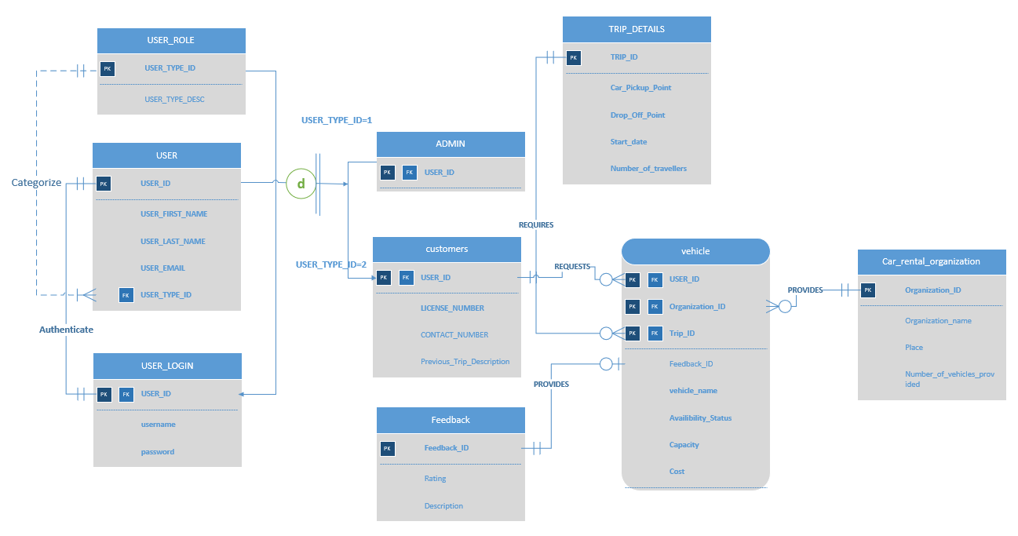
ER Diagram – MS Visio

Slide 6
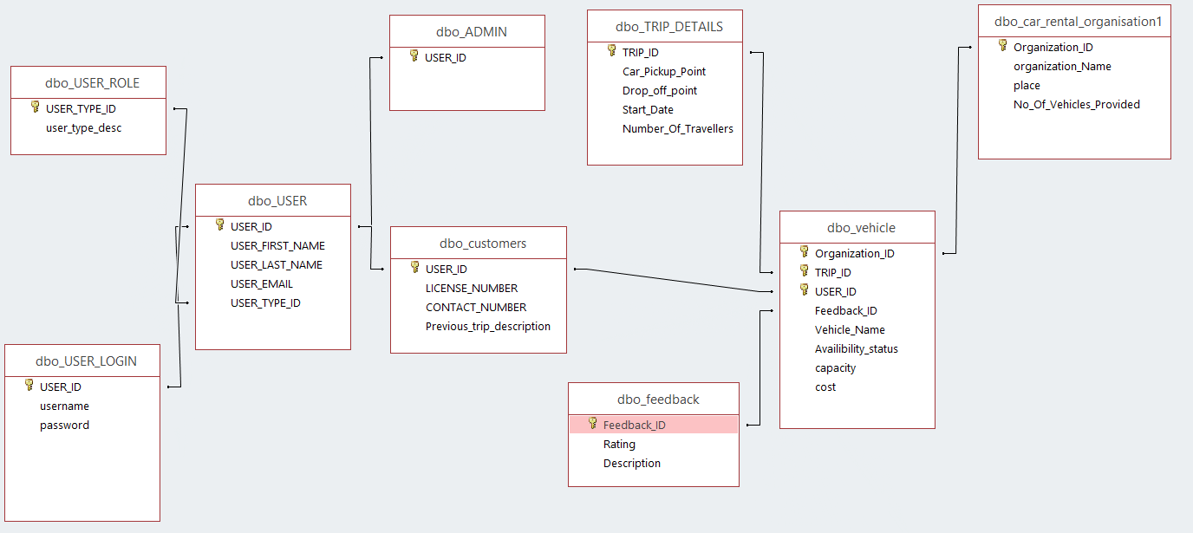
Access Relationship Diagram

Slide 7
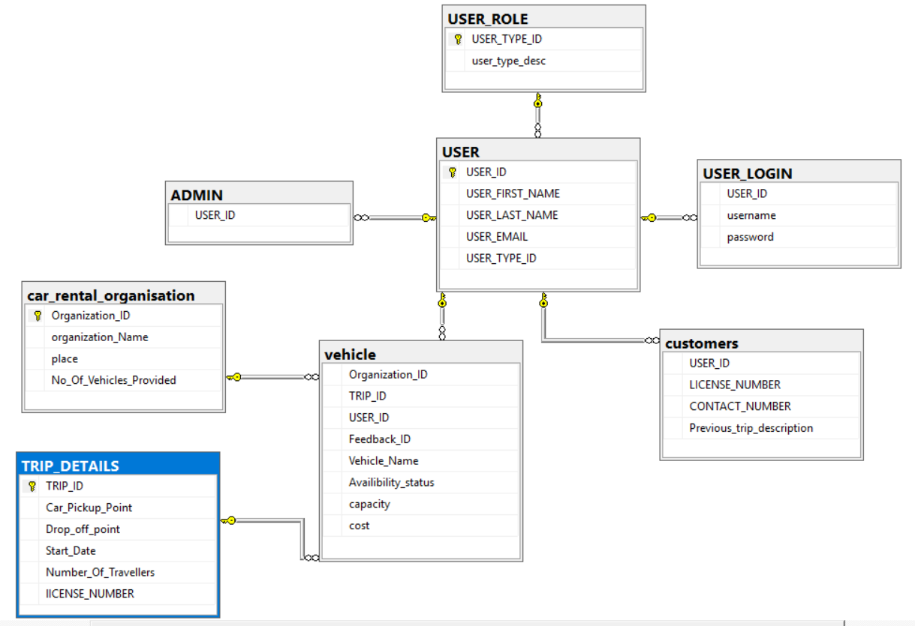
ER Diagram in SQL

Slide 8
Forms
Number of tables in the system: 9
1
Number of forms completed: 12
2
Number of tables that are edited using forms: 9
3
Number of Reports generated: 4
4

Slide 9
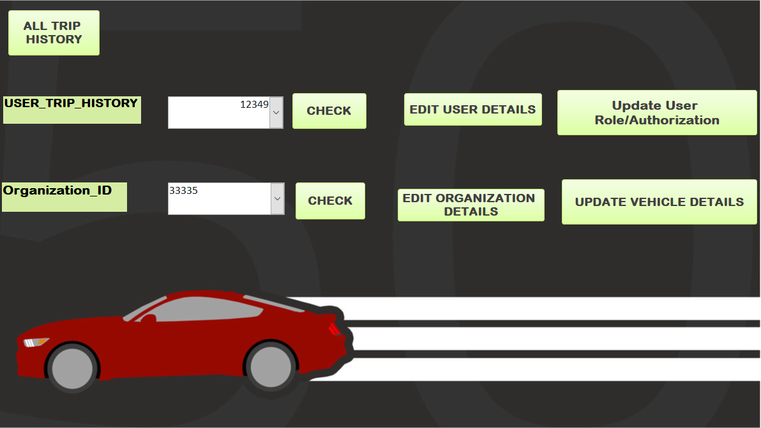
Admin Access form:

Slide 10
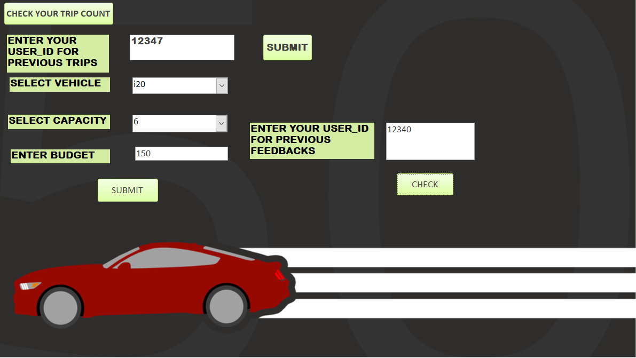
User Access Form:

Slide 11
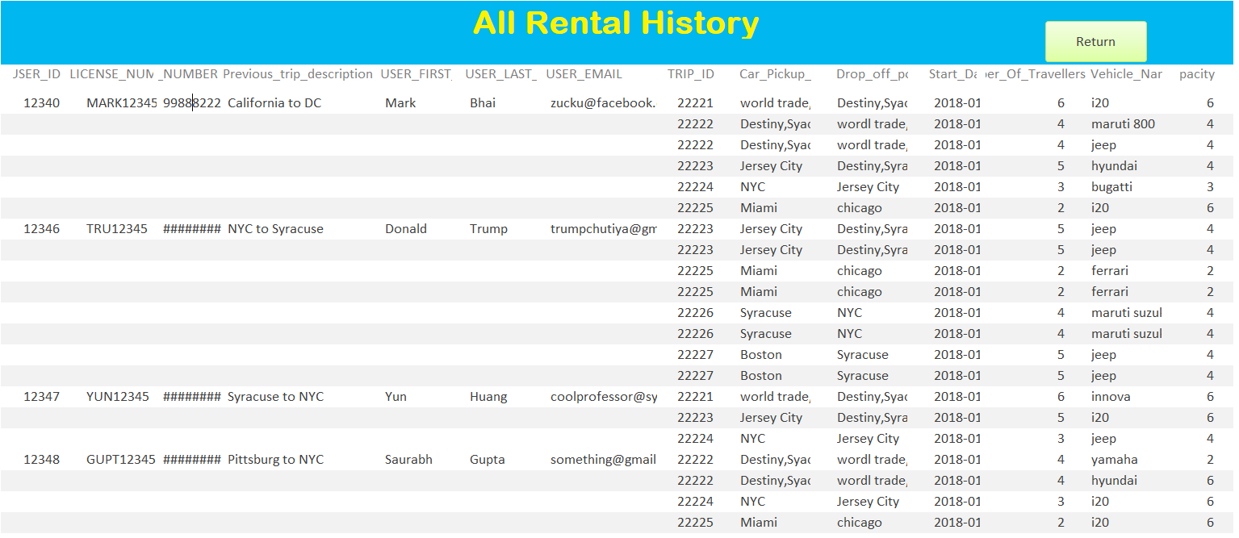
Report of All Trip History(Y)

Slide 12
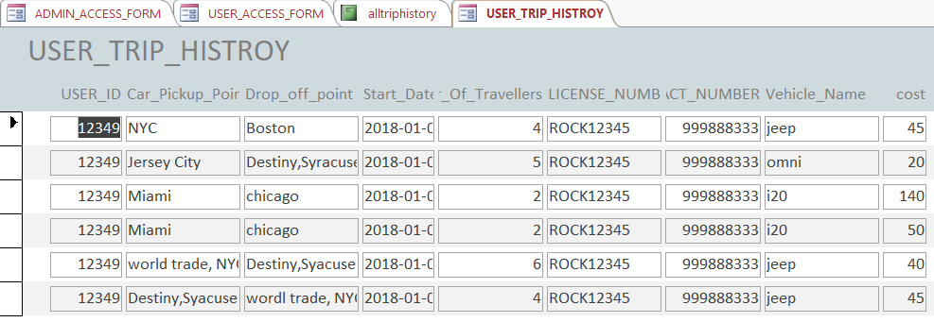
User Trip History Form (Admin Authorized)

Slide 13
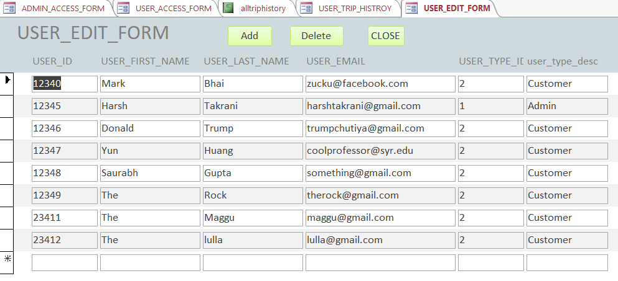
Edit User Detail Form (Admin Authorized)

Slide 14
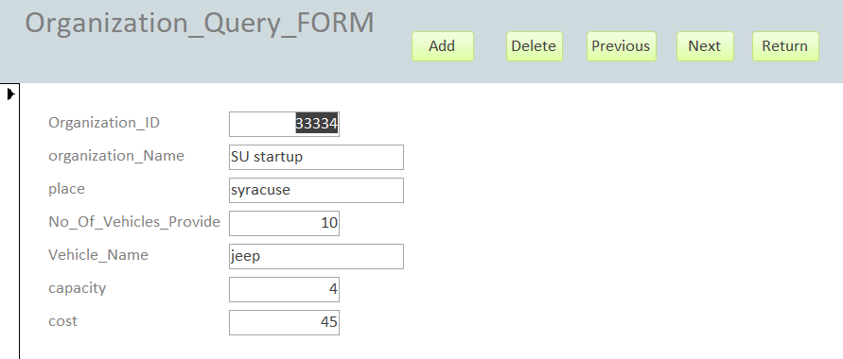
Organization Query Form (Admin Authorized)

Slide 15
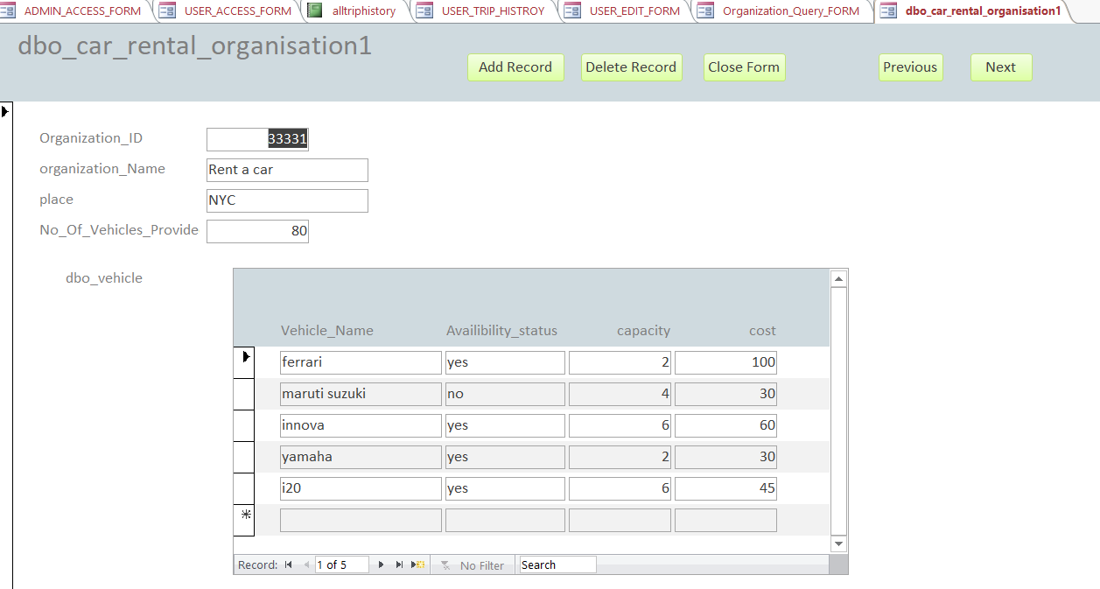
Organization Form (for modification)

Slide 16
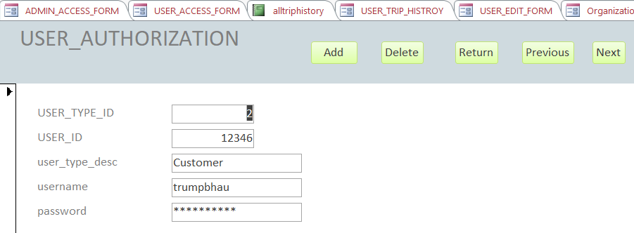
Update User Role/Authorization Form

Slide 17
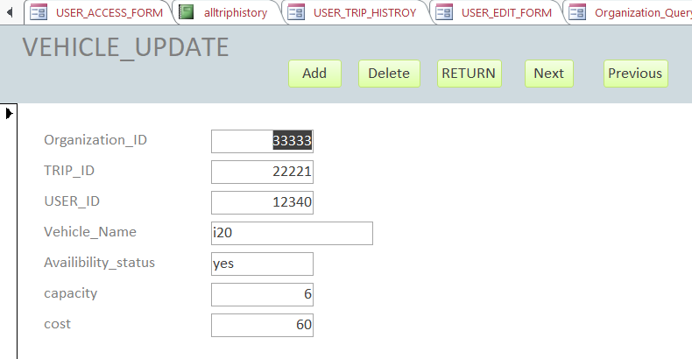
Vehicle Update Form (Admin Authorized)

Slide 18
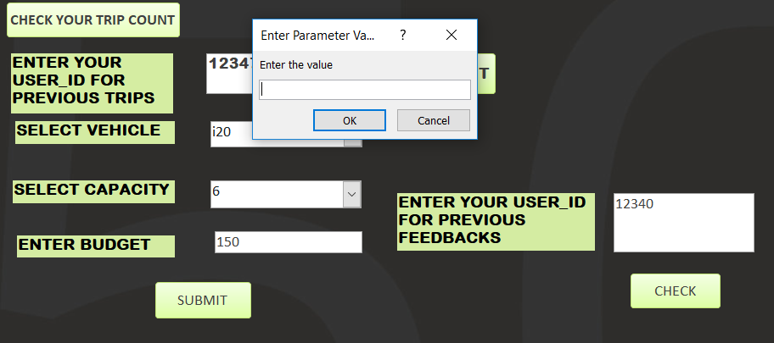
Aggregate Function
To count number of trips completed by users in the system
The customers enter the user id

Slide 19
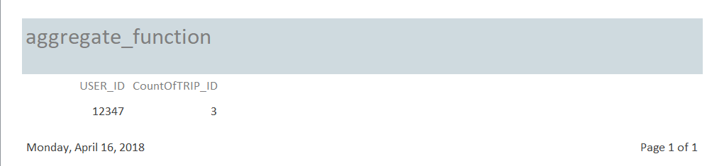
Aggregate Function
After putting in the user id this report pops up:

Slide 20
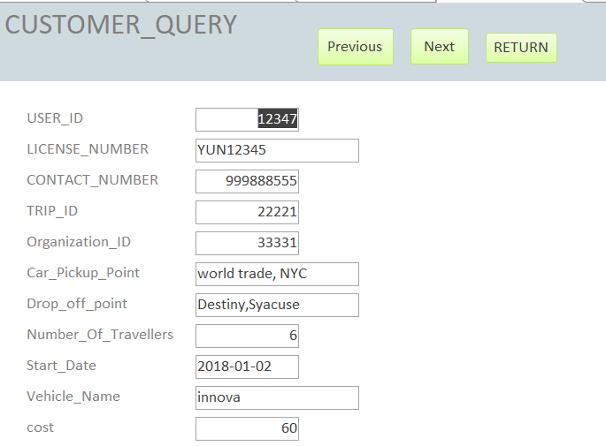
Customer Query For (for Trip History)

Slide 21
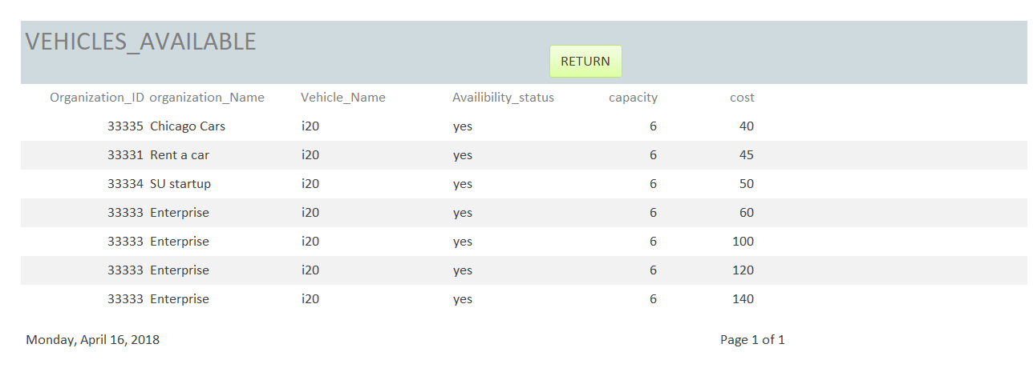
Vehicle Availability Report (vehicle, capacity and cost parameters) (Y)

Slide 22
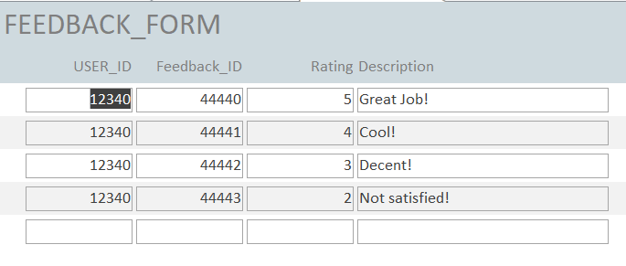
Feedback Form (to see previous feedbacks)

Slide 23
Trigger
Here, I will use trigger to add license number in the trip details table.
This will be done by using two inner joins as the two tables are not directly linked i.e. customers and Trip_Details are linked using Vehicle table.
First we link User_ID of customers to User_ID of vehicle using inner join
Then we link Trip_ID of vehicle table to Trip_ID of Trip_Details table

Slide 24
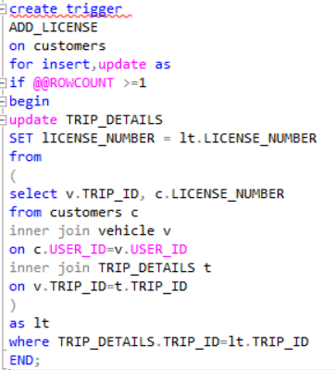
Trigger Query

Slide 25
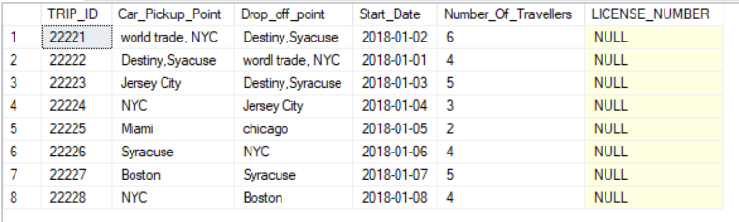
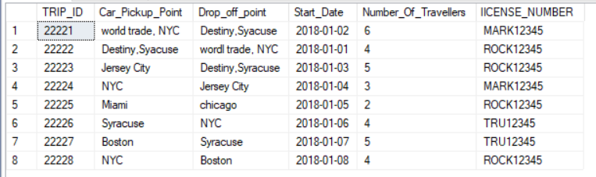
Before and After Trigger execution

Slide 26
Thank You!

