Slide 1

Fraud
DETECTION
Created By :-
HARSH THAKUR

Slide 2

INTRODUCTION:
DATA STRUCTURING
DATA ANALYSIS
VISUALIZATION
INSIGHTS

Slide 3
DATA STRUCTURING:-
Organization for Understanding:
In order to make our Understanding better, We organized our scattered tables.
Data Cleaning:
Data Cleaning by removing Null/Blank values and making Duplicate values as Distinct.
Data Modification:
To modify data in more relevant manner we used SQL queries to find more valuable insights.

Slide 4
DATA ANALYSIS:-
Creating Relationships and Joining data to get relevant data to meet our objectives.
Exploring the data to gain initial insights.
Conducted Statistical Analysis for uncovering patterns, behavior and drawing statistically valid conclusions.
Summarizing our analysis by drawing conclusions based on our observations.
Interpretation of our analysis findings by creating reports and representation with the help of Visualization.’

Slide 5
VISUALIZATION:-
Data Visualization was done with the help of SQL and Power BI.
Collected every possible Insights with the help of given data.
Wrote queries in SQL to get some insights as per our understanding.
Created Dashboards and visuals in Power BI.
To make representation and understanding the required data in more efficient manner.

Slide 6
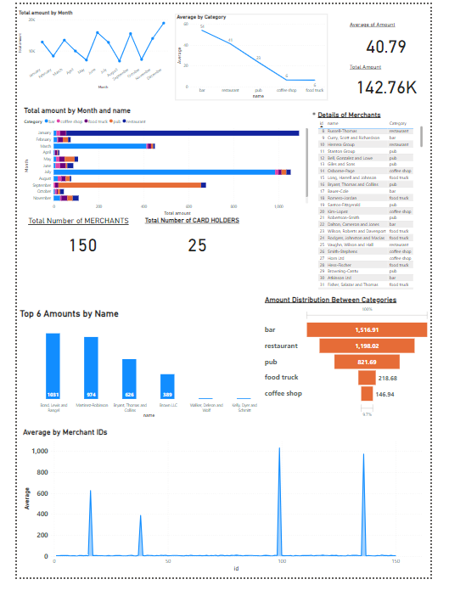
INSIGHTS:-
Extracted Insights and Relevant data as per our needs.
Understood the trends and changes in the data as we go through the data.
Created interactive dashboards for easy understanding.
Formatting visuals.

Slide 7
THANK YOU ☺
Beware of FRAUD:
Raise awareness on fraud detection to protect your financial well-being.

