Slide 1


Sports
REVENUE
ANALYSIS
-HARSH THAKUR

Slide 2
CONTENTS
Introduction
→
→
Methodology
Core Revelations
→
Resolutions
→

Slide 3
Introduction :
→
Curiosity-Driven Analysis: Initiated the project to compare the performance and market position of two major brands, Adidas and Nike.
Dataset Utilization: Discovered a relevant dataset containing comprehensive information on products, pricing, reviews, and traffic.
Objective:
Aimed to identify which brand performs better based on various quantitative metrics.
Analyzed multiple aspects such as pricing strategies, revenue trends, and customer reviews to gain insights.
Situation:
→
Market Comparison: Sought to understand competitive dynamics between Adidas and Nike to inform strategic decisions.
Dataset Insights: Leveraged the dataset to explore and quantify differences in performance between the two brands.

Slide 4
Methodology
Data Preparation:
Renamed tables for clarity and consistency.
Ensured correct data types for all columns.
Data Preparation:
Renamed tables for clarity and consistency.
Ensured correct data types for all columns.
Data Integration:
Joined multiple tables to create a comprehensive dataset for analysis.
Analytical Techniques:
Applied aggregation functions to summarize data.
Used window functions for advanced data analysis.
Implemented Common Table Expressions (CTEs) for modular and reusable queries.
Calculated correlations to identify relationships between variables.

Slide 5
Core Revelations
1
Data Quality before Analysis
2
Competitive Pricing Analysis between major Brands
3
Product segmentation for Marketing or Inventory management
4
Correlation Coefficient
5
Seasonal variations in Review activity
6
Quantitative metrics derived from CTE
7
Revenue Trends over time
8
Product quality and its impact on Sales performance
9
ROI based on Discount Effectiveness
10
Website Traffic

Slide 6
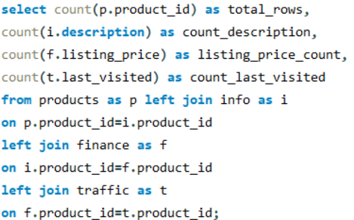

Resolutions
Data Quality before Analysis :
ANALYSIS DEMONSTRATED
Total Rows: The dataset contains 3120 rows in total.
Description Completeness:Description field is almost complete with 3117 entries, indicating minimal missing data.
Listing Price Completeness: All 3120 entries have listing prices, ensuring comprehensive data for pricing analysis.
Last Visit Data Gaps: The Last Visit field has 2876 entries, indicating some missing data (approximately 7.8% missing)

Slide 7
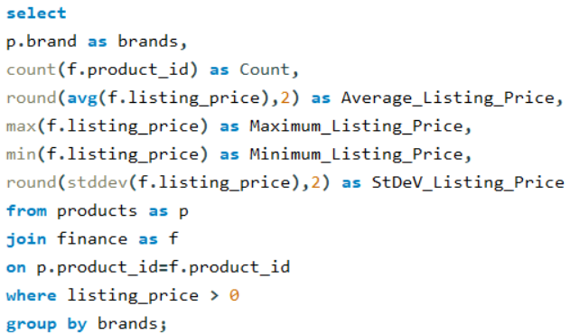
Competitive Pricing Analysis between major Brands :
ANALYSIS DEMONSTRATED
Adidas:
With 2575 listings, Adidas has a broad price range, from as low as $8.99 to $299.99, with an average price of $75.73.
The standard deviation of $40.52 indicates a significant variation in listing prices.
Nike:
Nike has 191 listings, with prices ranging from $29.95 to $199.95, and an average price of $117.97.
A standard deviation of $38.45 also suggests notable variability in listing prices.
Price Positioning:
Adidas generally offers more budget-friendly options compared to Nike, which has higher average listing prices.
Price Variability:
Both brands exhibit substantial price variability, indicating diverse product offerings and pricing strategies.

Slide 8
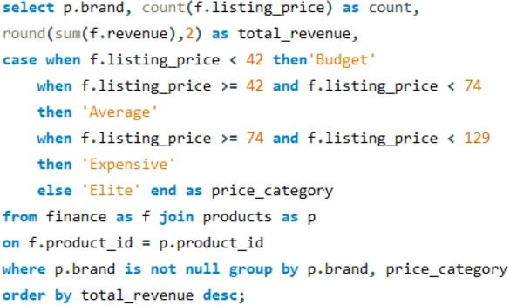
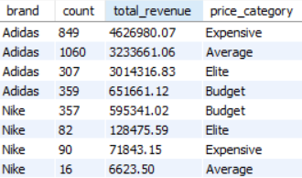
Product segmentation for Marketing or Inventory management :
ANALYSIS DEMONSTRATED
Adidas:
Revenue Distribution: Highest revenue from Expensive ($4,626,980.07) and Elite ($3,014,316.83) categories.
Product Distribution: Most listings in the Average category (1060 listings).
Nike:
Revenue Distribution: Highest revenue from Budget category ($595,341.02).
Product Distribution: Majority of products in the Budget category (357 listings).
Strategic Insights for Adidas:
Strong presence in higher price segments; balanced offering across categories.
Strategic Insights for Nike:
Focus on affordability with potential growth opportunities in higher price segments.
Conclusion:
Adidas excels in higher-priced segments, aiding targeted marketing and inventory decisions.
Nike dominates the budget-friendly market, driving strategic pricing and product placement.

Slide 9
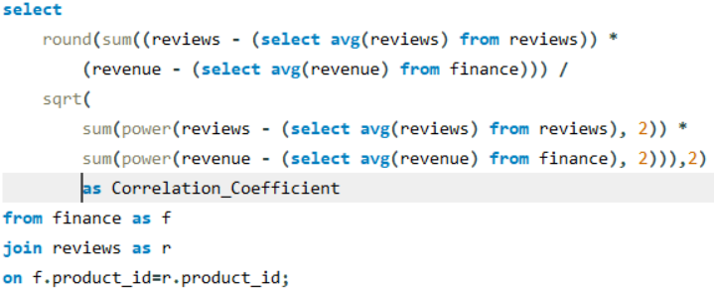

Correlation Coefficient :
ANALYSIS DEMONSTRATED
Correlation Coefficient: A value of 0.65 indicates a strong positive correlation between reviews and revenue.
Implication: Higher number of reviews is associated with increased revenue, suggesting customer feedback impacts sales.
Strategic Insight: Focus on boosting reviews to potentially enhance revenue growth.
Conclusion: Leveraging customer reviews can be a key strategy for driving revenue and improving sales performance.

Slide 10
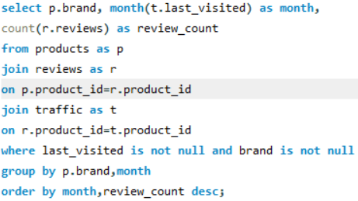
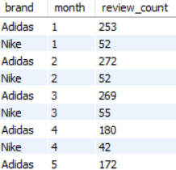
Seasonal variations in Review activity :
ANALYSIS DEMONSTRATED
Monthly Review Counts:
Adidas: Reviews range from 150 to 272 per month.
Nike: Reviews range from 28 to 55 per month.
Peak Review Months:
Adidas: Peaks in February (272) and March (269).
Nike: Peaks in March (55).
Lowest Review Months:
Adidas: Lowest in November (150).
Nike: Lowest in September (28).
Conclusion:
Both brands show seasonal variations in review activity, with Adidas consistently receiving more reviews than Nike across all months.

Slide 11
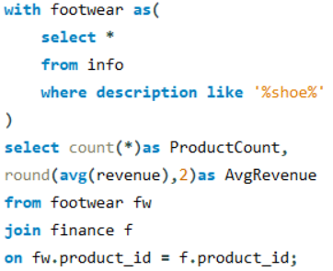

Quantitative metrics derived from CTE :
ANALYSIS DEMONSTRATED
Total Product Count: 2310 products analyzed for revenue trends.
Average Revenue per Product: $4522.90, indicating a substantial average revenue figure.
Revenue Insight: The average revenue suggests strong performance per product.
Product Contribution: Each product contributes significantly to the overall revenue.
Trend Analysis: Consistent revenue per product can reflect stable demand and pricing strategies.
Strategic Implication: Focus on maintaining or enhancing revenue per product to sustain financial performance.

Slide 12
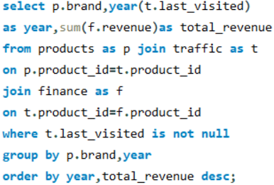
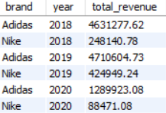
Revenue Trends over time :
ANALYSIS DEMONSTRATED
Adidas Revenue:
Nike Revenue:
Growth Trend:
Adidas: Increasing revenue from 2018 to 2019, with a significant drop in 2020.
Nike: Increasing revenue from 2018 to 2019, with a notable decrease in 2020.
Comparison:
Adidas consistently generates higher revenue than Nike across the years.
Both brands show a decrease in revenue in 2020.
Revenue Insight:
The drop in 2020 could be attributed to external factors like market conditions or global events.
Strategic Implication:
Focus on strategies to mitigate revenue drops in challenging years and leverage strong growth periods.
2018: $4,631,277.62 → 2019: $4,710,604.73 → 2020: $1,289,923.08
2018: $248,140.78 → 2019: $424,949.24 → 2020: $88,471.08

Slide 13
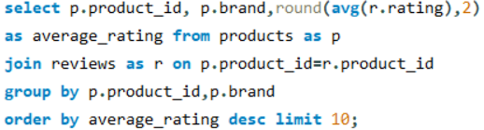
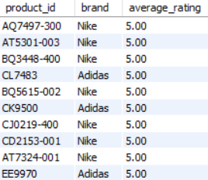
Product quality and its impact on Sales performance :
ANALYSIS DEMONSTRATED
Top-Rated Products:
All listed products have a perfect average rating of 5.00.
Brand Distribution:
Nike: 8 products with a rating of 5.00.
Adidas: 3 products with a rating of 5.00.
Quality Insight:
High average ratings indicate excellent product quality for both brands.
Sales Performance:
High ratings suggest strong customer satisfaction, which can positively impact sales.
Strategic Implication:
Leveraging high-rated products in marketing strategies could enhance brand reputation and drive sales.

Slide 14
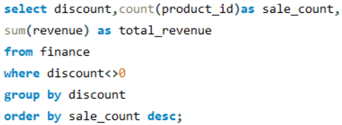
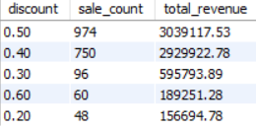
ROI based on Discount Effectiveness :
ANALYSIS DEMONSTRATED
Highest Discount Impact:
0.50 Discount : 974 sales → total revenue of $3,039,117.53
0.40 Discount: 750 sales →total revenue of $2,929,922.78
Lower Discount Impact:
0.30 Discount: 96 sales → total revenue of $595,793.89
0.20 Discount: 48 sales → total revenue of $156,694.78
Minimal Discount Impact:
0.60 Discount: 60 sales → total revenue of $189,251.28
Revenue Insight:
Higher discounts (0.50 and 0.40) lead to higher total revenue compared to lower discounts.
Discount Effectiveness:
Moderate to high discounts are more effective in driving higher sales volumes and revenue.

Slide 15
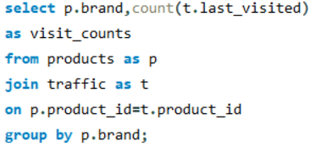

Website Traffic :
ANALYSIS DEMONSTRATED
Adidas Visits: 2377 visits, indicating a high level of online engagement.
Nike Visits: 499 visits, showing lower online traffic compared to Adidas.
Traffic Comparison: Adidas has significantly higher visit counts than Nike.
Strategic Implication: Focus on strategies to increase Nike's online visibility and attract more visitors to enhance brand presence.

Slide 16
Conclusion
4
The analysis provided a comprehensive comparison between Adidas and Nike, highlighting key differences in pricing strategies, revenue trends, and customer engagement. The findings reveal critical insights into brand performance and market positioning.
~Thank You

