Slide 1


SeatSNAP
Presented By-
Ashay Ravindra Sarve(239012)
Harsh Kumar Thakur(239028)

Slide 2
Project Introduction
In the age of digital convenience, the SeatSnap emerges as a transformative solution, designed to redefine the movie-going experience. This state-of-the-art movie ticket booking system is engineered to seamlessly integrate the excitement of cinema with the ease of online transactions, ensuring movie enthusiasts can book their favorite shows in just a few clicks. Our platform stands as a testament to technological innovation, catering to the needs of both cinema-goers and theaters alike.

Slide 3
Objective (Purpose):
This document is meant to delineate the features of SeatSnap , so as to serve as a guide to the developers on one hand and software validation document for the prospective client on the other.
A Website offers user to book ticket over internet. The SeatSnap provides complete functionality of listing and booking movies. It also offers comprehensive information on currently running movies including details on show timings,available seats and seat costs.

Slide 4
Scope:
This system encompasses various aspects related to providing personalized movie recommendations to users:
Design an intuitive and user-friendly interface that allows users to easily browse movies, showtimes, and theaters.
Display current and upcoming movies with details such as synopsis, cast, ratings, and trailers.
Allow users to view participating theaters, their locations, and available amenities
Provide up-to-date information on showtimes, allowing users to select their preferred date and time.
Offer an interactive seating chart for users to choose their preferred seats.

Slide 5
Technology Used:
Front End: ReactJS
Back End: Java Spring Boot API.
Database: MySQL

Slide 6
S/W and H/W Requirements
Server Side:
Processor: Intel core i5 or above
HDD: 500 GB or above
RAM: 2GB or above
Database: MySQL
Client Side (minimum requirement):
Processor: Intel Dual Core
HDD: Minimum 80GB Disk Space
RAM: Minimum 2GB
OS: Windows 7, Linux

Slide 7
Functionalities - Module wise /user wise
  SeatSnap consists of two modules named below
  1. Admin
  2. Customer
  User Roles:
    Admin : Login, add theatres,movies and Showtime.
    Customer: Register itself logins , find movies and book seats.

Slide 8
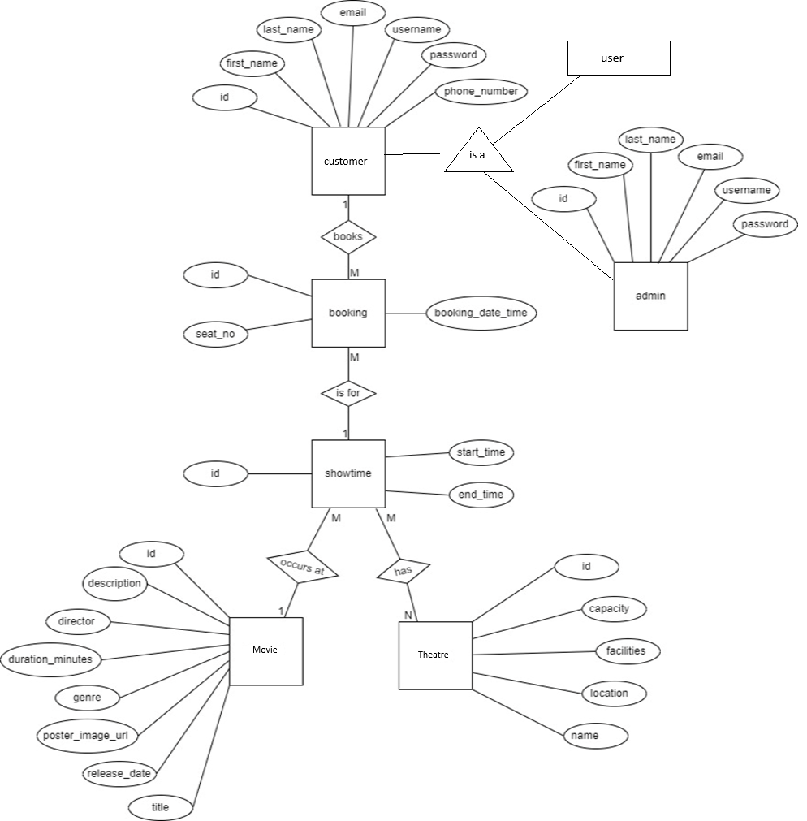
UML Diagrams: E-R Diagram

Slide 9
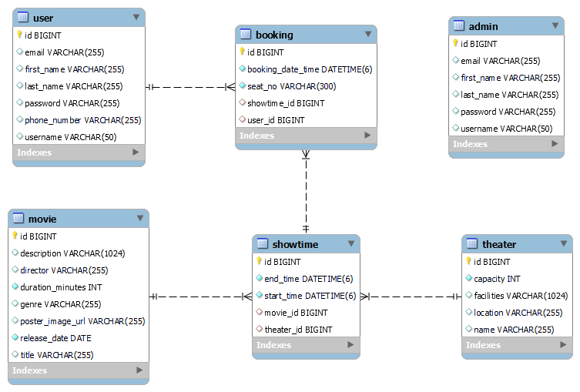
Class Diagram(MySQL Auto generated)

Slide 10
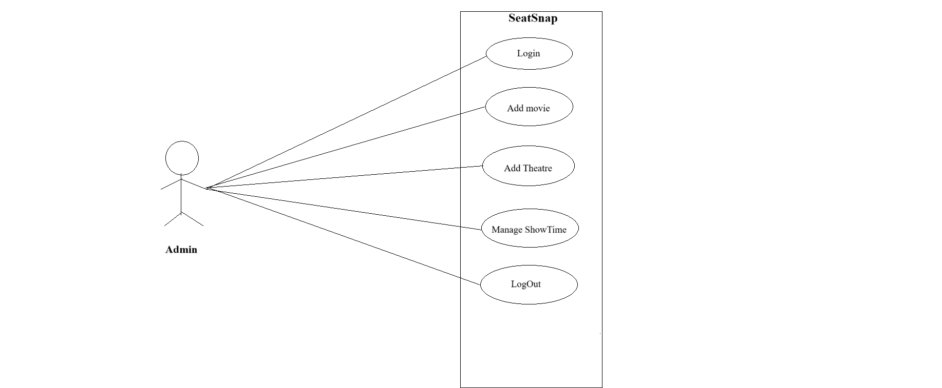
Use Case

Slide 11
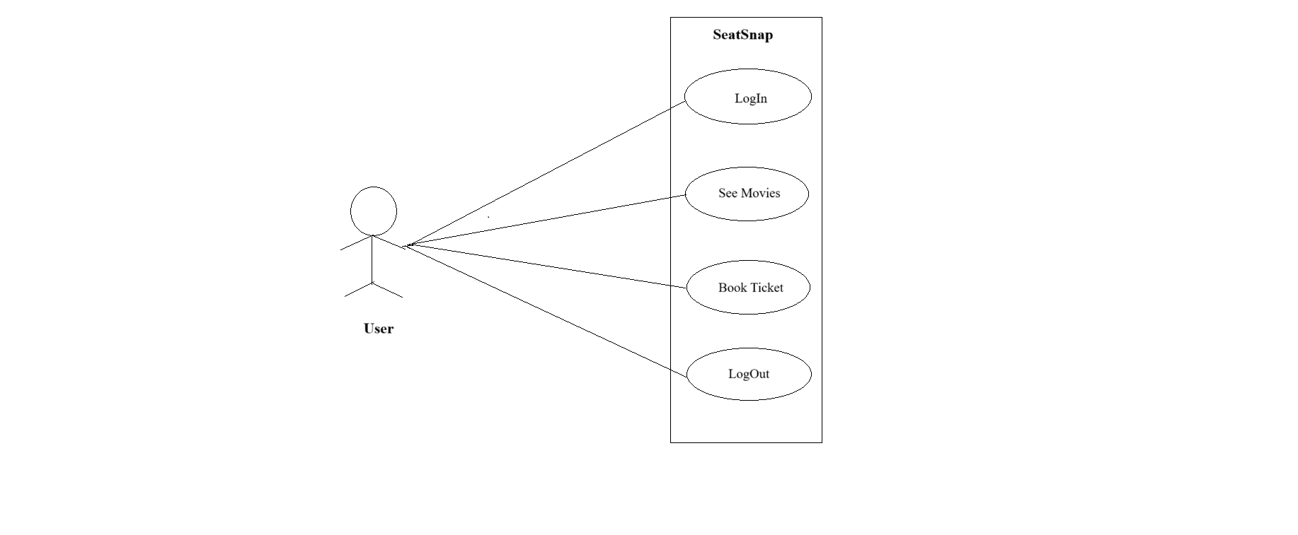

Slide 12
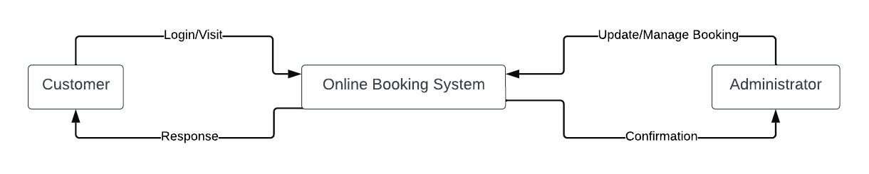
DFD diagrams
Level 0:

Slide 13
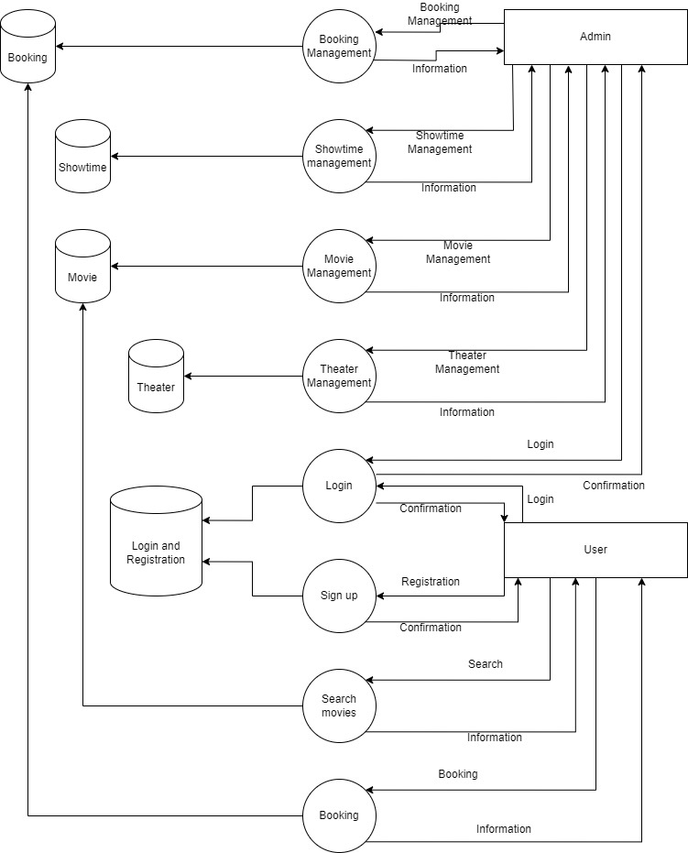
Level 1 :

Slide 14
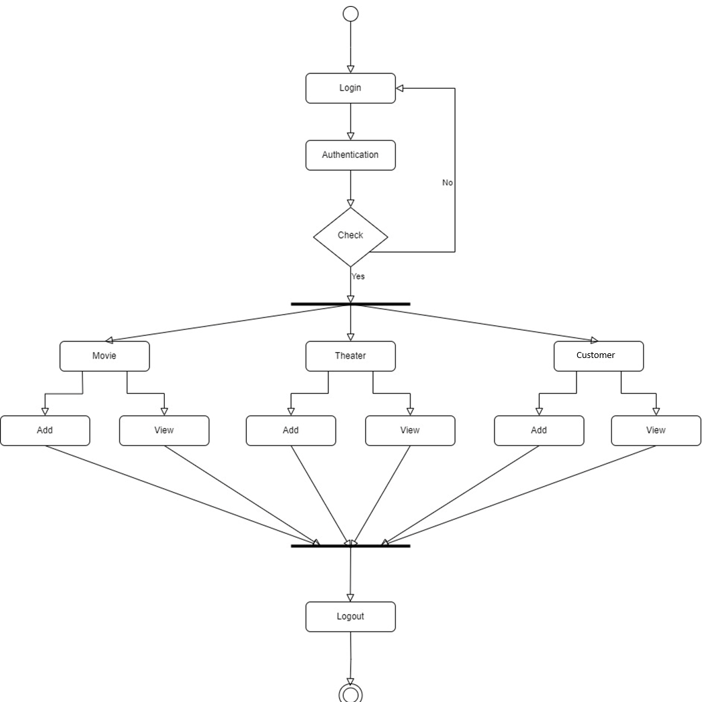
Activity Diagram
Admin Activity Diagram

Slide 15
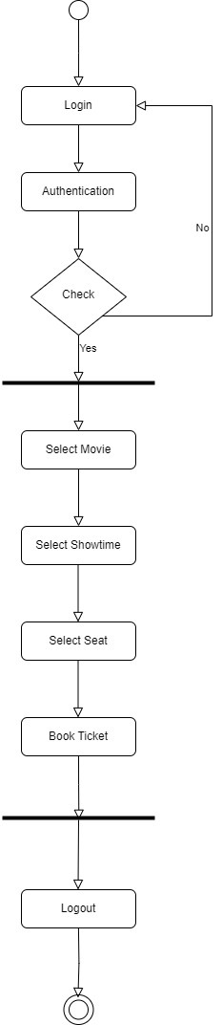
User Activity Diagram

Slide 16
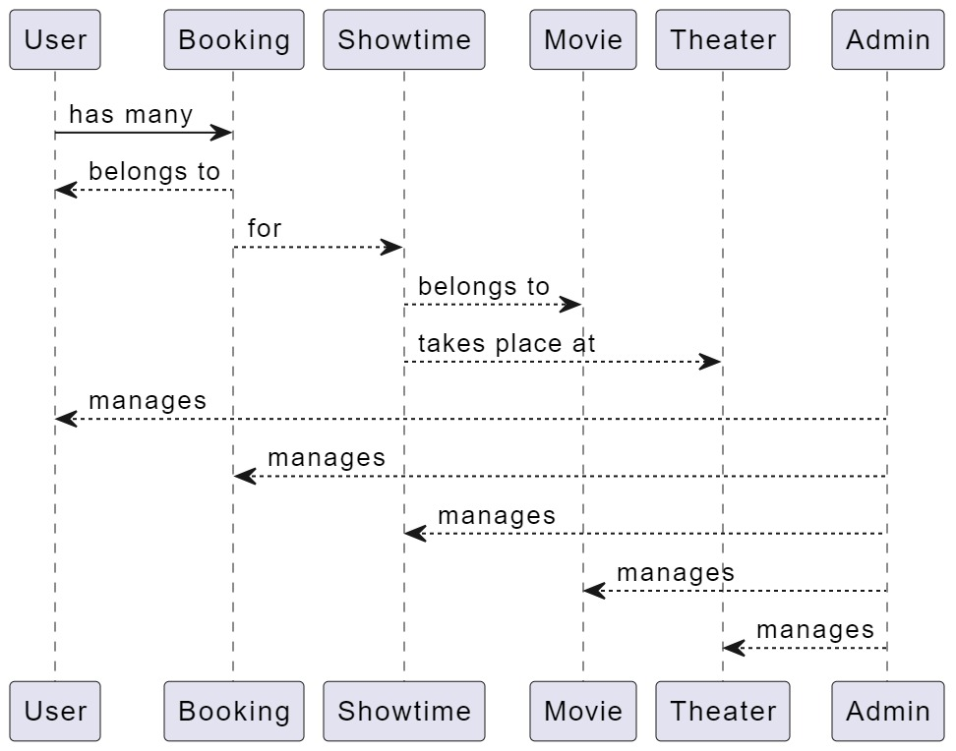
DATA FLOW Diagram

Slide 17
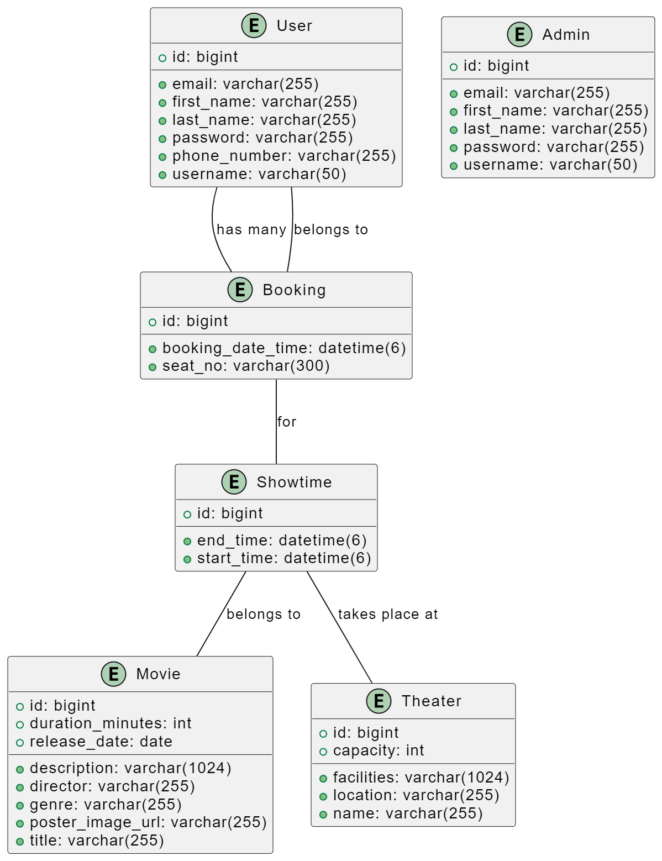
Class Diagram

Slide 18
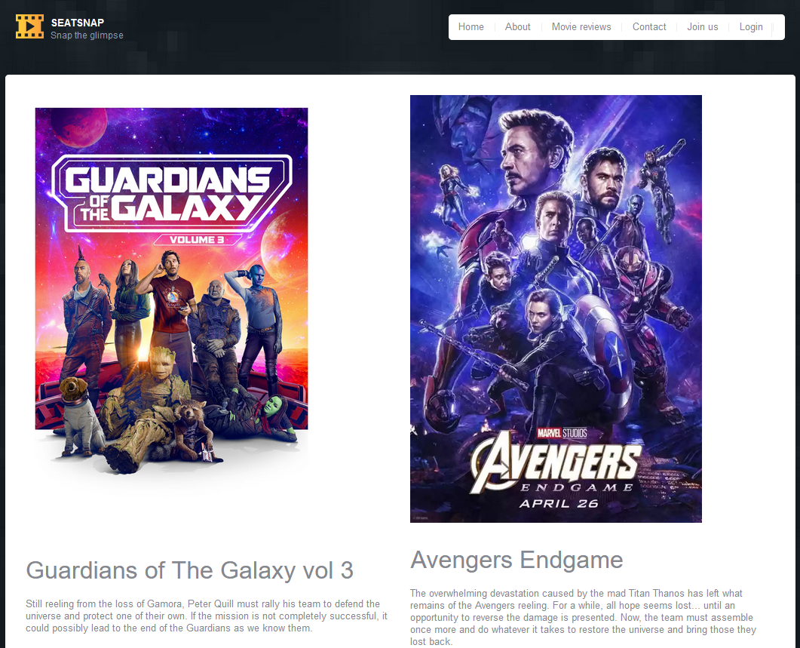
UI Screen Shots

Slide 19
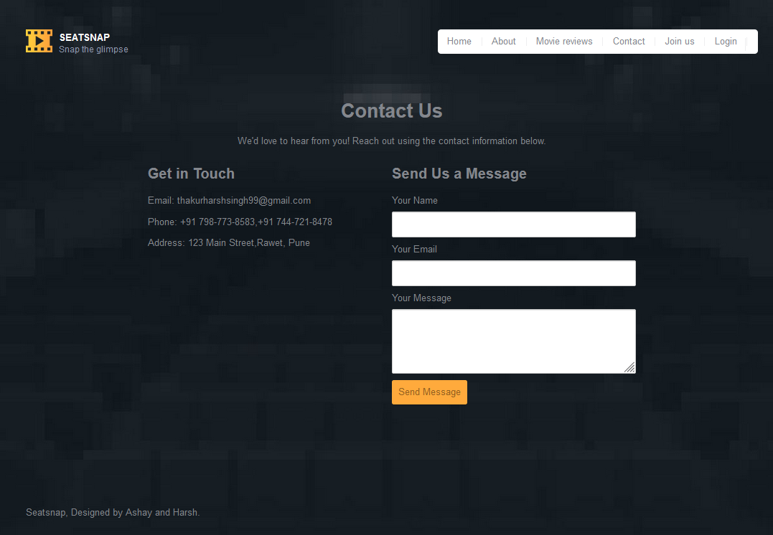

Slide 20
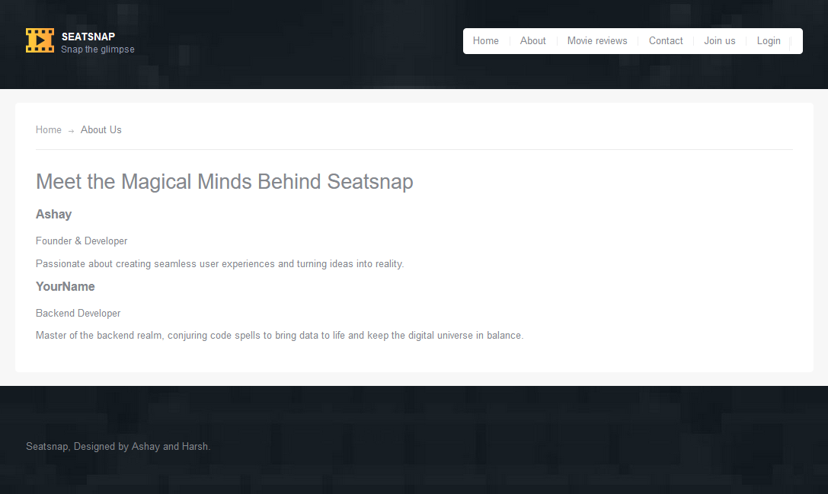

Slide 21
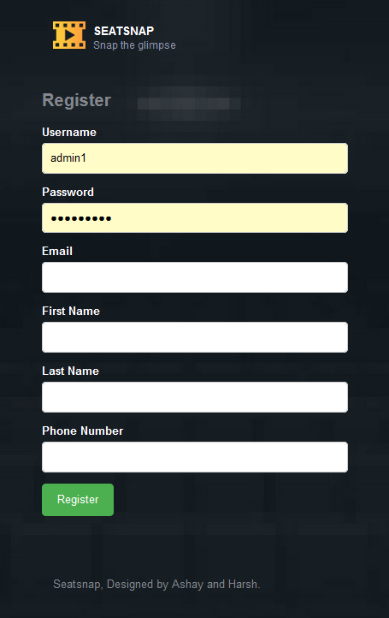
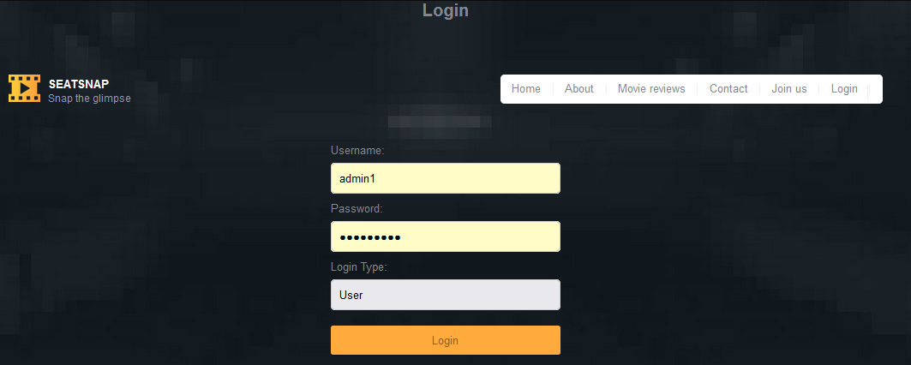

Slide 22
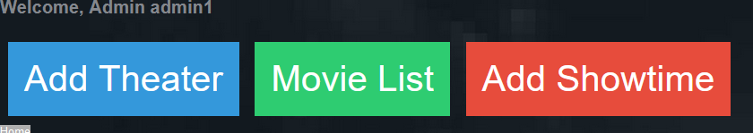

Slide 23
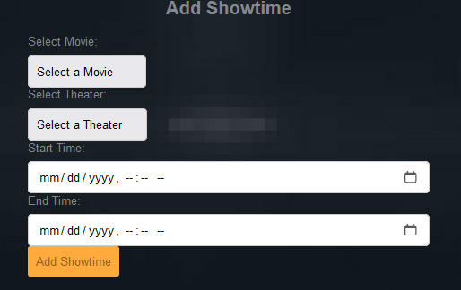
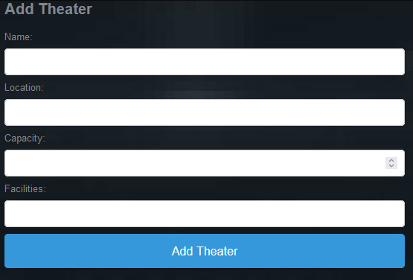

Slide 24
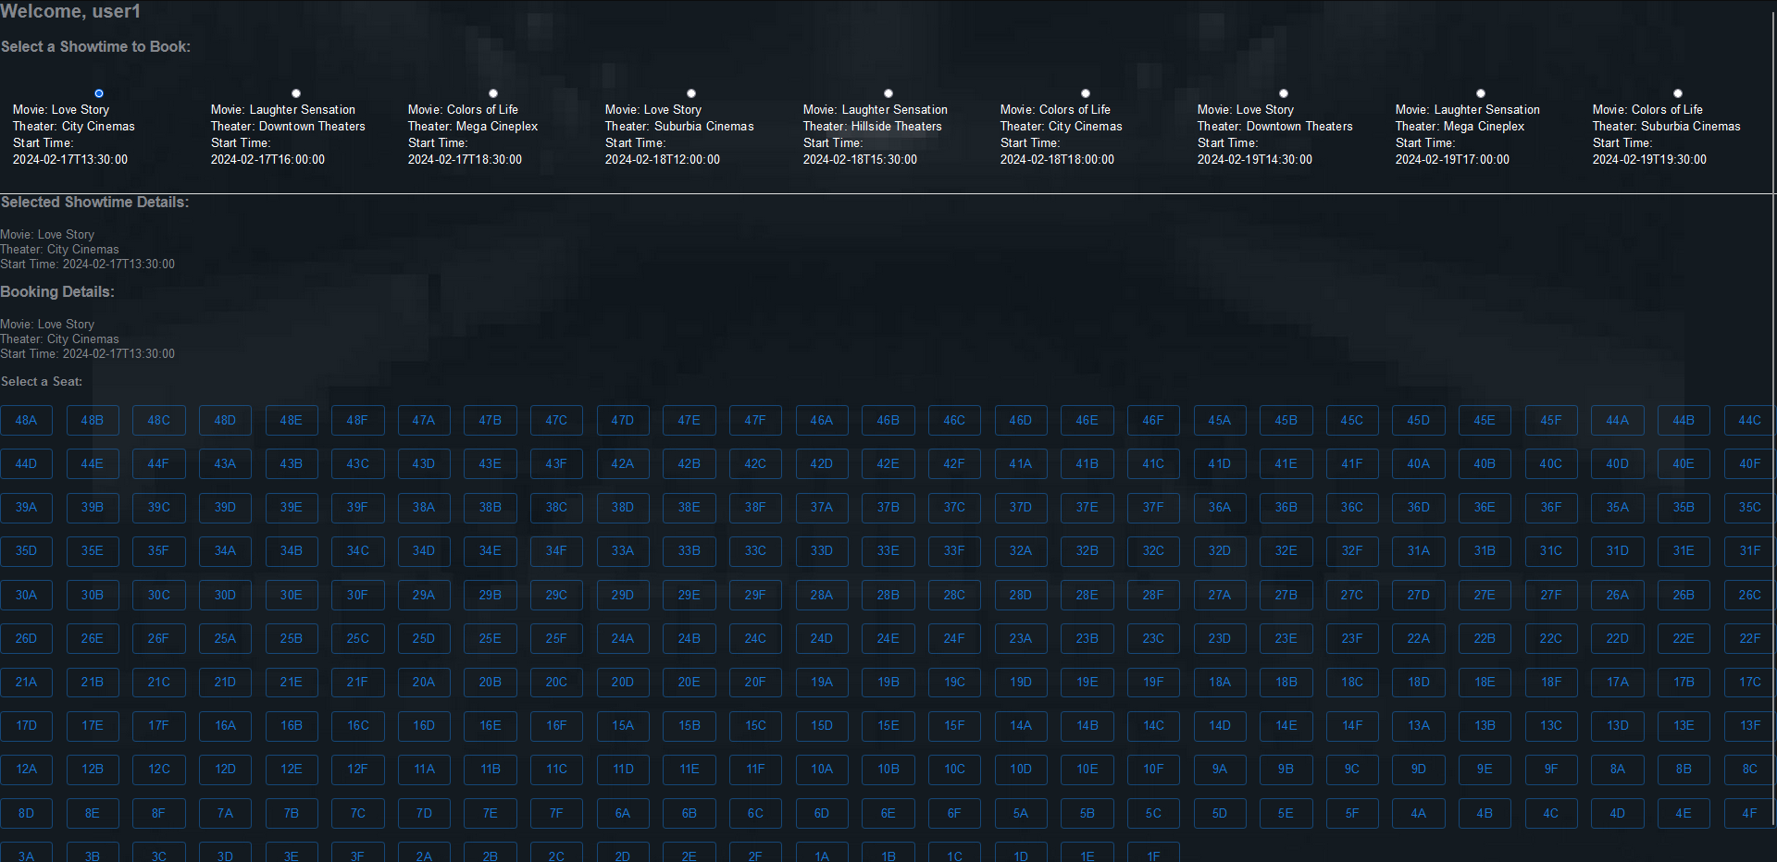

Slide 25
Futures Scope
The future scope for online movie booking systems encompasses innovative technologies and trends that aim to enhance user experience, operational efficiency, and engagement. As technology evolves, these systems have the potential to become more interactive, personalized, and immersive, offering users a seamless bridge between digital and physical movie experiences.
Things like Integration with Emerging Technologies, Enhanced Personalization, Blockchain for Transparency and Security, Social and Interactive Features, Data Analytics and Insights.
As online movie booking systems continue to evolve, the focus will increasingly be on creating more engaging, convenient, and personalized user experiences, leveraging the latest in technology and data analytics to stay ahead of consumer expectations and industry trends.

Slide 26
Conclusion
The “SeatSnap" project transforms movie ticket booking through an efficient online platform.
It addresses the need for a user-friendly and convenient ticket booking experience.
The project streamlines processes, enhances accessibility, and empowers users.
Features developed include user registration, movie listing, detailed information, authentication, and user profiles.
The project fosters transparency and trust between Customer and Theatre.
Ongoing updates will ensure the platform remains aligned with user needs and technological trends.
“SeatSnap" pioneers innovation in the E-Booking sector, catering to modern demands.
The project not only meets immediate requirements but also paves the way for future advancements.

Slide 27
References
http://www.javatpoint.com/java-tutorial
http://www.w3.org
http://www.wikipedia.org
https://www.tutorialspoint.com/java

Slide 28
THANK YOU

