Slide 1
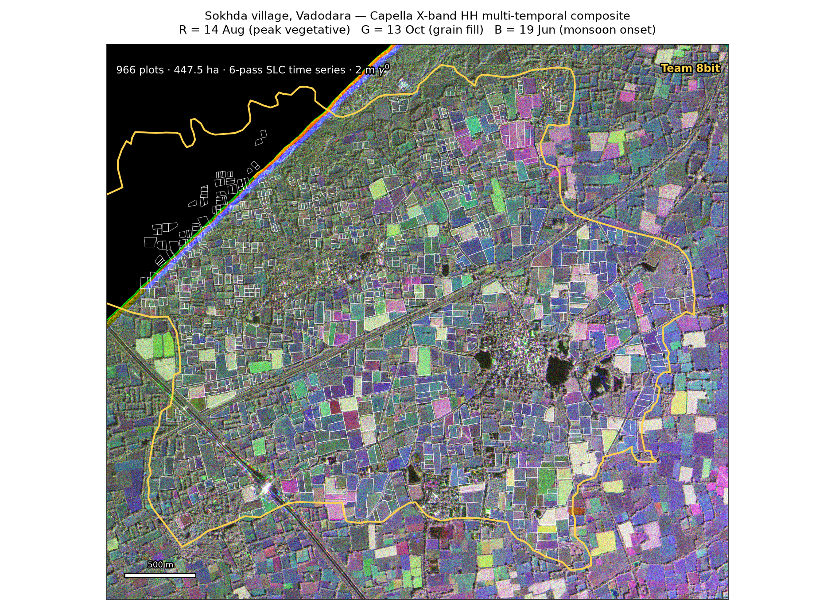
Six Looks, One Harvest
A final yield forecast for 966 plots in Sokhda, Vadodara — from six Capella X-band passes
Team 8bit · Harsh Thummar · Viraj Suhagiya
ANRF AISEHack 2.0 · Round 3 · Remote Sensing: Yield Estimation
Notes:
Good morning. Team 8bit. Sokhda village, Vadodara — 966 plots, 447 hectares, six Capella X-band passes across kharif 2025. Our job this round is a final at-harvest forecast, not a snapshot. Ten minutes, and I want to spend most of them on what we could NOT do as much as what we could.

Slide 2
Round 3 is a different problem
Round 2 asked how the crop was doing. Round 3 asks what comes off the field.
Crop | Cycle seen | So the forecast is…
Rice | 100% | a reconstruction — season complete
Cotton | 78% | genuine extrapolation past 12 Nov
Groundnut | 60% | one in-season look
Maize | 55% | one in-season look
Bajra | 50% | one in-season look
The 14 Aug → 13 Oct gap is 60 days. It contains the entire maturity and harvest of maize, bajra and groundnut.
This is what sets the uncertainty structure — bajra's interval is widest, rice's is tightest.
Notes:
Round 2 asked how the crop was doing on 13 October. Round 3 asks what comes off the field. Those are different problems. The six passes answer them very unevenly. Rice we see end to end. Cotton is still standing at the last pass, so its forecast is real extrapolation. Maize, bajra and groundnut have a sixty-day hole that swallows their entire maturity and harvest — one in-season look each. That asymmetry is not a caveat we bolted on. It sets the whole uncertainty structure.

Slide 3
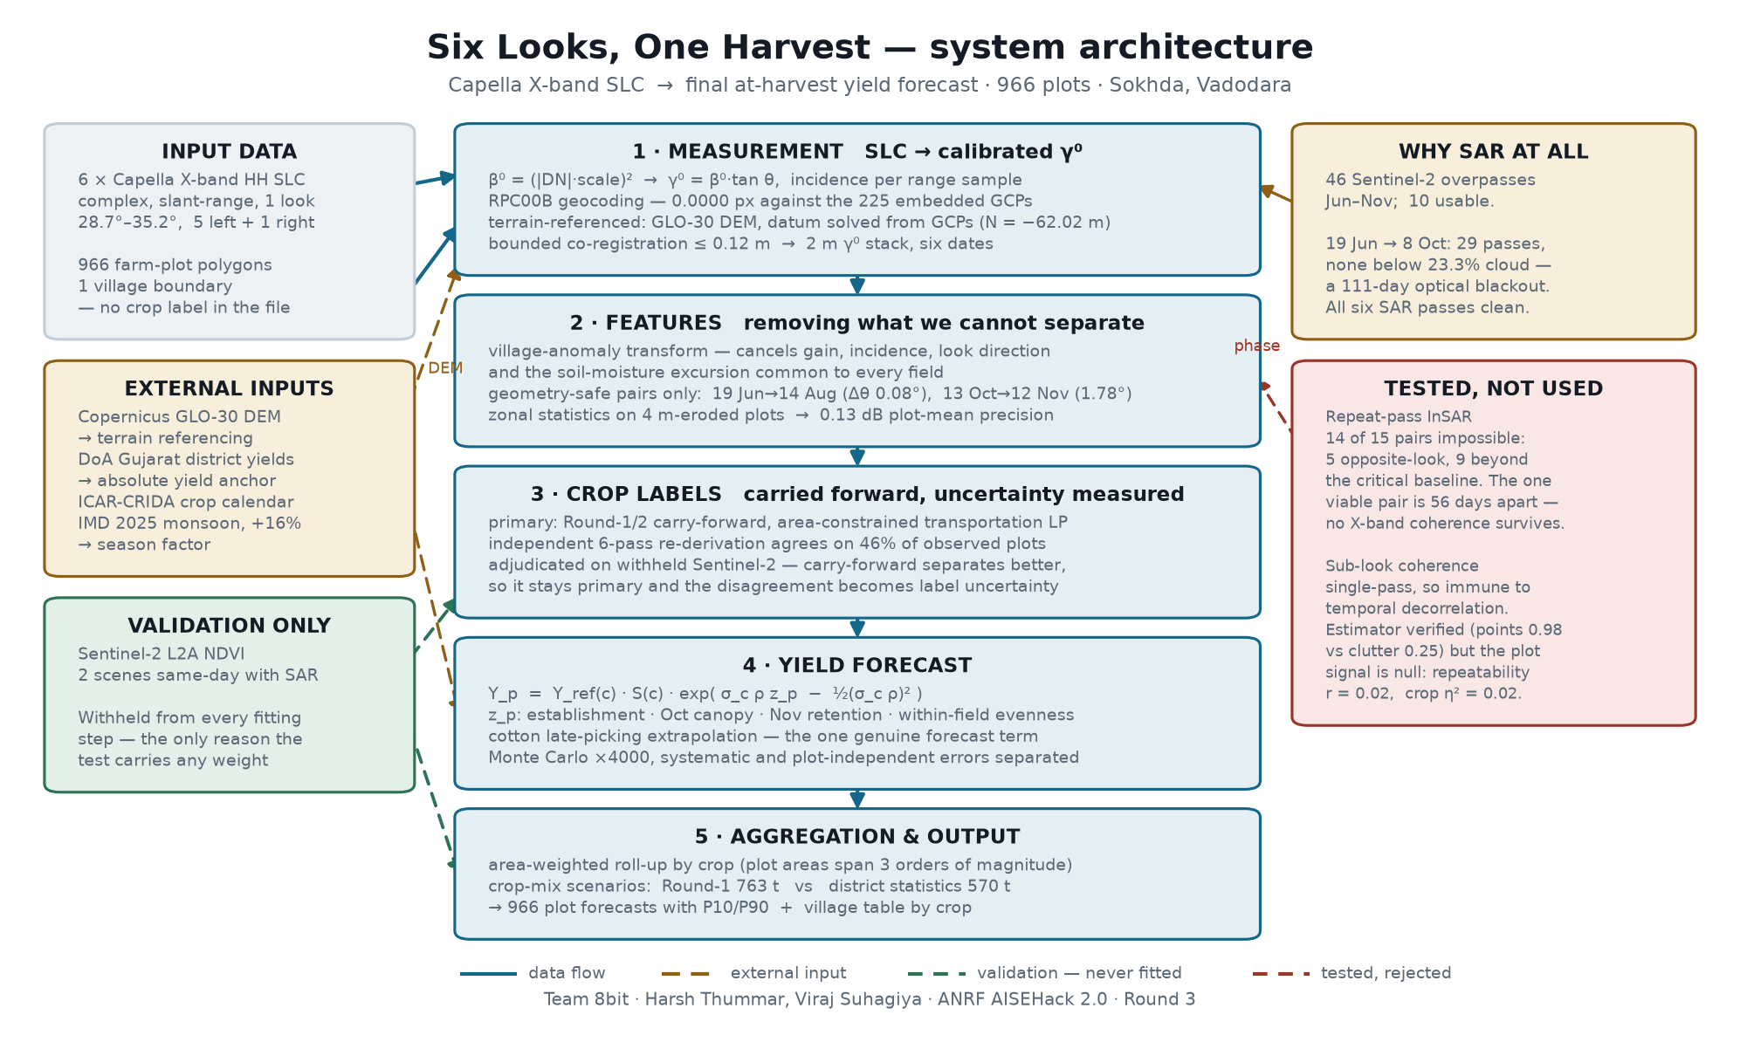
System architecture
Complex SLC in, at-harvest forecast out — and what we rejected on the way
Notes:
This is the whole system on one slide. Left, what goes in. Centre, five stages from complex SLC to the forecast. Right, two things we tested and did not use — I will come back to those, because they matter. And bottom left, Sentinel-2, which is held out of every fitting step. That is the only reason our validation means anything.

Slide 4
The measurement chain is ours, end to end
Built from the Capella metadata and the RPC model — no SNAP, no ISCE, no gdalwarp
0.0000 px
−62.02 m
≤ 0.12 m
0.13 dB
RPC geocoding error against
the 225 embedded GCPs
ellipsoid/geoid datum solved
from the GCPs (sd 0.12 m)
inter-pass co-registration,
all six passes
precision of the plot-mean γ⁰
on a 0.27 ha median plot
β⁰ = (|DN| · scale_factor)² → γ⁰ = β⁰ · tan θ
γ⁰ because the six passes span 28.7°–35.2° incidence, and γ⁰ is the quantity that is, to first order, invariant to it. Local incidence is computed per range sample from the product state vectors.
Notes:
Everything from the complex SLC to the CSV is ours, built from the Capella metadata and the RPC model. No SNAP, no ISCE, no gdalwarp. Four numbers: our RPC reproduces the 225 control points Capella ships to four decimal places of a pixel. The ellipsoid-geoid datum is solved from those same control points, not assumed. Co-registration is within twelve centimetres on all six passes. And a plot mean is good to about a tenth of a decibel.

Slide 5
A correction we made to our own work
26 m of relief becomes 46 m of ground-range error if you assume a flat Earth
Check | Constant height | Terrain-referenced
RPC round-trip RMSE | 15.1–16.6 px | 4.1–4.7 px
Correlation vs Capella's geocoding | 0.769 | 0.840
Co-registration, 29 Oct right-look | 2.54 m | 0.12 m
Passes improved | — | 6 of 6
A height error displaces opposite look directions in opposite senses. So a residual that shows up on the single right-looking pass and nowhere else is a terrain signature, not a registration failure.
That one diagnostic is what exposed the error — and confirms the fix.
Notes:
Here is a mistake we made and caught. We first geocoded at a single constant height. All six passes agreed on minus twenty metres, residual under three metres. It looked fine. It was not — because a global shift metric recovers the mean alignment and completely hides terrain, and this block has twenty-six metres of relief, worth forty-six metres of ground range. The tell was the one right-looking pass. A height error pushes opposite look directions in opposite directions. Once we carried per-pixel terrain, that residual fell from 2.54 metres to 12 centimetres.

Slide 6
Geometry drove the design, not the formula
1 · Every feature is a village anomaly — plot minus village median, same acquisition.
Cancels calibration, gain, incidence response, look direction, and the common soil-moisture excursion, in one step and without fitting anything.
Geometry-safe pair | Δ incidence | Look | Measures
19 Jun → 14 Aug | 0.08° | same | canopy establishment
13 Oct → 12 Nov | 1.78° | same | late retention vs harvest — new in Round 3
2 · Differences only between those two pairs. The 29 Oct pass is right-looking from the opposite azimuth and is used only to corroborate, never on its own.
Notes:
Geometry drove the design. Six passes, incidence from 28.7 to 35.2 degrees, one of them right-looking. No single normalisation removes that from a mixed scene. So two rules. First, every feature is a village anomaly — a plot minus the village median on that same date. In one step that cancels gain, incidence, look direction and the soil moisture common to all fields. Second, we only difference date pairs that are geometrically safe. There are exactly two.

Slide 7
What X-band HH can and cannot do here
Measured on this village, not assumed from the literature
Median Δγ⁰ at peak season = −0.58 dB relative to bare soil
Peak-season fields are darker than bare ground. At HH a developed canopy attenuates a rough, freshly-tilled soil surface more than its own volume return replaces it — and X-band saturates early against LAI.
So we do not invert X-band for biomass. We use what a metre-scale X-band series genuinely resolves: phenological timing, late-season retention, and within-field evenness.
Notes:
Now the uncomfortable measurement. On this village, the median change in gamma-nought at peak season is minus zero point five eight decibels relative to bare soil. Peak-season fields are darker than bare ground. That is physically right at HH — a closed canopy attenuates a rough tilled surface more than it scatters back. Combined with X-band's early saturation against LAI, it means inverting this data for biomass would be indefensible. So we do not. We use timing, retention and evenness instead.

Slide 8
You had six SLCs — why only the amplitude?
Because we checked, rather than assumed
Repeat-pass InSAR — all 15 pass pairs | Pairs
Opposite look direction | 5
Beyond the critical baseline | 9 | by up to 100×
Geometrically viable | 1 | …and 56 days apart — no X-band coherence survives
So we used the phase a different way. Sub-aperture decomposition splits one acquisition's Doppler spectrum in two — single-pass, so temporal decorrelation cannot touch it.
The estimator is sound: point scatterers reach γ = 0.98 against 0.25 for distributed clutter. But at plot level it carries nothing — repeatability r = 0.02, crop separation η² = 0.02.
A null result, reported as a null.
Notes:
The question a SAR audience will ask: you had six SLCs, why only the amplitude? We answer it with numbers. Of fifteen pass pairs, five are opposite-look and nine are beyond the critical baseline — some by a factor of a hundred. Exactly one pair is geometrically viable, and it is 56 days apart, which is far beyond X-band coherence over a growing canopy. So repeat-pass InSAR is structurally unavailable. We then tried sub-look coherence, which is single-pass and immune to temporal decorrelation. The estimator works — point scatterers reach 0.98 against 0.25 for clutter. But at plot level it is null. We report it as a null.

Slide 9
The forecast model
SAR sets the ranking and the spread. Official statistics set the level. Stated, not hidden.
Y_p = Y_ref(c) · S(c) · exp( σ_c · ρ · z_p − ½(σ_c · ρ)² )
Term | What it is | Value
Y_ref(c) | Vadodara district yield (DoA Gujarat 2022-23) | rice 1690 · cotton 776 · maize 2312 · bajra 2714 · groundnut 2514
S(c) | 2025 season factor from the +16% rainfall anomaly | 0.976 – 1.080, crop-specific
z_p | stage-weighted SAR index, standardised within crop | establishment · Oct canopy · Nov retention · evenness
σ_c , ρ | farm-to-farm yield CV, and the share of it SAR explains | 0.28–0.35 · ρ = 0.55 (varied 0.40–0.70)
The lognormal form makes the area-weighted village mean reproduce Y_ref · S by construction. Cotton adds an explicit late-picking term — the one genuine forecast in the model.
Notes:
The model in one line. District statistics set the level; the SAR index sets the distribution around it. We separate those two deliberately, because with no ground truth the radar can rank plots but it cannot tell you the absolute level. The lognormal form makes the area-weighted village mean reproduce the anchor by construction — so the anchor is a stated assumption, not a hidden result.

Slide 10
Crop labels: an honest negative result
We re-derived the map from six passes. It was worse. So we did not use it.
Label set | η² · 12 Nov NDVI | η² · 13 Oct NDVI | Adopted
Round-1/2 carry-forward (4 passes) | 0.138 | 0.280 | YES — primary
Our Round-3 re-derivation (6 passes) | 0.085 | 0.217 | no
The two sets agree on only 46% of observed plots. Adjudicated on data neither had seen, the carry-forward wins on both dates.
The disagreement is not discarded — it becomes a measured label uncertainty, carried through to the village result.
Crop labelling, not the radar, is the dominant uncertainty here.
Notes:
We re-derived the crop map from all six passes. It agrees with the carry-forward on only 46 per cent of plots. So we adjudicated using Sentinel-2, which neither classifier had seen. The carry-forward separates November greenness better on both dates. Our new classifier is not an improvement, so we did not adopt it. The disagreement becomes a measurement of label uncertainty instead. Crop labelling, not the radar, is the dominant uncertainty in this problem.

Slide 11
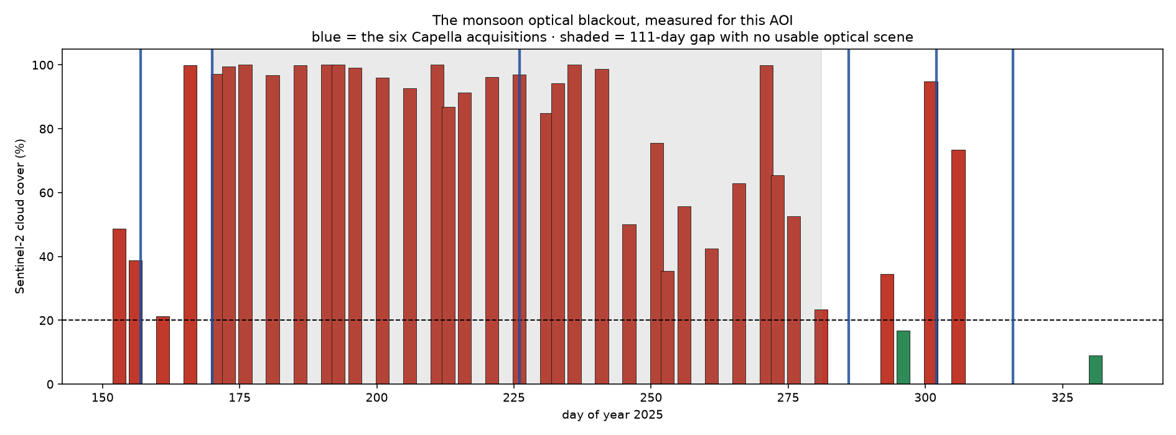
The index works exactly where the crop is still standing
Sentinel-2 tests the result — it never enters the model
Crop | ρ vs same-day NDVI | p | On 13 Oct
Rice | +0.365 | 2×10⁻⁸ | standing
Cotton | +0.361 | 1×10⁻¹² | standing
Groundnut | +0.112 | 0.079 | harvesting
Maize | +0.019 | 0.88 | harvested
Bajra | −0.071 | 0.61 | harvested
Significant for the two crops still in the field. Null for the three already cut.
An artefact would correlate everywhere or nowhere. This pattern is hard to produce by accident.
Whole village, same day: ρ = +0.56 (13 Oct) · +0.48 (12 Nov)
Why it must be SAR. 46 Sentinel-2 overpasses Jun–Nov, 10 usable. Between 19 Jun and 8 Oct: 29 passes, none below 23.3% cloud. A 111-day blackout over sowing, establishment and peak growth. All six SAR passes clean.
Notes:
Validation. Two Sentinel-2 scenes fall on exactly the same day as Capella passes, so no interpolation. The headline is the within-crop result. Our yield index correlates significantly for rice and cotton — the two crops still standing on 13 October — and is statistically null for maize, bajra and groundnut, the three already cut, where both sensors see bare soil. A speckle artefact would correlate everywhere or nowhere. This validates exactly where a crop is still in the field. And on the right, why SAR: a 111-day optical blackout across the whole monsoon.

Slide 12
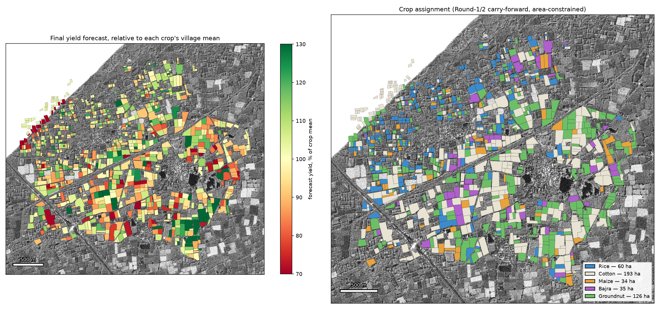
Plot-level final yield forecast — all 966 plots
Coherent spatial structure, not plot-level speckle
Notes:
The plot-level forecast, all 966 plots. What I want you to notice is that the pattern forms coherent spatial blocks — contiguous stronger and weaker areas — rather than plot-level noise. That is what genuine agronomic variation looks like. A speckle-driven artefact would not do that.

Slide 13
Village-level forecast — Sokhda, 447.5 ha
Crop | Plots | Area (ha) | Forecast (kg/ha) | P10 – P90 | Production (t) | Product
Rice | 226 | 60.4 | 1,717 | 1,401 – 2,021 | 103.7 | paddy grain
Cotton | 364 | 192.7 | 820 | 674 – 972 | 158.0 | lint
Maize | 74 | 34.3 | 2,479 | 2,008 – 2,968 | 85.0 | grain
Bajra | 54 | 34.6 | 2,932 | 2,377 – 3,572 | 101.4 | grain
Groundnut | 248 | 125.6 | 2,453 | 2,007 – 2,919 | 308.1 | pod
756 t
966 / 966
±18–20%
total forecast production
plots carry a forecast
832 full · 91 partial · 43 flagged
village interval, ordered by
how much of the crop we saw
Area-weighted, never a plain plot mean — plot areas span three orders of magnitude. Cotton as lint; 820 kg/ha ≈ 2,340 kg/ha seed cotton.
Notes:
The village result. 756 tonnes across 447 hectares. Every village mean sits on its district anchor by construction; the intervals come from the Monte Carlo. Note that the interval widths order correctly with how much of each crop we actually saw — bajra widest, rice tightest. Cotton is reported as lint; that is about 2,340 kilograms per hectare of seed cotton.

Slide 14
The one number that would move the answer
Not the radar — the crop map we inherited
Crop | A · Round-1 carry-forward | B · District statistics
Rice | 61 ha → 106 t | 79 ha → 135 t
Cotton | 188 ha → 154 t | 292 ha → 239 t
Maize | 35 ha → 88 t | 64 ha → 159 t
Bajra | 35 ha → 103 t | 11 ha → 32 t
Groundnut | 127 ha → 313 t | 1.7 ha → 4 t
VILLAGE TOTAL | 763 t | 570 t
Round-1 puts groundnut at 28% of Sokhda; the district figure is 0.35%. Both cannot be close to right.
A 25% swing in village production, essentially all of it groundnut. We publish both rather than choose silently.
Notes:
And here is the honest headline risk. The carry-forward puts groundnut at 28 per cent of Sokhda. The Directorate of Agriculture puts groundnut at nought point three five per cent of the district. Those cannot both be right. We ran the assignment under both area constraints and publish both. Village production moves from 763 tonnes to 570 — a 25 per cent swing, essentially all of it groundnut. Our plot-level radar work is solid. The crop map we inherited is the thing that would move the answer, and we would rather quantify that than hide it.

Slide 15
Where this is weakest
A forecast without its limits is not a forecast
No ground truth exists — absolute accuracy is untestable. Only internal consistency and independent optical agreement can be checked, and both are reported.
Maize, bajra and groundnut rest on one in-season observation. Their intervals are wide by construction and should be read that way.
Crop labels dominate the error budget, not the radar — a 25% swing in village production.
Only five classes are permitted, but Vadodara also grows castor and pigeon pea at areas comparable to maize. Some plots are certainly another crop.
43 plots fall outside every swath footprint — they carry the crop mean with inflated uncertainty and are flagged, not hidden.
Notes:
Where this is weakest, plainly. No ground truth exists, so absolute accuracy is untestable — only internal consistency and independent optical agreement. Three crops rest on a single in-season look. Labels dominate the error budget. Only five classes are allowed but Vadodara also grows castor and pigeon pea at areas like maize, so some plots are certainly something else. And 43 plots fall outside every swath — flagged, not hidden.

Slide 16
What we would want next
One acquisition in early September. A single pass inside the 60-day gap would convert maize, bajra and groundnut from one-look estimates into properly sampled seasons — the largest gain available for the least data.
Any dual-polarisation acquisition. HH alone cannot separate volume from surface scattering; HV would resolve much of what forced us away from biomass inversion.
Twenty ground-truth plots. Not to fit the model — to estimate ρ, the one parameter we currently have to assume.
Team 8bit · Harsh Thummar, Viraj Suhagiya · ANRF AISEHack 2.0 Round 3
Notes:
What we would ask for next. One acquisition in early September would convert three crops from one-look estimates into properly sampled seasons — the biggest gain available for the least data. Any dual-pol acquisition would let us separate volume from surface scattering, which is what forced us away from biomass inversion. And twenty ground-truth plots — not to fit the model, but to estimate the one parameter we currently have to assume. Thank you.

