Slide 1

Project-3 Twitter Real-Time Data Analysis
Under guidance of: Developed by:
Alwyn Micaiah Anosh Shaju
(Trainer) Omkar Gaikwad
Sai Dinesh
Sunil Gupta
David Stephen Raj
Divya Kumari
Ashish Fulwade
Harsh Tomar
Akshay Paurush Singh

Slide 2
Content
Introduction
i) Aim
ii) Description
Technologies used
Spark Overview
Getting Started
Kafka Overview
Code Walkthrough
Challenges
Conclusion

Slide 3
Introduction
Aim: Twitter real time data analysis using Kafka & SparkStreaming
Project Description:
For This Big-data Project, we took Twitter API for Real-Time Data Processing from https://developer.twitter.com/en/docs/tutorials/stream-tweets-in-real-time.
Firstly we have to check that Zookeeper server is up and running ,and then check the Kafka server.
Using Apache Kafka first we Created a topic in our system and produce the topic to subscribers with the help of producer and consumers consumes that particular topic.
Then we created the DStreams to store the real time Twitter Data and process that Data using Dstreams operations.

Slide 4
Technologies Used
Kafka: The open-source software platform developed by LinkedIn to handle real-time data is called Kafka. It publishes and subscribes a stream of records and also is used for fault-tolerant storage
Spark : Apache Spark is a lightning-fast cluster computing technology, designed for fast computation. It is based on Hadoop MapReduce and it extends the MapReduce model to efficiently use it for more types of computations, which includes interactive queries and stream processing.

Slide 5
Downloading and Getting started
Download at http://spark.apache.org/downloads.html
Select package type as “Pre-built for Hadoop 2.7 and later” and download the compressed TAR file. Unpack the tar file after downloading
Spark’s shell provides a simple way to learn the API, as well as a powerful tool to analyze data interactively.
Spark shell can be opened by typing “./bin/pyspark ” for Python Version

Slide 6
Download and Setup Kafka
Open the Kafka releases page which contains the latest binary downloads.
At the moment of writing the latest stable release was kafka-3.0.0-src.tgz.
For our project we have downloaded the Kafka-2.1.2 version.
Changed the environment Variables for Kafka.

Slide 7

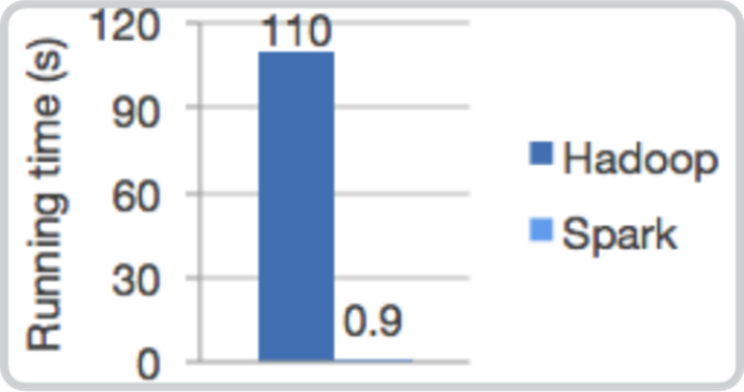
Spark Overview
Its a fast general-purpose engine for large-scale data processing.
Speed
Ease of use
Generality
Runs everywhere

Slide 8


PySpark +
PySpark in an interactive shell for Spark in Python.
The Python shell can be used explore data interactively and is a simple way to learn the API.
By default, the bin/pyspark shell creates SparkContext that runs applications.
In PySpark, RDDs(Resilient Distributed Dataset) support the same methods as their Scala counterparts but take Python functions and return Python collection types.
Spark revolves around the concept of a resilient distributed dataset (RDD), which is a fault-tolerant collection of elements that can be operated on in parallel.

Slide 9
What is Spark Streaming?
Framework for large scale stream processing
Scales to 100s of node
Can achieve second scale latencies
Integrates with Spark’s batch and interactive processing
Provides a simple batch-like API for implementing complex algorithm
Can absorb live data streams from Kafka, Flume, ZeroMQ, etc.

Slide 10
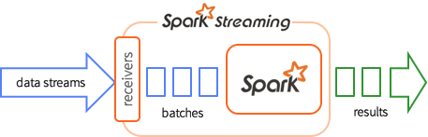
Discretized Stream Processing
Run a streaming computation as a series of very small, deterministic batch jobs
Chop up the live stream into batches of X seconds
Spark treats each batch of data as RDDs and processes them using RDD operations
Finally, the processed results of the RDD operations are returned in batches

Slide 11
KAFKA
It is a messaging system
Fault tolerant messaging system
Pub-sub based fault tolerant messaging system.
It is an event streaming platform.
OPEN-SOURCE APACHE PROJECT.
Kafka was invented with these outstanding featureS:
High throughput
built-in partitioning
replication ( 3 by default) Fault tolerant
Durability/availability
High speed. Performs 2 million writes/sec.

Slide 12
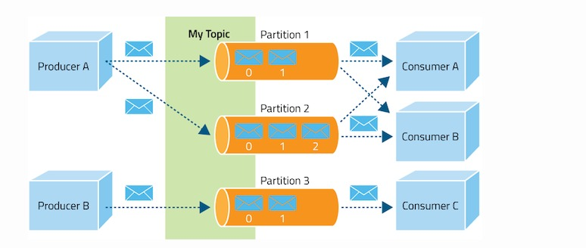
Kafka Architecture

Slide 13
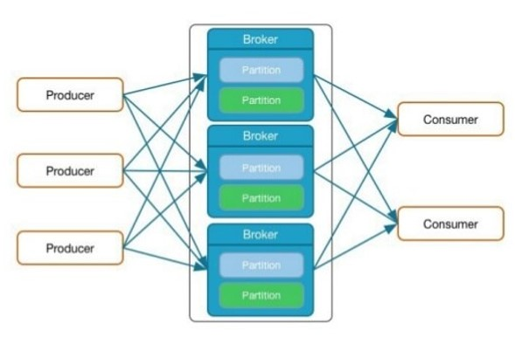
BROKER:
Producer sends messages to brokers.
Broker receives and store messages.
A Kafka cluster can have many brokers.
Each broker manages multiple partitions.
Kafka cluster typically consists of multiple brokers to maintain load balance.
Kafka brokers are stateless, so they use ZooKeeper for maintaining their cluster state.
One Kafka broker instance can handle hundreds of thousands of reads and writes per second.

Slide 14
TOPIC:
Events are organized and durably stored in topics.
A stream of messages belonging to a particular category. Data is stored in topics.
Topics are split into partitions. For each topic, Kafka keeps a minimum of one partition.
Each such partition contains messages in an immutable ordered sequence.
A partition is implemented as a set of segment files of equal sizes.
Very simplified, a topic is similar to a folder in a file system, and the events are the files in that folder.
Topics in Kafka are always multi-producer and multi-subscriber.
Create a topic: Open a new prompt in kakfa location and give the following command.
$ bin/windows/kafka-topics.bat --create
--zookeeper localhost:2181
--replication-factor 1
--partition 1
--topic kafkatopic

Slide 15
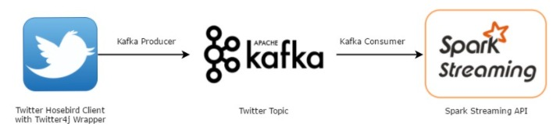
PRODUCER/PUBLISHER:
Producers/Publisher are those client applications that publish (write) events to Kafka.
Producers send data to Kafka brokers. Every time a producer publishes a message to a broker, the broker simply appends the message to the last segment file.
The messages will be appended to a partition.
Producer can also send messages to a partition of their choice.
They push the data to the broker without any acknowledgement.
Sends messages as fast as the broker can handle.

Slide 16
CONSUMER/SUBSCRIBER:
Consumer subscribes to a specific topic.
Once the consumer subscribes to a topic, Kafka will provide the current offset of the topic to the consumer and also saves the offset in the Zookeeper ensemble.
Once Kafka receives the messages from producers, it forwards these messages to the consumers.
Consumer will receive the message and process it.
Once the messages are processed, consumer will send an acknowledgement to the Kafka broker.
Consumer has the option to rewind/skip to the desired offset of a topic at any time and read all the subsequent messages.

Slide 17
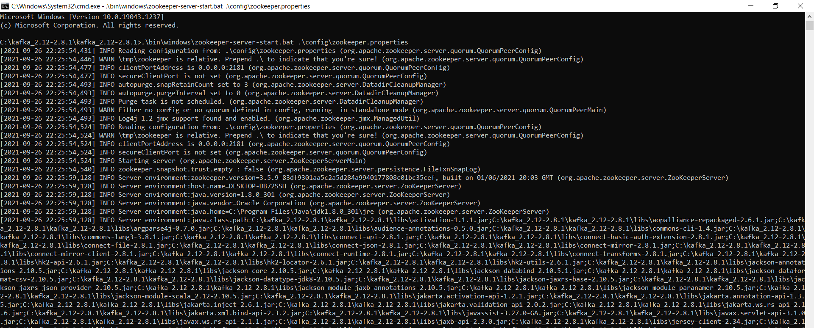
CODE WALKTHROUGH
run zookeeper using terminal
C:\kafka>.\bin\windows\zookeeper-server-start.bat .\config\zookeeper.properties

Slide 18
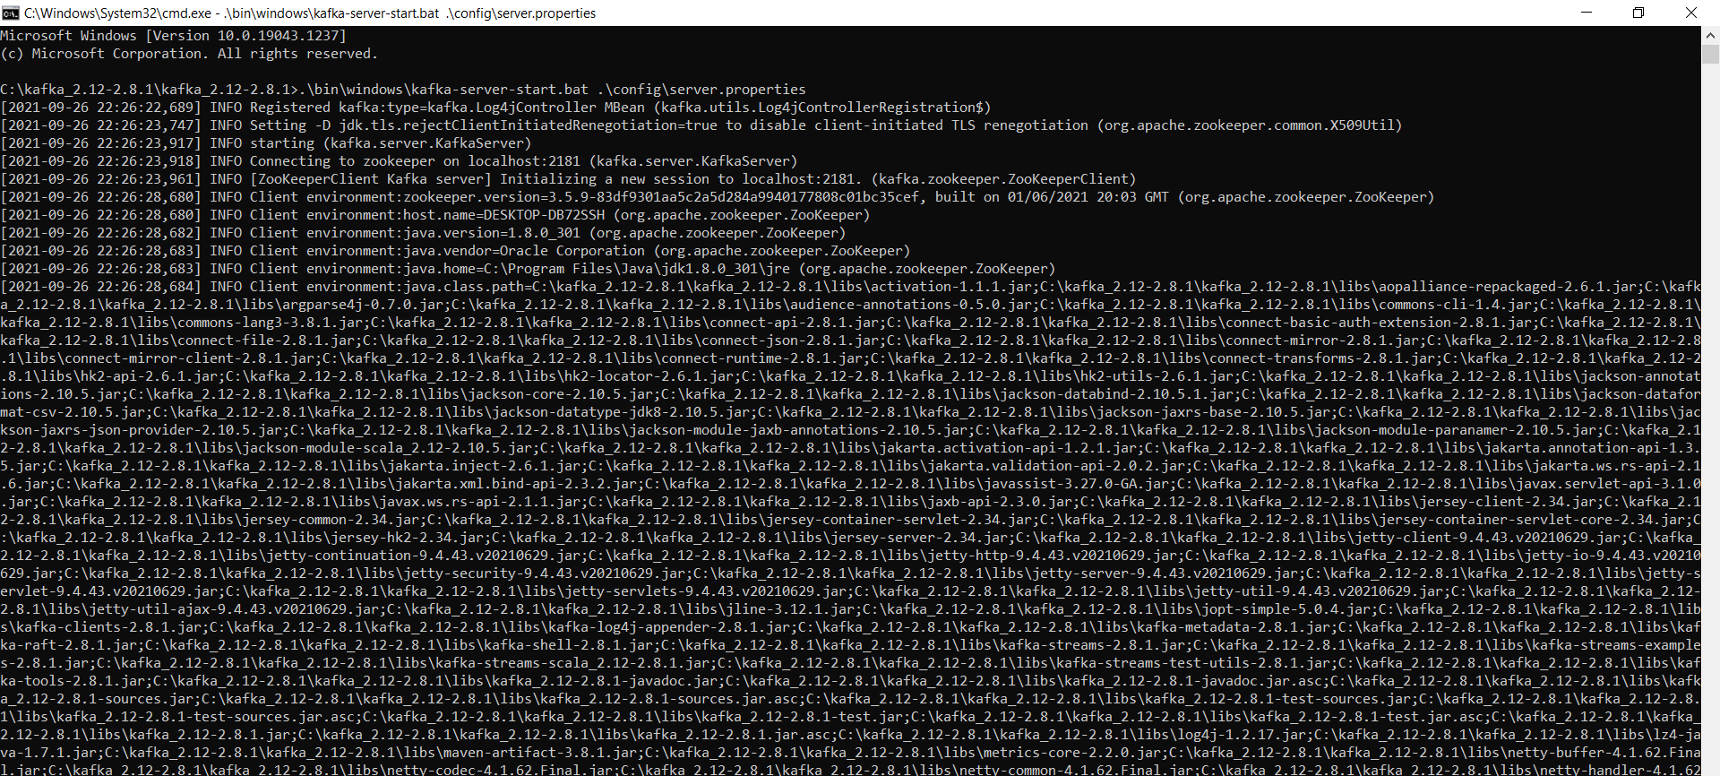
run apache kafka on another terminal C:\kafka>.\bin\windows\kafka-server-start.bat .\config\server.properties

Slide 19
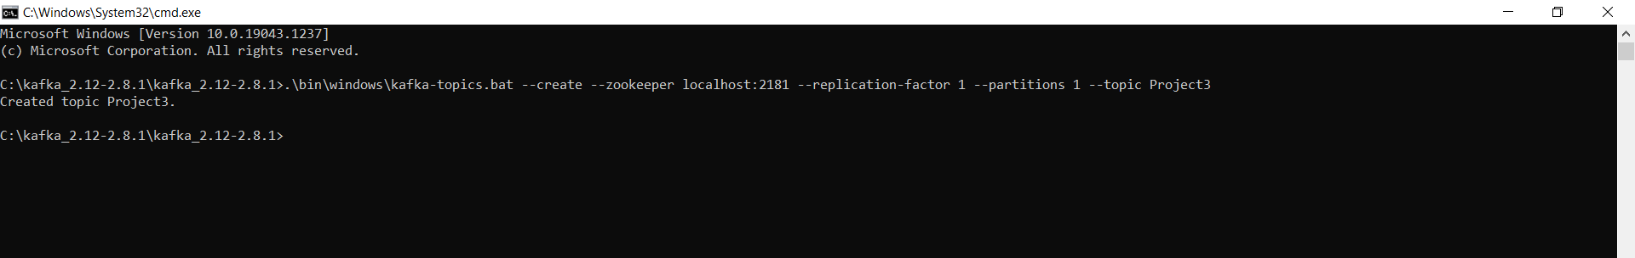
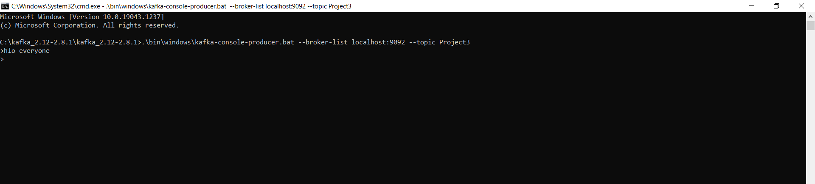
create topic on another terminal C:\kafka>.\bin\windows\kafka-topics.bat --create --zookeeper localhost:2181 --replication-factor 1 --partitions 1 --topic Project3
add the messages into the topics(producer) using new terminal
C:\kafka> .\bin\windows\kafka-console-producer.bat --broker-list localhost:9092 --topic Project3

Slide 20
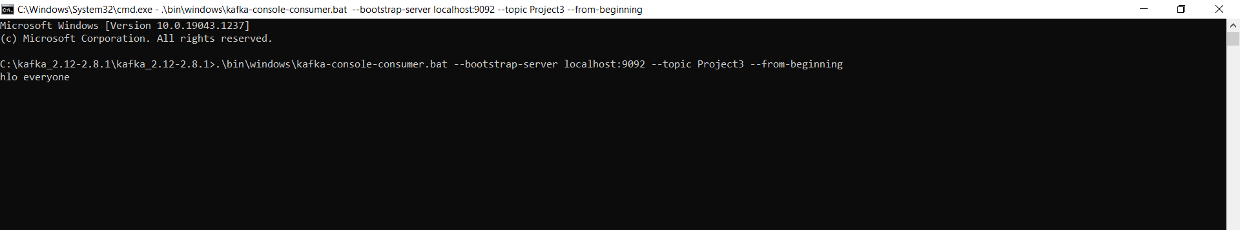
open new terminal to run consumer C:\kafka> .\bin\windows\kafka-console-consumer.bat --bootstrap-server localhost:9092 --topic Project3 --from-beginning

Slide 21
Code For Trending Topics In India
import tweepy
access_token="1397178062647693321-98deqStu35EJo7hsSE9PM7rf6sVaZZ"
access_token_secret="lLg9liDgsuOa3Us1Y3GeBefZRecEzwUUxnrq3FTMHOdJ1"
api_key="dSz5TgR3oRR0aAcx8sLg1dWJ7"
api_key_secret="B7RaKQA14bRVp9yViQrQNhHU7cZQP7cyhJdRffnt7TPWHdYtue"
auth=tweepy.OAuthHandler(consumer_key=api_key,consumer_secret=api_key_secret)
auth.set_access_token(access_token,access_token_secret)
api=tweepy.API(auth)
print(api)
named=[]
volumed=[]
woeid = 23424848
Trends = api.trends_place(woeid)
for value in Trends:
print(value)

Slide 22
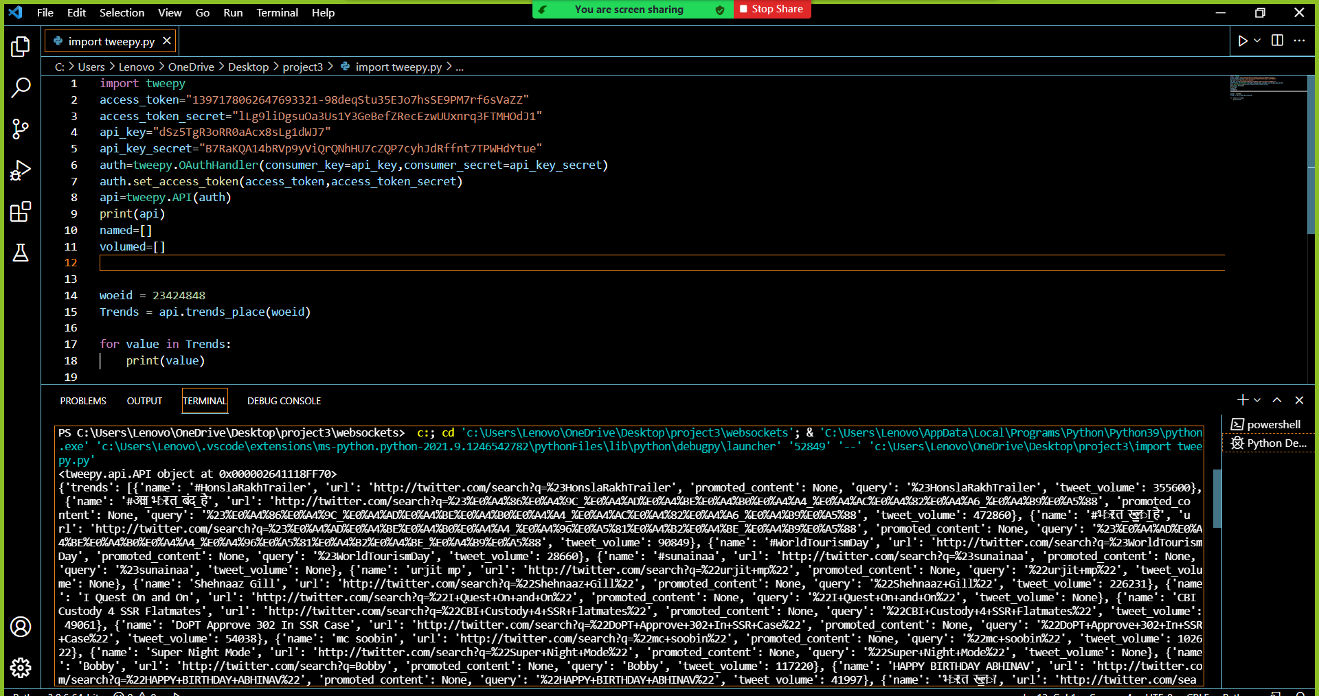
Trending Output

Slide 23
Producer Code-1
from tweepy import Stream
from tweepy import OAuthHandler
from tweepy.streaming import StreamListener
import time
import json
from kafka import KafkaProducer
import pprint
#consumer key, consumer secret, access token, access secret.
ckey="dSz5TgR3oRR0aAcx8sLg1dWJ7"
csecret="B7RaKQA14bRVp9yViQrQNhHU7cZQP7cyhJdRffnt7TPWHdYtue"
atoken="1397178062647693321-98deqStu35EJo7hsSE9PM7rf6sVaZZ"
asecret="lLg9liDgsuOa3Us1Y3GeBefZRecEzwUUxnrq3FTMHOdJ1"
class listener(StreamListener):
def on_data(self, data):
all_data = json.loads(data)
data = str(all_data['in_reply_to_screen_name']).encode("ascii", "ignore").decode()
if(data !="None"):
producer.send('new',data)
producer.flush()
pprint.pprint(data)
#pprint.pprint(all_data)
return True
def on_error(self, status):
print(status)
producer = KafkaProducer(value_serializer=lambda m: json.dumps(m).encode('utf-8'),bootstrap_servers=['localhost:9092'])
auth = OAuthHandler(ckey, csecret)
auth.set_access_token(atoken, asecret)
twitterStream = Stream(auth, listener())
twitterStream.filter(track=["आज_भारत_बंद_है", "भारत_खुला_है","BharatBandh"])

Slide 24
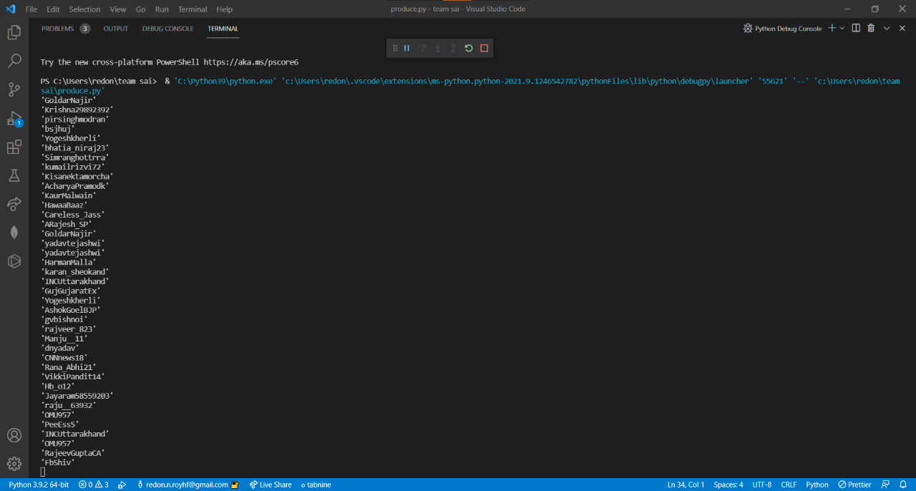
Output For Producer

Slide 25
Streaming Code-1
from pyspark.sql import SparkSession
from pyspark.sql.functions import *
spark = SparkSession.builder.appName("TwittterAnalysis").getOrCreate()
spark.sparkContext.setLogLevel('ERROR')
kafkaDF = spark.readStream.format("kafka").option("kafka.bootstrap.servers", "localhost:9092").option("subscribe","new").load()
kafkaDF_String = kafkaDF.selectExpr("CAST(value AS STRING)")
tweetsTable = kafkaDF_String.alias("tweets")
groupingHashtags = tweetsTable.groupBy("value").count().orderBy(desc("count"))
query = groupingHashtags.writeStream.outputMode("complete").format("console").option("truncate", "false").start()
query.awaitTermination()

Slide 26
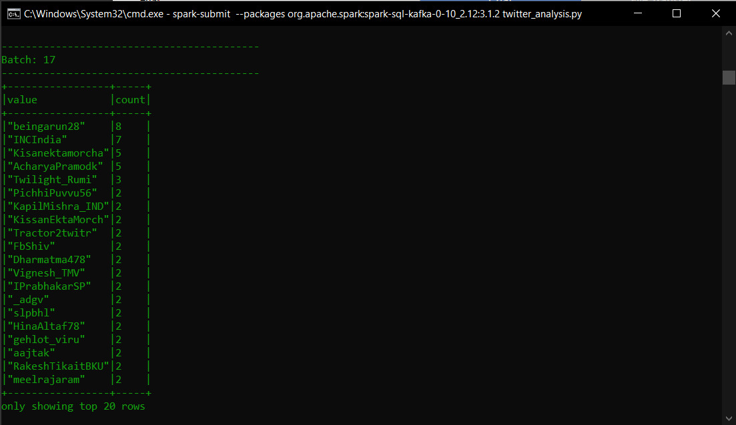
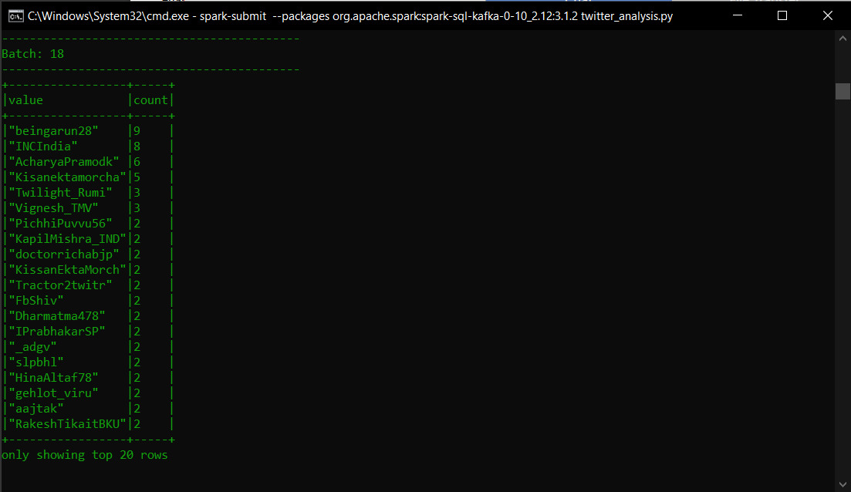

Output For Streaming

Slide 27
Producer Code-2
class listener(StreamListener):
def on_data(self, data):
all_data = json.loads(data)
producer.send('Project3',all_data)
producer.flush()
print(all_data)
return True
def on_error(self, status):
print(status)
producer = KafkaProducer(value_serializer=lambda m: json.dumps(m).encode('utf-8'),bootstrap_servers=['localhost:9092'])
auth = OAuthHandler(ckey, csecret)
auth.set_access_token(atoken, asecret)
twitterStream = Stream(auth, listener())
twitterStream.filter(track=["car"])
from tweepy import OAuthHandler
from tweepy.streaming import StreamListener
import time
import json
from kafka import KafkaProducer
from tweepy import Stream
#consumer key, consumer secret, access token, access secret.
ckey="dSz5TgR3oRR0aAcx8sLg1dWJ7"
csecret="B7RaKQA14bRVp9yViQrQNhHU7cZQP7cyhJdRffnt7TPWHdYtue"
atoken="1397178062647693321-98deqStu35EJo7hsSE9PM7rf6sVaZZ"
asecret="lLg9liDgsuOa3Us1Y3GeBefZRecEzwUUxnrq3FTMHOdJ1"

Slide 28
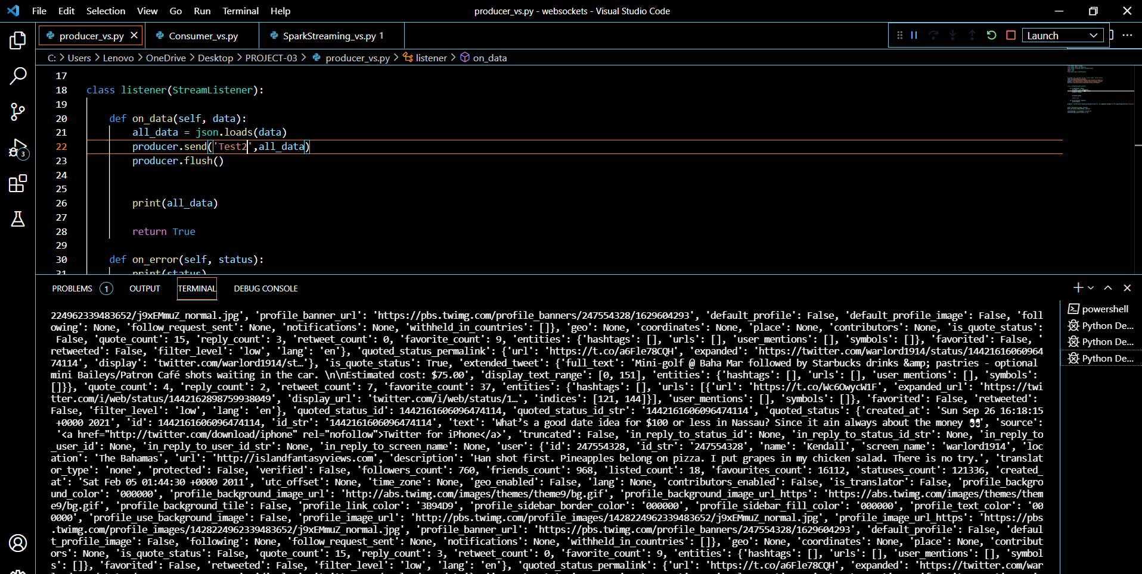
Producer Output:

Slide 29
Consumer Code
from kafka import KafkaConsumer
import json
consumer = KafkaConsumer('Project3',
bootstrap_servers=['localhost:9092'],
value_deserializer=lambda m: json.loads(m.decode('utf-8')))
print("consumer started ...")
for message in consumer:
data = str(message.value)
print("Sending: ", data)

Slide 30
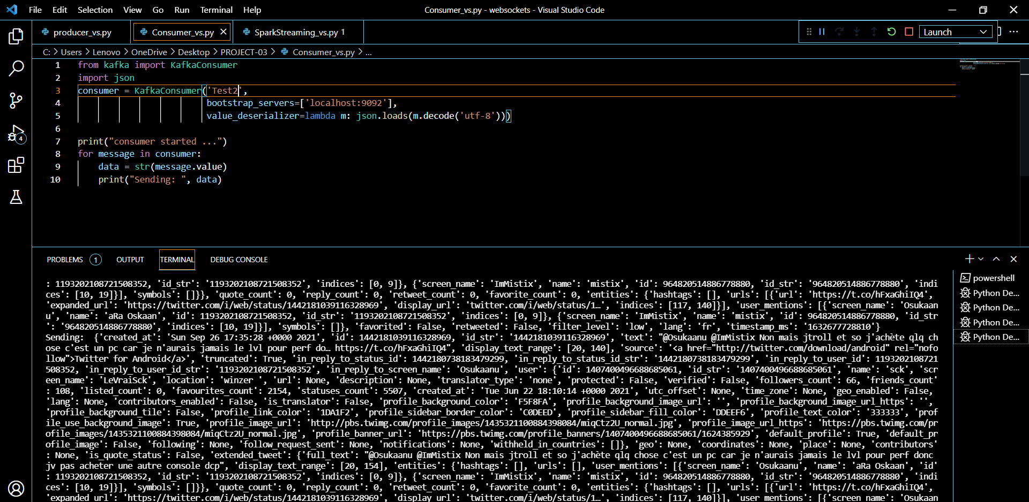
Consumer Output:

Slide 31
Streaming Code-2
from pyspark.sql import SparkSession
from pyspark.sql.functions import from_json, col, explode, to_json, struct, count
from pyspark.sql.types import *
spark = SparkSession .builder.appName("twitter").getOrCreate()
raw_df = spark.readStream.format("kafka").option("kafka.bootstrap.servers", "localhost:9092").option("subscribe", "twitter").option("startingOffsets", "latest").load().selectExpr("CAST(value AS STRING)")

Slide 32
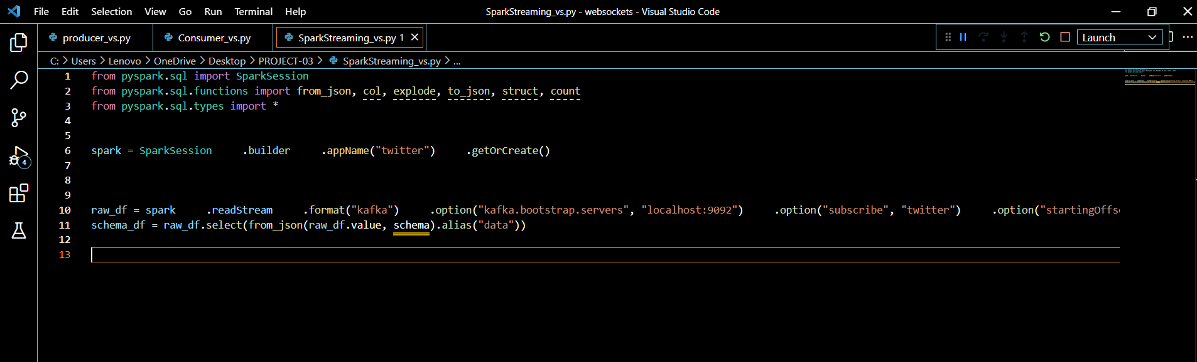
Streaming Code Snippet

Slide 33
Challenges Faced:
Uninstalled the java version 17.4.2 as it was not supported by spark 3.2.1 version.
We got dependencies error while connecting kafka with spark as “Please deploy the application as per the deployment section of "Structured Streaming + Kafka Integration Guide".
Zookeeper and kafka server disconnected many times.
We faced difficulties while Structuring the schema of streaming data.

Slide 34
Conclusion:
Spark Streaming library, part of Apache Spark eco-system, is used for data processing of real-time streaming data. In this project, we learned about how to use Spark Streaming API to process data generated by server logs and perform analytics on the real-time data streams.
Spark helps to simplify the challenging and computationally intensive task of processing high volumes of real-time or archived data, both structured and unstructured, seamlessly integrating relevant complex capabilities such as machine learning and graph algorithms.

Slide 35
Thank You!!

