Slide 1
TITLE PAGE
Problem Statement ID - HACXPB003
Problem Statemen title – Build a two-wheeler marketplace web app
Team ID – XL0222
Team Name (Registered on portal) - Cognizant Coders

Slide 2
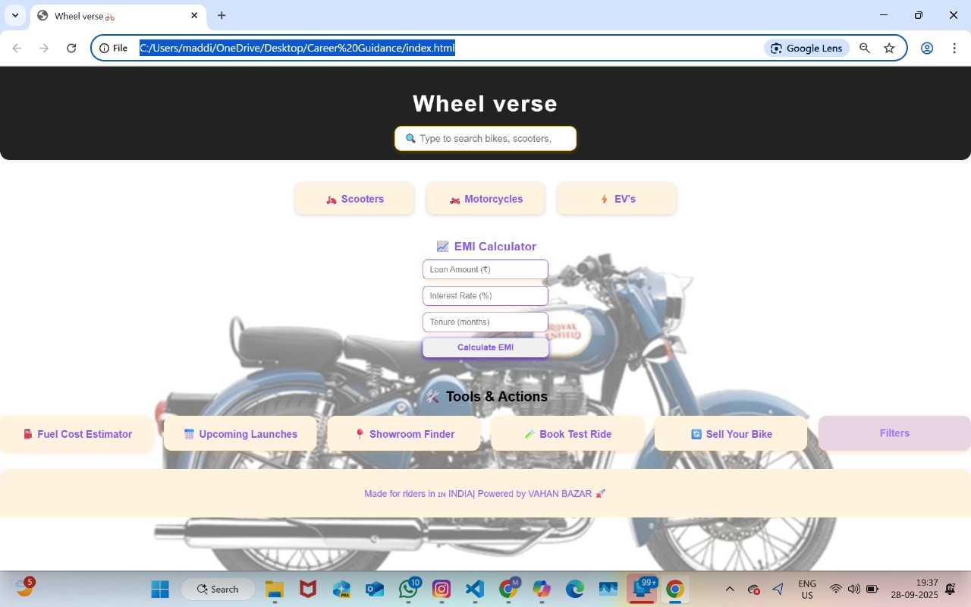
IDEA PAGE
Page
02

Slide 3
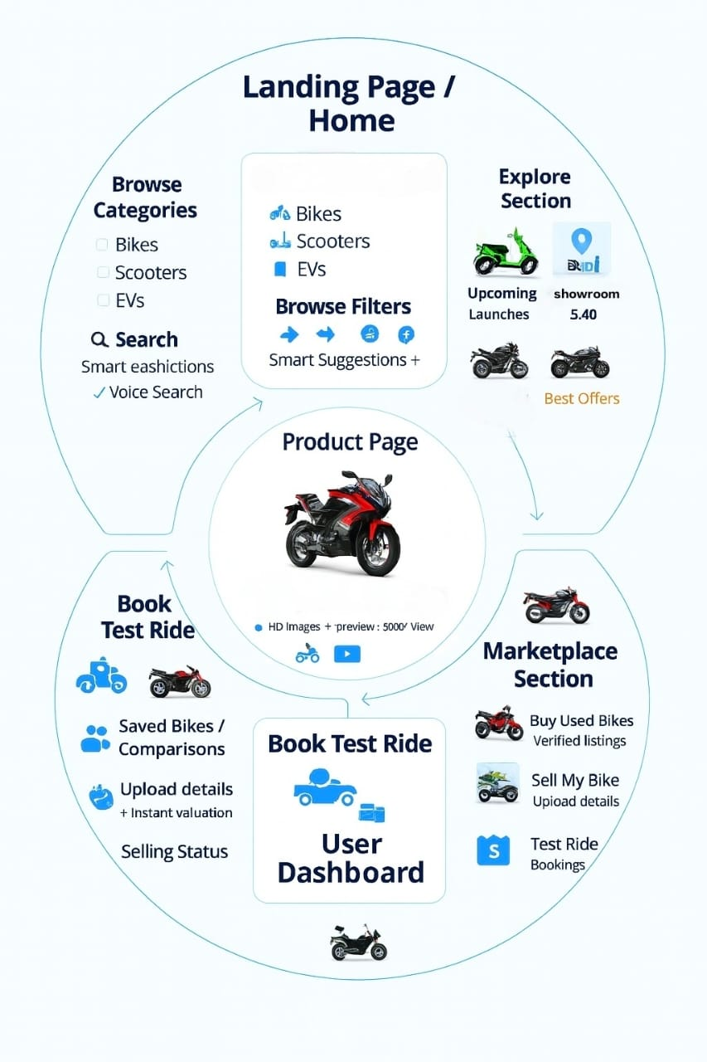
METHODOLOGY
0

Slide 4
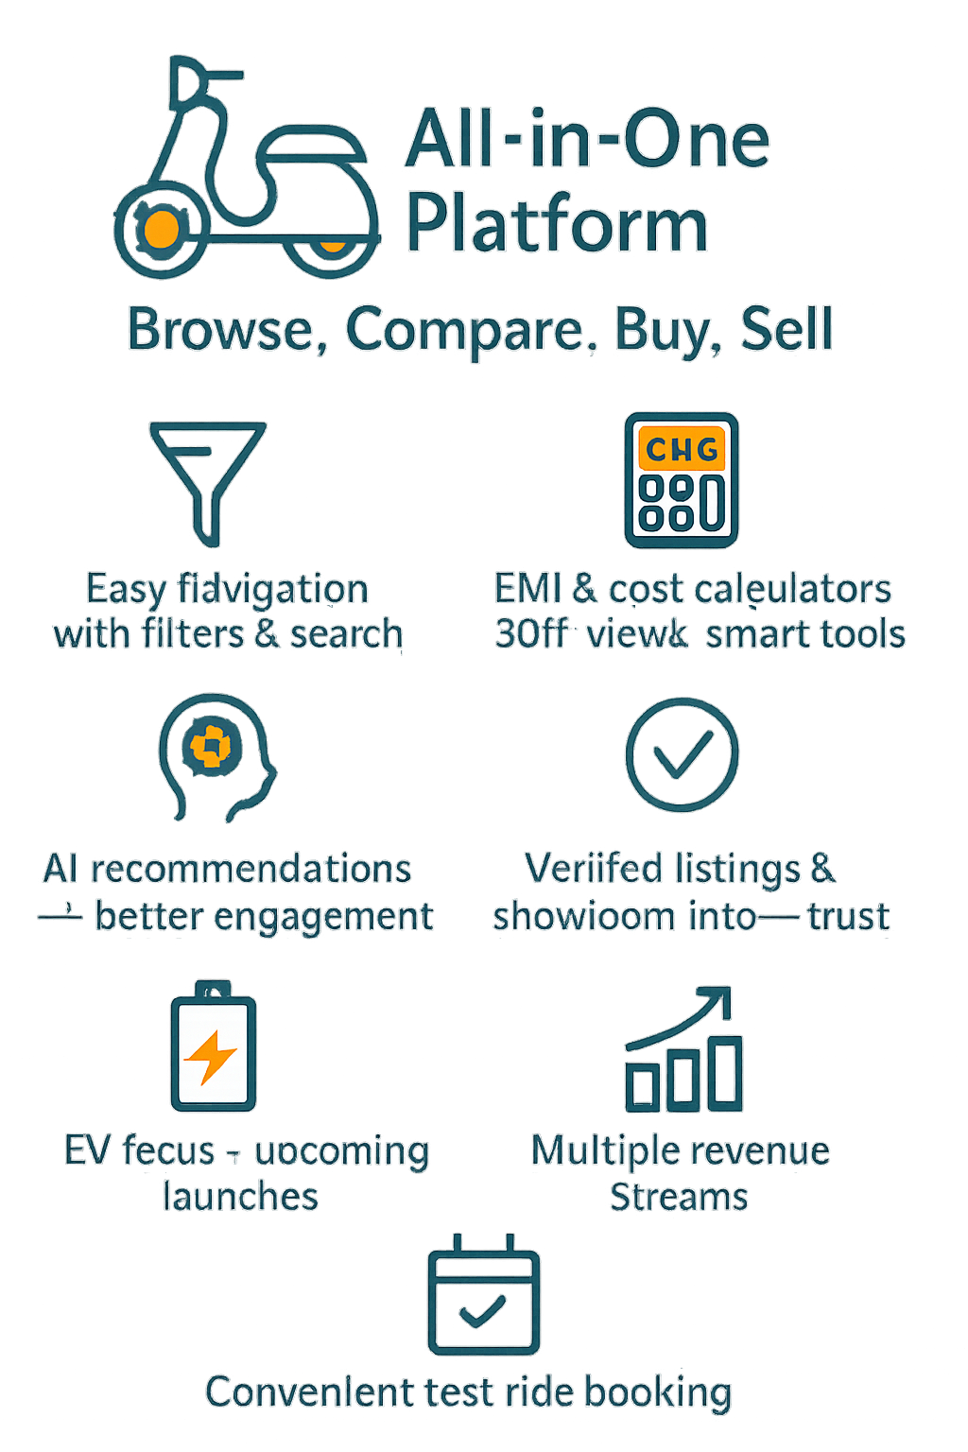







Technical Approach
2025
Impacts and Benefits
API’s Used :
Front-End :-
Html
Css
Back-end :-
Java script
SQL
Hosting/Execution :
GitHUb
TECH STACK
Front-End :
AI References:
Back-End :

Slide 5
Features to be implemented:
1.Browse two wheeler vehicle categorized by scooters, motorbikes, Electric bikes.
2.User or buyer can calculate the EMI
3.Buyer can calculate monthly fuel cost
4.Buyer can easily book test rides
5.Customers can watch the upcoming models
6.Sellers can sell their old bikes easily.
7. Customers can easily browse by filtering their bike by brand, price and mileage.
Team Members Contributions:
Team Lead (Uma): Designed the solution and its overview and lead the team.
Team member 1(Harshavardhan):Designed backend for the prototype.
Team member 2(Pavan): Designed front end for the prototype.
Team member 3(Yasmine):Researched on classification of vehicles with brands, models and prices and variants too.
Team member 4(Kiranmai):Has found the uniqueness of the every site and found the uniqueness for the solution.
0

