Slide 1
PROJECT TITLE
SEOUL BIKE SHARING DEMAND PREDICTION
Presented By:
1. Kolluru Saharsh-Sri Sri University-FMS

Slide 2
CONTENT
Content
❑ Data Pipeline
❑ Data Description
❑ Exploratory Data Analysis
❑ Models performed
❑ Model Validation & Selection
❑ Evaluation Matrix of All the models
❑ Model Explainability - SHAP
❑ Challenges
❑ Conclusion

Slide 3
Problem Statement
Example: Currently Rental bikes are introduced in many urban cities for the enhancement of mobility comfort. It is important to make the rental bike available and accessible to the public at the right time as it lessens the waiting time. Eventually, providing the city with a stable supply of rental bikes becomes a major concern. The crucial part is the prediction of bike count required at each hour for the stable supply of rental bikes.

Slide 4
Data pipeline
● Exploratory Data Analysis (EDA): In this part we have done some
EDA on the features to see the trend.
● Data Processing: In this part we went through each attributes and
encoded the categorical features.
● Model Creation: Finally in this part we created the various models.
These various models are being analysed and we tried to study
various models so as to get the best performing model for our project

Slide 5
To elaborate on the steps outlined in the PowerPoint presentation regarding Exploratory Data Analysis (EDA), Data Processing, and Model Creation, let's discuss how these phases contribute to the success of a data science project, focusing on the specifics mentioned.
Exploratory Data Analysis (EDA)
In the EDA phase, I embarked on an in-depth analysis of the dataset's features to uncover underlying trends, distributions, and relationships among the variables. This involved a thorough examination of each feature individually and in combination with others, employing a variety of visualization tools and statistical tests. For example, we might have used:
Histograms and box plots to understand the distribution of individual features, identifying any skewness or outliers that could affect model performance.
Scatter plots and correlation matrices to explore relationships between variables, helping to identify which features might be predictive of the outcome and should be included in the model.
Heatmaps to visually represent the strength of correlations between variables, highlighting potential multicollinearity issues that could be addressed in the data processing stage.
This initial exploration was crucial for forming hypotheses about the data, guiding the subsequent data processing steps, and informing our choice of modeling techniques.

Slide 6
DATA PREPROCESSING
Following EDA, I have performed various tests and focused on preparing the data for modeling. This involved a meticulous examination and processing of each attribute, with a particular emphasis on encoding categorical features. The steps undertaken likely included:
Handling missing values, either by imputation or removal, based on the insights gained during EDA and the nature of each feature.
Encoding categorical variables to transform them into a format that could be effectively utilized by machine learning algorithms. Techniques such as one-hot encoding, label encoding, or more sophisticated encodings like target encoding were applied based on the specific requirements of each categorical feature and the chosen modeling techniques.
Normalizing or standardizing numerical features to ensure that all features contributed equally to the model's predictions, avoiding biases towards variables with larger scales.
These processing steps were essential to optimize the dataset for the machine learning algorithms, ensuring that the models could learn from the data efficiently and effectively.

Slide 7
Model Creation
In the model creation phase, we leveraged the insights and preparations from the earlier stages to build and evaluate various models. This process involved several key activities:
Selection and Development of Models: We experimented with a range of algorithms suitable for the project's objectives. This could include linear models for their simplicity and interpretability, tree-based methods for their ability to capture non-linear relationships, or more complex models like ensemble methods or neural networks if the problem demanded it.
Analysis and Evaluation of Models: Each model was rigorously tested and evaluated to assess its performance. We utilized metrics appropriate to our project's goals, such as accuracy, precision, recall, or the area under the ROC curve for classification problems, and MSE or RMSE for regression problems.
Comparative Analysis: By comparing the performance of different models, we aimed to identify the most effective approach for our specific project. This involved not just looking at performance metrics, but also considering factors like model complexity, interpretability, and computational efficiency.
Iterative Refinement: Based on the comparative analysis, we iteratively refined our models, adjusting parameters, and potentially revisiting our data processing steps to further enhance model performance.
This comprehensive approach to model creation was aimed at identifying the best-performing model(s) for our project, ensuring that the final model chosen was well-suited to meet the project's objectives and deliver robust, actionable insights or predictions.

Slide 8
DATA DESCRIPTION
Dependent variable:
• Rented Bike count - Count of bikes rented at each hour
Independent variables:
• Date : year-month-day
• Hour - Hour of he day
• Temperature-Temperature in Celsius
• Humidity - %
• Windspeed - m/s
• Visibility - 10 m
• Dew point temperature - Celsius
• Solar radiation - MJ/m2
• Rainfall - mm
• Snowfall - cm
• Seasons - Winter, Spring, Summer,
Autumn
• Holiday - Holiday/No holiday
• Functional Day - NoFunc(Non
Functional Hours), Fun(Functional
hours)

Slide 9
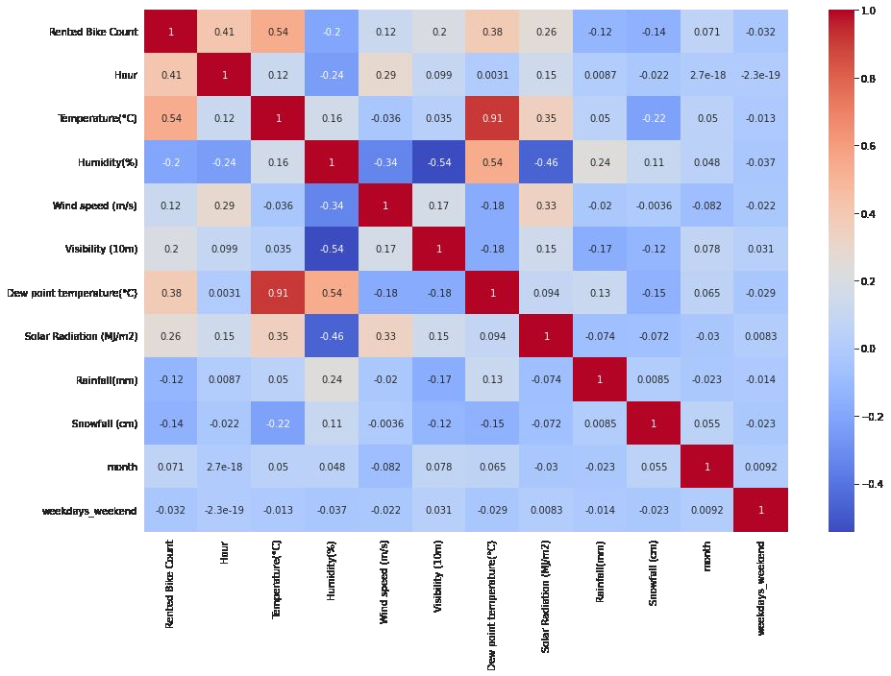
EDA - Feature Correlation

Slide 10
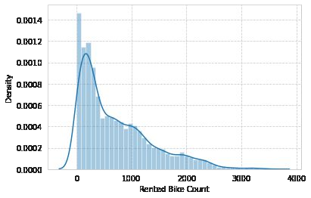
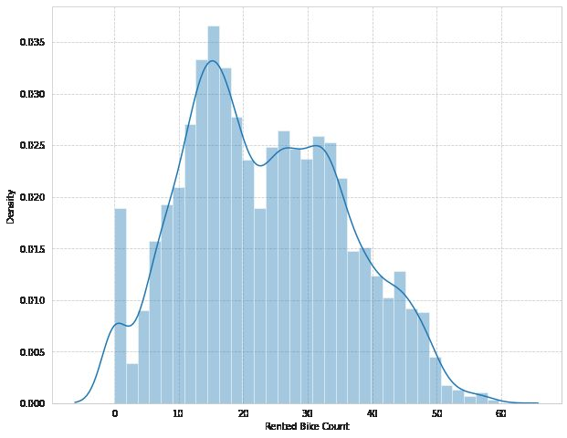
EDA (contd...)
Distribution of Rented Bike Count
Square root transformation of rented bike count

Slide 11
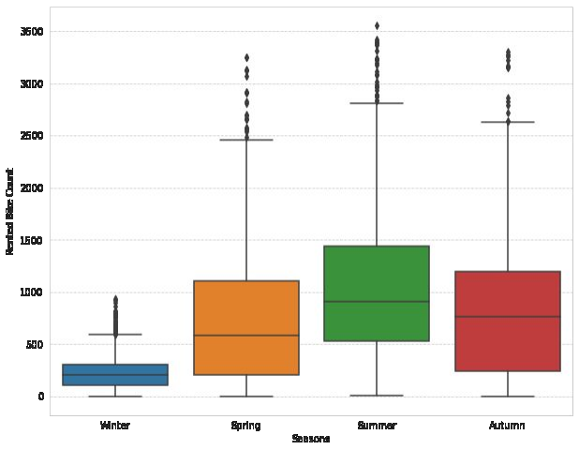
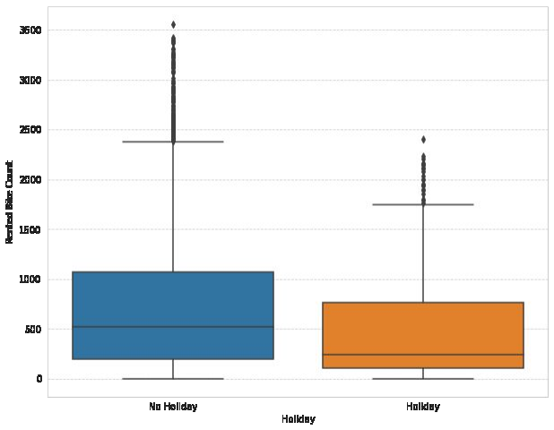
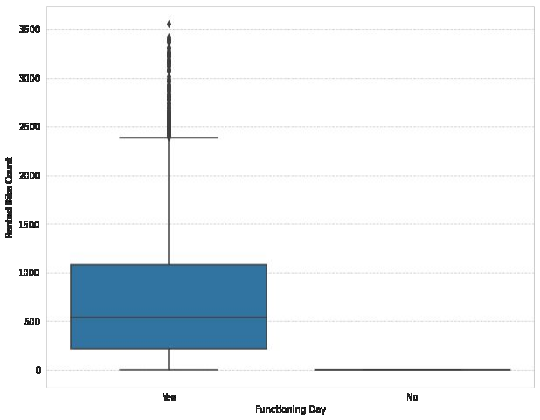
EDA (Contd..)
Less Demand on winter seasons
Slightly higher demand During Non Holidays
Almost no demand on Non Functioning Day

Slide 12
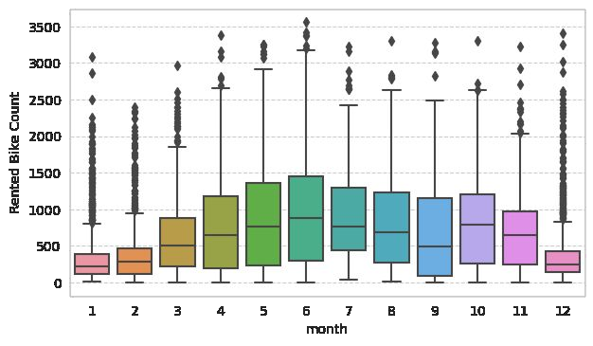
EDa (cONTD...)
We can see that
there less demand
of Rented bike in the
month of December, January, February
i.e. during winter
seasons
• Also demand of bike
is maximum during
May, June, July i.e
Summer season

Slide 13
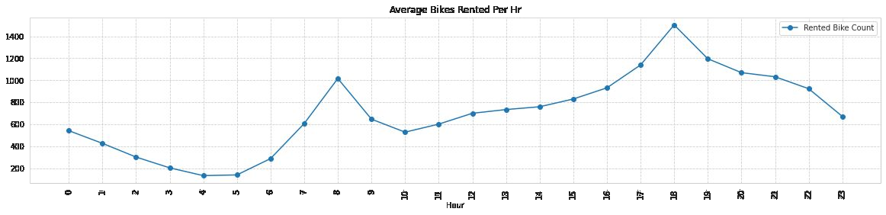
EDA (Contd...)

Slide 14
Model’s Performed
Linear Regression with regularizations
● Polynomial Regression
● K nearest neighbours
● Decision tree
● Random forest
● Gradient Boost
● eXtreme Gradient Boost
● lightGBM
● CatBoost

Slide 15
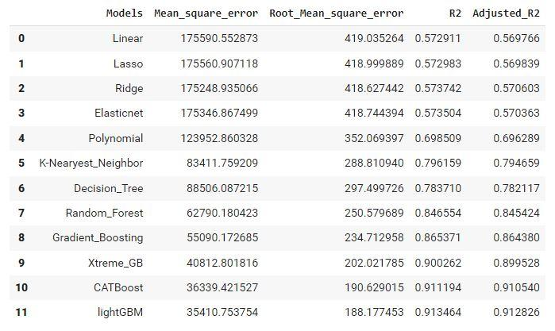
Model’s Evaluation Matrices

Slide 16
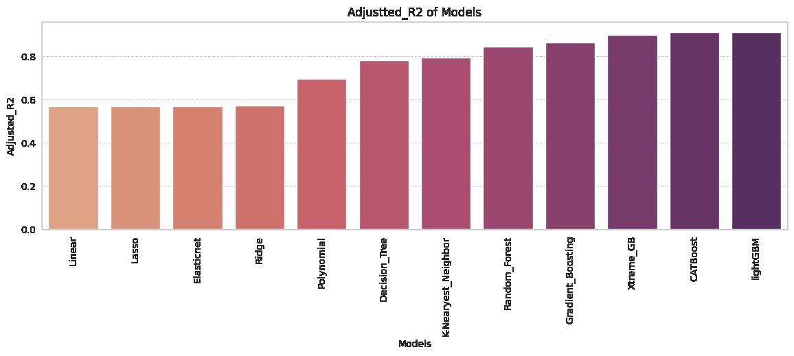
Adjusted R2 of Model’s Performed

Slide 17
Model Validation & Selection(continued)
● Observation 1: As seen in the
Model Evaluation Matrices table,
Linear Regression, KNN is not
giving great results.
● Observation 2: Random forest &
GBR have performed equally
good in terms of adjusted r2.
● Observation 3: We are getting
the best results from lightGBM
and CatBoost.

Slide 18
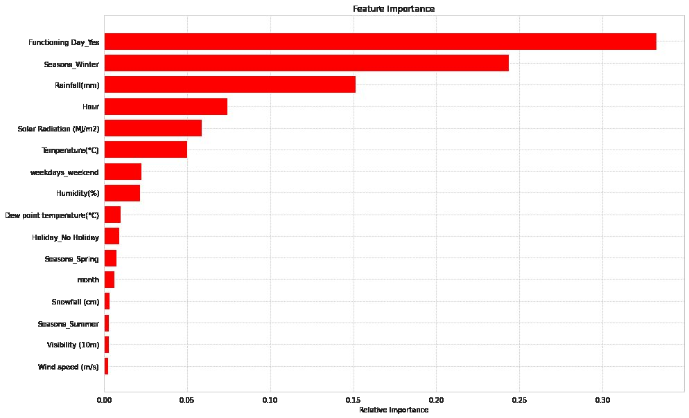
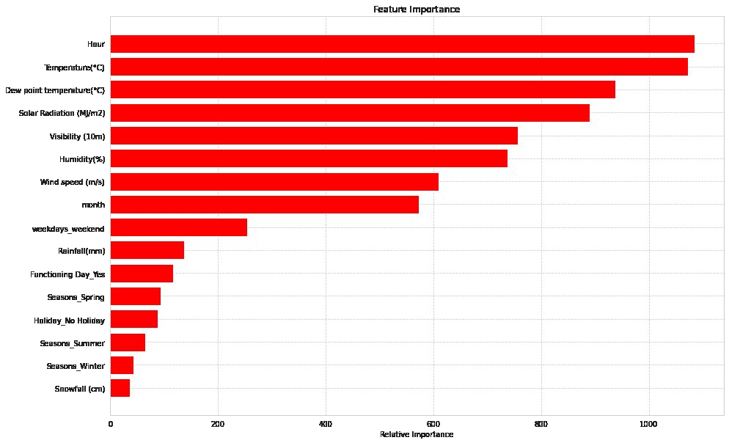
Feature Importance
Light GBM
CatBoost

Slide 19
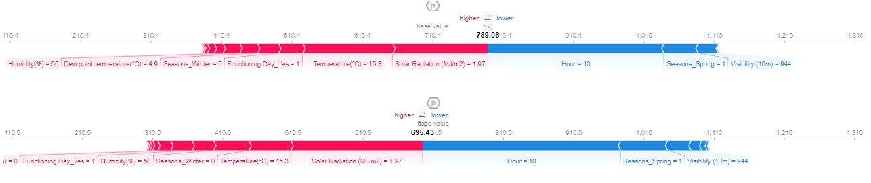
MODEL EXPLAINABILITY - SHAP
LIGHT GBM
CatBoost

Slide 20
CHALLENGES FACED
Addressing the challenges faced during the project on predicting hourly rental bike demand highlights key issues encountered in data-driven projects, especially those involving large datasets and the need for precise predictions.
1. Handling Large Volumes of Data:- The project's dataset encompassed extensive records over time, capturing various factors influencing bike rental demand. Managing this vast amount of data posed significant challenges, primarily in processing and analysis. The sheer volume required robust data handling and storage solutions to ensure efficient data manipulation and analysis without compromising performance.
2. Computational Complexity: Given the dataset's size, the computational demands were substantial. Processing the data, especially running complex models to predict hourly bike rental demand, required significant computational resources. This increased the time needed for model training and optimization, impacting the project's pace and potentially its scalability.
3. Attention to Detail in Inferences:The project required meticulous attention to small but critical details within the data. Even minor trends or patterns could significantly influence the prediction accuracy. Identifying and incorporating these subtle inferences into the model was crucial for enhancing its predictive performance and ensuring that the bike rental service could meet demand efficiently.
These challenges underscore the complexities of working with large datasets and the importance of computational efficiency and detailed analysis in making accurate predictions to support urban mobility solutions.

Slide 21
System Approach
To ensure the smooth operation and scalability of the rental bike prediction system, the following system requirements are essential:
Computational Resources: Adequate processing power and memory to handle data preprocessing, model training, and real-time prediction. This may involve powerful local machines for development and cloud-based solutions for deployment to manage workload efficiently.
Storage: Sufficient storage capacity to archive historical bike rental data, real-time input data, and model artifacts. Cloud storage solutions could be considered for flexibility and scalability.
Connectivity: Reliable internet connection for accessing real-time data sources (e.g., weather updates, event calendars) and for deploying the application on cloud platforms.
Security: Robust security measures to protect data integrity and user privacy, especially when dealing with user location data and real-time inputs.
Library Requirements
Building an efficient and accurate predictive model requires the utilization of specific programming libraries and tools. The primary libraries include:
Data Analysis and Preprocessing:
Pandas: For data manipulation and cleaning. Essential for handling and preprocessing structured data.
NumPy: For numerical operations, especially useful in data preprocessing and feature engineering phases.

Slide 22
Algorithm & Deployment
Deployment:
Flask/Django: For creating a web application or API that serves the model's predictions to end-users or integrates with a bike rental management system.
Docker: To containerize the application, ensuring consistency across different development and deployment environments.
Monitoring and Logging:
Prometheus/Grafana: For real-time monitoring of the system's performance and logging usage statistics, which is crucial for maintaining system reliability and optimizing resource allocation.
ALGORITHMS USED
and Performed
● Linear Regression with regularizations
● Polynomial Regression
● K nearest neighbours
● Decision tree
● Random forest
● Gradient Boost
● eXtreme Gradient Boost
● lightGBM
● CatBoos
Machine Learning and Time-Series Forecasting:
Scikit-learn: Offers a wide range of tools for machine learning model development, evaluation, and hyperparameter tuning.
Statsmodels: Useful for implementing traditional time-series forecasting models like ARIMA or SARIMA.
TensorFlow/Keras: For building more complex models like LSTM (Long Short-Term Memory networks), particularly useful in capturing temporal dependencies in time-series data.

Slide 23
Visualization
Matplotlib and Seaborn: For visualizing data and model performance metrics, aiding in the analysis and presentation of findings.
Monitoring and Logging:
Prometheus/Grafana: For real-time monitoring of the system's performance and logging usage statistics, which is crucial for maintaining system reliability and optimizing resource allocation.

Slide 24
Result
It is quite evident from the results that
lightGBM and Catboost is the best
model that can be used for the Bike
Sharing Demand Prediction since the
performance metrics (mse,rmse) shows
lower and (r2,adjusted_r2) show a
higher value for the lightGBM and
Catboost models.
• So, we can use either lightGBM or
catboost model for the above problem

Slide 25
Conclusion
The Seoul bike sales prediction project, with a focus on Exploratory Data Analysis (EDA) and supplemented by data preprocessing and machine learning model creation, has provided valuable insights into factors influencing bike rental demand in Seoul. The project's conclusion highlights the significance of EDA in uncovering trends, patterns, and relationships within the bike rental data, enabling the development of a predictive model tailored to the unique dynamics of Seoul's urban mobility landscape.
Key Takeaways:
Importance of EDA: Through comprehensive EDA, we identified critical variables affecting bike rental demand, such as weather conditions, time of day, and day of the week. This phase allowed us to visualize and understand the dataset deeply, ensuring informed decisions during the feature selection and model building stages.
Data Preprocessing: The preprocessing steps, including handling missing values and encoding categorical variables, were crucial for preparing the dataset for modeling. This process improved the quality of the data, directly impacting the predictive model's accuracy.
Predictive Modeling: Leveraging insights from EDA, we applied machine learning algorithms to predict bike rental demand. The models were evaluated based on their performance, with a focus on achieving high accuracy while maintaining the model's interpretability and computational efficiency.
Challenges Overcome: Handling the large volume of data and ensuring computational efficiency were significant challenges. The project adopted strategies to manage these issues effectively, such as optimizing data processing techniques and selecting appropriate models.
Future Directions: The project opens avenues for future enhancements, such as integrating more diverse data sources, exploring advanced machine learning techniques, and expanding the predictive model to accommodate varying urban contexts.
In conclusion, the Seoul bike sales prediction project successfully demonstrates the power of EDA combined with machine learning to address complex real-world problems. The insights gained not only enhance our understanding of urban bike rental patterns but also provide a solid foundation for improving and expanding bike-sharing services in Seoul and similar urban environments.

Slide 26
In concluding the Seoul bike sales prediction project, it is important to recognize the breadth and depth of machine learning techniques applied to enhance the accuracy and reliability of the predictive model. The project incorporated a diverse array of algorithms, each offering unique strengths and approaches to modeling the data:
Linear Regression with Regularizations: This technique helped prevent overfitting, enabling the model to generalize better to unseen data while still capturing linear relationships between features and bike rental counts.
Polynomial Regression: By extending the linear model to consider polynomial terms, we captured more complex, non-linear relationships within the dataset, providing a more nuanced understanding of the factors affecting bike rentals.
K Nearest Neighbours (KNN): The KNN algorithm offered a non-parametric method to predict bike rentals by looking at similar historical data points, leveraging the proximity of data in the feature space.
Decision Tree: This model provided an interpretable structure for making predictions, with the added benefit of capturing non-linear decision boundaries.
Random Forest: By building an ensemble of decision trees, the random forest model improved predictive accuracy and robustness, reducing the variance that single decision trees might introduce.
Gradient Boost: This ensemble technique focused on correcting the mistakes of previous models in the sequence, boosting the performance incrementally with each iteration.
eXtreme Gradient Boost (XGBoost): XGBoost pushed the boundaries of gradient boosting by optimizing the algorithm for performance and speed, making it a powerful tool for this project.
LightGBM: As a gradient boosting framework that uses tree-based learning algorithms, LightGBM was particularly useful due to its efficiency and effectiveness at dealing with large datasets.
CatBoost: This algorithm provided yet another gradient boosting variant that excels in handling categorical features and preventing overfitting, which is essential in datasets with many categorical variables.
The application of these algorithms demonstrates a comprehensive approach to the predictive modeling process, underlining the commitment to leveraging advanced analytics to ensure the successful forecasting of bike rental needs. Each model contributed to a deeper understanding of the predictive landscape, and their comparative analysis ensured the selection of the best-performing model for the project's objectives. Moving forward, these models provide a solid foundation for further refinement and scaling of the predictive system, potentially incorporating real-time data and advanced features to maintain the relevance and accuracy of the bike rental predictions

Slide 27
Future scope
Leveraging additional data sources, refining algorithms, and broadening the system's geographical coverage could significantly improve performance and utility. Furthermore, integrating cutting-edge technologies could propel the system to new heights of efficiency and effectiveness. Below are potential avenues for these improvements:
Incorporating Additional Data Sources
User Feedback and Interaction Data: Collecting data on user preferences, feedback on bike availability, and interaction patterns could provide insights into demand nuances not captured by other data types.
Traffic and Infrastructure Changes: Real-time traffic data and information on infrastructural developments (like new bike lanes or construction work) could refine demand predictions by accounting for factors that directly affect cycling routes and safety.
Social Media and Event Feeds: Monitoring social media and event feeds for mentions of local events, weather alerts, or public gatherings could offer real-time insights into sudden changes in demand.

Slide 28
Future scope (Continued...)
Optimizing the Algorithm
Advanced Machine Learning Techniques: Exploring more complex models such as deep learning and neural network architectures (e.g., Convolutional Neural Networks for spatial data analysis and Recurrent Neural Networks for temporal data predictions) could uncover patterns missed by traditional models.
Custom Ensemble Models: Combining predictions from multiple models in an ensemble approach could enhance accuracy. Techniques like stacking, blending, or boosting may be employed to leverage the strengths of various predictive models.
Hyperparameter Optimization: Utilizing more sophisticated techniques for hyperparameter tuning, such as Bayesian optimization, could further refine model performance by finding the optimal configuration more efficiently.

Slide 29
FUTURE SCOPE (Contd..)
Expanding Geographical Coverage
Scalability to Multiple Cities or Regions: Adapting the model to predict bike rental demand in various cities or regions by incorporating city-specific data and characteristics. This might involve modularizing the model to adjust to different urban layouts, weather patterns, and cultural factors affecting bike usage.
Cross-City Analytics: Implementing a system that not only predicts demand within individual cities but also analyzes patterns across multiple locations. This could identify broader trends and facilitate knowledge transfer between regions.
Integration of Emerging Technologies
Edge Computing: Utilizing edge computing to process data closer to where it's generated (e.g., within smart bike stations) can reduce latency, decrease server load, and enable real-time analytics and responses to changing demand.
Internet of Things (IoT): Integrating IoT devices on bikes and docking stations could provide richer data on bike usage patterns, condition monitoring, and immediate demand sensing.
Advanced Machine Learning and AI Techniques: Investigating the use of Generative Adversarial Networks (GANs) for data augmentation in areas with sparse data and Reinforcement Learning for dynamic adjustment of bike distribution strategies could offer sophisticated solutions to demand prediction and management challenges.

Slide 30
Future scope (Contd..)
User Experience and Accessibility Enhancements
Personalized Recommendations: Offering personalized bike rental suggestions based on user history and preferences, potentially integrating with other transportation modes for comprehensive mobility solutions.
Accessibility Improvements: Ensuring the system is accessible to a wider range of users, including those with disabilities, by incorporating features tailored to their needs in the app and service design.
Each of these enhancements and expansions has the potential to significantly improve the accuracy of demand predictions, the efficiency of bike distribution, and ultimately, the user experience. By continuously evolving and integrating new technologies and methodologies, the rental bike prediction system can remain at the forefront of urban mobility solutions.

Slide 31
References
Scikit-learn Documentation: https://scikit-learn.org/stable/documentation.html
For understanding and implementing machine learning models.
TensorFlow Tutorials: https://www.tensorflow.org/tutorials
Guides and tutorials on using TensorFlow for building deep learning models, including time-series predictions.
"Deep Learning for Time Series Forecasting" by Jason Brownlee on Machine Learning Mastery. Provides practical guides on applying deep learning models to time-series data.
Emerging Technologies and Future Trends
"Edge Computing for Smart Cities: Opportunities and Challenges" in the International Journal of Computer Applications. Discusses the role of edge computing in urban environments, relevant for integrating real-time data processing in bike-sharing systems.
"The Internet of Things in the Evolution of Smart Cities" in IEEE Internet of Things Journal. Explores IoT applications within smart cities, including transportation and mobility solutions.

Slide 32

course certificate 1

Slide 33

course certificate 2

Slide 34
Link of my project
Link :- https://github.com/harshu722/Edunet-Seoul-bike-sharing-prediction

Slide 35
THANK YOU

